Slide 1
Spam Classification Based on Signed
Network Analysis
Sihyun Jeong and Kyu-haeng Lee
모바일시스템공학과
32181928 박찬호

Slide 2
Contents
Conventional Spam Classifications
Proposed Scheme
Social Balance Theory
Social Status Theory
Concept of Surprise
Graph-Converting Method
PageRank & Conductance
Conclusion
Contribution

Slide 3
Conventional
Spam Classifications
Spam detection = classification problem
Identifying the appropriate data features to distinguish spam/non-spam
- text examining : e.g. template-matching scheme
- meta information (user profile, activity logs, timestamps)
→ become rapidly ineffective by cleverer and more multifaceted attacks

Slide 4
Conventional
Spam Classifications
Network Properties - highlighted as alternative features for spam classification
- not easily imitated by attackers
Thus, social network analysis are more robust (Node Ranking; PageRank, HITS)
However, attackers adroitly avoid such spam detection

Slide 5
Proposed Scheme
Similar approaches with proposed scheme
- NFS (Network Footprint Score)
- Graph propagation algorithm for fake accounts detection (Li et al.)
- Integro
- SybilEdge
- Triad Significance Profile (TSP)-Filtering
limitation - restricted to only undirected or unsigned network

Slide 6
Proposed Scheme
Structural Balance Theory (= Balance Theory)
Social Status Theory (= Status Theory)
Concept of Surprise
Graph-Converting Method

Slide 7
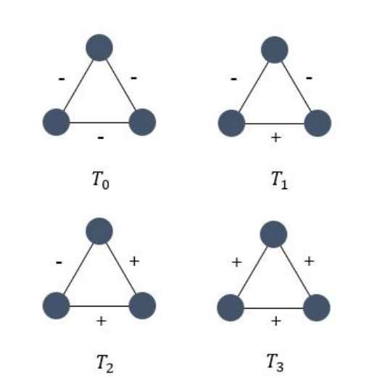
Proposed Scheme
- Balance Theory
Balanced (plausible) : T₁ , T₃ // Unbalanced (not plausible) : T₀ , T₂
The friend of my friend is my friend (T₁)
The enemy of my friend is my enemy (T₃)
Intended for undirected graphs
a decrease in classification performance due to the
information loss for edge directionality

Slide 8
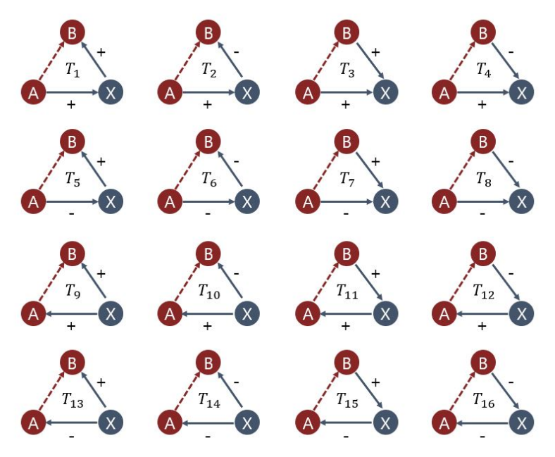
Proposed Scheme
- Status Theory
determined by the status difference between nodes
a positive(negative) directed link : the recipient as having higher(lower) status
Sixteen triad types for signed directed
networks
predicting the sign of the red link
considering the signs of the A–X and B–X

Slide 9
Concept of Surprise
certain type of motif
shows how much the target motif appears in the actual network compared to our expectation

Slide 10
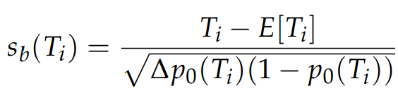
Concept of Surprise
(Balance Theory)
T_{i} : number of certain triad T_{i}
E[T_{i}] : expected number of type T_{i}
∆ : the total number of triads in the network
∆p₀(T_{i}) : expected fraction of triads that are of type T_{i}
s_{b}(T_{i}) : surprise value for a certain motif T_{i}

Slide 11
Concept of Surprise
(Status Theory)
Measure surprise separately for the edge initiator and the edge destination
Generative baseline, Receptive baseline
computed by the number of standard deviations by which the actual number of positive A–B edges in the data differs from the expected positive numbers created by the baseline

Slide 12
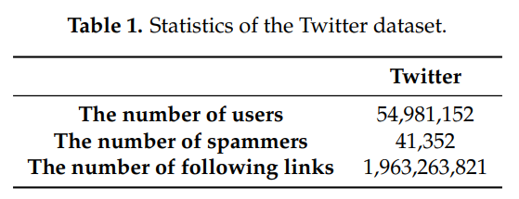
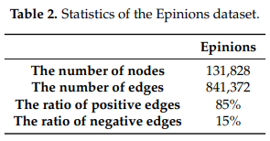
Graph-Converting Method
Among all E edges, we select α · E edges and assign them negative signs
α is the fraction of negative edges (0.2 from real world data)
how to appropriately select α · E edges

Slide 13
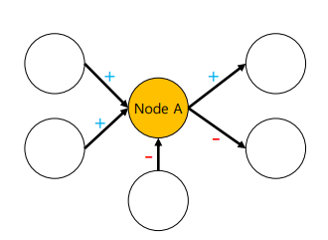
PageRank
Positive : ratio of incoming = 2/3
Negative : ratio of incoming = 1/2

Slide 14
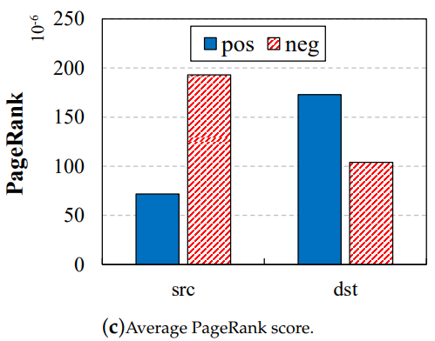
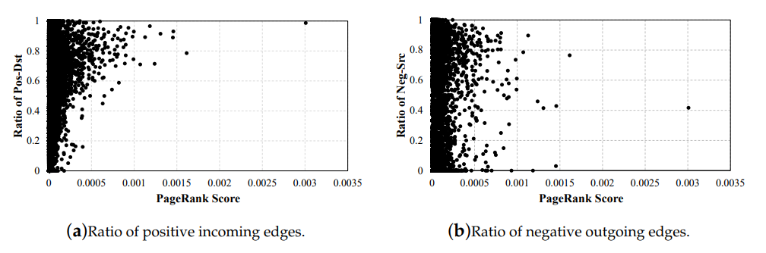
PageRank
high ratio values of positive incoming edges → high PageRank scores

Slide 15
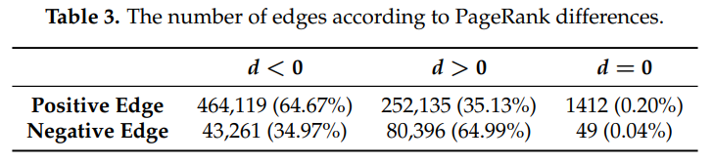
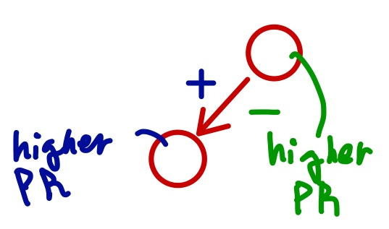
PageRank
PR(x) = PageRank score of node x, dst = destination node, src = source node
d = PR(dst) – PR(src)

Slide 16
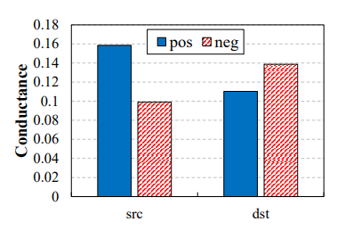
Conductance
generate clusters → measure the Conductance for each cluster that an edge belongs to
internal and external connectivity
higher Conductance means higher separability of the cluster
From the analysis, conductance score is
Positive edges : src node > dst node
Negative edges : src node < dst node
↑ internal connectivity & ↓external separability
= ↓ conductance → ↑PageRank score

Slide 17
Conductance
generate clusters → measure the Conductance for each cluster that an edge belongs to
internal and external connectivity
higher Conductance means higher separability of the cluster
From the analysis, conductance score is
Positive edges : src node > dst node
Negative edges : src node < dst node
↑ internal connectivity & ↓external separability
= ↓ conductance → ↑PageRank score

Slide 18
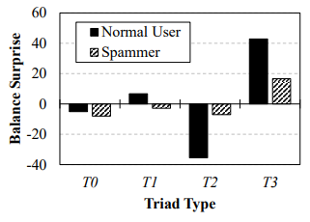
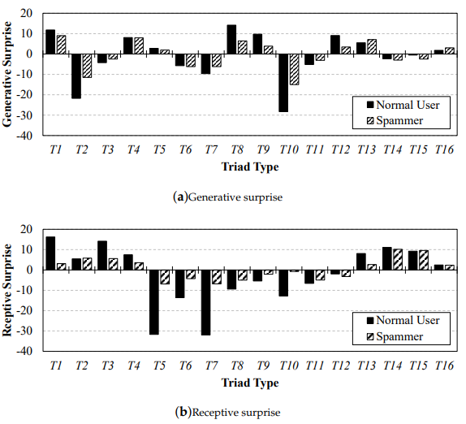
Validation
Balance
Spammers are inconsistent with T₁
T₂ , T₃ → spammers’ gap is smaller
Status
Spammers are consistent with different degrees
Generative : T₂ , T₈ , T₁₀
Receptive : most types of triads

Slide 19
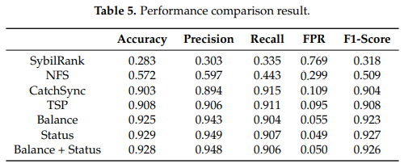
Performance Evaluation
Proposed method
Best accuracy, precision
Recall of CatchSync, TSP is higher
with higher false positive rate(FPR)
Best performance when only using Statu

Slide 20
Contribution
First spam classification utilizing structural balance theory and social status theory
the edge signs are highly likely to be determined by considering users’ social relationships
a substantial difference between the edge sign patterns of spammers and those of non-spammers
Graph-converting method using PageRank and Conductance scores

Slide 21
Future Work
Recommendation System – the sign of an edge might be determined based on ratings
Sentiment analysis
Advanced Classifiers with graph-embedding methods
Semi-supervised learning for given network data lack information (sign)

Slide 22
Thank
You
감사합니다.

