Slide 1
A Dell or Adele
A hackers approach to Deep learning
Charlie Ringer @chardr27

Slide 2
Who am I?
Charlie Ringer @chardr27
Notes:
PhD Student
Been studying here for 3 years already
I like AI stuff
Hacksmiths Committee member
What I am not:
A teacher (see Mohammeds class)
A JavaScript Programmer
An Artist

Slide 3
Why AM I doing THIS?
Charlie Ringer @chardr27
Notes:
Go to demo

Slide 4
What are we going to do?
Charlie Ringer @chardr27
Notes:
Go to demo

Slide 5

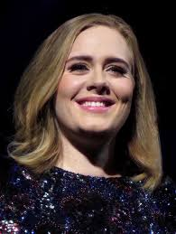
or
In 40 lines of Python code…
Charlie Ringer @chardr27
Notes:
Go to demo

Slide 6
But first… a smidge of theory
Charlie Ringer @chardr27
Notes:
Inspired by nature
Finds a solution to problems when we know what the answer looks like but don’t know how to get there

Slide 7
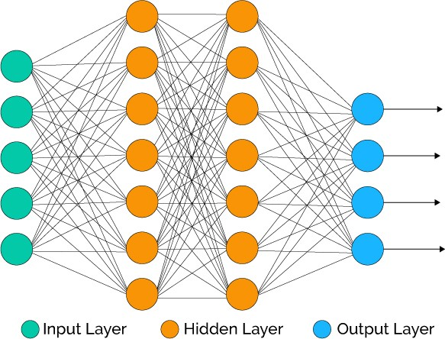
What is a Neural Network?
Charlie Ringer @chardr27

Slide 8
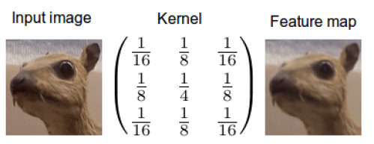
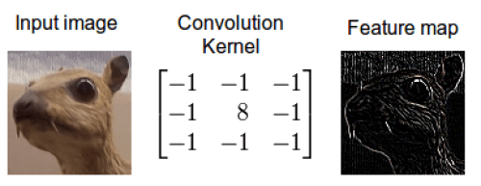
What is a Convolution kernel?
Charlie Ringer @chardr27

Slide 9
Let’s get practical…
1. Install Keras (pip/easy_install/conda)
2. Download the code/data here:
bit.do/adell_adele
3. (optional) Live code this with me
Charlie Ringer @chardr27

Slide 10
Last but not Least
Inspired? Here are some challenges:
Try to classify things that are clearly not A Dell or Adele
Find a different data set and use that
Build a classifier with more than two classes
Build this into some sort of useable app
Charlie Ringer @chardr27

