Slide 1




Lessons for each age track are split into different weeks.
There are different lessons in each week, giving lots of variety to teachers
This also means that if students go to a different centre, they won’t repeat a lesson

Slide 2
The UKLC Syllabus
LANGUAGE FOCUS
LEADERSHIP FOCUS
CULTURE FOCUS
These lessons aim to empower our students’ linguistic awareness and capabilities by working on all language skills (reading, writing, listening, speaking) and systems (grammar, phonology, lexis, discourse), as well as using materials relevant to exam preparation.
This programme is designed to equip students with essential 21st-century skills, focusing on leadership development, communication and teamwork. Students build the confidence and competencies needed to grow into empowered young adults.
These lessons combine CLIL and British culture, allowing students to use English to explore a range of disciplines, including art, literature, natural sciences, as well as the history and geography of the UK.

Slide 3
English Pluses include:
Intensive English (Community Building): We understand that we aren’t just delivering lessons, but we are also creating communities at summer schools whether intentionally or not, and there are challenges, needs, and opportunities involved in this such as social or cultural integrations, resources being wasted, leaving a mess in the canteen, accommodation or in the classrooms. Issues could also include student isolation, mental wellbeing and neurodiversity. Teachers will liaise with the SWC who will support in these areas. The Community Building lessons focus on how to empower students to work together to find possible solutions to these needs and issues by communicating with people on campus. Students create these projects that they are responsible for in order to improve these issue on campus. Lessons are similar to Task-based Learning. Students start by analysing particular issues raised by the teacher (e.g. students leaving trays on tables in the canteen). Students then decide which project they’d like to focus on and then all come up with ideas on who they need to talk to and what they need to do to solve this problem. Through qualitative research, lessons would also be based on survey feedback from the students concerning their likes and dislikes. For example, students could work with the EAM and centre staff to design their own evening activity.
Performing Arts: Combines dance and drama lessons. The content will be decided by the teacher leading the sessions.

Slide 4
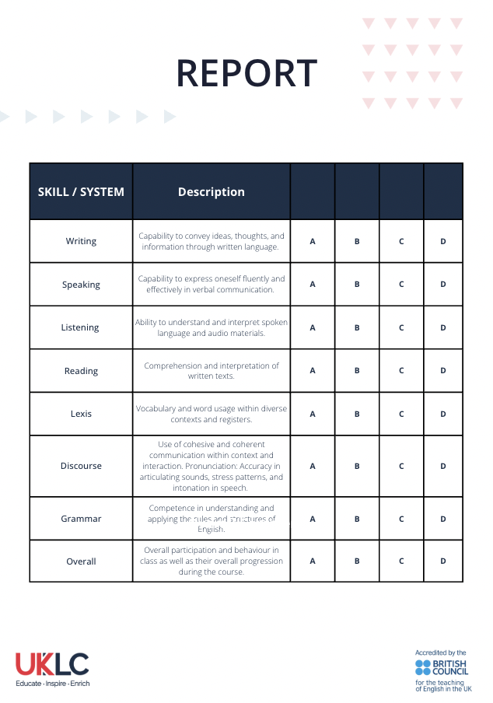
Reports

Slide 5
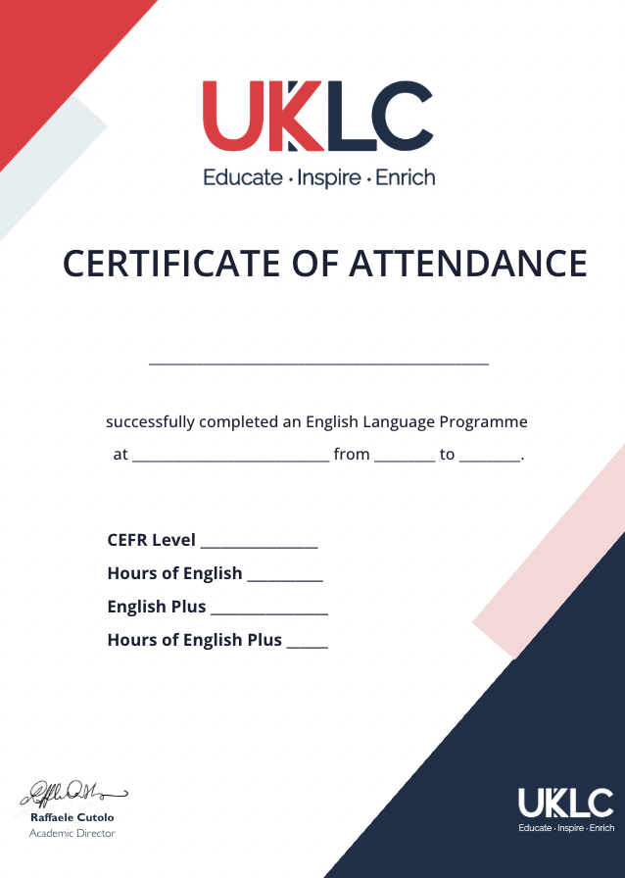
Certificates

