Slide 1
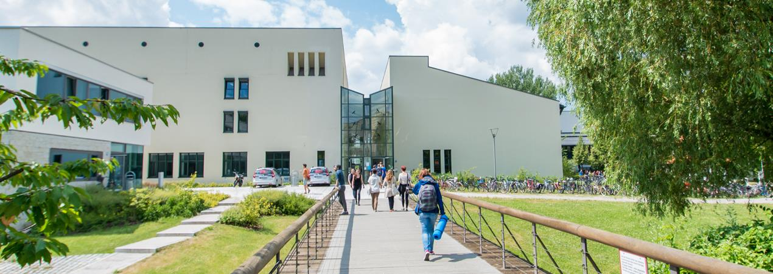
Pedestrian Trajectory Prediction
Chenxiao Tian, Zubair Ahmed, Yashu Wang
07.02.2022

Slide 2
Content
Introduction
Motivation
Problem Statement
Data preprocessing
Implementation
Evaluation
Conclusion

Slide 3
Introduction
Pedestrian Trajectory Prediction: Predict people's future trajectory based on the observed trajectory.
Applications: Auto-driving, monitoring, etc.
Implementation:
Deterministic: social forces[1], formulated stationary crowd group energy map[2].
Non-deteministic: machine learning, deep learning.

Slide 4
Motivation
Disentangle control factors from the experiments.
What the benefits we can get from the factors.

Slide 5



Problem Statement
Using nfo GAN to fit a function
, where is the predicted trajectory, is the observed trajectory, c is the latent space we want to disentangled from the input data and z is the input random noise.

Slide 6
References
[1]D. Helbing and P. Molnar. 1995. Social force model for pedestrian dynamics. Physical review E (1995), 4282–4286. https://doi.org/10.1103/PhysRevE.51.4282
[2]Shuai Yi, Hongsheng Li, and Xiaogang Wang. 2015. Understanding pedestrian behaviors from stationary crowd groups. In 2015 IEEE Conference on Computer Vision and Pattern Recognition (CVPR). 3488–3496. https://doi.org/10.1109/CVPR.2015.7298971

