Slide 1
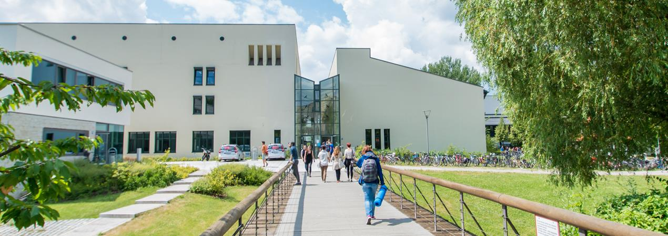
Pedestrian Trajectory Prediction
Chenxiao Tian, Zubair Ahmed, Yashu Wang
07.02.2022

Slide 2
Content
Introduction
Motivation
Problem Statement
Data preprocessing
Implementation
Evaluation
Conclusion

Slide 3
Introduction
Pedestrian Trajectory Prediction: Predict people's future trajectory based on the observed trajectory.
Applications: Auto-driving, monitoring, etc.
Implementation:
Deterministic: social forces[1], formulated stationary crowd group energy map[2].
Non-deteministic: machine learning, deep learning.

Slide 4
Motivation
Disentangle control factors from the experiments.
What the benefits we can get from the factors.

Slide 5



Problem Statement
Using nfo GAN to fit a function
, where is the predicted trajectory, is the observed trajectory, c is the latent space we want to disentangled from the input data and z is the input random noise.

Slide 6
Data acquisition and preprocessing
Pedestiran trajectory prediction is a Data-Drivien task which requires dataset of quality and sufficient quantity.
Datasets ETH (BIWI Walking Pedestrian ) - Pellegrini et al. from ETH Zurich University
ETH
Hotel
UCY – (Lerner et al. from the University of Cyprus)
Univ
Zara1
Zara2

Slide 7
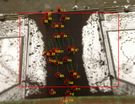
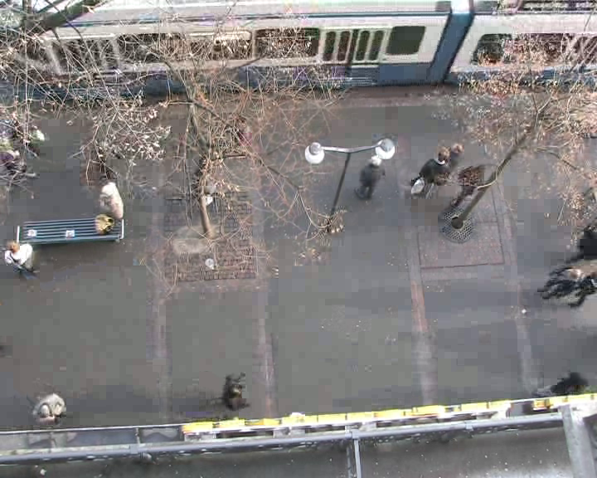
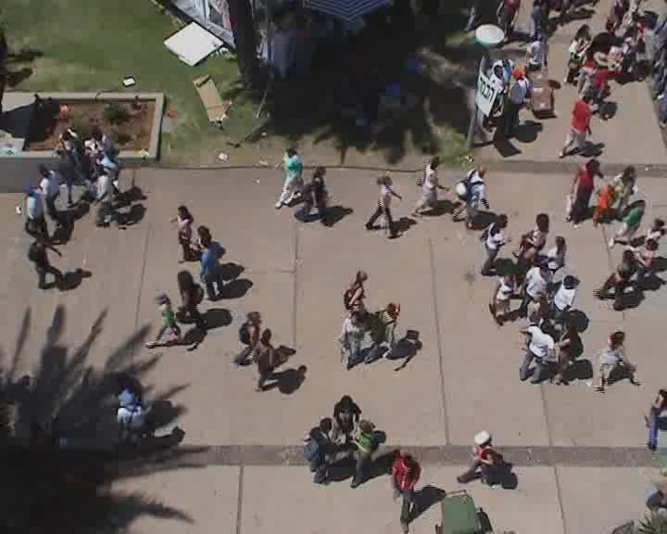
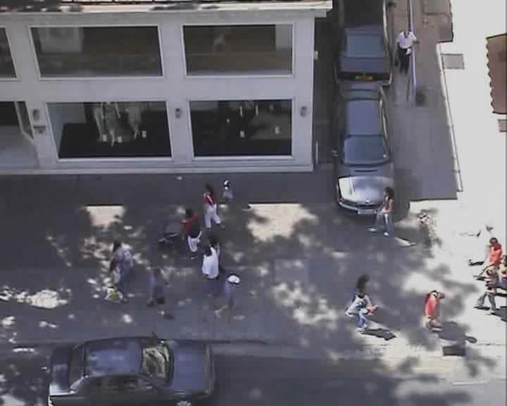
Data acquisition and preprocessing
datasets scenes
Most left image represents scene from eth, 2nd one is ETH hotel dataset
3rd image is UCY univ scene and 4th represents zara1 and zara2
Format
[frame_number, pedestrian_ID, pos_x, pos_z, pos_y, v_x, v_z, v_y]
UCY contain 1100 trajectories data 850, 148, and 204 for univ, zara1 and zara2
ETH contain total 785. 365 and 420 for eth and hotel respectively

Slide 8
References
[1]D. Helbing and P. Molnar. 1995. Social force model for pedestrian dynamics. Physical review E (1995), 4282–4286. https://doi.org/10.1103/PhysRevE.51.4282
[2]Shuai Yi, Hongsheng Li, and Xiaogang Wang. 2015. Understanding pedestrian behaviors from stationary crowd groups. In 2015 IEEE Conference on Computer Vision and Pattern Recognition (CVPR). 3488–3496. https://doi.org/10.1109/CVPR.2015.7298971

