Slide 1
Amazone Online Shopping Website Database
Team 1
Affan Abid Imam
Charlie George Unsworth
Menglei Guo
Poorva Shashikant Nimbalkar
Jiaqi Yao
Leming Liu
Silang Nimai

Slide 2
01
03
Members and Sub-tasks Assigned
Database Design
02
04
ER Digrarm and NOSQL Schema
Database Query Analysis

Slide 3
Members and Sub-tasks Assigned
01

Slide 4
1.1 Members and Sub-tasks Assigned
Name | Sub-tasks
Affan Abid Imam
Charlie George Unsworth
Menglei Guo | ER Dirgrarm; 2 Customer Purchase Product Queries Design; 1 Customer RecommendationSystem Query Design
Poorva Shashikant Nimbalkar
Jiaqi Yao | 3 Fresh Product Order Queries Design
Leming Liu
Silang Nimai

Slide 5
02
ER Digrarm and NOSQL Schema

Slide 6
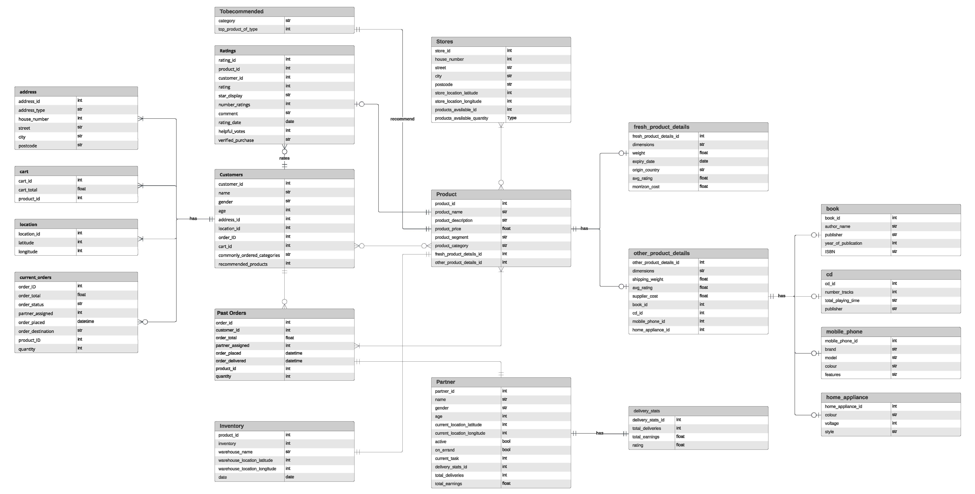
2.1 ER Digrarm
Amazone online shopping website

Slide 7
2.2 NOSQL Schema

Slide 8
Database Design
03

Slide 9
3.1

Slide 10
3.2

Slide 11
3.3

Slide 12
3.4

Slide 13
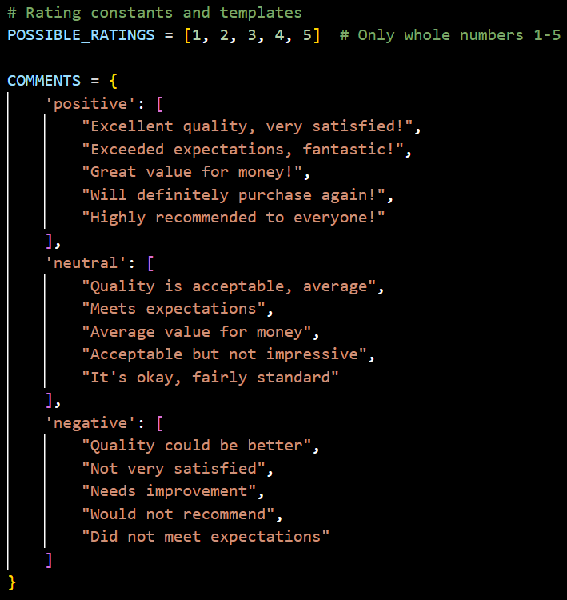
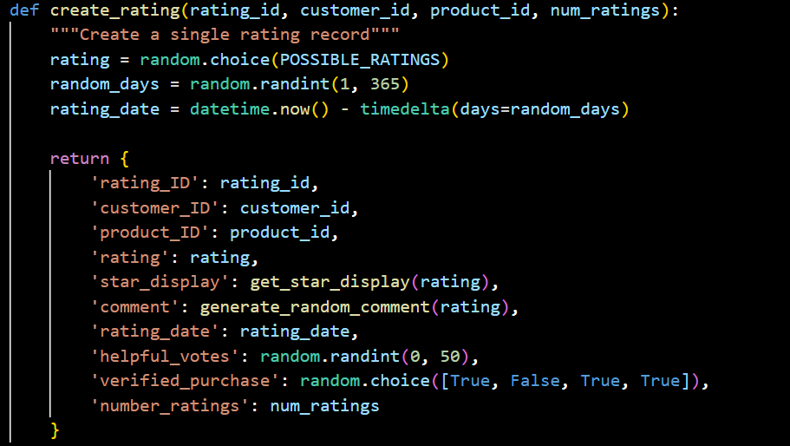
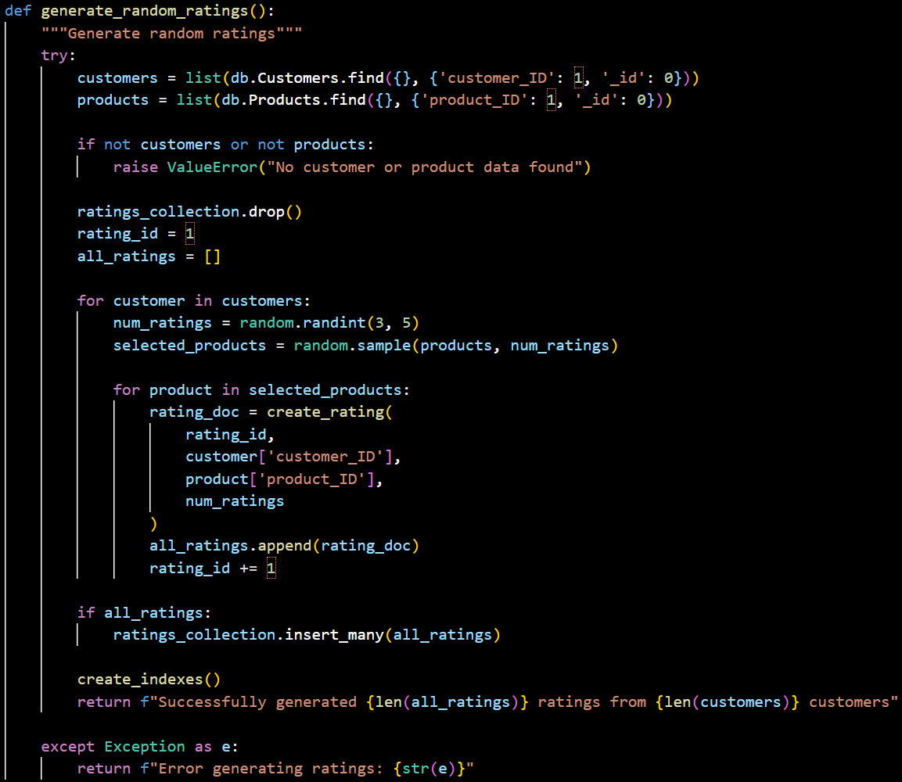
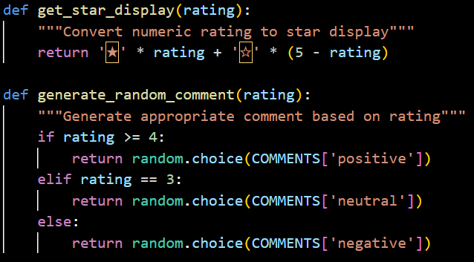
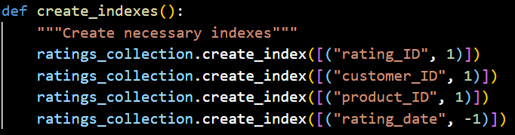
3.5 Ratings_collection
3.5.1 Definition: Rating Ranges and Review Templates
3.5.3 Generate a single rating record and use the main function to generate rating data for all customers
3.5.2 Rating conversion to star display
and random review generation
3.5.4 Create indexes to improve
query efficiency

Slide 14
Database Query Analysis
04

Slide 15
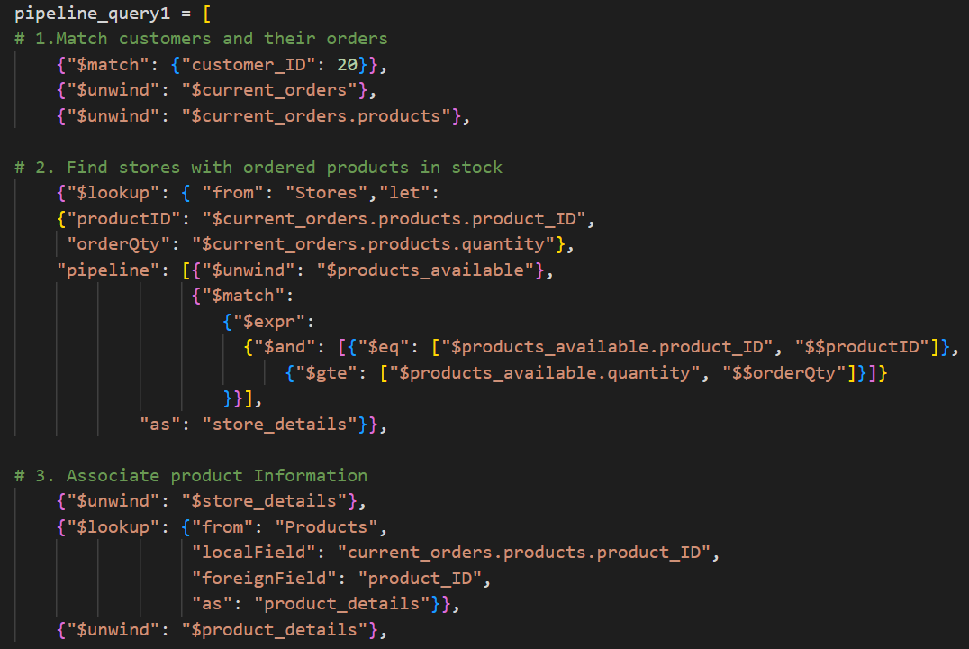
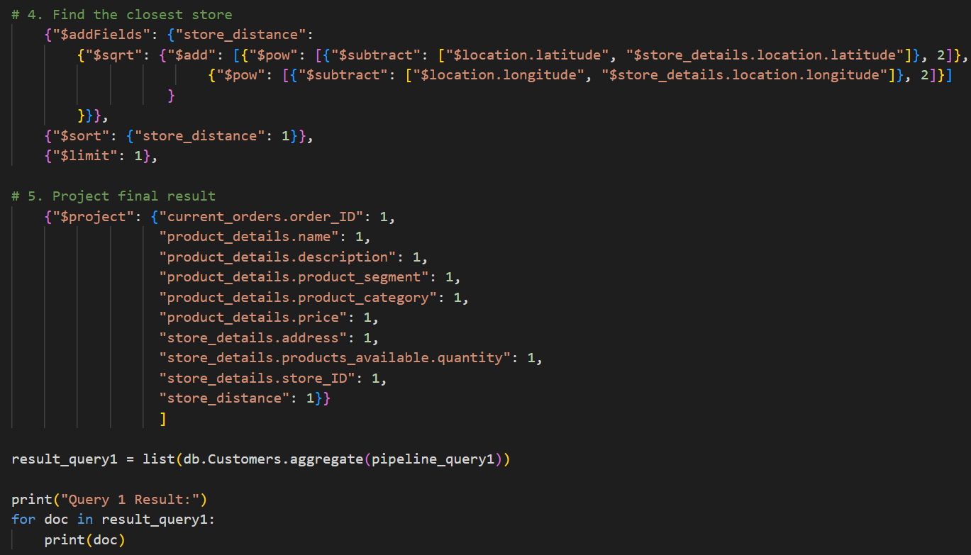
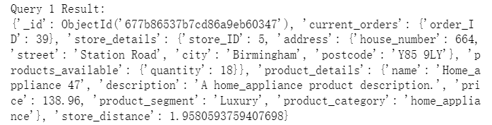
4.1
Fresh Product Order Queries Design 1
4.1.1 Query:
Assign the store when a customer orders fresh products. Return products details and the information of the assigned store.
The conditions set are: customer_ID = 20.
4.1.2 Design steps
Matching customers and their orders
Finding stores with ordered products in stock
Associating product Information
Finding the closest store
Projecting final result
4.1.3 Results

Slide 16
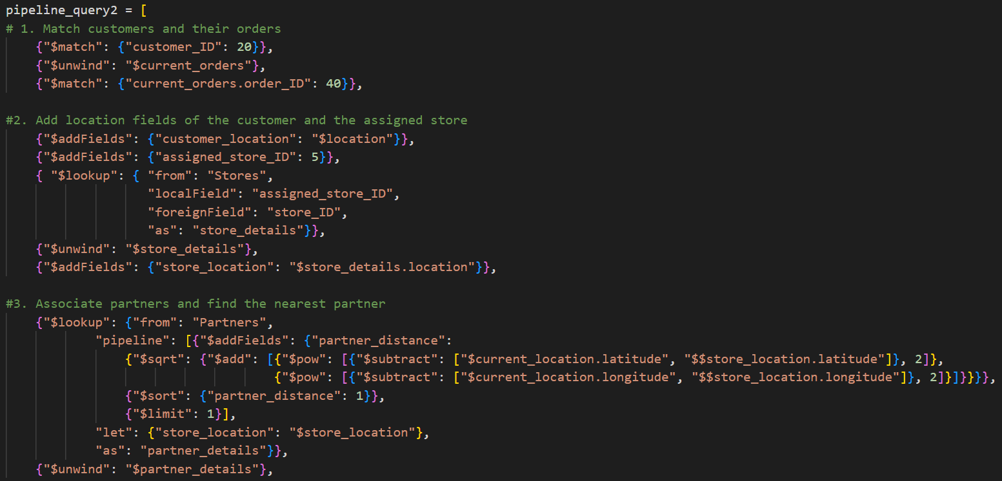
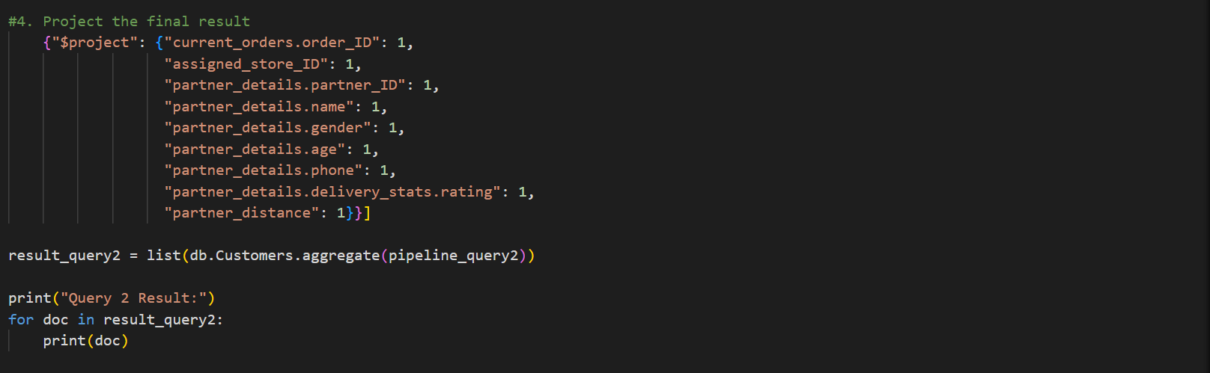
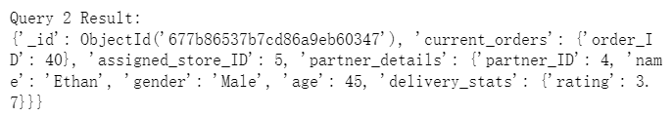
4.2
Fresh Product Order Queries Design 2
4.2.1 Query:
Assign the nearest active delivery partner after assigning the store. Return details of the partner.
The conditions set are: customer_ID = 20; assigned_store_ID=5.
4.2.2 Design steps
Matching customers and their orders
Add location fields of the customer and the assigned store
Associating partners and find the nearest partner
Finding the nearest partner
Projecting final result
4.2.3 Results

Slide 17
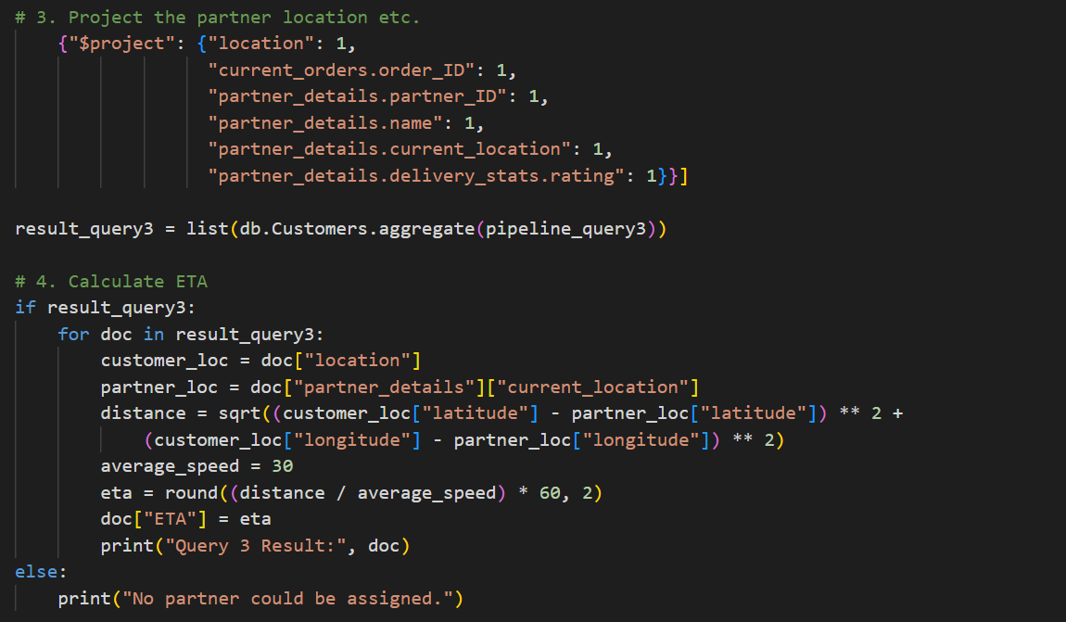
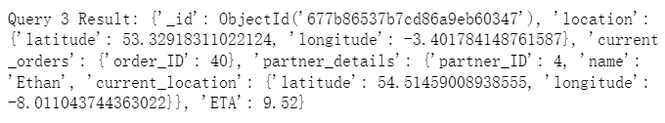
4.3
Fresh Product Order Queries Design 3
4.3.1 Query:
Calculate the ETA(Estimated Time of Arrival) of the partner after assigning the store and the partner. Return the partner’s current location and ETA.
The conditions set are: customer_ID = 20; assigned_store_ID=5; assigned_partner_ID: 4.
4.3.2 Design steps
Matching customers and their orders
Adding partner ID and lookup partner details
Project the partner location etc.
Calculate ETA
4.3.3 Results

Slide 18
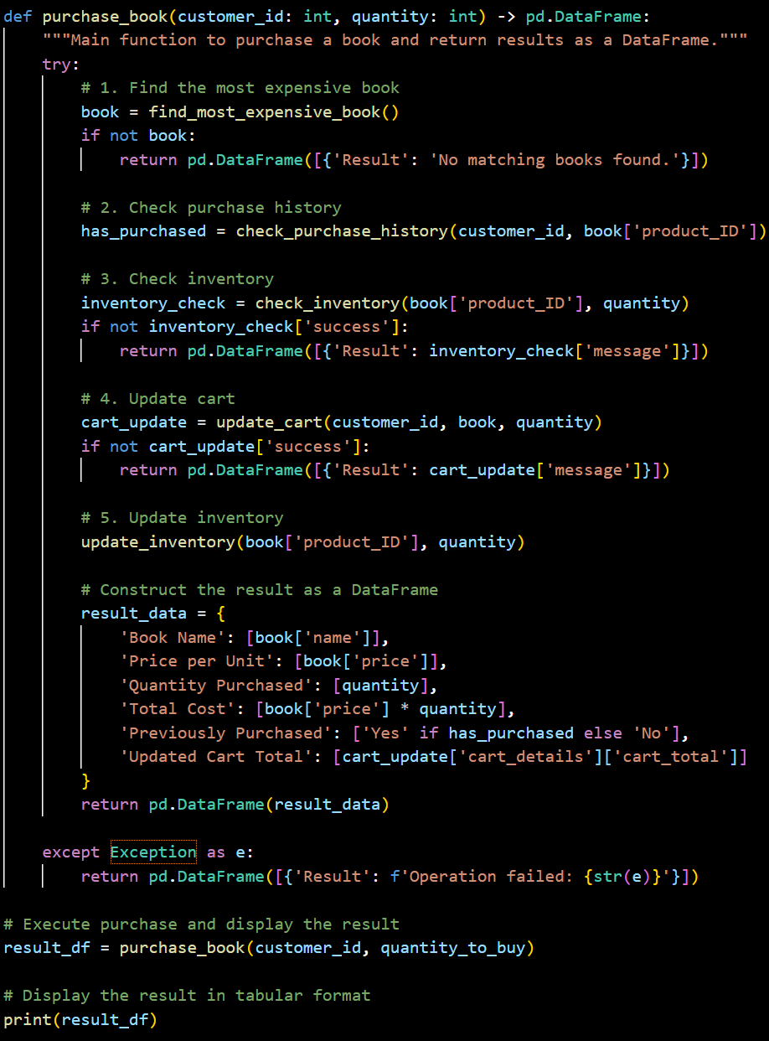
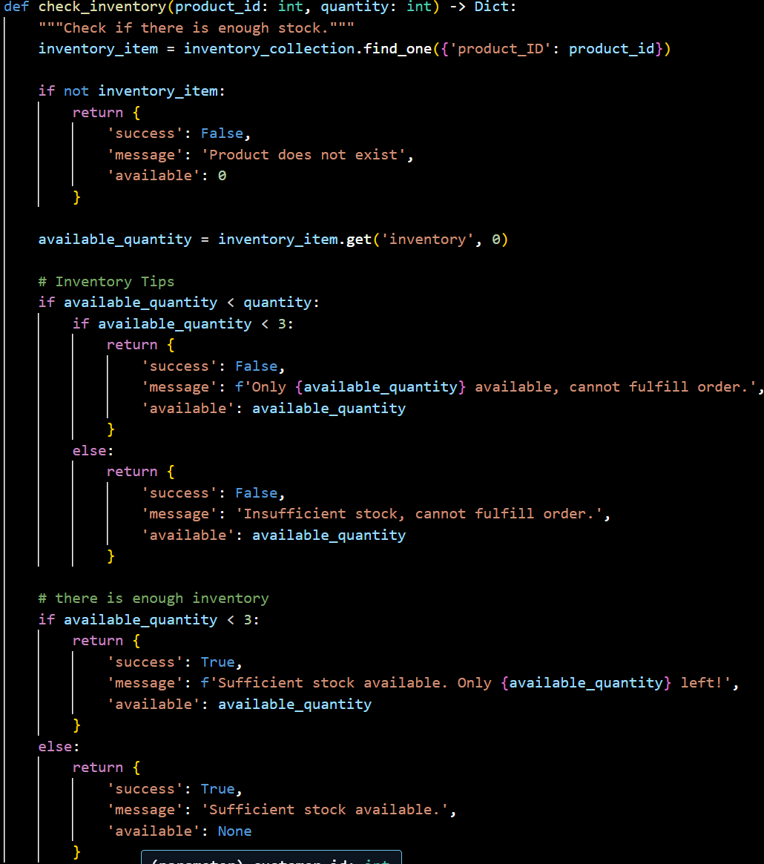
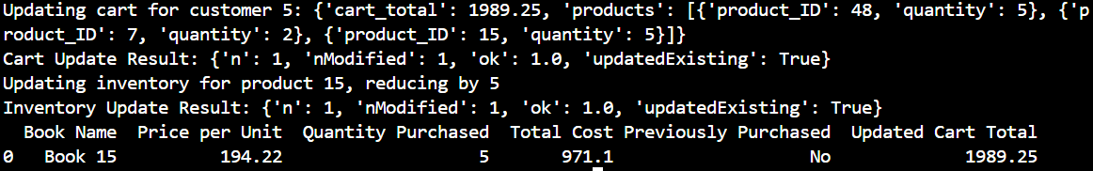
4.4 Customer Purchase Product Queries Design 1
4.4.1 Query:
Customers search for the most expensive product within a specific price range among a fixed category of goods, displaying its current inventory status.
The conditions set are： customer_id = 5，product_type = “book”，
price_range = (150, 200)，quantity_to_buy = 5
4.4.2 Design steps
Finding the Product
Checking Current Inventory
Adding to Cart
Marking Purchase History
Updating Inventory
4.4.3 Results

Slide 19
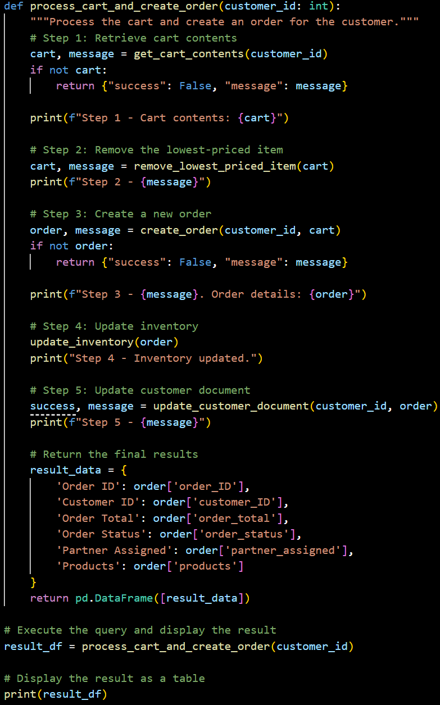
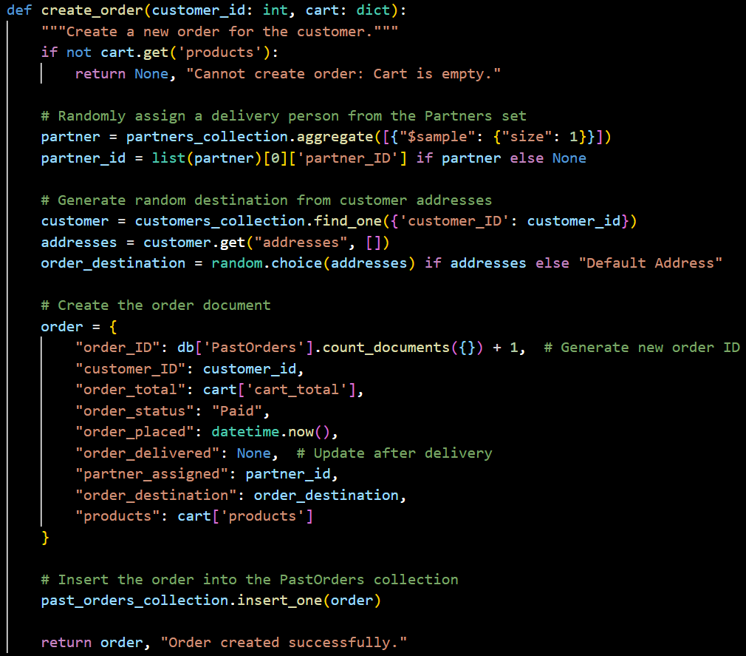
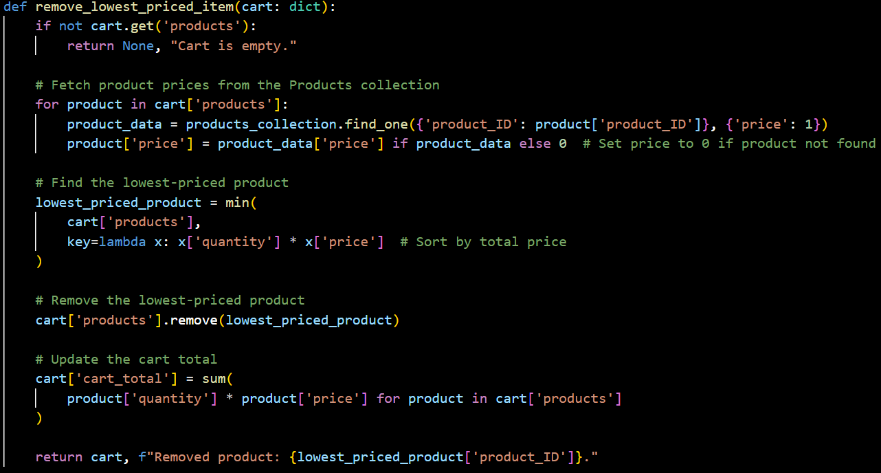
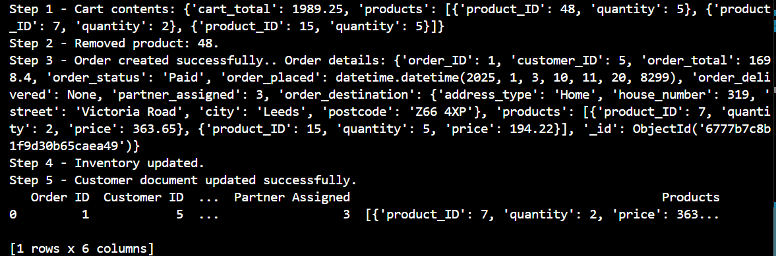
4.5 Customer Purchase Product Queries Design 2
4.4.1 Query:
Customer checks the current shopping cart contents and remove the lowest-priced item. A new order is then created based on the remaining items in the shopping cart, and payment is processed.
The conditions set are: customer_id = 5, remove lowest-priced item
4.4.2 Design steps
Retrieve Shopping Cart Contents
Remove the Lowest-Priced Item
Update Shopping Cart Total
Create a New Order
Record the Order in the Database
Update Customer Document
Adjust Inventory Levels
4.4.3 Results

Slide 20
4.6

Slide 21
4.7

Slide 22
4.8

Slide 23
4.9

Slide 24
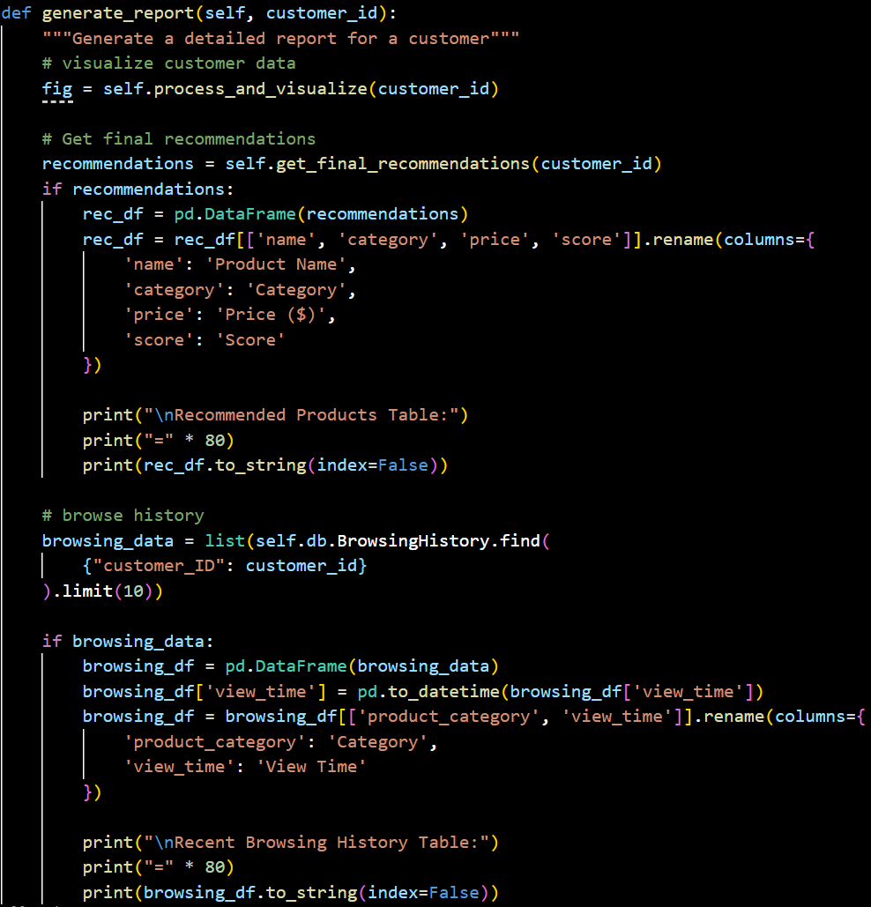
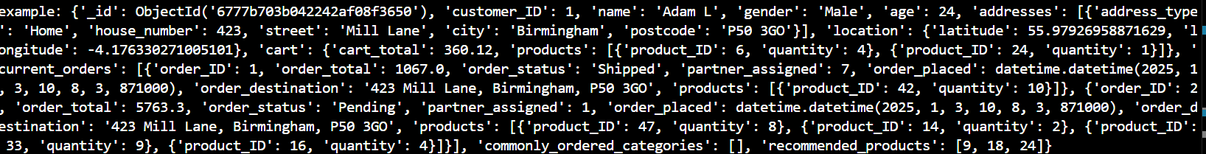
4.10 Recommendation System’s Query Design
4.10.1 Query:
A recommendation system based on user behavior data, which generates personalized recommendations by analyzing the user's browsing history, purchase history and other data.
The conditions set are：limits to 15 recent records, uses current_time and day_ago for recent data, limits recommendations to top 5 products
4.10.2 Design steps
Core recommendation aggregation pipeline
get browsing and purchase history in parallel
Process and visualize customer data
browsing_history_data
purchase_history_data
browsing_timeline
recommendations
Get final product recommendations
Generate a detailed report for a customer
Analyze system performance for a customer

