Slide 1
Impostor Polluting Tor Metadata
Mike Larsen
Charlie Vedaa

Slide 2

Impostor Polluting Tor Metadata
Mike Larsen
Charlie Vedaa

Slide 3
tl;dr
example Snort rule-
alert tcp $HOME_NET any -> $EXTERNAL_NET 9030:9031 (msg:"POLICY-OTHER TOR traffic anonymizer server request"; flow:established,to_server; content:"GET /tor/server"; fast_pattern:only; classtype:policy-violation; sid:9324; rev:5;)
code can be found here-
https://impostor.io

Slide 4
Tor overview
“””
Tor relays publish to directory authorities
Directory authorities create a consensus of relays
Clients bootstrap by downloading the consensus
Clients choose their own network path
“””
from ‘Anonymity and Censorship: The Tor Network’
(@ln4711 and @ioerror)

Slide 6
opportunity cost

Slide 7
about us

Slide 8
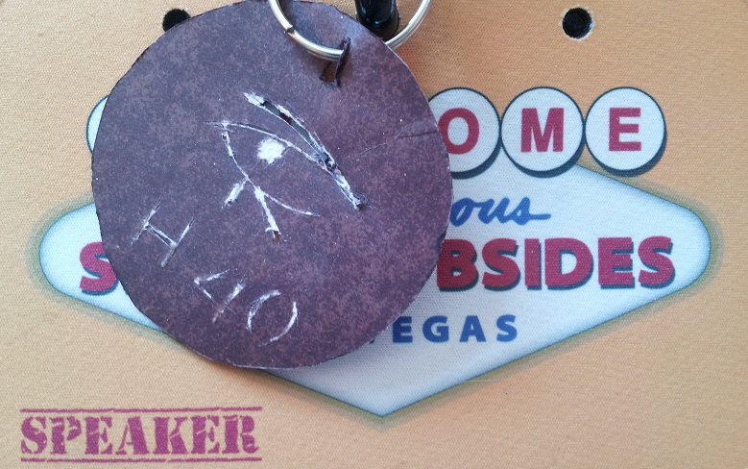
about us

Slide 9
warning
https://www.torproject.org/download/download.html#warning
f. Use bridges and/or find company
Tor tries to prevent attackers from learning what destination websites you connect to. However, by default, it does not prevent somebody watching your Internet traffic from learning that you're using Tor. If this matters to you, you can reduce this risk by configuring Tor to use a Tor bridge relay rather than connecting directly to the public Tor network. Ultimately the best protection is a social approach: the more Tor users there are near you and the more diverse their interests, the less dangerous it will be that you are one of them. Convince other people to use Tor, too!

Slide 10
the impact
AFFIDAVIT OF SPECIAL AGENT THOMAS M. DALTON 835 1682 (Harvard bomb threat case)
December 16 2013 ~08:30 – Harvard officials receive bomb threat via email
“Specifically, Harvard received the e-mail messages from a service called Guerrilla Mail, an Internet application that creates temporary and anonymous e-mail addresses available free of charge. Further investigation yielded information that the person who sent the e-mail messages accessed Guerrilla Mail by using a product called TOR [sic]”
“Harvard University was able to determine that, in the several hours leading up to the receipt of the e-mail messages described above, [kid] accessed TOR using Harvard’s wireless network.”

Slide 11
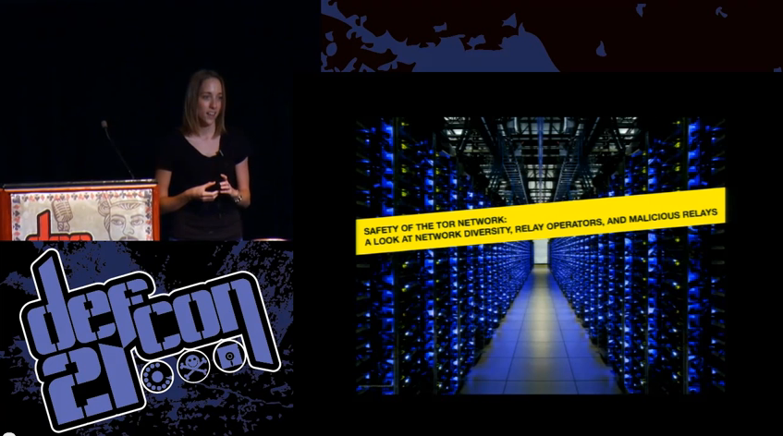
is Tor safe?
@runasand

Slide 12
other considerations
implementations
Onion Browser https://cure53.de/pentest-report_onion-browser.pdf (@0x6D6172696F, @7a_, @insertScript)
endpoints
CVE-2013-1690 https://community.rapid7.com/community/metasploit/blog/2013/08/07/heres-that-fbi-firefox-exploit-for-you-cve-2013-1690 (@_sinn3r)

Slide 13
PORTAL
blocks egress except via Tor
managed out of band
https://github.com/grugq/ (@thegrugq)

Slide 14
obfsproxy and FTE
defaults matter
https://trac.torproject.org/projects/tor/wiki /doc/AChildsGardenOfPluggableTransports

Slide 15
detection models
connections to the Tor network
connections from the Tor network
leaking Tor clients

Slide 16
history of IDS
1998 Insertion Evasion and Denial of Service: Eluding Network Intrusion Detection by @tqbf and @newshtwit

Slide 17
history of IDS
1998 Insertion Evasion and Denial of Service: Eluding Network Intrusion Detection by @tqbf and @newshtwit
1999 nothing much happened

Slide 18
history of IDS
1998 Insertion Evasion and Denial of Service: Eluding Network Intrusion Detection by @tqbf and @newshtwit
1999 nothing much happened
2000 nothing much happened

Slide 19
history of IDS
1998 Insertion Evasion and Denial of Service: Eluding Network Intrusion Detection by @tqbf and @newshtwit
1999 nothing much happened
2000 nothing much happened
2001 nothing much happened

Slide 20
history of IDS
1998 Insertion Evasion and Denial of Service: Eluding Network Intrusion Detection by @tqbf and @newshtwit
1999 nothing much happened
2000 nothing much happened
2001 nothing much happened
2002 nothing much happened

Slide 21
history of IDS
1998 Insertion Evasion and Denial of Service: Eluding Network Intrusion Detection by @tqbf and @newshtwit
1999 nothing much happened
2000 nothing much happened
2001 nothing much happened
2002 nothing much happened
2003 nothing much happened

Slide 22
history of IDS
1998 Insertion Evasion and Denial of Service: Eluding Network Intrusion Detection by @tqbf and @newshtwit
1999 nothing much happened
2000 nothing much happened
2001 nothing much happened
2002 nothing much happened
2003 nothing much happened
2004 nothing much happened

Slide 23
history of IDS
1998 Insertion Evasion and Denial of Service: Eluding Network Intrusion Detection by @tqbf and @newshtwit
1999 nothing much happened
2000 nothing much happened
2001 nothing much happened
2002 nothing much happened
2003 nothing much happened
2004 nothing much happened
2005 nothing much happened

Slide 24
history of IDS
1998 Insertion Evasion and Denial of Service: Eluding Network Intrusion Detection by @tqbf and @newshtwit
1999 nothing much happened
2000 nothing much happened
2001 nothing much happened
2002 nothing much happened
2003 nothing much happened
2004 nothing much happened
2005 nothing much happened
2006 nothing much happened

Slide 25
history of IDS
1998 Insertion Evasion and Denial of Service: Eluding Network Intrusion Detection by @tqbf and @newshtwit
1999 nothing much happened
2000 nothing much happened
2001 nothing much happened
2002 nothing much happened
2003 nothing much happened
2004 nothing much happened
2005 nothing much happened
2006 nothing much happened
2007 nothing much happened

Slide 26
history of IDS
1998 Insertion Evasion and Denial of Service: Eluding Network Intrusion Detection by @tqbf and @newshtwit
1999 nothing much happened
2000 nothing much happened
2001 nothing much happened
2002 nothing much happened
2003 nothing much happened
2004 nothing much happened
2005 nothing much happened
2006 nothing much happened
2007 nothing much happened
2008 nothing much happened

Slide 27
history of IDS
1998 Insertion Evasion and Denial of Service: Eluding Network Intrusion Detection by @tqbf and @newshtwit
1999 nothing much happened
2000 nothing much happened
2001 nothing much happened
2002 nothing much happened
2003 nothing much happened
2004 nothing much happened
2005 nothing much happened
2006 nothing much happened
2007 nothing much happened
2008 nothing much happened
2009 nothing much happened

Slide 28
history of IDS
1998 Insertion Evasion and Denial of Service: Eluding Network Intrusion Detection by @tqbf and @newshtwit
1999 nothing much happened
2000 nothing much happened
2001 nothing much happened
2002 nothing much happened
2003 nothing much happened
2004 nothing much happened
2005 nothing much happened
2006 nothing much happened
2007 nothing much happened
2008 nothing much happened
2009 nothing much happened
2010 nothing much happened

Slide 29
history of IDS
1998 Insertion Evasion and Denial of Service: Eluding Network Intrusion Detection by @tqbf and @newshtwit
1999 nothing much happened
2000 nothing much happened
2001 nothing much happened
2002 nothing much happened
2003 nothing much happened
2004 nothing much happened
2005 nothing much happened
2006 nothing much happened
2007 nothing much happened
2008 nothing much happened
2009 nothing much happened
2010 nothing much happened
2011 nothing much happened

Slide 30
history of IDS
1998 Insertion Evasion and Denial of Service: Eluding Network Intrusion Detection by @tqbf and @newshtwit
1999 nothing much happened
2000 nothing much happened
2001 nothing much happened
2002 nothing much happened
2003 nothing much happened
2004 nothing much happened
2005 nothing much happened
2006 nothing much happened
2007 nothing much happened
2008 nothing much happened
2009 nothing much happened
2010 nothing much happened
2011 nothing much happened
2012 nothing much happened

Slide 31
history of IDS
1998 Insertion Evasion and Denial of Service: Eluding Network Intrusion Detection by @tqbf and @newshtwit
1999 nothing much happened
2000 nothing much happened
2001 nothing much happened
2002 nothing much happened
2003 nothing much happened
2004 nothing much happened
2005 nothing much happened
2006 nothing much happened
2007 nothing much happened
2008 nothing much happened
2009 nothing much happened
2010 nothing much happened
2011 nothing much happened
2012 nothing much happened
2013 Cisco buys Sourcefire for $2.7 billion

Slide 32
Snort VRT
alert tcp $HOME_NET any -> $EXTERNAL_NET 9030:9031 (msg:"POLICY-OTHER TOR traffic anonymizer server request"; flow:established,to_server; content:"GET /tor/server"; fast_pattern:only; classtype:policy-violation; sid:9324; rev:5;)
https://gitweb.torproject.org/torspec.git/blob_plain/HEAD: /dir-spec.txt (TunnelDirConns, PreferTunneledDirConns)
alert tcp $HOME_NET any -> $EXTERNAL_NET 9001:9030 (msg:"POLICY-OTHER TOR proxy connection initiation"; flow:to_server,established; content:"TOR"; content:"client "; classtype:policy-violation; sid:13696; rev:3;)
https://lists.torproject.org/pipermail/tor-talk/2008-November/015471.html (@nickm_tor)
False positives- https://impostor.io/snort_vrt.js

Slide 33
Snort ETOpen
alert udp $HOME_NET any -> any 53 (msg:"ET POLICY DNS Query for TOR Hidden Domain .onion Accessible Via TOR"; content:"|01 00 00 01 00 00 00 00 00 00|"; depth:10; offset:2; content:"|05|onion|00|"; fast_pattern; distance:0; reference:url,en.wikipedia.org/wiki/.onion; classtype:policy-violation; sid:2014939; rev:1;)
alert udp $HOME_NET any -> any 53 (msg:"ET POLICY TOR .exit Pseudo TLD DNS Query"; content:"|01 00 00 01 00 00 00 00 00 00|"; depth:10; offset:2; content:"|04|exit|00|"; fast_pattern; distance:0; reference:url,en.wikipedia.org/wiki/.onion; classtype:policy-violation; sid:2014941; rev:3;)
http://www.ietf.org/rfc/rfc1035.txt
10 bytes- flags, questions, anwser RRs, authority RRs, additional RRs QNAME - each label consists of a length octet followed by that number of octets

Slide 34
Snort ETOpen
alert tcp [101.109.17.96,101.55.12.75,103.10.197.50,103.4.19.125,106.186.21.31, 106.187.45.156,106.187.90.158,107.161.153.170,107.161.158.146,107.161.81.187] any -> $HOME_NET any (msg:"ET TOR Known Tor Exit Node TCP Traffic group 1"; flags:S; reference:url,doc.emergingthreats.net/bin/view/Main/TorRules; threshold: type limit, track by_src, seconds 60, count 1; classtype:misc-attack; flowbits:set,ET.TorIP; sid:2520000; rev:1815;)
alert udp [101.109.17.96,101.55.12.75,103.10.197.50,103.4.19.125,106.186.21.31, 106.187.45.156,106.187.90.158,107.161.153.170,107.161.158.146,107.161.81.187] any -> $HOME_NET any (msg:"ET TOR Known Tor Exit Node UDP Traffic group 1"; reference:url,doc.emergingthreats.net/bin/view/Main/TorRules; threshold: type limit, track by_src, seconds 60, count 1; classtype:misc-attack; flowbits:set,ET.TorIP; sid:2520001; rev:1815;)
False positives- https://impostor.io/snort_et.js

Slide 35
Bro
event ssl_established(c: connection )
{
if ( c$ssl?$subject && /^CN=[^=,]*$/ == c$ssl$subject && c$ssl?$issuer && /^CN=[^=,]*$/ == c$ssl$issuer )
{
SumStats::observe("ssl.tor-looking-cert", [$host=c$id$orig_h], [$str=c$ssl$subject]);
}
}
https://github.com/sethhall/bro-junk-drawer/blob/master/detect-tor.bro
https://gitweb.torproject.org/torspec.git/blob_plain/HEAD:/proposals/195-TLS-normalization-for-024.txt
False positives- https://impostor.io/bro.js

Slide 36
JavaScript pros
low impact
easy to opt out
easy to publish
XSS
ad networks https://media.blackhat.com/us-13/us-13-Grossman-Million-Browser-Botnet.pdf (@jeremiahg and @mattjay)
<script src="https://impostor.io/all.js" async></script>
<script src="https://impostor.io/all_https.js" async></script>

Slide 37
JavaScript cons
XHR limitations
http://xhr.spec.whatwg.org/ “certain headers cannot be set and are left up to the user agent”
browser prohibited ports
prevents cross-protocol scripting
‘The Tangled Web’ pages 190-192 (@lcamtuf)
little ability to generate UDP traffic
mixed content warnings
extends to redirects, other protocols, WebSockets
Content Security Policy (CSP) report-uri

Slide 38
other detection techniques?
time synchronization https://tails.boum.org/contribute/design/Time_syncing/
TBB user-agent https://www.torproject.org/projects/torbrowser/design/#fingerprinting-linkability
512 bytes cells https://gitweb.torproject.org/torspec.git/blob_plain/HEAD:/tor-spec.txt

Slide 39
endgame
is it possible to write rules that cannot be spoofed by a browser?

Slide 40
testing your tools
verify https://impostor.io doesn’t work
verify detection does work (e.g. boot Tails)
.pcap yourself, and identify alerting flow(s)
look for clues in alert description/details
just ask

Slide 41
how you can help
visit https://impostor.io
test against your security tools
support the Tor Project https://www.torproject.org/donate/donate

Slide 42
supporting anonymity ain’t easy
"If your secure communications platform isn’t being used by terrorists and pedophiles, you’re probably doing it wrong. – [REDACTED]“ http://grugq.github.io/blog/2013/12/01/yardbirds-effective-usenet-tradecraft/

Slide 43
summary
Tor traffic is easy to detect
detection is easy to fool
you can help make Tor safer

Slide 44
questions? comments?
https://impostor.io

Slide 45
thanks!
https://impostor.io
@charlievedaa

