Slide 1
Lecture 9: introduction to the Linux kernel
CS 3281
Daniel Balasubramanian

Slide 2
Overview
The Linux operating system is considered the most successful open source project
Supports many architectures
Hundreds of contributors
It’s the OS used by Netflix to stream TV to everyone!
A good talk by a Netflix engineer: https://www.youtube.com/watch?v=FJW8nGV4jxY
We’re going to learn about it by:
Building a kernel (current assignment)
Adding a system call, building modules, using netfilter (future assignments),

Slide 3
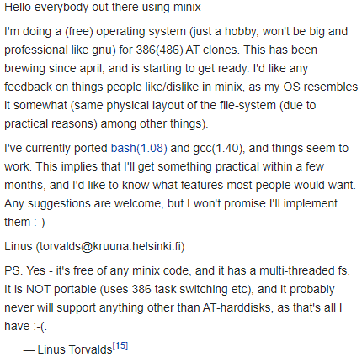
History...
1969: Unix invented by Dennis Ritchie and Ken Thompson at Bell Labs
Many derivatives of Unix since then, including:
FreeBSD, OpenBSD, macOS (Darwin)
But Unix was expensive
Bell Labs estimated its IP in Unix at ~$250 million in the early 90s
1991: Linus Torvalds creates his own OS
Frustrated by Minix
Unix-like, but not Unix

Slide 4
Monolithic vs microkernels
Linux is a monolithic kernel
Translation: it’s one big process running in one big address space
Good things: runs fast, simplifies implementation
Bad things: if one bad thing happens, the whole OS can crash
Including drivers: if a driver does something bad, the whole OS can crash
This is in contrast to a microkernel
Functionality broken down into separate processes
These processes communicate with each other
Good things: perhaps a “cleaner” design, isolation between subsystems
Bad things: substantial overhead with the communication between processes

Slide 5
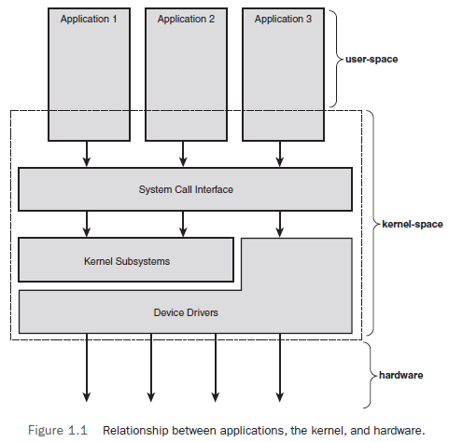
Recall this diagram
We’ve talked about system calls since day 1
*Figure from Linux Kernel Development by Robert Love

Slide 6
Getting the kernel sources
The creator of Linux also created git
There are many repositories
https://github.com/torvalds/linux
https://git.kernel.org/pub/scm/linux/kernel/git/stable/linux.git/
Or, you can go to:
https://www.kernel.org

Slide 7
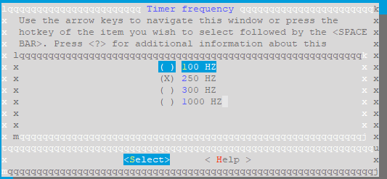
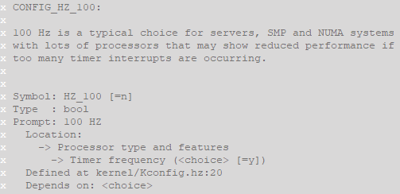
Configuring the kernel
You need to configure what you want in your kernel before building it
Options are either booleans, tristates, strings, or integers
Booleans: yes or no
Determine whether a feature is included
Tristates: yes, no, or module
Determine whether a feature is included, or if it is a loadable module
Strings/Integers: insert values in the source code (usually as preprocessor macros)
Example on right

Slide 8
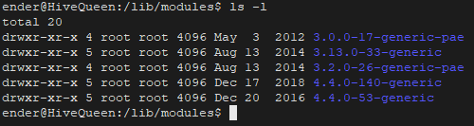
Building the kernel
Can be sped up using multiple cores; to build with 4 parallel jobs:
make -j 4
Recommended: use 2x the number of cores you have (2 cores = 4 parallel jobs, etc)
Building modules:
make modules_install
Modules are installed to /lib/modules
Installing:
make install
Updates your grub2 config file for you, copies kernel to /boot
Note: building a new kernel does not delete your old files
Your file system is independent of your kernel

Slide 9
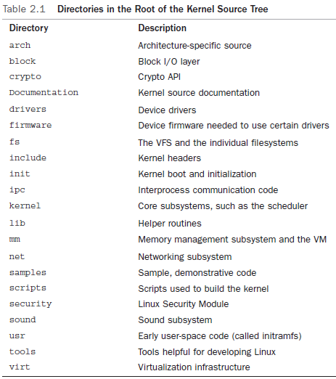
Overview of the source directories
This table explains the directories:
Question: where’s the majority of the code?
*Figure from Linux Kernel Development by Robert Love

Slide 10
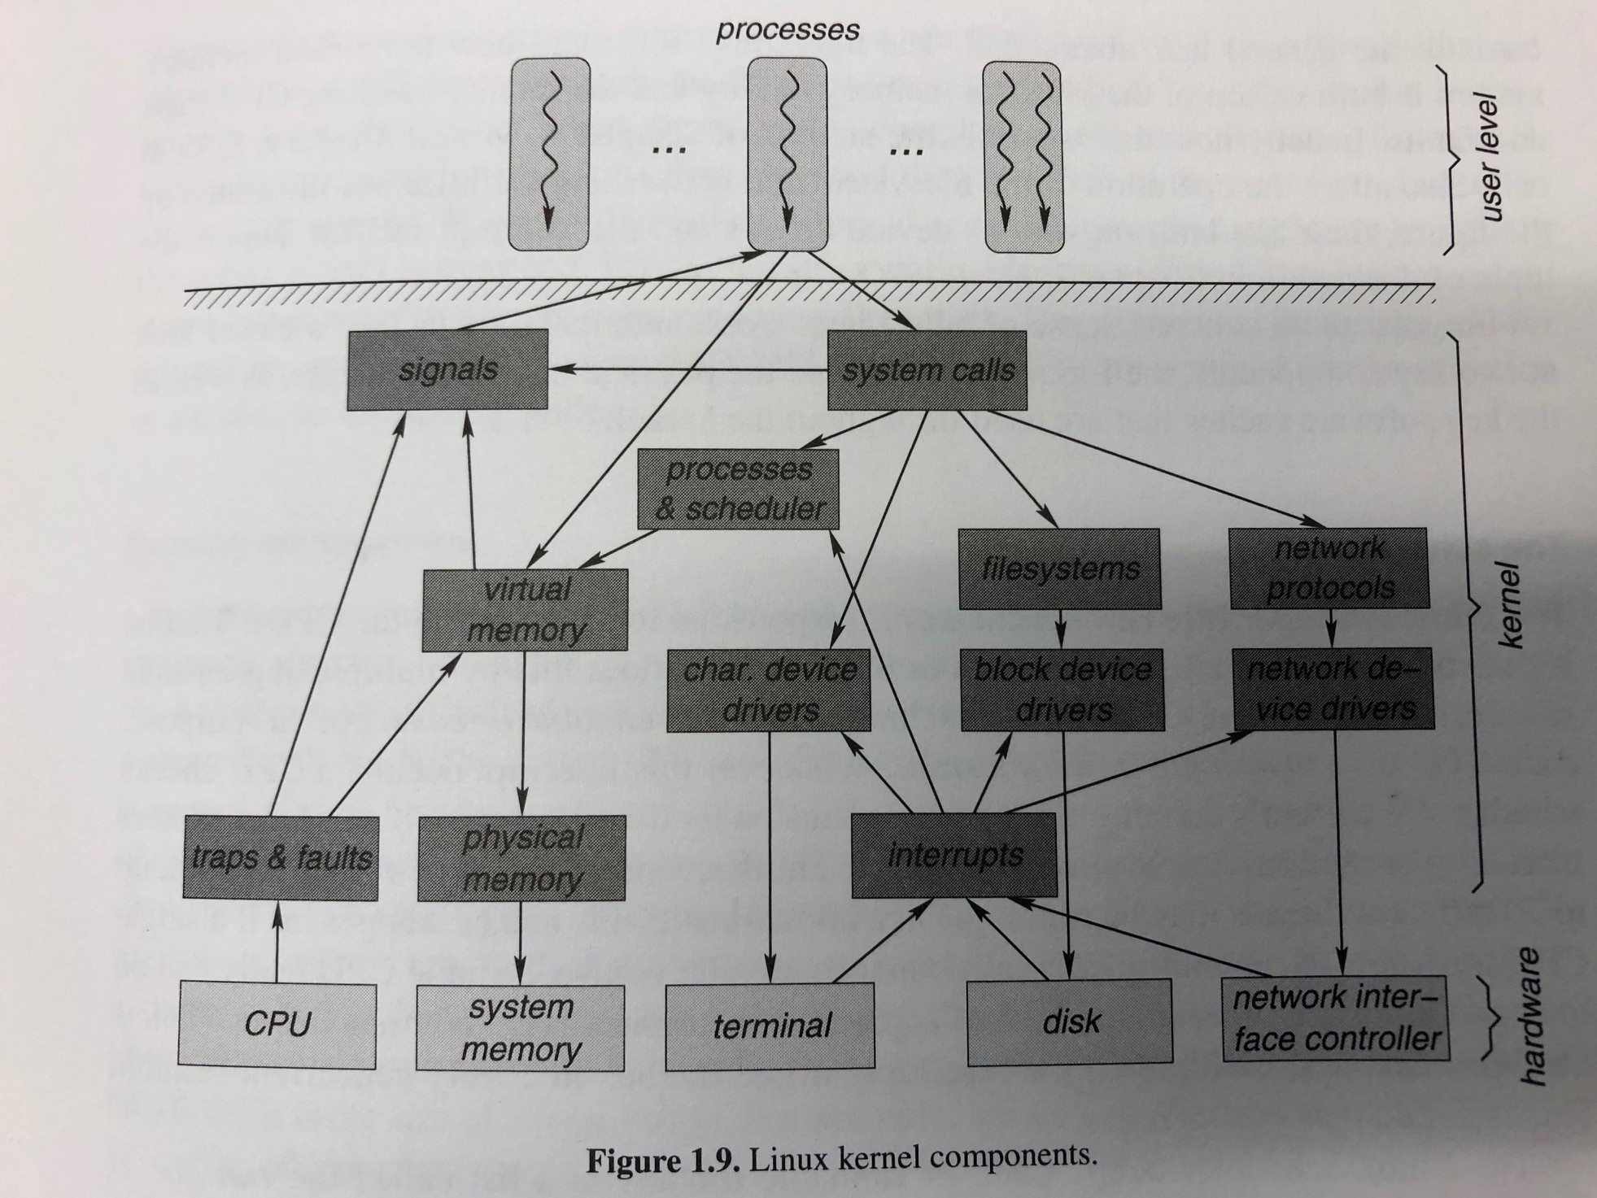
Kernel subsystems and their interaction
Diagram on the right shows kernel subsystems
For example:
User level processes interact with the kernel through system calls and virtual memory
Signals are one way to “talk” to userspace from the kernel
*Figure from ia-64 linux kernel by Mosberger and Eranian

Slide 11
Other notes about the kernel
The kernel isn’t a user-space application
Thus no libc! For example, no printf or malloc
There are often kernel-specific equivalents
kprint or kmalloc
Linux is heavily tied to gcc
Many gcc specific extensions needed to build kernel
There are efforts to make it build with clang/llvm
Fixed size stacks
Architecture specific, but in the kernel, your stack is usually 8kB (32-bit) or 16kB (64-bit)
No memory protection like userspace
Example: userspace processes get a SIGSEGV signal when dereferencing a null pointer
Portability is important
https://en.wikipedia.org/wiki/List_of_Linux-supported_computer_architectures

Slide 12
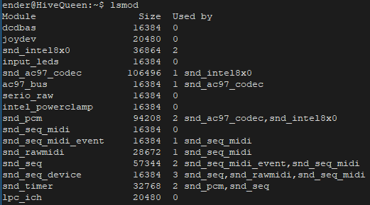
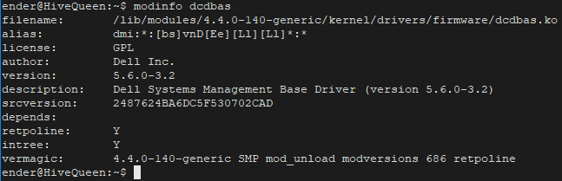
Modules
Linux is monolithic
The whole kernel runs in a single address space
But code can be dynamically inserted and removed at runtime with modules
Module: a loadable kernel object
Allows the base kernel image to be relatively small
Insert modules for extra functionality on-demand
In-tree: modules (drivers) that come with the linux kernel source
Out-of-tree: modules that don’t ship with the linux kernel source
Maintainer has to make sure it works with each kernel version
lsmod and modinfo
Get info about loaded modules

Slide 13

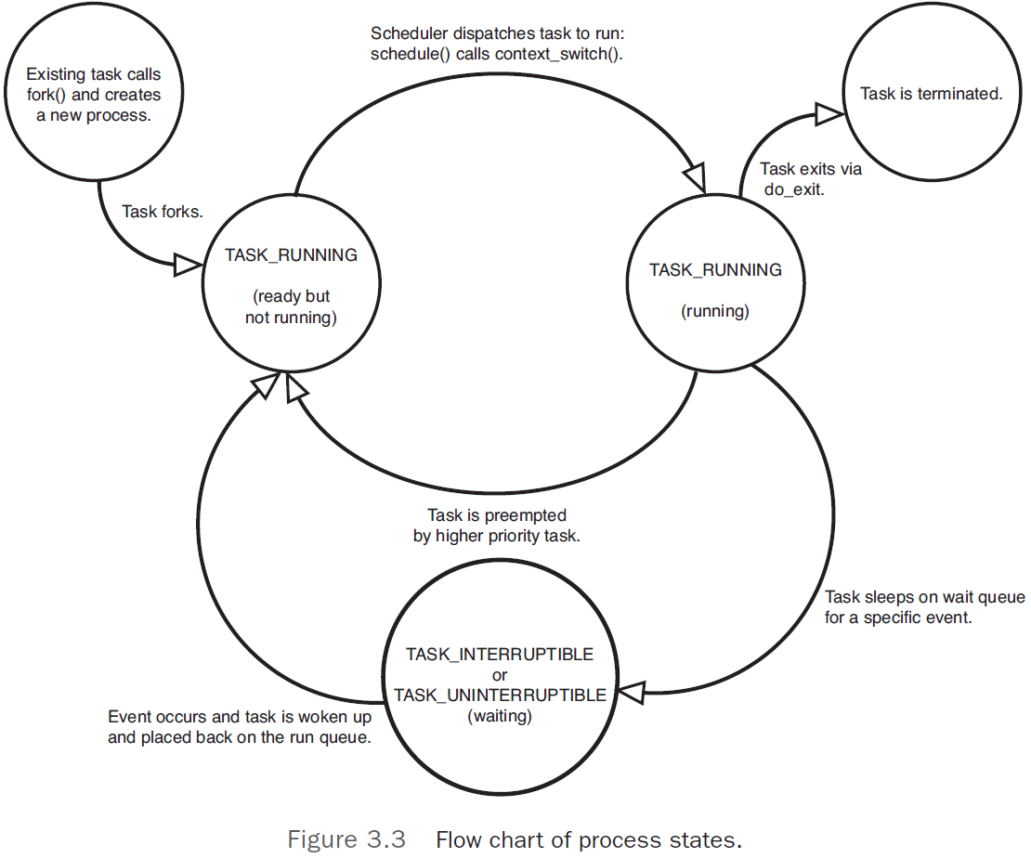
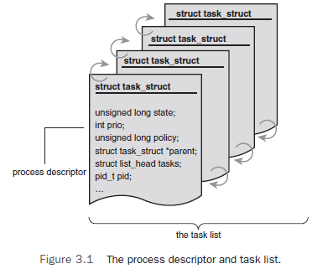
A short look: processes
Each process is represented by a struct task_struct defined in <linux/sched.h>
Kernel keeps a doubly linked list of these called the task list
Relatively large: ~1.7kB
*Figure from Linux Kernel Development by Robert Love

