Slide 1
Lecture 11: threads and synchronization
CS 3281
Daniel Balasubramanian

Slide 2
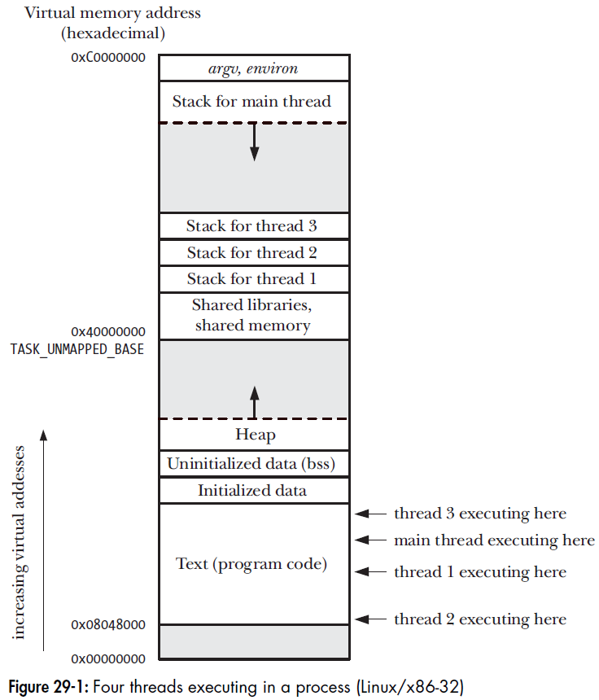
Review
Threads enable concurrency in an application
Example: update a progress bar while simultaneously doing background work
Processes also enable concurrency
But independent processes do not share an address space
Linux implements threads as processes that share certain resources
Threads of the same process share almost everything except stacks
*Figure from The Linux Programming Interface by Michael Kerrisk

Slide 3
POSIX thread API
Linux exposes threads via the POSIX thread, or pthread, API
Basic functions:
pthread_create() -- create a thread
pthread_join() -- join (“wait for”) a terminated thread
pthread_exit() -- terminate the calling thread (does not cause the whole program to terminate)
Other functions:
pthread_attr_init() -- specify “attributes” for the thread, e.g., stack size, is the thread detached
pthread_self() -- get a “handle” to a pthread
pthread_cancel() -- cancel a thread
pthread_kill() -- send a signal to a thread
pthread_detach() -- detach a thread: automatically free its resources when it’s done
pthread_equal() -- compare two threads for equality

Slide 4
Items not shared between threads
Threads do not share their stacks
They also do not share:
thread ID
signal mask: set of signals whose delivery is currently blocked
thread-specific data: allows function to have separate data for each thread
alternate signal stack (sigaltstack()): a location to use for a signal handler’s stack frame
the errno variable: global integer variable that identifies error when a system call fails
floating-point environment (see fenv(3)): how floating point rounding/exceptions are handled
realtime scheduling policy and priority
CPU affinity (Linux-specific): which CPU (or core) thread executes on
capabilities (Linux-specific): allow processes to perform some privileged operations

Slide 5
Race condition
Race condition: a situation where the result produced by multiple threads (or processes) operating on shared resources depends in an unexpected way on the relative order in which the processes gain access to the CPU(s).
What causes race conditions?
In a nutshell: non-atomic operations

Slide 6
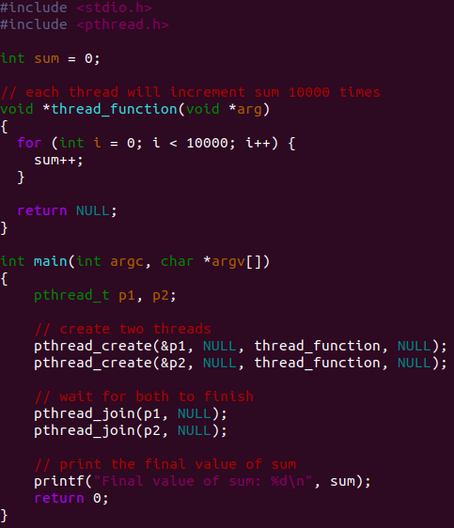
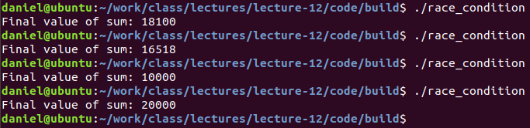
Simple example to demonstrate
Consider the race_condition.c code in the repo:
Running it yields different results each time:
What causes this behavior?

Slide 7
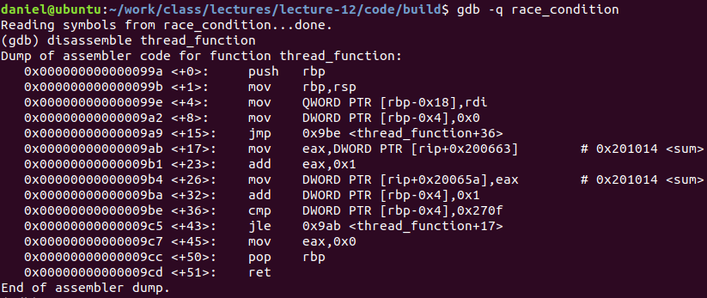
Simple example (cont’d)
This race condition is caused by the fact that sum++ is implemented as three non-atomic instructions:
mov eax, DWORD PTR [rip+0x200663]
add eax, 0x1
mov DWORD PTR [rip+0x20065a], eax
Key point: the OS can switch to a different process after any of these instructions!

Slide 8
Locks
The typical way to prevent race conditions is to use locks. The idea is:
Obtain lock
Perform critical section
Release lock
Question: how do we build locks?
We need at least two operations:
Obtain lock
Release lock
How do we implement these operations?

Slide 9
Implementing locks
Simple implementation: use an integer variable to represent the lock
0: lock is free
1: lock is taken
Releasing the lock is simple
Set the value to 0! Guaranteed to be atomic (by the architecture)
But what about obtaining the lock?
Check if the current value is 0
If current value is 0, then set it to 1
But that’s at least two non-atomic operations!

Slide 10
Atomic instructions to the rescue!
Modern operating systems use special hardware instructions as the building blocks for locks
On the x86: xchg, cmpxchg
What do these do?
Atomically swap the value of a register and memory
Let’s use these to build a spin-lock

Slide 11
Using xchg to build a spin-lock
A spin-lock is a lock that just keeps trying to obtain the lock until it succeeds
Let’s use the xchg instruction to build a spin-lock:
void init(int *lock) {
// 0 = free, 1 = taken
*lock = 0;
}
void lock(int *lock) {
while (xchg(lock, 1) == 1)
; // spin-wait (do nothing)
}
void unlock(int *lock) {
*lock = 0;
}
// xchg does two things atomically:
// 1. Set the value of *lock to 1
// 2. Returns the previous value of *lock

Slide 12
Critical sections
Critical section: piece of code that accesses a shared resource and whose execution should be atomic
In other words, it shouldn’t be interrupted by another thread that also accesses the resource
In the example on the previous slide, updating sum was the critical section
Must be careful that multiple threads don’t perform simultaneous updates

Slide 13
Reentrancy
A function is reentrant if it can safely be simultaneously executed by multiple threads of execution in the same process
What does “safely” mean?
The function achieves its expected result, regardless of the state of execution of any other thread of execution.
A function that uses only local variables: guaranteed to be reentrant
Functions that update global variables: may be nonreentrant
Functions that use static data: may be nonreentrant

