Slide 1
Lecture 7: virtual memory
CS 3281
Daniel Balasubramanian

Slide 2
Review
Simple systems (digital picture frames, elevators) might use physical addressing
The addresses used by a program correspond to real, physical addresses
Also called single memory, or flat address space
All modern operating systems use virtual addressing
The addresses used by a program are translated to physical addresses
This translation is done mostly in hardware; the OS plays a big role in setting up data structures used by the hardware

Slide 3
Definition: context switch
A context switch is when the OS decides that the current process should stop running and a different process should be run instead
The OS:
Saves the state of the currently running process
Restores the context of the process that will begin running
The state of a process includes:
Register values
Memory mappings (the translations from virtual to physical addresses)
The parent process
List of open files
Its priority, PID, etc

Slide 4
Why is virtual memory good?
It helps use main memory efficiently
Simplifies memory management
Each process gets the “same” linear address space layout
Easy to share code and data between processes
Isolates address spaces
One process can’t access/wreck the address space of another process
User-space can’t access the kernel’s address space

Slide 5
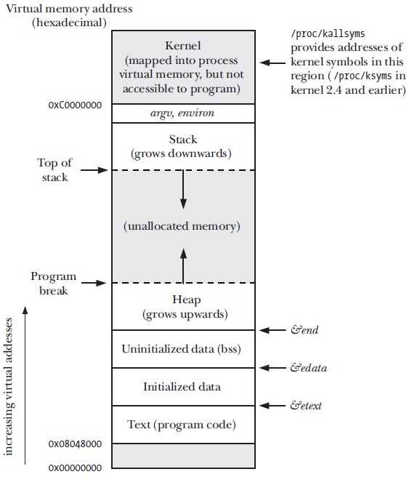
Address space layout of a process
Typical address space layout of a user-level process is shown on the right
These addresses are all virtual
It’s the job of the hardware (MMU) + OS to translate these to physical addresses
So, how is this translation done?
*Figure from The Linux Programming Interface by Michael Kerrisk

Slide 6
Paging introduction
A process’s virtual memory is divided into equal sized units
These are called pages
Physical memory is also divided into units of this size
These are called page frames or just frames
The hardware + OS maps from virtual memory pages to physical page frames
When a process makes a memory access it uses a virtual address
The hardware + OS translates this into a physical address

Slide 7
Paging (cont’d)
Paging is good for many reasons:
A virtual address can be mapped anywhere in physical memory that the OS wants.
Pages can be marked with different permissions, such as read-only. If a process tries to access a page in a way that doesn't match the page's permissions, the OS can detect this.
It helps to minimize the amount of wasted space.
Physical pages can be swapped out to disk when physical memory is low. When it is swapped back in, it can go somewhere else in physical memory -- the OS only needs to adjust the virtual to physical mapping.

Slide 8
Demand paging
Pages are only brought into memory when a reference is made to a location on that page
In other words, the page isn’t resident until it’s accessed (read from or written to)
We saw an example of this last class:
We called malloc(1000000) and looked at the process using the top command
Only after we wrote to that memory was physical memory allocated
Demand paging is really good!
The OS avoids wasting time/space loading parts of your program that are never referenced
Example: if you never make it past level 1 in a video game, the OS can avoid loading up the code for level 2

Slide 9
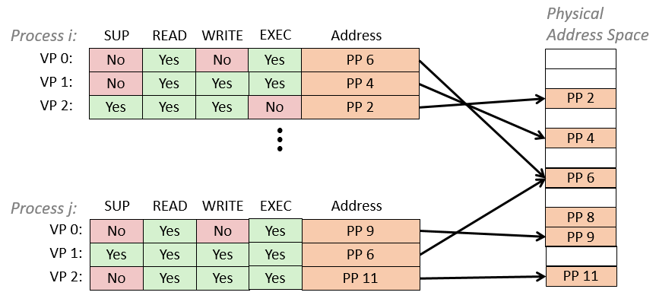
Basic virtual address translation
So, how is a virtual address translated into a physical address?
The OS + hardware divides a virtual address into two parts:
An index into a page table
An offset into the address provided by the table
The page table maps a virtual page to a physical page
The offset tells which byte on the physical page to access
*Figure from CMU 5-213: Introduction to Computer Systems

Slide 10
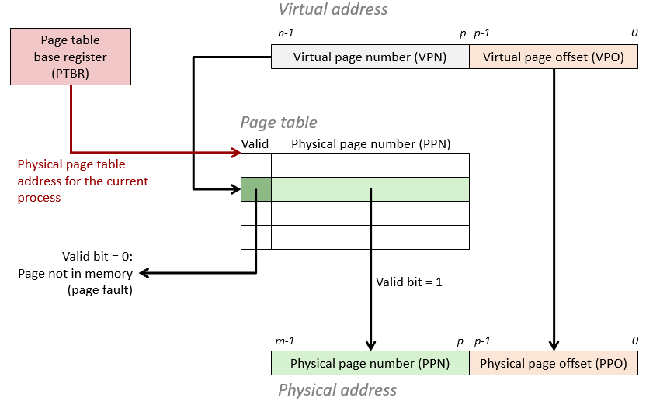
Simplified address translation
*Figure from CMU 5-213: Introduction to Computer Systems
Notes:
The PTBR points to the current page table.
An n-bit virtual address has two components: a p-bit virtual page offset, and an (n-p) bit virtual page number (VPN).
The MMU uses the VPN to select the appropriate PTE. The corresponding physical address is the concatenation of the physical page number from the PTE and the VPO from the virtual address.

Slide 11
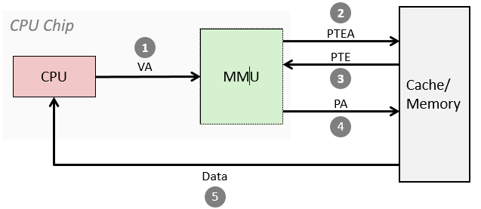
Address translation: page hit
1. Processor sends virtual address to MMU
2-3. MMU fetches PTE from page table in memory
4. MMU sends physical address to cache/memory
5. Cache/memory sends data word to processor
*Figure from CMU 5-213: Introduction to Computer Systems

Slide 12
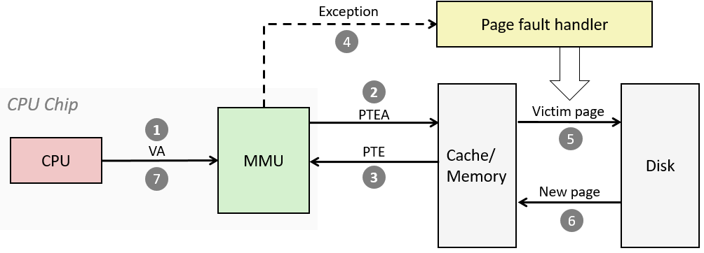
Address translation: page fault
1. Processor sends virtual address to MMU
2-3. MMU fetches PTE from page table in memory
4. Valid bit is zero, so MMU triggers page fault exception
5. Handler identifies victim (and, if dirty, pages it out to disk)
6. Handler pages in new page and updates PTE in memory
7. Handler returns to original process, restarting faulting instruction
*Figure from CMU 5-213: Introduction to Computer Systems

Slide 13
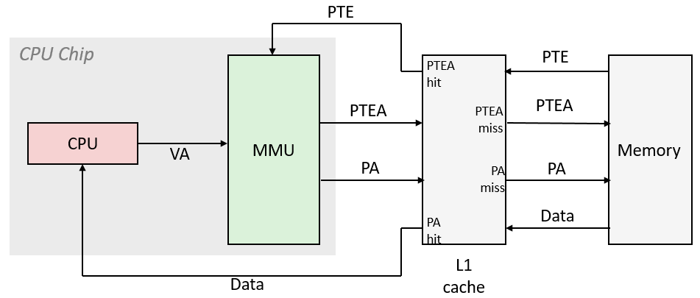
What about cache?
VA: virtual address, PA: physical address, PTE: page table entry, PTEA = PTE address
*Figure from CMU 5-213: Introduction to Computer Systems

Slide 14
The TLB
Page table entries (PTEs) are cached in L1 like any other memory word
PTEs may be evicted by other data references
PTE hit still requires a small L1 delay
Solution: Translation Lookaside Buffer (TLB)
Small set-associative hardware cache in MMU
Maps virtual page numbers to physical page frames
Contains complete page table entries for small number of pages
Some architectures have multiple TLBs:
Instruction TLB (ITLB)
Data TLB (DTLB)
Can even have multiple levels of TLBs
Smaller, faster
Notes:
It is a cache used to store the page table entries.
The basic algorithms for accessing the TLB is described in the slides.
One of the core problems with TLB is what to do with the page table entries upon context switch
A simple solution is to add an extra bit that identifies the address id (similar to pid)
TLB operation is fully associative. A cache can be either set associative or fully associative. Fully associative means that the entry can be stored anywhere in the cache and the access mechanism is designed such that the all areas are simultaneously checked for the entry being compared. Set associative restricts where an entry can be stored.

Slide 15
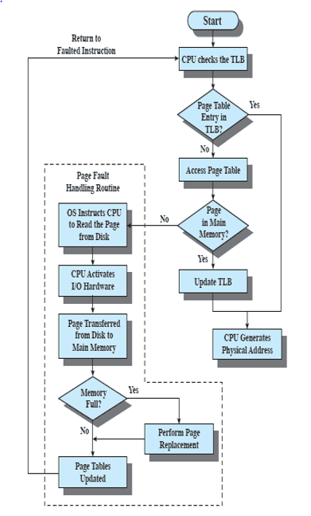
TLB access algorithm

