Slide 1
Lecture 4: process creation
CS 3281
Daniel Balasubramanian

Slide 2
Preliminaries
Assignment 1 is due next Monday evening at 11:59pm

Slide 3
Review
System calls are how user-level processes request services from the kernel
Many kinds of system calls: connect to a network host, read bytes, open a file, close a file, etc
System calls are supported by special machine-code instructions
On x86: int 80h or syscall
These instructions cause a lot of “hidden” work to happen!
Today we’ll look at the system call for creating a process

Slide 4
fork(): the system call for process creation
fork() allows one process, the parent, to create a new process, the child.
fork() creates an (almost identical) copy of the calling process
Things like the PID are different
After a program calls fork(), there is a new process that begins executing the next line of the original program right after the call to fork()!
fork() is called once, but returns twice!
This is very different than most functions!
The biggest difference is the return value from fork()
After fork(), the parent and child are separate processes that run concurrently!
Their instructions might be interleaved by the kernel in any order
The child inherits all of the open files of the parent
The child can write to any files the parent had open when it called fork
The parent and child have duplicate but separate address spaces
What does this mean?

Slide 5
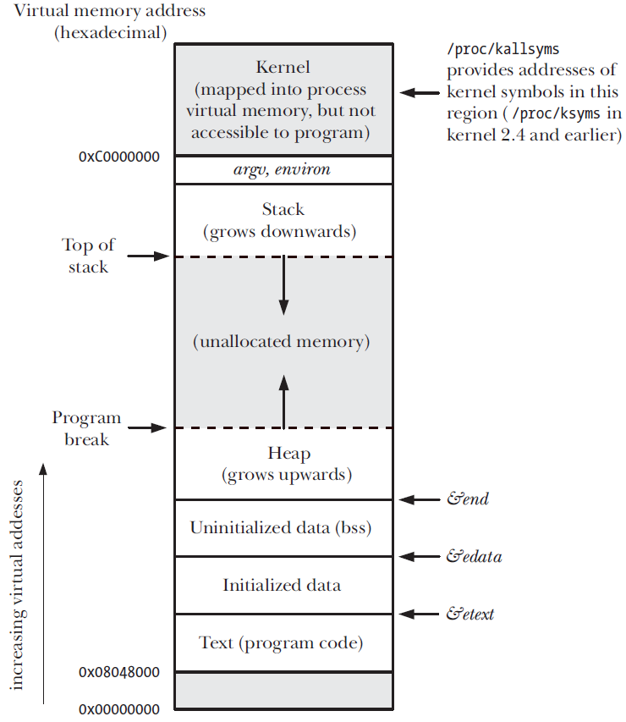
Address spaces
Every process has its own address space that looks (roughly) like the figure on the right
Different areas include:
text: the process’s instructions
data: initialized (global) data
bss: uninitialized (global) data
heap: dynamically allocated memory
stack: organizes procedure calls with stack frames
Use the “size” command to find the sizes of these segments on an executable

Slide 6
After fork()
The new process inherits:
Process group ID
Resource limits
Working directory
Open file descriptors
We will cover these again later -- they help implement pipelines such as:
find . | grep ‘\.java’ | wc -l // find all the .java files and tell me how many there are
But what if we want to execute a different program?

Slide 7
exec(): loading a new program
The exec() function loads a new program
The existing address space is blown away and loaded with the data and instructions of the new program
However, things like the PID and file descriptors remain the same
exec() causes the OS to:
Destroy the address space of the calling process
Load the new program in memory, creating a new stack and heap
Run the new program from its entry point

Slide 8
Why are fork() and exec() separate?
Why are fork() and exec() separated into two calls?
The separation allows the parent process to “fix-up” file descriptors after fork() but before exec()
We’ll cover this in detail later; they allow the parent to redirect the input and output of the new process

Slide 9
Process state
The kernel has a processor descriptor of type struct task_struct for each process
Defined in <linux/sched.h>
Process descriptor contains all the information about a process
The kernel stores the list of processes in a circular doubly linked list called the task list
What does the state of a process include?
State: running, ready, terminated, waiting
Priority
Parent
PID (process identifier)
Address space
Pending signals
Open files

Slide 10
Examples
Let’s code some examples together

