Slide 1
Lecture 12: mutexes
CS 3281
Daniel Balasubramanian

Slide 2
Review
Threads enable concurrency
Data sharing and non-atomic operations can lead to race conditions
Most architectures provide atomic machine instructions that provide the building blocks for synchronization primitives
The xchg instruction is an example of such an instruction; it does two things atomically
Obtain the previous value of a variable
Update the current value

Slide 3
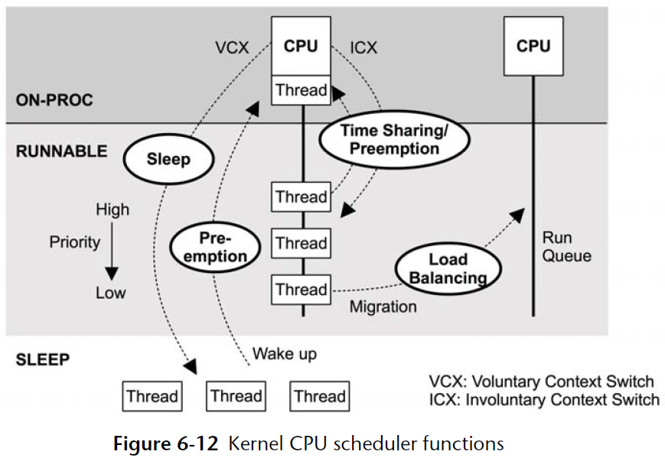
Thread scheduling in more detail
Figure on the right shows the functions of the scheduler
Time sharing: every runnable thread gets a chance to run; highest priority goes first
Preemption: the scheduler can preempt the currently running thread and run another
Load balancing: the scheduler can move runnable threads to other CPUS
Time sharing is driven by the timer interrupt
Calls scheduler_tick(), which invokes the scheduler to see if another thread should run
*Figure from Systems Performance Enterprise and the Cloud by Brendan Gregg

Slide 4
Mutexes
Spin-locks are usually not the right solution for locking
They waste CPU cycles when the lock is contended
Better solution is to sleep if the lock is not available
Have the OS wake you up when the lock is available
Linux provides mutexes for just this purpose
Part of the POSIX library

Slide 5
Pthread mutexes
Data type:
pthread_mutex_t
Operations:
int pthread_mutex_lock(pthread_mutex_t *mutex);
int pthread_mutex_unlock(pthread_mutex_t *mutex);
Typical use:
static pthread_mutex_t mtx = PTHREAD_MUTEX_INITIALIZER;
void *thread_func(void *arg)
{
pthread_mutex_lock(&mtx); // get the lock
// access shared data
pthread_mutex_unlock(&mtx); // release the lock }

Slide 6
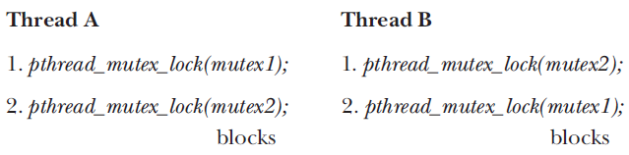
Deadlocks with mutexes
Consider the following scenario
The result is a deadlock!
Lesson: threads should always acquire locks in the same order
*Figure from The Linux Programming Interface by Michael Kerrisk

Slide 7
Locking the same lock?
What if the same thread tries to obtain the same mutex multiple times?
The result depends on how the mutex was initialized
Types of pthread mutexes:
PTHREAD_MUTEX_DEFAULT or PTHREAD_MUTEX_NORMAL
Results in a deadlock if the same pthread tries to lock it a second time using the pthread_mutex_lock subroutine without first unlocking it. This is the default type.
PTHREAD_MUTEX_ERRORCHECK
Avoids deadlocks by returning a non-zero value if the same thread attempts to lock the same mutex more than once without first unlocking the mutex.
PTHREAD_MUTEX_RECURSIVE
Allows the same pthread to recursively lock the mutex using the pthread_mutex_lock subroutine without resulting in a deadlock or getting a non-zero return value from pthread_mutex_lock. The same pthread has to call the pthread_mutex_unlock subroutine the same number of times as it called pthread_mutex_lock subroutine in order to unlock the mutex for other pthreads to use.

Slide 8
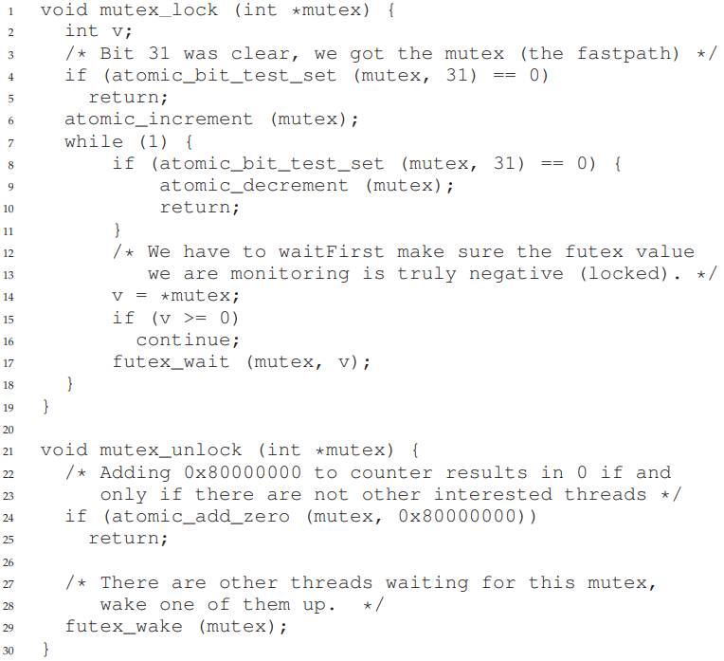
Linux implementation of mutexes
Locking:
Bit 31: indicates if lock is taken
1: taken
0 free
Remaining bits: number of waiters
Line 7: don’t return from here until we get the lock
Lines 8-10: check lock is free and decrement # of waiters if so
Decrement because we incremented
Line 15: check if lock is taken
Line 17: futex system call
Put calling process on queue
*Figure from Operating Systems: Three Easy Pieces by Arpaci-Dusseau and Arpaci-Dusseau

Slide 9
Linux implementation of mutexes
Unlocking:
Lines 24-25: if *mutex == 0 after adding 0x80000000, then nobody was waiting
Line 29: invoke the futex system call
Argument of FUTEX_WAKE
futex() is a multiplexed system call
Different arguments change the behavior
FUTEX_WAIT: go to sleep until mutex is available
FUTEX_WAKE: wake up someone waiting on this mutex
Described in paper “Futexes are Tricky” by Ulrich Drepper
*Figure from Operating Systems: Three Easy Pieces by Arpaci-Dusseau and Arpaci-Dusseau

Slide 10
Examples
Let’s code some examples together

