Slide 1
Lecture 8: advanced memory topics
CS 3281
Daniel Balasubramanian

Slide 2
Review
All modern operating systems use virtual addressing
The addresses used by a program are translated to physical addresses
The MMU and the OS do the translation
Virtual memory is divided into “chunks” called pages
Physical memory is also divided into chunks of the same size called frames
Page tables map virtual pages into physical frames
The TLB is a special cache for page table entries (PTEs)
Usually a separate TLB for instructions (ITLB) and data (DTLB)
Today:
Core i7
Linux
malloc() implementation

Slide 3
Thrashing and page replacement
When physical memory gets low, physical frames are swapped out
They are “swapped” to a swap file; often a separate partition on your hard drive
The OS has to select a “victim” frame to swap out
Different algorithms: FIFO, LRU, Clock replacement
Can’t predict which will be the best choice
Thrashing is when you have many page faults and the OS spends most of the time loading in pages
Happens when you have a lot of processes running simultaneously and they use a lot of memory

Slide 4
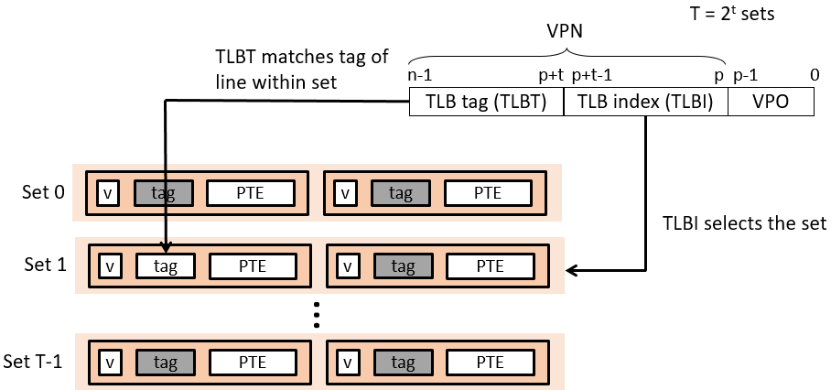
TLB in more detail
MMU uses the VPN portion of the virtual address to access the TLB:
*Figure from CMU 5-213: Introduction to Computer Systems
Notes:
Each line in the TLB holds a single PTE.

Slide 5
The TLB and context switches
When a context switch happens, the TLB entries are often invalid
On the x86, the kernel can flush the entire TLB or individual entries
Which is better depends; the kernel can’t always know ahead of time
Example: you switch back to the original process quickly
Flushing only a few entries is better

Slide 6
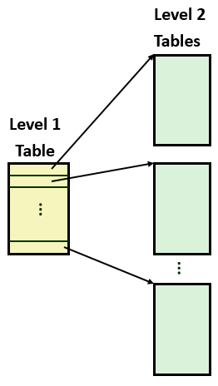
Page tables revisited
A single level page table usually takes up too much space
Examples:
4kB page size, 32-bit address space, 4-byte PTE
Need 2²⁰ PTEs; each is 4 bytes;
2²² = 4MB -- not too bad, but still quite a bit
4kB page size, 48-bit address space, 8-byte PTE
Need 2³⁶ PTEs; each is 8 bytes
2³⁹ bytes = 512 GB -- way too big!
Common solution: multiple levels of page tables

Slide 7
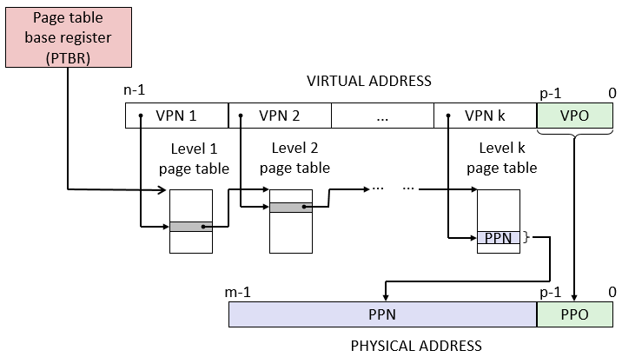
Multi-level page tables
A four-level page table is usually used on modern systems
The number of bits used for each level depends
X64 Linux uses 48-bit virtual addresses and 4kB pages (normally)
12 bits for offset; 9 bits for each lookup level
*Figure from CMU 5-213: Introduction to Computer Systems

Slide 8
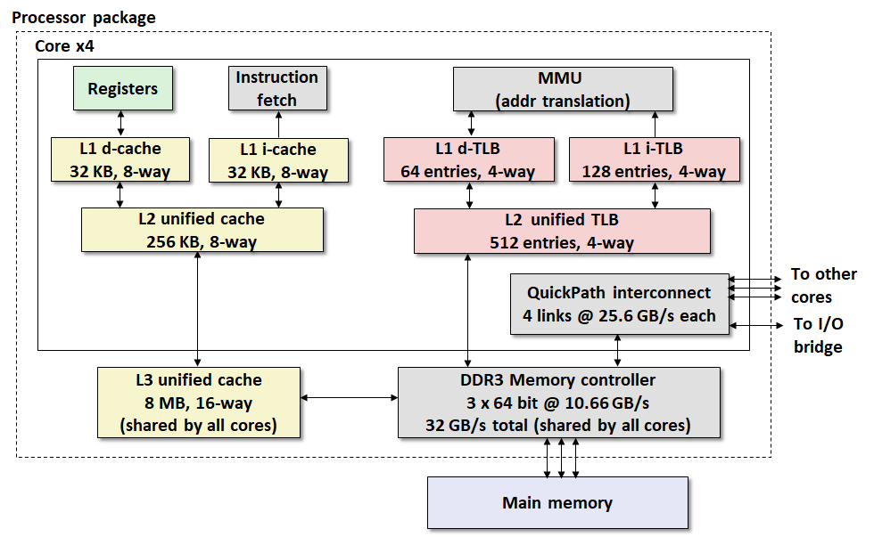
Intel Core i7 Memory System
*Figure from CMU 5-213: Introduction to Computer Systems
Notes:
Note: uses a 48-bit virtual address space and 52-bit physical address space. Why? The ISA supports full 64-bit instructions, but (at least for now) 48-bits is large enough to address the practical amount of memory a system supports. In other words, the CPU uses 48-bits.
The processor package includes four cores.

Slide 9
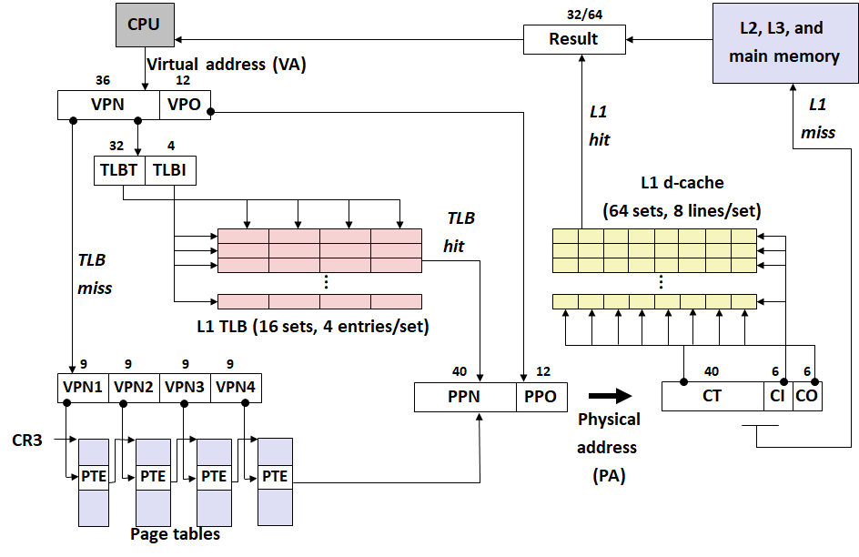
End to end Core i7 address translation
*Figure from CMU 5-213: Introduction to Computer Systems
Notes:
Each process has its own private page table hierarchy. Even though the processor allows page tables themselves to be swapped out, the page tables associated with allocated pages are all memory resident.
The L1 cache is 32kB in size. So:
32kB / (block size * set associativity) = 32kB / (64B * 8 sets) = 32kB / 512B = 64 = 2^6, or 6 bits for the index tag. The offset is 6 bits because the block size is 64B.

Slide 10
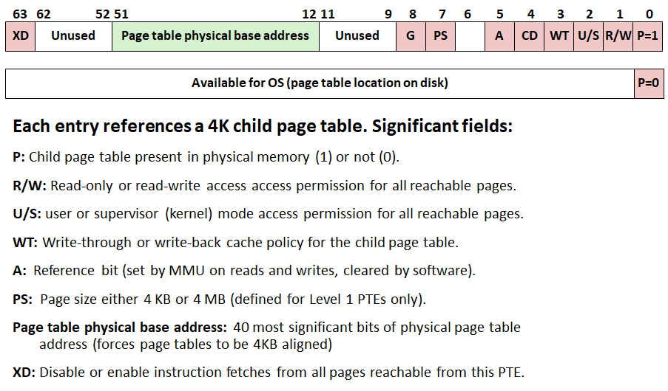
Core i7 level 1-3 page table entries
*Figure from CMU 5-213: Introduction to Computer Systems
Notes:
Note: P is always 1 on Linux. The address field contains a 40-bit physical page number (PPN).
The XD bit was introducted in 64-bit systems. Allows you to disable instruction fetches from individual pages. This allows the OS kernel to reduce the risk of buffer overflow attacks by restricting execution to the read-only code segment.
The A bit is set by the MMU, and the OS’s page replacement algorithm can use this.

Slide 11
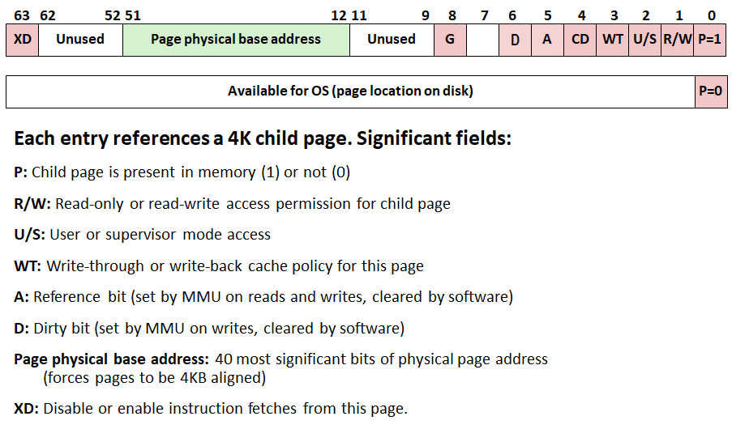
Core i7 level 4 page table entries
*Figure from CMU 5-213: Introduction to Computer Systems
Notes:
Kernel sets the dirty bit (D) each time page is written to (marking it as a dirty page that must write back this page if it is a page replacement victim).

Slide 12
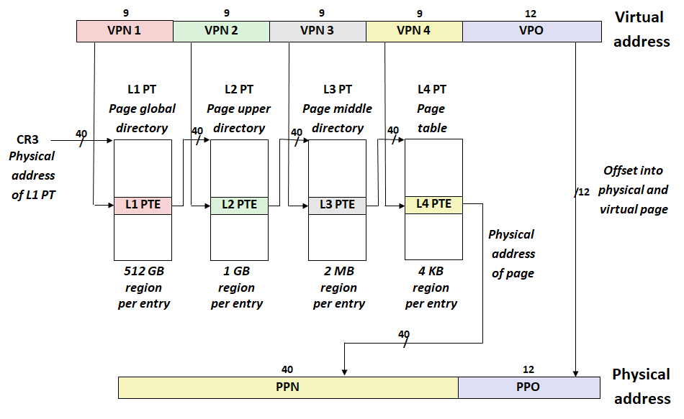
Core i7 page table translation
*Figure from CMU 5-213: Introduction to Computer Systems

Slide 13
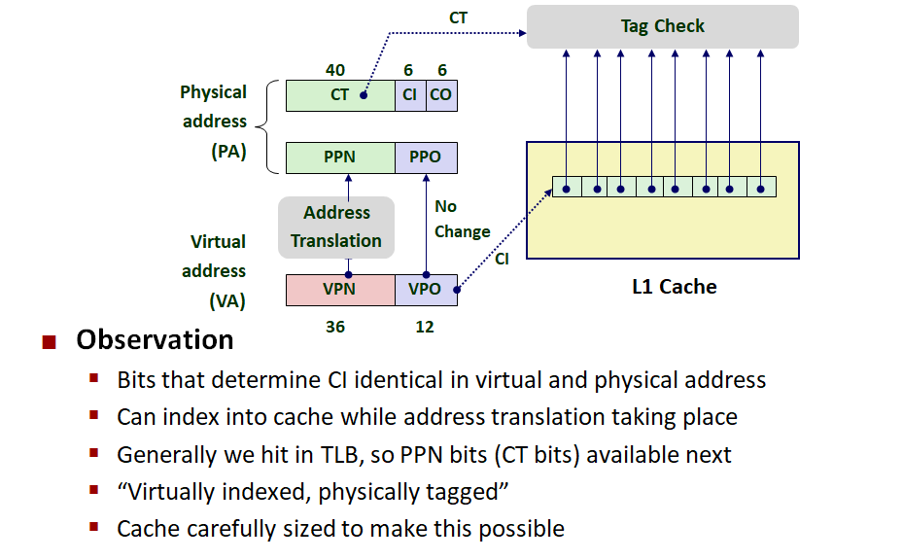
Trick for speeding up L1 access
*Figure from CMU 5-213: Introduction to Computer Systems

Slide 14
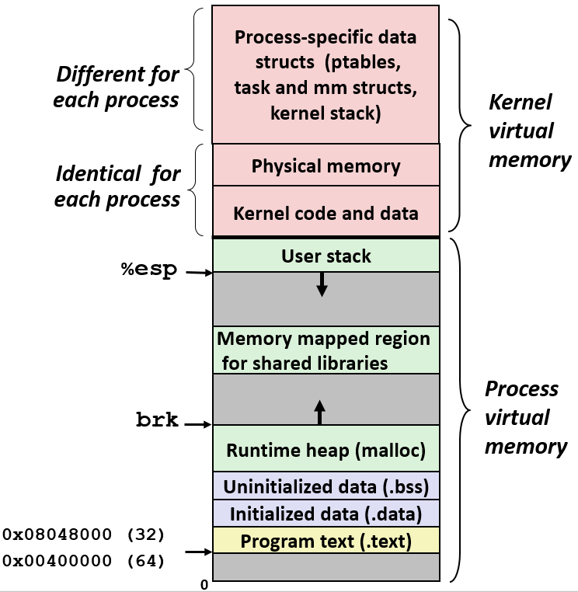
Linux VM revisited
We’re familiar with the address space diagram on the right
But how does the Linux kernel view this?
*Figure from CMU 5-213: Introduction to Computer Systems

Slide 15
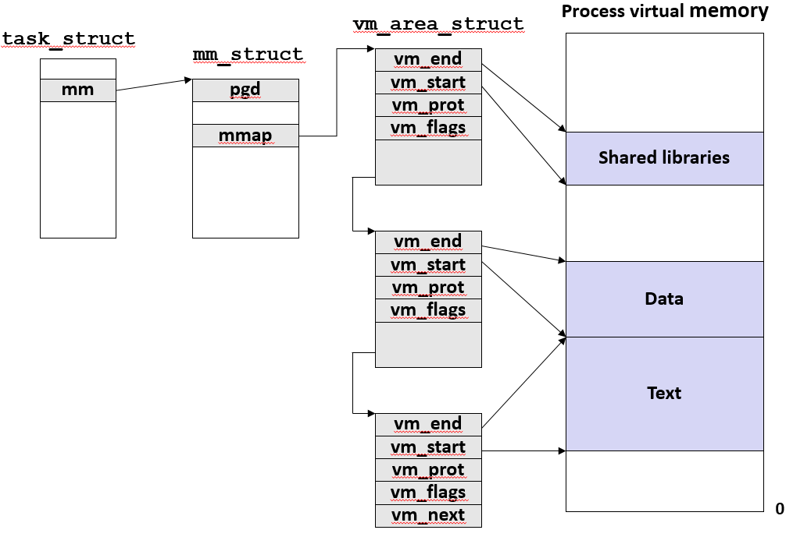
Linux representation of memory
The Linux kernel organizes VM as a collection of “areas”
vm_start and vm_end: point to the beginning and end of the area
vm_prot: describes read/write permissions
vm_flags: tells whether pages in this area are private
vm_next: points to next area vm_area_struct in list
Notes:
vm_start and vm_end: point to the beginning and end of the area
vm_prot: describes read/write permissions

Slide 16
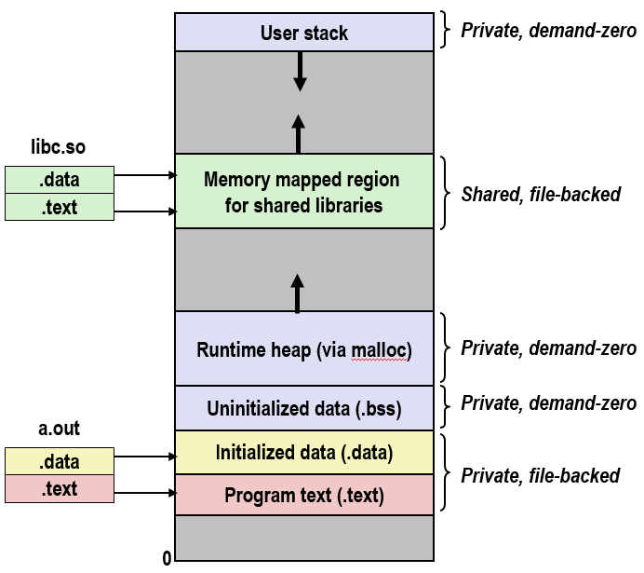
exec() in more detail
Now we can see how exec works in detail!
“Blowing away” the address space of the current process means freeing the vm_area_structs and page tables for old areas
New vm_area_structs and page tables are created for new areas
Programs and initialized data are backed by object files
.bss and stack backed by anonymous files
Set the program counter (PC) to the entry point in the .text section

Slide 17
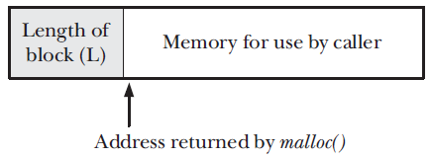
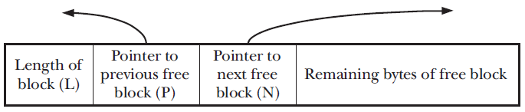
Implementation of malloc
Recall: malloc and free allocate and free memory on the heap
Internally they use the brk() or sbrk() system calls to ask the OS to adjust the size of the process’s heap
brk() and sbrk() grow or shrink the heap, but malloc is responsible for managing free memory
When you ask malloc() to give you memory, it allocates more than you ask
Why? So free() will know how much was allocated!
There’s an integer right before the address you get
*Figure from The Linux Programming Interface by Michael Kerrisk

Slide 18
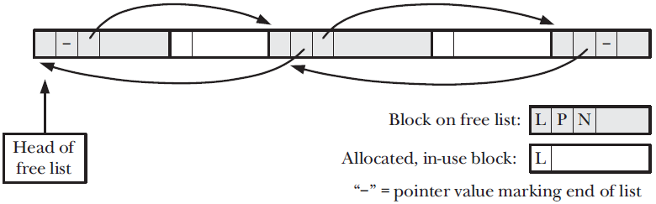
Malloc (cont’d)
Over time, the free memory looks like this
Question: what happens when you pass an incorrect address to free?
*Figure from The Linux Programming Interface by Michael Kerrisk

