Slide 1
Lecture 3: virtualization and system calls
CS 3281
Daniel Balasubramanian

Slide 2
Operating system: definition
Operating systems
Many definitions
A program that shares a computer among multiple programs and provides a more useful set of services than the hardware alone
A program that makes the hardware do “something useful”
Accomplishes this by “virtualizing” the hardware
The OS makes it appear as though every process has the hardware all to itself
Provides services through a system call interface
The core part of the OS is called the OS kernel, or just kernel
Layers:
Hardware: CPU, memory, disks
OS kernel: provides many services
Libraries: provide access to the above services
Applications: gcc (compiler), bash (shell), vi (editor), etc
Key point: the operating system is itself a program!
But unlike other programs, it should have full access to all resources! How can we accomplish this?

Slide 3
Processes
A process is a running instance of a program
It’s the primary unit of isolation/abstraction provided by the OS
Serves several purposes:
Prevents a process X from wrecking or spying on a process Y.
Prevents a process from wrecking the operating system itself.
The process is the abstraction that gives the illusion to a program that it has the machine to itself.
Each process thinks it has the whole CPU.
Each process thinks if has all memory to itself.

Slide 4
System calls
The system call API is the interface that makes OS services available to user-level programs.
What are examples of these services?
Create a process
Wait for a process to terminate
Request memory
Tell me what my unique process identifier is
Read/write from/to a file
Send data over the network
A process requests these service from the OS by making a system call
Why does the OS provide these services?
User-level processes cannot be trusted to be non-malicious
Example: one malicious process could erase your entire hard drive!

Slide 5
Kernel mode vs user mode (Review about Rings)
Recall: the kernel needs full access to all hardware and CPU instructions
User-level processes (like Chrome or Firefox) should not be allowed full access to all hardware nor should they be able to execute call CPU instructions
How should we enforce this? With hardware support!
A flag in a CPU register determines whether privileged instructions are allowed
On the x86 it’s called the CPL (current privilege level)
The bottom two bits of the cs register.
CPL = 0 means kernel mode: privileged
CPL = 3 means user mode: no privilege
The CPL enforces isolation in several ways:
It guards access to the CS register
It checks every memory read/write
I/O port access
Control register access (like the EFLAGS register)
In summary:
The CPL, represented by the bottom two bits of the cs register, determine whether instructions can access privileged hardware.
Only the kernel should be allowed to operate in the privileged mode.

Slide 6
Invoking a system call
So how and when should the CPL change?
On the x86 it happens when a system call is invoked
The instruction used to invoke the system call sets CPL=0.
Execution jumps to a specific entry point in the kernel of the OS, which can then do further validation.
The system call return sets CPL=3 before returning to user code.

Slide 7
Details of system call implementation
The program invokes a wrapper function in the C library. The reason for this is that the wrapper function sets up the system call arguments as expected by the OS. If you've ever noticed files like "libc.so", that's the C library.
The wrapper function puts any arguments to the system call in the registers expected by the kernel.
All system calls enter the kernel the same way, so the kernel must be able to identify them. The wrapper function in the C library copies the system call number into the %eax register of the CPU.
The wrapper function executes a trap machine instruction. This is int 0x80. This causes the processor to switch from user mode to kernel mode (that is, it sets CPL=0) and executes the code pointed to by location 0x80 of the system's trap vector.
The kernel invokes its system_call routine to handle the trap to location 0x80. This is where the meat of the system call logic happens: the kernel does some bookkeeping, checks the validity of the arguments, invokes the service routine, and finally the service routine returns a result status to the system_call routine.
Kernel looks up syscall number in the interrupt vector (we will show that table in next slide)
The wrapper function checks if the service returned an error, and if so, sets a global variable named errno with this error value. The wrapper function then returns to the caller and provides an integer return value to indicate success or failure.

Slide 8
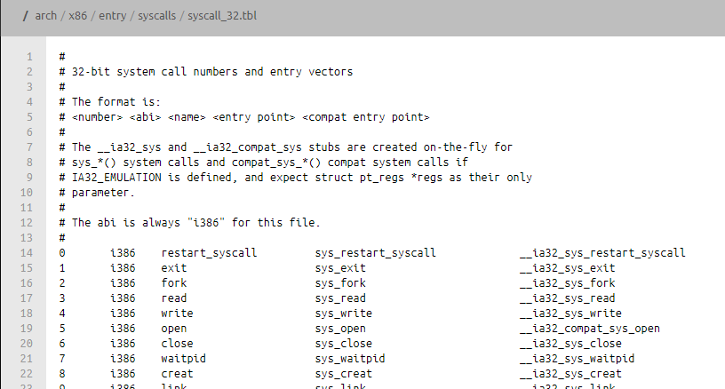
System call numbers
The syscall interface relies on an integer

Slide 9
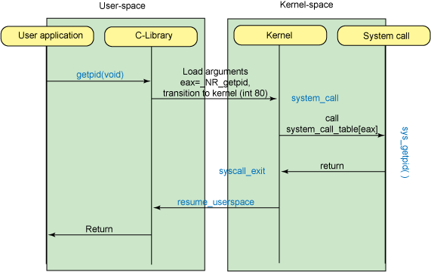
System Call Control Flow example
http://www.ibm.com/developerworks/library/l-system-calls/

Slide 10
System Call Control Flow example
This is an interrupt
http://www.ibm.com/developerworks/library/l-system-calls/

Slide 11
System Call Control Flow example
This is an interrupt
The instruction used to invoke the system call sets CPL=0.
Execution jumps to a specific entry point
in the kernel of the OS, which can then do further validation.
The system call return sets CPL=3 before returning to user code.
http://www.ibm.com/developerworks/library/l-system-calls/

Slide 12
Extending the Kernel in C
Linux is open source: you can modify a kernel
Adding your own system call prototypes
asmlinkage long sys_noargs(void);
Adding your own system call definitions
SYSCALL_DEFINE0( noargs ){ … }
Connecting them to the system call dispatch table
Adding the new definition files to the Makefile
In a future assignment you’ll add your own system call

Slide 13
Tracing system calls
The strace command lets you see the system calls that are made by a process
Example: type “strace ls” at a terminal to see all the system calls that the ls (which lists files in the current directory) makes. You might see calls like:
execve -- this loads a new program and starts running it
open -- open a file
read -- read from a file
close -- close a file
fstat -- get information about a file
See the examples in the repository

Slide 14
Tracing systems calls
strace ls
Execv call loads in a new program into a process
- We will learn more about it in next lecture
vagrant@cs281spring2017devbox:~$ strace ls
execve("/bin/ls", ["ls"], [/* 58 vars */]) = 0
brk(NULL) = 0x1164000
access("/etc/ld.so.nohwcap", F_OK) = -1 ENOENT (No such file or directory)
…..
open("/etc/ld.so.cache", O_RDONLY|O_CLOEXEC) = 3
fstat(3, {st_mode=S_IFREG|0644, st_size=70675, ...}) = 0
mmap(NULL, 70675, PROT_READ, MAP_PRIVATE, 3, 0) = 0x7f21e9c83000
close(3)
….
exit_group(0) = ?
+++ exited with 0 +++ = 0
The exit_group call terminates a process

Slide 15
Accessing the system – The C Library

Slide 16
C library
The C library provides mechanisms for the application program to interact with the kernel.
It also includes the entry point of every process code.
https://git.uclibc.org/uClibc/tree/libc/misc/internals/__uClibc_main.c#n327
This function is called by special assembler files linked to every program Ctrl1.s .
These assembly files do what is needed before calling main() (like initializing stack, setting irqs, etc.). You should link with one or the other but not both. They are not really libraries but really inline assembly code.
The main function you know is called by the __uClibc_main or corresponding main function for any C library

Slide 17
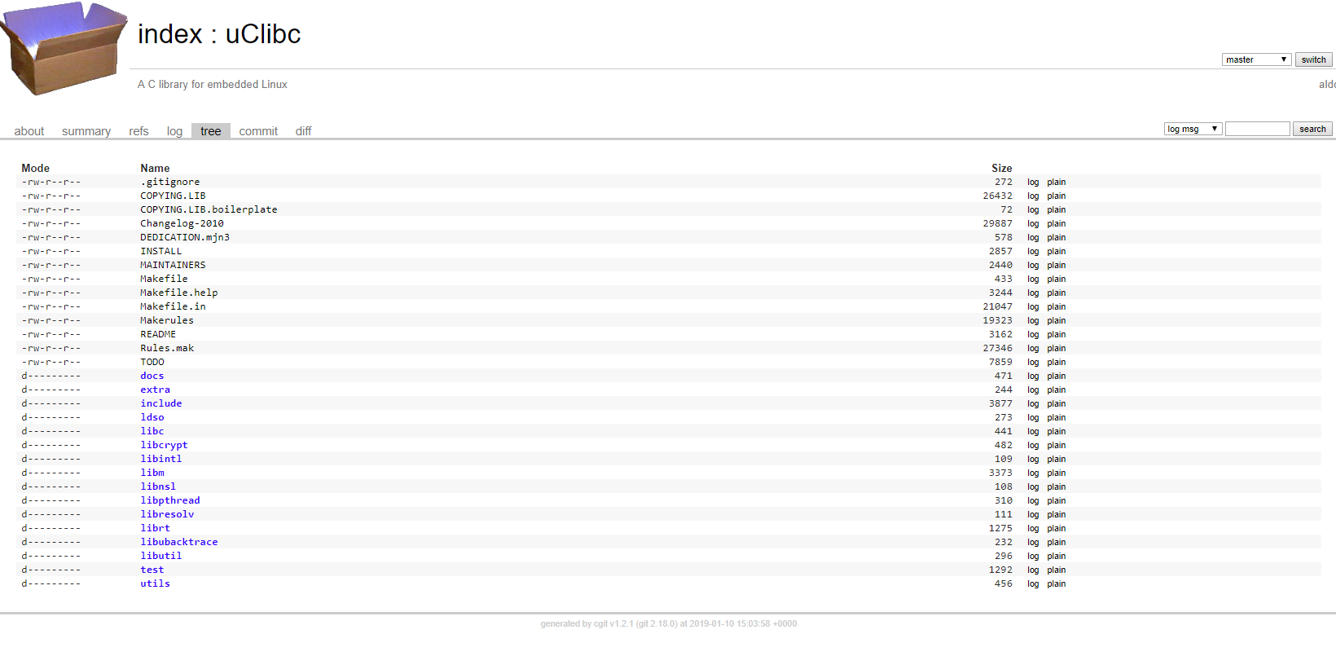
Other Elements of the C library

Slide 18
System calls in C library
https://git.uclibc.org/uClibc/tree/libc/sysdeps/linux/i386/syscall.S -- the assembly function used to invoke system calls.
https://git.uclibc.org/uClibc/tree/libc/sysdeps/linux/common -- all common system calls
For example --https://git.uclibc.org/uClibc/tree/libc/sysdeps/linux/common/write.c

Slide 19
Using the System call functions from C library
User space programs may call kernel functions
Indirectly via library calls (more portable)
printf ("getuid returned: %u\n", getuid());
Directly via the syscall interface
printf ("syscall to getuid returned: %u\n", syscall(__NR_getuid));
Look at the man pages, for files to #include
[shell]$ man getuid
[shell]$ man syscall
Use manifest constants (portability, good style)
__NR_getuid

