Slide 1
Lecture 2: background and review
CS 3281
Daniel Balasubramanian

Slide 2
Overview
Today we’ll review background concepts everyone should know
Compiling, linking, assembly, the shell, CMake, make, running a program
We’ll also discuss how we go from source code to a running program

Slide 3
Takeaways from the video
Some takeaways from the Linus Torvalds interview (https://www.youtube.com/watch?v=actgZVvs_Jk)
Creating a program because you like programming
Software is very difficult to write
Working on interesting things
Linux evolved in ways he didn’t expect
Thought it would dominate the desktop (was this right or wrong?)
Did he see the mobile market coming?

Slide 4
Background
Terminal: a program that “mimics” an old physical terminal. Runs a shell.
Terminal emulators come with Mac and Linux
Shell: a command line interpreter. You type commands, it interprets them. Repeat.
Most terminals use “bash” as the default shell. Others are zsh, ksh, csh.
Make: a program that builds programs for you
You specify dependencies, and make figures out when/how to build it
CMake: a program that generates build dependencies
CMake can generate Makefiles

Slide 5
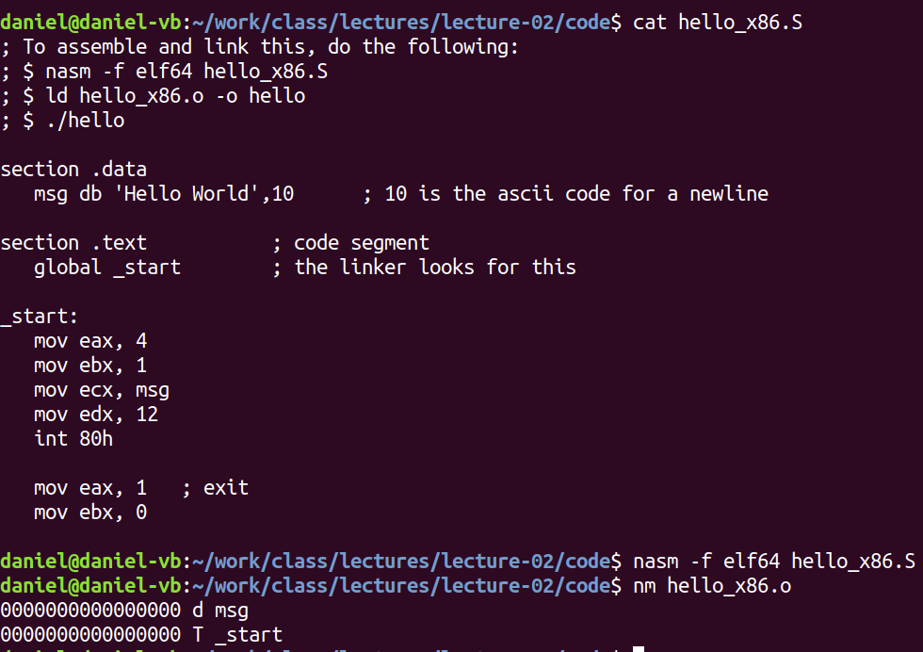
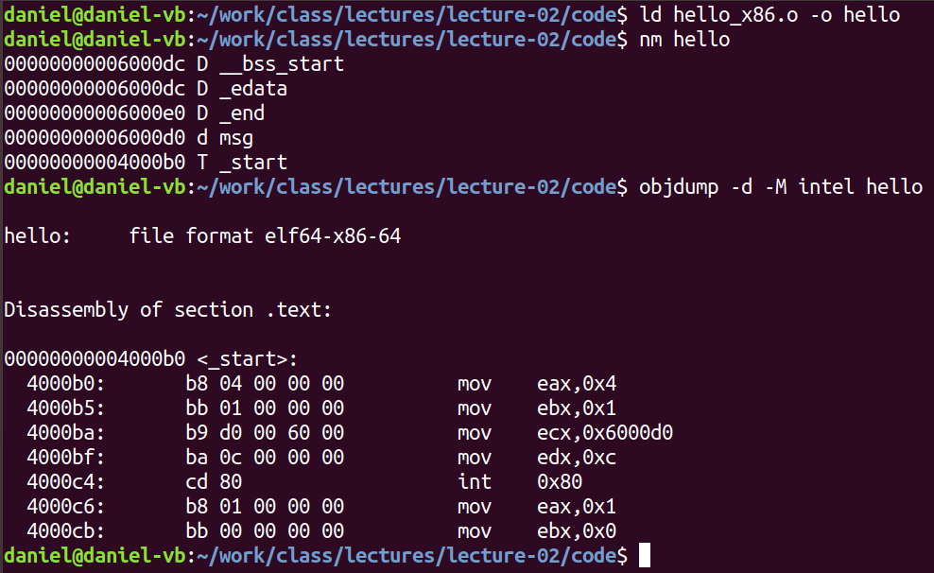
Example in assembly: Hello, world
Commands:
nasm: “assembles” a program
ld: “links” a program
nm: lists the symbols in an object file
objdump: display information in object file

Slide 6
From source code to running program (1)
How do we go from text to a running program?
We begin with a source file saved in a text file
This is a sequence of bits organized into 8-bit chunks called bytes. Each byte represents a character.
ASCII: unique byte sized integer value for each character. Source file stored as sequence of bytes. Files that consist exclusively of ASCII chars is a text file; binary file otherwise.
-Everything is bits: the distinguishing difference is the context in which we view them

Slide 7
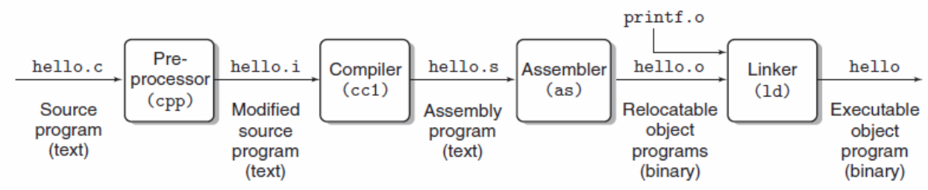
From source code to running program (2)
Before it can run, must be translated into a sequence of machine-language instructions.
These are packaged into a form called an executable object program and stored as a binary disk file. Also called executable object files.
Translation on Unix is done by a compiler driver.
Do this individually with:
gcc -E hello.c -o hello.i // produces a modified source program
gcc -S hello.i // produces an assembly language program
gcc -c hello.s // produces linked executable

Slide 8
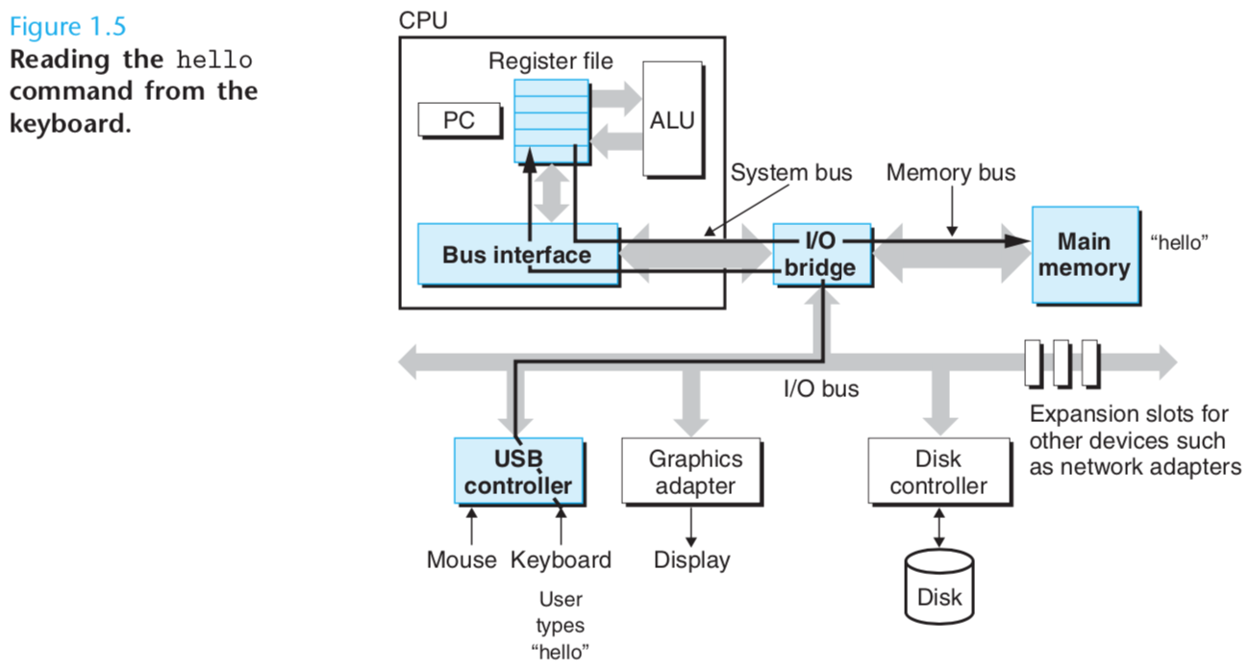
From source code to running program (3)
Running hello world
Initially, the shell is executing its instructions
We type “./hello” at the keyboard, the shell program reads each into a register, then stores it in memory. We press enter and it knows we are finished typing the command.

Slide 9
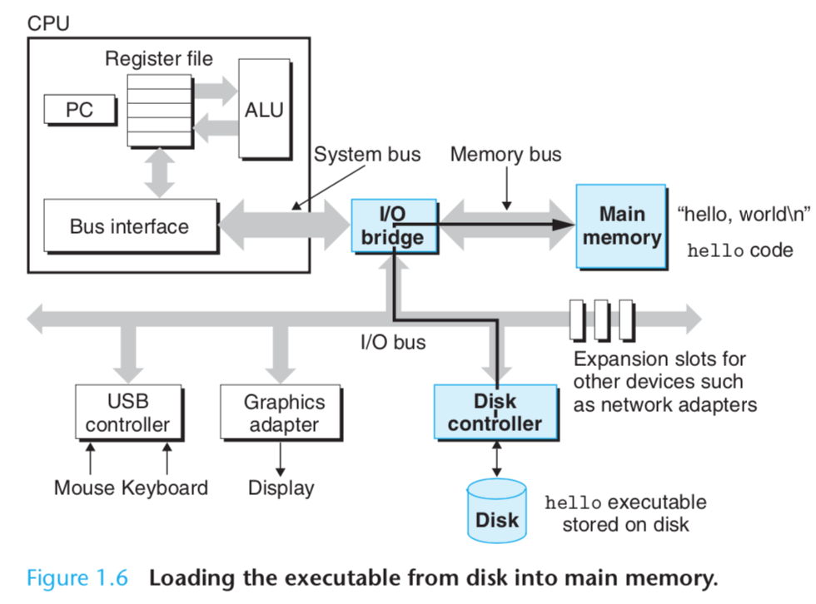
From source code to running program (4)
Running hello world
The shell then loads the executable hello file by executing instructions that copy the code and data in the hello object file into main memory. DMA allows the data to go from disk to main memory directly.
Once the code and data are in memory, the OS switches to the hello process and begins executing its instructions.

Slide 10
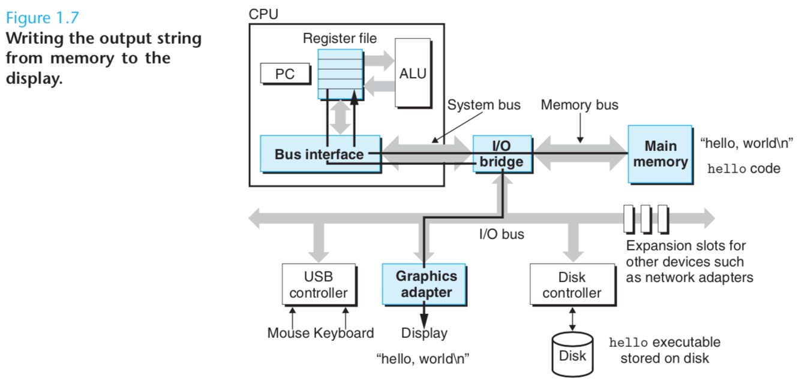
From source code to running program (5)
Running hello world
These instructions copy the data bytes “hello, world\n” from main memory to a register. From there they go to the display device where they are displayed on the screen.

