Slide 1
Operating Systems
CS 3281
Spring 2020
Dr. Daniel Balasubramanian
https://github.com/cs3281/lectures

Slide 2
Team
Instructor
Dr. Daniel Balasubramanian
Graders
Conner Pinson
Matthew Sedam

Slide 3
Important Links
Textbook | http://pages.cs.wisc.edu/~remzi/OSTEP/
Discussion Forum/ Question and Answers/ Announcements | https://piazza.com/configure-classes/spring2020/cs328103
Lectures, schedule, assignment submissions | https://github.com/cs3281/
Reading Assignments | https://vanderbilt.edu//brightspace/

Slide 4
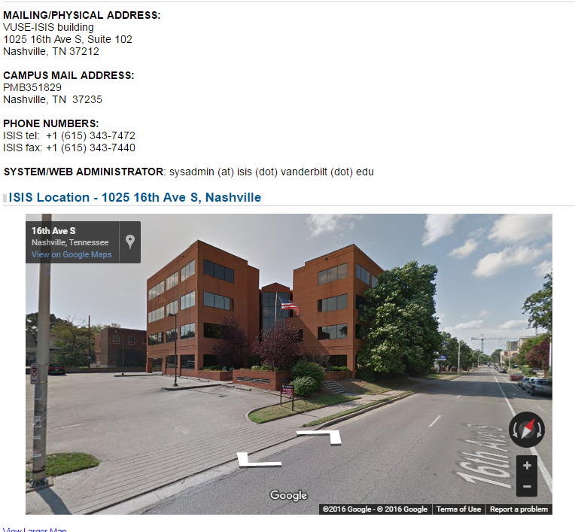
Office Hours
TBD
By appointment other times at 1025 16th avenue south

Slide 5

Textbook
Chapters available for free at http://pages.cs.wisc.edu/~remzi/OSTEP/
Strongly recommended (but not “required”): The Linux Programming Interface
Computer Systems: A Programmer’s Perspective

Slide 6
Course Assessment
Programming assignments: 50%
Learn by doing
Quizzes + mid-term: 35%
Solidify understanding
Final project: 10%
Build a cool Linux kernel module!
Attendance: 5%
Show up! I’ll be here, too.

Slide 7
Course expectations
You are expected to read the material for a lecture beforehand and participate in class discussions.
We may occasionally assign videos to watch; please watch them ahead of time so you can participate in class discussions

Slide 8
Development Environment
Most of this course will use C
We will use Ubuntu 18.04.03 as the development environment
You’re free to choose your particular Linux distribution as long as you can compile and run the assignments
If we have issues compiling/running your programs, we’ll request to switch to an Ubuntu-based distribution
The Linux Lab is setup with CentOS; you can also use those machines to do your assignments
We will use GitHub and git for content and assignment management.

Slide 9
Github Details
If you have not already done so, I need your response: https://forms.gle/n3z9mcoteMwPzDUJ8

Slide 10

Course Goals
Understand operating systems by learning their architecture and services

Slide 11
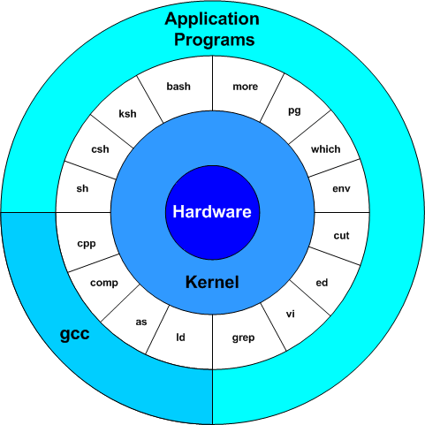
Course Goals
Understand operating systems by learning their architecture and services
Experience with writing applications that use operating system services

Slide 12
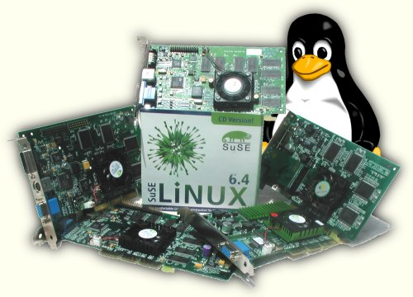
Why is this important?
Operating system is responsible for
Abstracting the hardware details for convenience and portability
Multiplex the hardware among multiple applications
Isolate applications to contain bugs
Allow sharing of resources among applications

Slide 13
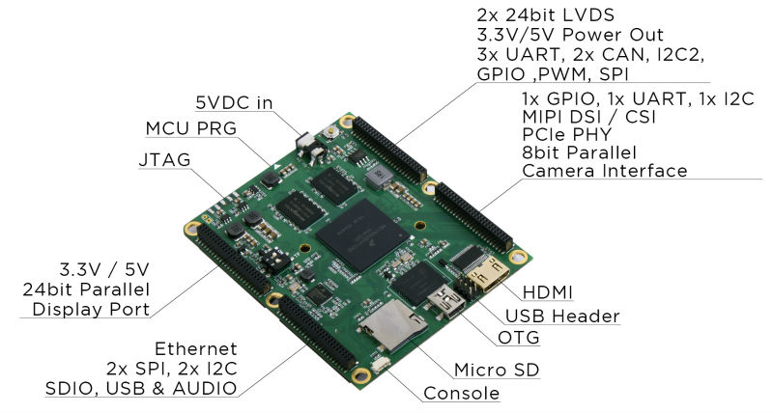
Why is this important?
Operating system is responsible for
Abstracting the hardware details for convenience and portability
Multiplex the hardware among multiple applications
Isolate applications to contain bugs
Allow sharing of resources among applications

Slide 14

Why is this important?
Operating system is responsible for
Abstracting the hardware details for convenience and portability
Multiplex the hardware among multiple applications
Isolate applications to contain bugs
Allow sharing of resources among applications

Slide 15
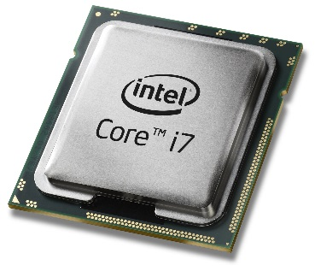
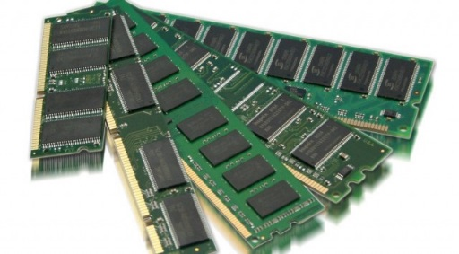


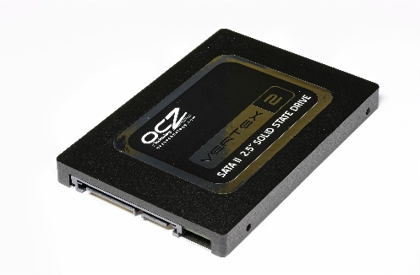
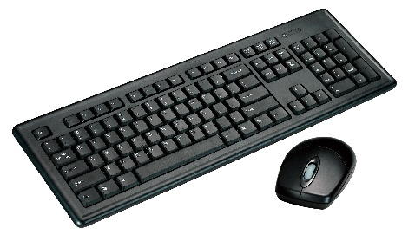
Why is this important?
Operating system is responsible for
Abstracting the hardware details for convenience and portability
Multiplex the hardware among multiple applications
Isolate applications to contain bugs
Allow sharing of resources among applications
And many more

Slide 16
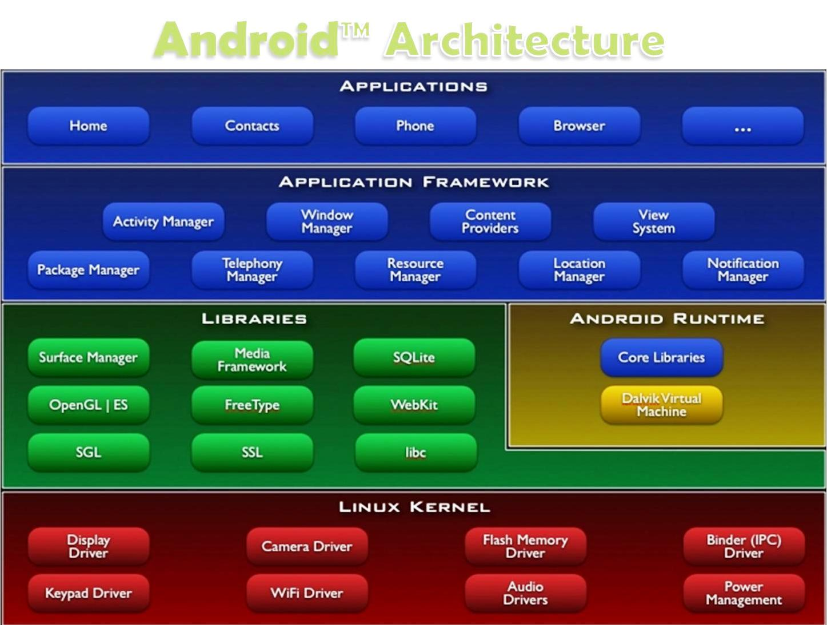
Layers of a modern computing system
Application – the user program.
Application framework
Helpful libraries for providing modularity and reuse
System Libraries – the core services of OS are encapsulated by these libraries, e.g. libc
The operating system kernel

Slide 17
Layers of a modern computing system
Application – the user program.
Application framework
Helpful libraries for providing modularity and reuse
System Libraries – the core services of OS are encapsulated by these libraries, e.g. libc
The operating system kernel

Slide 18
Layers of a modern computing system
Application – the user program.
Application framework
Helpful libraries for providing modularity and reuse
System Libraries – the core services of OS are encapsulated by these libraries, e.g. libc
The operating system kernel

Slide 19
Layers of a modern computing system
Application – the user program.
Application framework
Helpful libraries for providing modularity and reuse
System Libraries – the core services of OS are encapsulated by these libraries, e.g. libc
The operating system kernel

Slide 20
Layers of a modern computing system
Application – the user program.
Application framework
Helpful libraries for providing modularity and reuse
System Libraries – the core services of OS are encapsulated by these libraries, e.g. libc
The operating system kernel
In this course we will primarily focus on
The kernel and the system libraries.

Slide 21
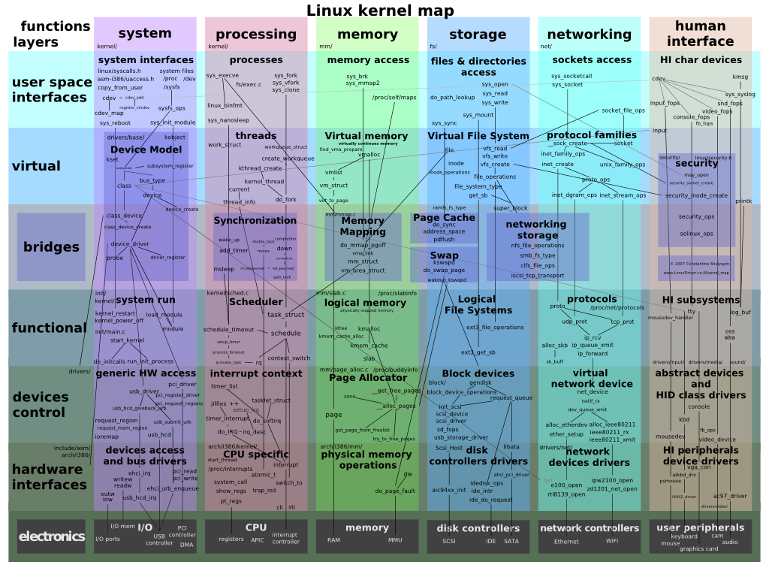
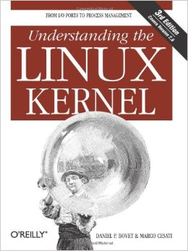
The OS Kernel

Slide 22
The OS Kernel
Process management
Memory management
File system management
Security
Communication and networking
Time Synchronization
Many others: users, IPC, network, time, terminals

Slide 23
How do we interact with the kernel?
Applications only see them via system calls (system calls are the API of the kernel)
Examples, from UNIX / Linux:
fd = open("out", 1);
write(fd, "hello\n", 6);
pid = fork();

Slide 24
How do we interact with the kernel?
Applications only see them via system calls (system calls are the API of the kernel)
Examples, from UNIX / Linux:
fd = open("out", 1);
write(fd, "hello\n", 6);
pid = fork();
brk(0x18c9000) = 0x18c9000
clone(child_stack=0, flags=CLONE_CHILD_CLEARTID|CLONE_CHILD_SETTID|SIGCHLD, child_tidptr=0x7fbf4bda1a10) = 3710
getpid() = 3709
fstat(1, {st_mode=S_IFCHR|0620, st_rdev=makedev(136, 6), ...}) = 0
write(1, "mypid is 3709\n", 14mypid is 3709
) = 14
exit_group(0)
Strace output (system calls in bold)

Slide 25
Why is OS design challenging
The environment is unforgiving: weird h/w, hard to debug
It must be efficient (thus low-level?)
but abstract/portable (thus high-level?)
Powerful (thus many features?)
but simple (thus a few composable building blocks?)
Features interact: `fd = open(); ...; fork()`
Behaviors interact: CPU priority vs memory allocator.
Open problems: security, multi-core

Slide 26
Why is OS design challenging
The environment is unforgiving: weird h/w, hard to debug
It must be efficient (thus low-level?)
but abstract/portable (thus high-level?)
Powerful (thus many features?)
but simple (thus a few composable building blocks?)
Features interact: `fd = open(); ...; fork()`
Behaviors interact: CPU priority vs memory allocator.
Open problems: security, multi-core

Slide 27
Why is OS design challenging
The environment is unforgiving: weird h/w, hard to debug
It must be efficient (thus low-level?)
but abstract/portable (thus high-level?)
Powerful (thus many features?)
but simple (thus a few composable building blocks?)
Features interact: `fd = open(); ...; fork()`
Behaviors interact: CPU priority vs memory allocator.
Open problems: security, multi-core

Slide 28
Why is OS design challenging
The environment is unforgiving: weird h/w, hard to debug
It must be efficient (thus low-level?)
but abstract/portable (thus high-level?)
Powerful (thus many features?)
but simple (thus a few composable building blocks?)
Features interact: `fd = open(); ...; fork()`
Behaviors interact: CPU priority vs memory allocator.
Open problems: security, multi-core

Slide 29
Why is OS design challenging
The environment is unforgiving: weird h/w, hard to debug
It must be efficient (thus low-level?)
but abstract/portable (thus high-level?)
Powerful (thus many features?)
but simple (thus a few composable building blocks?)
Features interact: `fd = open(); ...; fork()`
Behaviors interact: CPU priority vs memory allocator.
Open problems: security, multi-core

Slide 30
Why is OS design challenging
The environment is unforgiving: weird h/w, hard to debug
It must be efficient (thus low-level?)
but abstract/portable (thus high-level?)
Powerful (thus many features?)
but simple (thus a few composable building blocks?)
Features interact: `fd = open(); ...; fork()`
Behaviors interact: CPU priority vs memory allocator.
Open problems: security, multi-core

Slide 31
Before Next Class
Signup for a GitHub account if you don’t already have one
Provide your information here: https://forms.gle/n3z9mcoteMwPzDUJ8
If you are not familiar with how to use the command line, do this tutorial:
https://www.codecademy.com/learn/learn-the-command-line
Go here and see how far you can get:
https://overthewire.org/wargames/bandit/
The next class will be a review of the C programming language, an overview of Git, and and an overview of Linux
Install the VM
Watch this video: https://www.youtube.com/watch?v=actgZVvs_Jk

