Slide 1
Lecture 6: memory management basics
CS 3281
Daniel Balasubramanian

Slide 2
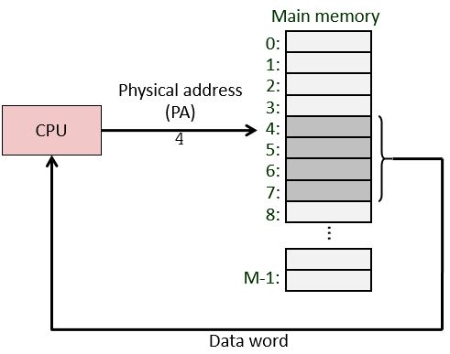
Background: physical memory and addressing
Physical memory is the RAM installed in a computer
Example: there might be 4GB or 8GB of DRAM installed
Physical addressing: used in simple systems like embedded microcontrollers in devices like cars, elevators, and digital picture frames
Also called single memory or flat address space

Slide 3
Why don’t we use a single physical address space?
Question: why don’t modern OS’es have a single shared address space?
Many reasons:
Safety: if all processes share the same address space, one process could crash another process (or crash the kernel)
Management: processes would need to know where they reside in physical RAM, they’d need to know or detect how much physical RAM there is
Virtual memory solves these issues...

Slide 4
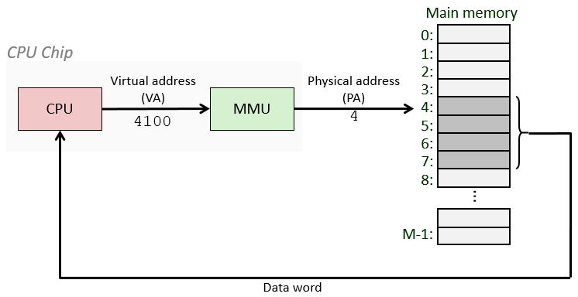
Systems using virtual addressing
Used in all modern laptops, phones, servers, desktops
One of the great ideas in computer science

Slide 5
Virtual memory
Virtual memory is a system that uses an address mapping
Maps virtual address space to the physical address space
Every process has its own virtual address space
These are the address spaces we’ve looked at so far
When a process references an address, it is using a virtual address
Virtual addresses are translated into physical addresses by a combination of software + hardware
The software is the OS kernel
The hardware is called the MMU

Slide 6
Virtual memory advantages
Each process can have a different (but similar) memory mapping
Similar in that they may have the same general layout: text, data, bss, heap, stack, etc
Memory can be moved and swapped
OS can do this without a user-space process knowing or caring
Physical RAM can be mapped into multiple processes at once
Facilitates reuse, reduces overhead
For instance, the C-library: the read-only portions can be shared between many processes!
Memory regions can have access permissions
Read, write, execute

Slide 7
Common misconceptions about memory
If you take the address of a variable in a program, you get a physical address
Not true: you get a virtual address; the OS translates this to a physical address
Memory leaks mean memory is lost when the process terminates
Not true: the OS reclaims a process’s resources, including the memory it used, upon termination
A computer with 2GB of physical RAM can’t simultaneously run processes that consume more than 2GB total
Not true: the OS can “swap” the contents of memory to disk when it runs low
When you launch a program (like a video game) whose size is 1GB, it immediately consumes 1GB of physical RAM
Not true: the OS brings in the data it needs on-demand
Virtually contiguous means physically contiguous
Not necessarily true: two adjacent virtual pages may not be mapped to adjacent physical pages

Slide 8
For the next lecture
Please read chapters 13, 18, 19 from the online textbook
Please watch this video: https://www.youtube.com/watch?v=0OvQfEcEp-U
Important: write down any questions you have about this material and we will discuss it during the next class
Submit (anonomously, if you wish) your questions on Piazza

