Slide 1
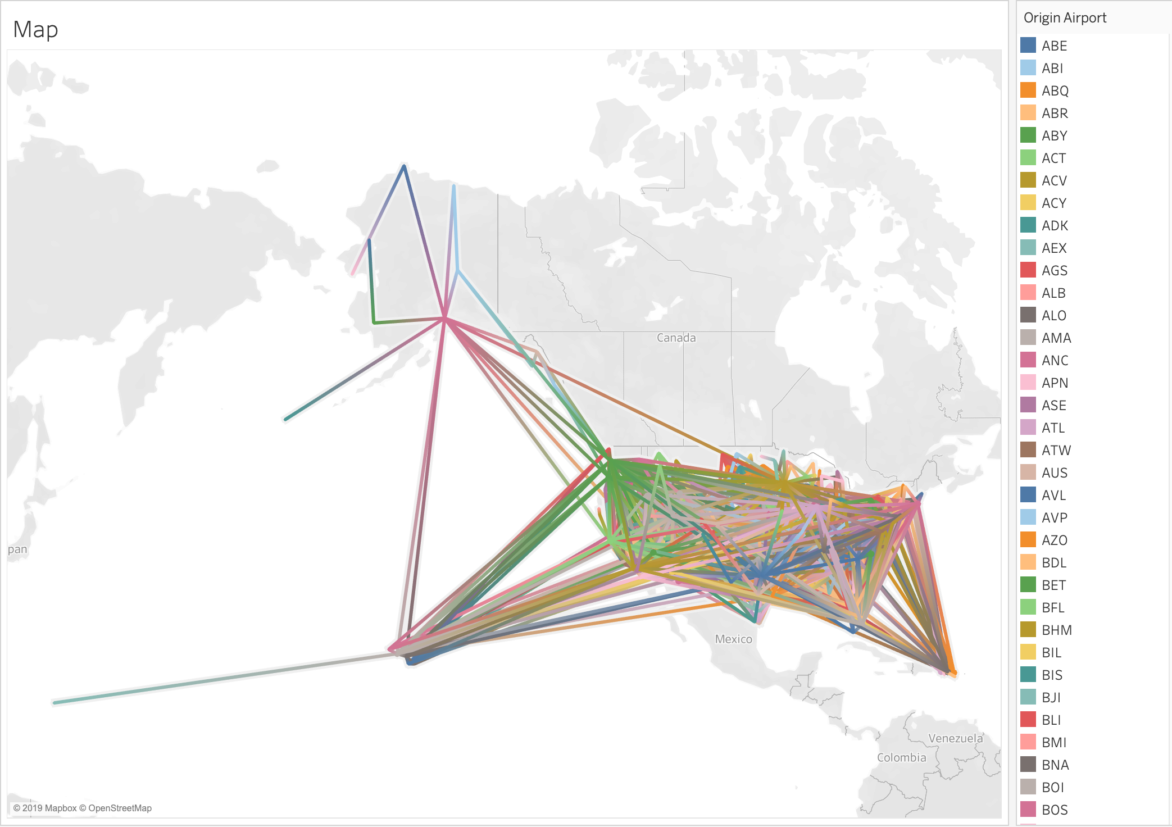
Delayed
Domestic Flights
in U.S.
on 01/01/
2015
Notes:
As we’ve done the map showing the distances between cities in Australia, I decided to apply it to the delayed flights in US.

Slide 2
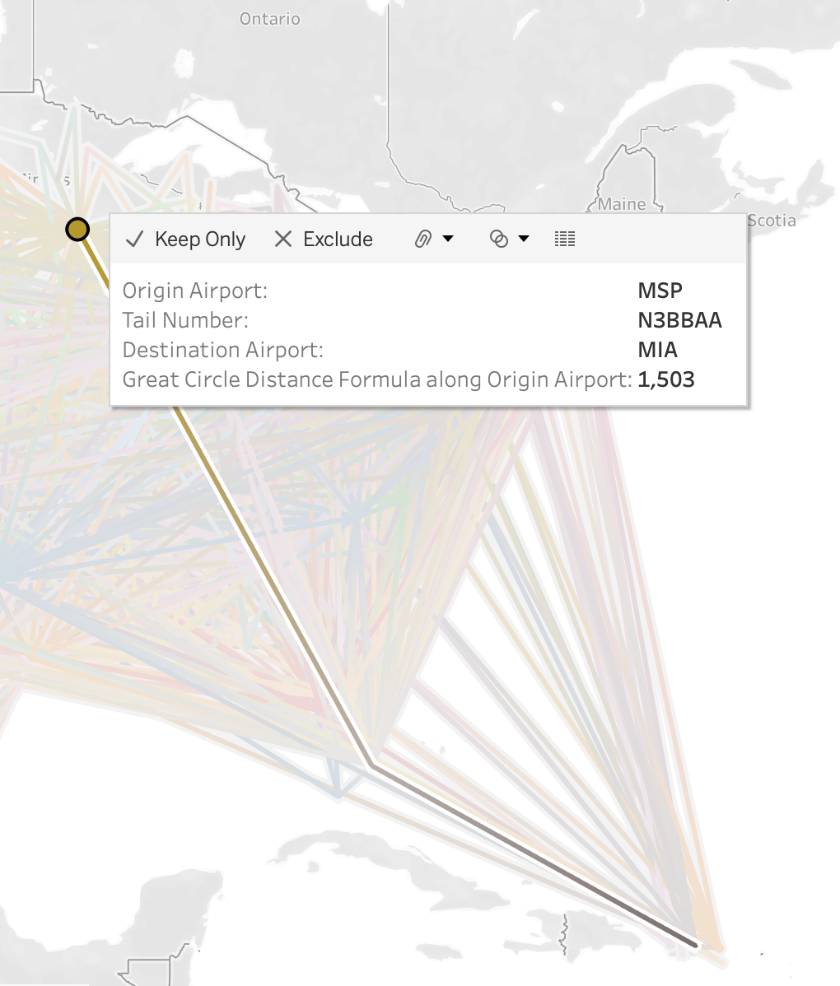
Features
Click on a specific flight
Color Changes along with airports’ color
(e.g. MSP -> MIA -> SJU)
Information Box

Slide 3
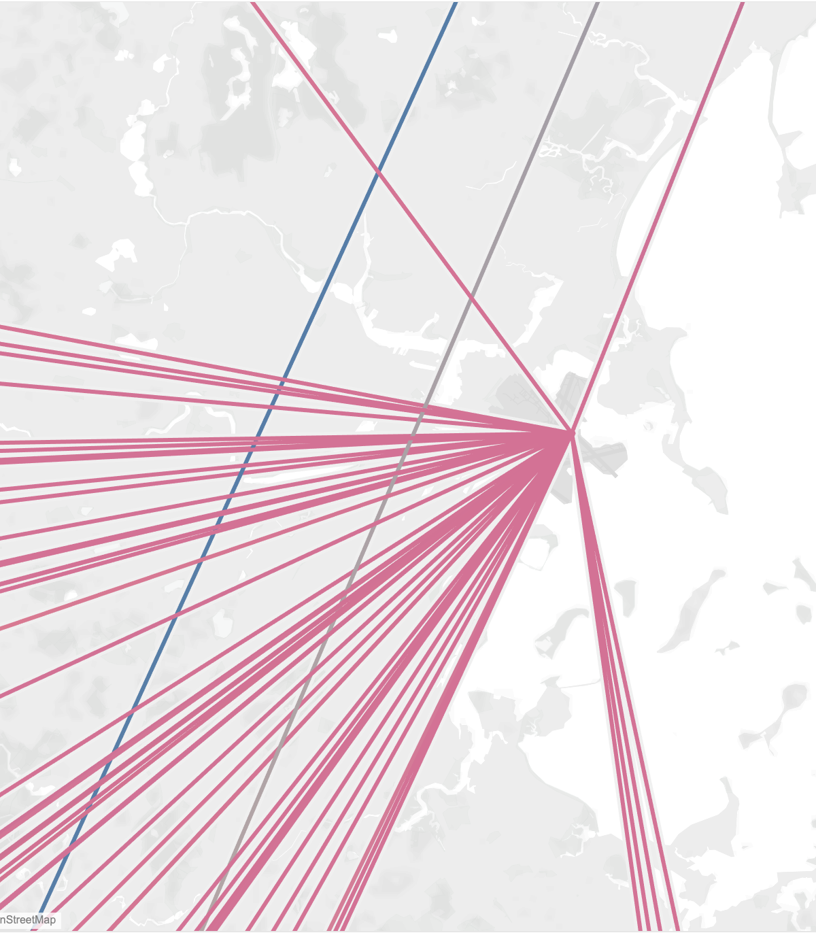
Let’s Take a Closer Look at BOS
How Many Delayed Flights Are There???
236!
Reflection:
This map cannot clearly showcase large amounts of data as the lines will coincide. It is hard for viewers to differentiate

