Slide 1
Lecture 3: Multi-Class Classification
Kai-Wei Chang
CS @ UCLA
kw@kwchang.net
Couse webpage: https://uclanlp.github.io/CS269-17/

Slide 2
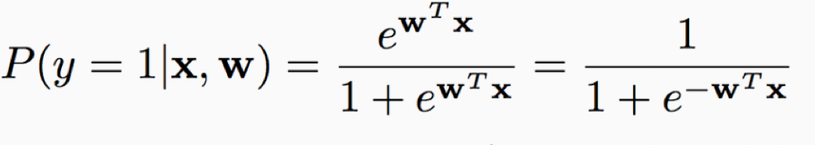
Previous Lecture
Binary linear classification models
Perceptron, SVMs, Logistic regression
Prediction is simple:
Given an example $x$, prediction is $sgn\left(w^{T}x\right)$
Note that all these linear classifier have the same inference rule
In logistic regression, we can further estimate the probability
Question?

Slide 3
This Lecture
Multiclass classification overview
Reducing multiclass to binary
One-against-all & One-vs-one
Error correcting codes
Training a single classifier
Multiclass Perceptron: Kesler’s construction
Multiclass SVMs: Crammer&Singer formulation
Multinomial logistic regression

Slide 4
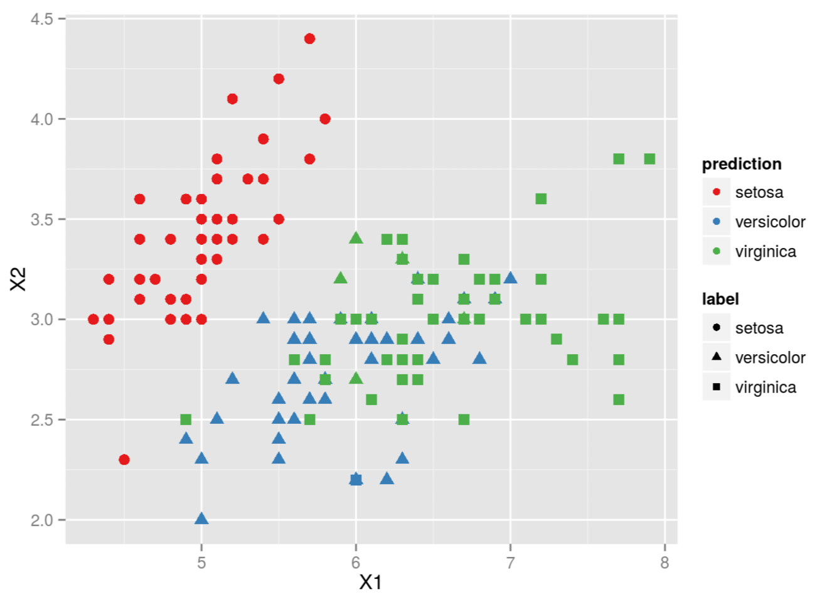
What is multiclass
Output $∈\left\{1,2,3, …K\right\}$
In some cases, output space can be very large (i.e., K is very large)
Each input belongs to exactly one class (c.f. in multilabel, input belongs to many classes)

Slide 5
Multi-class Applications in NLP?

Slide 6
Two key ideas to solve multiclass
Reducing multiclass to binary
Decompose the multiclass prediction into multiple binary decisions
Make final decision based on multiple binary classifiers
Training a single classifier
Minimize the empirical risk
Consider all classes simultaneously

Slide 7
Reduction v.s. single classifier
Reduction
Future-proof: binary classification improved so does muti-class
Easy to implement
Single classifier
Global optimization: directly minimize the empirical loss; easier for joint prediction
Easy to add constraints and domain knowledge

Slide 8
A General Formula
$\hat{y}={argmax}_{y∈𝒴}{f(y;w,x)}$
Inference/Test: given $w,x$, solve $argmax$
Learning/Training: find a good $w$
Today: $x∈ℝ^{n},𝒴=\{1,2,…K\}$ (multiclass)
input
model parameters
output space

Slide 9
This Lecture
Multiclass classification overview
Reducing multiclass to binary
One-against-all & One-vs-one
Error correcting codes
Training a single classifier
Multiclass Perceptron: Kesler’s construction
Multiclass SVMs: Crammer&Singer formulation
Multinomial logistic regression

Slide 10

One against all strategy

Slide 11
One against All learning
Multiclass classifier
Function f : R^{n} → {1,2,3,...,k}
Decompose into binary problems
Notes:
Most work in ML is for the BINARY problem
Well understood (Theory)
Many algorithms work well (Practice)
Therefore
Tempting and DESIREABLE to use binary algs to solve multiclass
The most common approach : **OvA**
Learn a set of classifiers: one for each class versus the rest
Notice however, that while it may be possilbe to find such a classifier
-NOT ALWAYS THE CASE.
In the last partition here, it is impossible to separate the red points
from the rest using a linear function.
Therefore this classifier will FAIL
**No theoretical justification unless the problem is easy**

Slide 12
One-again-All learning algorithm
Learning: Given a dataset $D=\left\{\left(x_{i},y_{i}\right)\right\}$ $x_{i}∈R^{n}, y_{i}∈\left\{1,2,3,…K\right\}$
Decompose into K binary classification tasks
Learn K models: $w_{1}, w_{2}, w_{3},…w_{K}$
For class k, construct a binary classification task as:
Positive examples: Elements of D with label k
Negative examples: All other elements of D
The binary classification can be solved by any algorithm we have seen

Slide 13
One against All learning
Multiclass classifier
Function f : R^{n} → {1,2,3,...,k}
Decompose into binary problems
Ideal case: only the correct label will have a positive score
$$w_{black}^{T} x>0$$
$$w_{blue}^{T} x>0$$
$$w_{green}^{T} x>0$$
Notes:
Most work in ML is for the BINARY problem
Well understood (Theory)
Many algorithms work well (Practice)
Therefore
Tempting and DESIREABLE to use binary algs to solve multiclass
The most common approach : **OvA**
Learn a set of classifiers: one for each class versus the rest
Notice however, that while it may be possilbe to find such a classifier
-NOT ALWAYS THE CASE.
In the last partition here, it is impossible to separate the red points
from the rest using a linear function.
Therefore this classifier will FAIL
**No theoretical justification unless the problem is easy**

Slide 14
One-again-All Inference
Learning: Given a dataset $D=\left\{\left(x_{i},y_{i}\right)\right\}$ $x_{i}∈R^{n}, y_{i}∈\left\{1,2,3,…K\right\}$
Decompose into K binary classification tasks
Learn K models: $w_{1}, w_{2}, w_{3},…w_{K}$
Inference: “Winner takes all”
$\hat{y}={argmax}_{y∈\{1,2,…K\}} w_{y}^{T} x$
An instance of the general form $\hat{y}={argmax}_{y∈𝒴}{f(y;w,x)}$
For example: $y=argmax⁡(w_{black}^{T} x ,{ w}_{blue}^{T} x{, w}_{green}^{T} x)$
$w=\{w_{1},w_{2},…w_{K}\}$, $f\left(y;w,x\right)=w_{y}^{T} x$

Slide 15
One-again-All analysis
Not always possible to learn
Assumption: each class individually separable from all the others
No theoretical justification
Need to make sure the range of all classifiers is the same – we are comparing scores produced by K classifiers trained independently.
Easy to implement; work well in practice

Slide 16

One v.s. One (All against All) strategy

Slide 17
One v.s. One learning
Multiclass classifier
Function f : R^{n} → {1,2,3,...,k}
Decompose into binary problems
Training
Test
Notes:
Most work in ML is for the BINARY problem
Well understood (Theory)
Many algorithms work well (Practice)
Therefore
Tempting and DESIREABLE to use binary algs to solve multiclass
The most common approach : **OvA**
Learn a set of classifiers: one for each class versus the rest
Notice however, that while it may be possilbe to find such a classifier
-NOT ALWAYS THE CASE.
In the last partition here, it is impossible to separate the red points
from the rest using a linear function.
Therefore this classifier will FAIL
**No theoretical justification unless the problem is easy**

Slide 18
One-v.s-One learning algorithm
Learning: Given a dataset $D=\left\{\left(x_{i},y_{i}\right)\right\}$ $x_{i}∈R^{n}, y_{i}∈\left\{1,2,3,…K\right\}$
Decompose into C(K,2) binary classification tasks
Learn C(K,2) models: $w_{1}, w_{2}, w_{3},…w_{K∗(K−1)/2}$
For each class pair (i,j), construct a binary classification task as:
Positive examples: Elements of D with label i
Negative examples Elements of D with label j
The binary classification can be solved by any algorithm we have seen

Slide 19
One-v.s-One Inference algorithm
Decision Options:
More complex; each label gets k-1 votes
Output of binary classifier may not cohere.
Majority: classify example x to take label i if i wins on x more often than j (j=1,…k)
A tournament: start with n/2 pairs; continue with winners

Slide 20
Classifying with One-vs-one
Tournament
Majority Vote
1 red, 2 yellow, 2 green
➔ ?
All are post-learning and might cause weird stuff

Slide 21
One-v.s.-one Assumption
Every pair of classes is separable
It is possible to separate all k classes with the O(k²) classifiers
Decision
Regions

Slide 22
Comparisons
One against all
O(K) weight vectors to train and store
Training set of the binary classifiers may unbalanced
Less expressive; make a strong assumption
One v.s. One (All v.s. All)
O($K^{2}$) weight vectors to train and store
Size of training set for a pair of labels could be small $⇒$ overfitting of the binary classifiers
Need large space to store model

Slide 23
Problems with Decompositions
Learning optimizes over local metrics
Does not guarantee good global performance
We don’t care about the performance of the local classifiers
Poor decomposition ⇒ poor performance
Difficult local problems
Irrelevant local problems
Efficiency: e.g., All vs. All vs. One vs. All
Not clear how to generalize multi-class to problems with a very large # of output
Notes:
However, a PROBLEM W/ DECOMPOSITION TECHNIQUES
Induced Binary problems are optimized INDEPENDENTLY
NO GLOBAL METRIC IS USED.
FOR EXAMPLE, in MC,
we don’t care about 1 vs rest performance
only about the FINAL MC Classification
TRANSISTION:
We can look at a simple example:

Slide 24
Still an ongoing research direction
Key questions:
How to deal with large number of classes
How to select “right samples” to train binary classifiers
Error-correcting tournaments [Beygelzimer, Langford, Ravikumar 09]
Logarithmic Time One-Against-Some [Daume, Karampatziakis, Langford, Mineiro 16]
Label embedding trees for large multi-class tasks. [Bengio, Weston, Grangier 10]
…

Slide 25
Decomposition methods: Summary
General Ideas:
Decompose the multiclass problem into many binary problems
Prediction depends on the decomposition
Constructs the multiclass label from the output of the binary classifiers
Learning optimizes local correctness
Each binary classifier don’t need to be globally correct and isn’t aware of the prediction procedure

Slide 26
This Lecture
Multiclass classification overview
Reducing multiclass to binary
One-against-all & One-vs-one
Error correcting codes
Training a single classifier
Multiclass Perceptron: Kesler’s construction
Multiclass SVMs: Crammer&Singer formulation
Multinomial logistic regression

Slide 27
Revisit One-again-All learning algorithm
Learning: Given a dataset $D=\left\{\left(x_{i},y_{i}\right)\right\}$ $x_{i}∈R^{n}, y_{i}∈\left\{1,2,3,…K\right\}$
Decompose into K binary classification tasks
Learn K models: $w_{1}, w_{2}, w_{3},…w_{K}$
$w_{k}:$separate class $k$ from others
Prediction $\hat{y}={argmax}_{y∈\{1,2,…K\}} w_{y}^{T} x$

Slide 28
Observation
At training time, we require $w_{i}^{T}x$to be positive for examples of class $i$.
Really, all we need is for $w_{i}^{T}x$ to be more than all others $⇒$ this is a weaker requirement
For examples with label $i$, we need $w_{i}^{T}x>w_{j}^{T}x$ for all $j$

Slide 29
Perceptron-style algorithm
For examples with label $i$, we need $w_{i}^{T}x>w_{j}^{T}x$ for all $j$
For each training example $\left(x,y\right)$
If for some y’, $w_{y}^{T}x≤w_{y′}^{T}x$ mistake!
$w_{y}←w_{y}+ηx$ update to promote y
$w_{y′}←w_{y′}−ηx$ update to demote y’
Why add $ηx$ to $w_{y}$promote label $y$:
Before update $s\left(y\right)= {<w}_{y}^{old}, x>$
After update $s\left(y\right)={<w}_{y}^{new}, x>={<w}_{y}^{old}+ηx, x>$ $= {<w}_{y}^{old}, x>+η<x, x>$
Note! $<x , x> {=x}^{T}x>0$

Slide 30
A Perceptron-style Algorithm
Given a training set $𝒟=\{\left(x, y\right)\}$
Initialize $w←0∈ℝ^{n}$
For epoch $1…T$:
For $(x,y)$ in $𝒟$:
For $y^{′}≠y$
if$w_{y}^{T}x<w_{y′}^{T}x$ make a mistake
$w_{y}←w_{y}+ηx$promote y
$w_{y′}←w_{y′}−ηx$ demote y’
Return $w$
How to analyze this algorithm
and simplify the update rules?
Prediction: $argmax_{y} w_{y}^{T}x$

Slide 31
Linear Separability with multiple classes
Let’s rewrite the equation $w_{i}^{T}x>w_{j}^{T}x$ for all $j$
Instead of having $w_{1}, w_{2}, w_{3},…w_{K},$ we want to represent the model using a single vector $w$ $w_{}^{T} > w_{}^{T} \text{for} \text{all} \text{j}$
How?
?
?
Change the input representation
Let’s define $φ(x, y)$, such that
$w_{}^{T}φ\left(x, i\right)>w_{}^{T}φ\left(x, j\right) ∀j$
multiple models v.s. multiple data points

Slide 32
Kesler construction
Assume we have a multi-class problem with K class and n features.
$$w_{i}^{T }x>w_{j}^{T} x ∀ j$$
models: $w_{1}, w_{2},…w_{K}, w_{k}∈R^{n}$
Input: $x∈R^{n}$
$$w_{}^{T}φ\left(x, i\right)>w_{}^{T}φ\left(x, j\right) ∀ j$$

Slide 33
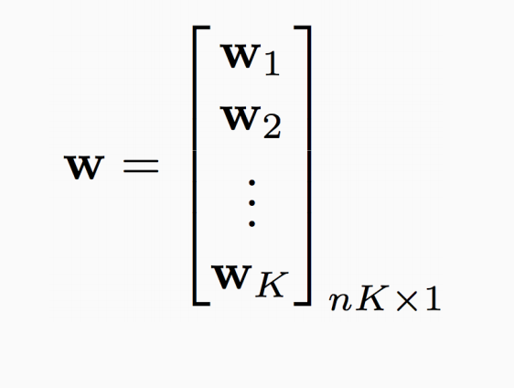
Kesler construction
Assume we have a multi-class problem with K class and n features.
$$w_{i}^{T }x>w_{j}^{T} x ∀ j$$
models: $w_{1}, w_{2},…w_{K}, w_{k}∈R^{n}$
Input: $x∈R^{n}$
$$w_{}^{T}φ\left(x, i\right)>w_{}^{T}φ\left(x, j\right) ∀ j$$
Only one model: $w∈R^{n×K}$

Slide 34
Kesler construction
Assume we have a multi-class problem with K class and n features.
$$w_{i}^{T }x>w_{j}^{T} x ∀ j$$
models: $w_{1}, w_{2},…w_{K}, w_{k}∈R^{n}$
Input: $x∈R^{n}$
$$w_{}^{T}φ\left(x, i\right)>w_{}^{T}φ\left(x, j\right) ∀ j$$
Only one model: $w∈R^{nK}$
Define $φ\left(x, y\right)$ for label y being associated to input x
$φ\left(x,y\right)={\left[\begin{matrix}0_{n} \\ \begin{aligned}⋮ \\ x \\ ⋮ \\ 0_{n}\end{aligned}\end{matrix}\right]}_{nK×1}$
$x in y^{th}$ block;
Zeros elsewhere

Slide 35
Kesler construction
Assume we have a multi-class problem with K class and n features.
$$w_{i}^{T }x>w_{i}^{T} x ∀ i$$
models: $w_{1}, w_{2},…w_{K},$ $w_{k}∈R^{n}$
Input: $x∈R^{n}$
$$w_{}^{T}φ\left(x, i\right)>w_{}^{T}φ\left(x, j\right) ∀ j$$
$$w={\left[\begin{matrix}w_{1} \\ \begin{aligned}⋮ \\ w_{y} \\ ⋮ \\ w_{n}\end{aligned}\end{matrix}\right]}_{nK×1} φ\left(x,y\right)={\left[\begin{matrix}0_{n} \\ \begin{aligned}⋮ \\ x \\ ⋮ \\ 0_{n}\end{aligned}\end{matrix}\right]}_{nK×1}$$
$$w_{}^{T}φ\left(x, y\right)=w_{y}^{T }x$$
$x in y^{th}$ block;
Zeros elsewhere

Slide 36
Kesler construction
Assume we have a multi-class problem with K class and n features.
$$binary classification problem$$
$$w_{}^{T}φ\left(x, i\right)>w_{}^{T}φ\left(x, j\right) ∀ j \\ ⇒w^{T}\left[φ\left(x, i\right)−φ\left(x, j\right)\right]>0 ∀j$$
$$w={\left[\begin{matrix}w_{1} \\ \begin{aligned}⋮ \\ w_{y} \\ ⋮ \\ w_{n}\end{aligned}\end{matrix}\right]}_{nK×1}[φ\left(x,i\right)−φ\left(x,j\right)]={\left[\begin{matrix}0_{n} \\ \begin{aligned}⋮ \\ x \\ ⋮ \\ −x \\ ⋮ \\ 0_{n}\end{aligned}\end{matrix}\right]}_{nK×1}$$
$x in i^{th}$ block;
$−x in j^{th}$ block;

Slide 37
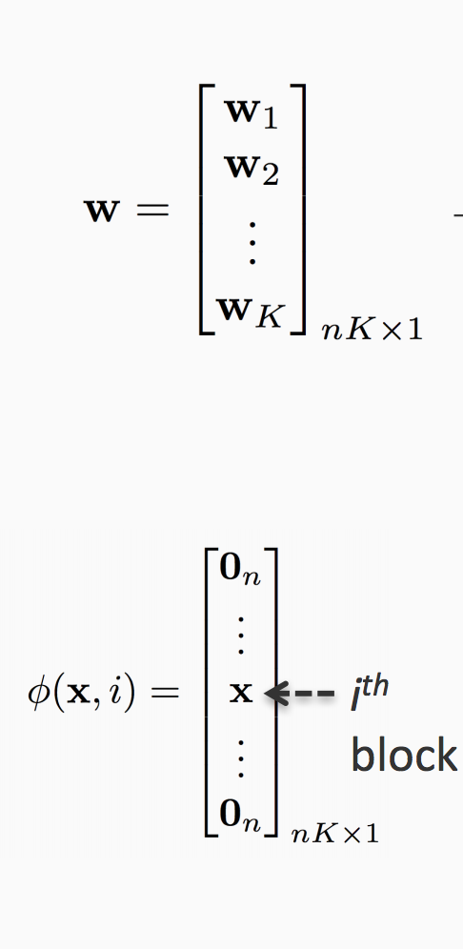
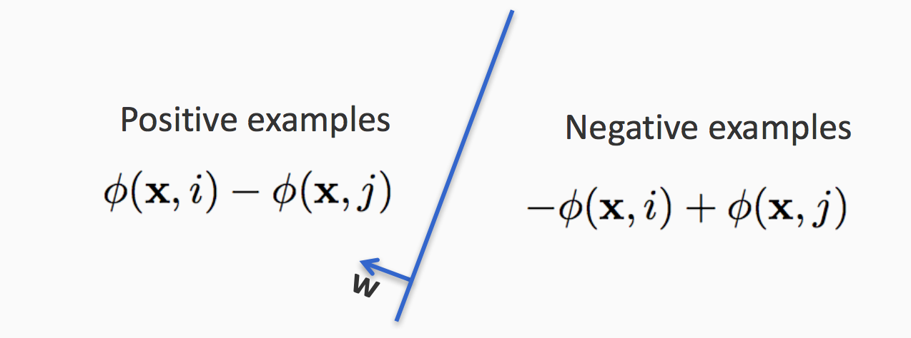
Linear Separability with multiple classes
What we want
$$w_{}^{T}φ\left(x, i\right)>w_{}^{T}φ\left(x, j\right) ∀ j \\ ⇒w^{T}\left[φ\left(x, i\right)−φ\left(x, j\right)\right]>0 ∀j$$
For all example (x, y) with all other labels y’ in dataset, $w$ in nK dimension should linearly separate $φ\left(x, i\right)−φ\left(x, j\right)$ and $−[φ\left(x, i\right)−φ\left(x, j\right)]$

Slide 38
How can we predict?
For input an input x, the model predict label is 3
$argmax_{y} w^{T}φ(x,y)$
$$w={\left[\begin{matrix}w_{1} \\ \begin{aligned}⋮ \\ w_{y} \\ ⋮ \\ w_{n}\end{aligned}\end{matrix}\right]}_{nK×1} φ\left(x,y\right)={\left[\begin{matrix}0_{n} \\ \begin{aligned}⋮ \\ x \\ ⋮ \\ 0_{n}\end{aligned}\end{matrix}\right]}_{nK×1}$$
$$φ(x,3)$$
$$φ(x,2)$$
$$w$$
$$φ(x,4)$$
$$φ(x,1)$$
$$φ(x,5)$$

Slide 39
How can we predict?
For input an input x, the model predict label is 3
$argmax_{y} w^{T}φ(x,y)$
$$w={\left[\begin{matrix}w_{1} \\ \begin{aligned}⋮ \\ w_{y} \\ ⋮ \\ w_{n}\end{aligned}\end{matrix}\right]}_{nK×1} φ\left(x,y\right)={\left[\begin{matrix}0_{n} \\ \begin{aligned}⋮ \\ x \\ ⋮ \\ 0_{n}\end{aligned}\end{matrix}\right]}_{nK×1}$$
$$w$$
$$φ(x,3)$$
$$φ(x,2)$$
$$φ(x,4)$$
$$φ(x,1)$$
$$φ(x,5)$$
This is equivalent to
$${argmax}_{y∈\{1,2,…K\}} w_{y}^{T} x$$

Slide 40
Constraint Classification
Goal:
Training:
For each example $\left(x, i\right)$
Update model if $w^{T}\left[φ\left(x, i\right)−φ\left(x, j\right)\right]<0 , ∀ j$
$$w\left[φ\left(x, i\right)−φ\left(x, j\right)\right]≥0 ∀j$$
x
-x
Transform Examples
2>4
2>1
2>1
2>3
2>4
2>3

Slide 41
A Perceptron-style Algorithm
Given a training set $𝒟=\{\left(x, y\right)\}$
Initialize $w←0∈ℝ^{n}$
For epoch $1…T$:
For $(x,y)$ in $𝒟$:
For $y^{′}≠y$
if$w^{T}\left[φ\left(x, y\right)−φ\left(x, y′\right)\right]<0$
$w←w+η \left[φ\left(x, y\right)−φ\left(x, y′\right)\right]$
Return $w$
This needs $\left|D\right|×K$ updates, do we need all of them?
How to interpret this update rule?
Prediction: $argmax_{y} w^{T}φ(x,y)$

Slide 42
An alternative training algorithm
Goal:
Training:
For each example $\left(x, i\right)$
Find the prediction of the current model: $\hat{y}= argmax_{j} w^{T}φ(x,j)$
Update model if $w^{T}\left[φ\left(x, i\right)−φ\left(x, \hat{y}\right)\right]<0 , ∀ y′$
$w\left[φ\left(x, i\right)−φ\left(x, j\right)\right]≥0 ∀j$
$⇒$ $w^{T}φ\left(x, i\right) −\max_{j≠i}\left[w^{T}φ\left(x, i\right)\right]≥0$
$⇒w^{T}φ\left(x, i\right) −\max_{j}\left[w^{T}φ\left(x, i\right)\right]≥0$

Slide 43
A Perceptron-style Algorithm
Given a training set $𝒟=\{\left(x, y\right)\}$
Initialize $w←0∈ℝ^{n}$
For epoch $1…T$:
For $(x,y)$ in $𝒟$:
$\hat{y}=argmax_{y′} w^{T}φ(x,y′)$
if$w^{T}\left[φ\left(x, y\right)−φ\left(x, \hat{y}\right)\right]<0$
$w←w+η \left[φ\left(x, y\right)−φ\left(x,\hat{y}\right)\right]$
Return $w$
How to interpret this update rule?
Prediction: $argmax_{y} w^{T}φ(x,y)$

Slide 44
A Perceptron-style Algorithm
Given a training set $𝒟=\{\left(x, y\right)\}$
Initialize $w←0∈ℝ^{n}$
For epoch $1…T$:
For $(x,y)$ in $𝒟$:
$\hat{y}=argmax_{y′} w^{T}φ(x,y′)$
if$w^{T}\left[φ\left(x, y\right)−φ\left(x, \hat{y}\right)\right]<0$
$w←w+η \left[φ\left(x, y\right)−φ\left(x, \hat{y}\right)\right]$
Return $w$
There are only two situations:
1. $\hat{y}=y$: $φ\left(x, y\right)−φ\left(x, \hat{y}\right)$ =0
2. $w^{T}\left[φ\left(x, y\right)−φ\left(x, \hat{y}\right)\right]<0$
How to interpret this update rule?
Prediction: $argmax_{y} w^{T}φ(x,y)$

Slide 45
A Perceptron-style Algorithm
Given a training set $𝒟=\{\left(x, y\right)\}$
Initialize $w←0∈ℝ^{n}$
For epoch $1…T$:
For $(x,y)$ in $𝒟$:
$\hat{y}=argmax_{y′} w^{T}φ(x,y′)$
$w←w+η \left[φ\left(x, y\right)−φ\left(x,\hat{y}\right)\right]$
Return $w$
How to interpret this update rule?
Prediction: $argmax_{y} w^{T}φ(x,y)$

Slide 46
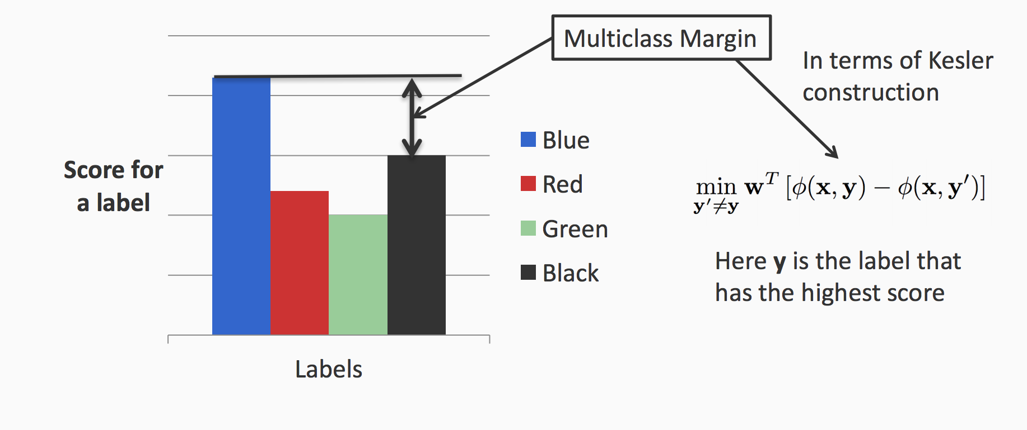
Consider multiclass margin

Slide 47
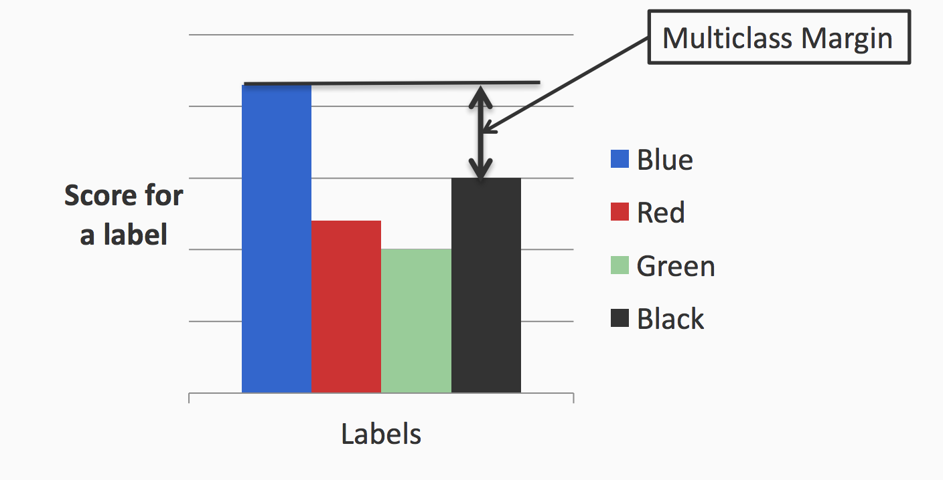
Marginal constraint classifier
Goal: for every (x,y) in the training data set
$\min_{y^{′}≠y}{w^{T}\left[φ\left(x, y\right)−φ\left(x, y′\right)\right]}≥δ$
$⇒w^{T}φ\left(x, y\right)−\max_{y≠y′}{w^{T}φ\left(x, y′\right)}$ $≥δ$
$⇒w^{T}φ\left(x, i\right)−[\max_{y≠y′}{w^{T}φ\left(x, j\right)+δ]}$ $≥0$
Constraints violated $⇒$ need an update
$$δ$$
Let’s define:
$$Δ\left(y,y^{′}\right)=\left\{\begin{aligned}δ if y≠y′ \\ 0 if y=y′\end{aligned}\right.$$
Check if $$y=argmax_{y^{′}}w^{T}φ\left(x, y′\right)+Δ(y,y^{′})$$
$$δ$$
$$δ$$

Slide 48
A Perceptron-style Algorithm
Given a training set $𝒟=\{\left(x, y\right)\}$
Initialize $w←0∈ℝ^{n}$
For epoch $1…T$:
For $(x,y)$ in $𝒟$:
$\hat{y}=argmax_{y′} w^{T}φ\left(x,y′\right)+Δ(y,\text{y}’)$
$w←w+η \left[φ\left(x, y\right)−φ\left(x,\hat{y}\right)\right]$
Return $w$
$$δ$$
$$δ$$
$$δ$$
How to interpret this update rule?
Prediction: $argmax_{y} w^{T}φ(x,y)$

Slide 49
Remarks
This approach can be generalized to train a ranker; in fact, any output structure
We have preference over label assignments
E.g., rank search results, rank movies / products

Slide 50
A peek of a generalized Perceptron model
Given a training set $𝒟=\{\left(x, y\right)\}$
Initialize $w←0∈ℝ^{n}$
For epoch $1…T$:
For $(x,y)$ in $𝒟$:
$\hat{y}=argmax_{y′} w^{T}φ(x,y′)+Δ(y,\text{y}’)$
$w←w+η \left[φ\left(x, y\right)−φ\left(x,\hat{y}\right)\right]$
Return $w$
Structured output
Structural prediction/Inference
Structural loss
Model update
Prediction: $argmax_{y} w^{T}φ(x,y)$

Slide 51
Recap: A Perceptron-style Algorithm
Given a training set $𝒟=\{\left(x, y\right)\}$
Initialize $w←0∈ℝ^{n}$
For epoch $1…T$:
For $(x,y)$ in $𝒟$:
For $y^{′}≠y$
if$w_{y}^{T}x<w_{y′}^{T}x$ make a mistake
$w_{y}←w_{y}+ηx$promote y
$w_{y′}←w_{y′}−ηx$ demote y’
Return $w$
Prediction: $argmax_{y} w_{y}^{T}x$

Slide 52
Recap: Kesler construction
Assume we have a multi-class problem with K class and n features.
$$w_{i}^{T }x>w_{i}^{T} x ∀ i$$
models: $w_{1}, w_{2},…w_{K},$ $w_{k}∈R^{n}$
Input: $x∈R^{n}$
$$w_{}^{T}φ\left(x, i\right)>w_{}^{T}φ\left(x, j\right) ∀ j$$
$$w={\left[\begin{matrix}w_{1} \\ \begin{aligned}⋮ \\ w_{y} \\ ⋮ \\ w_{n}\end{aligned}\end{matrix}\right]}_{nK×1} φ\left(x,y\right)={\left[\begin{matrix}0_{n} \\ \begin{aligned}⋮ \\ x \\ ⋮ \\ 0_{n}\end{aligned}\end{matrix}\right]}_{nK×1}$$
$$w_{}^{T}φ\left(x, y\right)=w_{y}^{T }x$$
$x in y^{th}$ block;
Zeros elsewhere

Slide 53
Geometric interpretation
# features = n; # classes = K
In $R^{N}$ space
In $R^{NK}$ space
$$w$$
$$w_{2}$$
$$φ(x,3)$$
$$w_{1}$$
$$φ(x,2)$$
$$φ(x,4)$$
$$w_{5}$$
$$φ(x,1)$$
$$w_{3}$$
$$φ(x,5)$$
$$w_{4}$$
$${argmax}_{y∈\{1,2,…K\}} w_{y}^{T} x$$
$argmax_{y} w^{T}φ(x,y)$

Slide 54
Recap: A Perceptron-style Algorithm
Given a training set $𝒟=\{\left(x, y\right)\}$
Initialize $w←0∈ℝ^{n}$
For epoch $1…T$:
For $(x,y)$ in $𝒟$:
$\hat{y}=argmax_{y′} w^{T}φ(x,y′)$
$w←w+η \left[φ\left(x, y\right)−φ\left(x,\hat{y}\right)\right]$
Return $w$
How to interpret this update rule?
Prediction: $argmax_{y} w^{T}φ(x,y)$

Slide 55
Multi-category to Constraint Classification
Multiclass
(x, A) ⇒ (x, (A>B, A>C, A>D) )
Multilabel
(x, (A, B)) ⇒ (x, ( (A>C, A>D, B>C, B>D) )
Label Ranking
(x, (5>4>3>2>1)) ⇒ (x, ( (5>4, 4>3, 3>2, 2>1) )
Notes:
The TRANSFORMATIONS are very natural
GO THROUGH!!!
MC:
ML:
LR:
In general, we define a constraint example as one where the labels
partial order
defined by pairwise preferences.
CC classifier produces this order
Then we map the problem to the (PSEUDO) space
where each of the pairwise constraints can be maintained
and LEARN
TRANSITION: I describe this mapping for the linear case.

Slide 56
Generalized constraint classifiers
In all cases, we have examples (x,y) with y ∈ S_{k}
Where S_{k} : partial order over class labels {1,...,k}
defines “preference” relation ( > ) for class labeling
Consequently, the Constraint Classifier is: h: X → S_{k}
h(x) is a partial order
h(x) is consistent with y if (i<j) ∈ y ➔ (i<j) ∈h(x)
Just like in the multiclass we learn one w_{i} ∈ R^{n} for each label, the same is done for multi-label and ranking. The weight vectors are updated according with the requirements from y ∈ S_{k}

Slide 57
Multi-category to Constraint Classification
Solving structured prediction problems by ranking algorithms
Multiclass
(x, A) ⇒ (x, (A>B, A>C, A>D) )
Multilabel
(x, (A, B)) ⇒ (x, ( (A>C, A>D, B>C, B>D) )
Label Ranking
(x, (5>4>3>2>1)) ⇒ (x, ( (5>4, 4>3, 3>2, 2>1) )
y ∈ S_{k}
h: X → S_{k}
Notes:
The TRANSFORMATIONS are very natural
GO THROUGH!!!
MC:
ML:
LR:
In general, we define a constraint example as one where the labels
partial order
defined by pairwise preferences.
CC classifier produces this order
Then we map the problem to the (PSEUDO) space
where each of the pairwise constraints can be maintained
and LEARN
TRANSITION: I describe this mapping for the linear case.

Slide 58
Properties of Construction (Zimak et. al 2002, 2003)
Can learn any argmax w_{i}.x function (even when i isn’t linearly separable from the union of the others)
Can use any algorithm to find linear separation
Perceptron Algorithm
ultraconservative online algorithm [Crammer, Singer 2001]
Winnow Algorithm
multiclass winnow [ Masterharm 2000 ]
Defines a multiclass margin by binary margin in R^{KN}
multiclass SVM [Crammer, Singer 2001]
Notes:
Take a moment to go over some of the implications of the previous construction
1. ANY BINARY classifier can be used -- as long as it respects constraints!!!
2. In the LINEAR CASE, many nice results
1. PERCEPTRON CONVERGENCE implies that ANY argmax function can be learnined
(ulike OvA and other decomp. methods)
2. Related to some recent work in MC setting
perceptron --> Ultraconservative online alg
winnow --> multiclass winnow
3. Not only ALG, but ANALYSIS as well
BEFORE: new bounds were developed.
NOW: extension is easy.
[CLICK]
LOOK at separation in low and high!
Requires just a small amount of tweaking to develop margin bounds and VC bounds.

Slide 59
This Lecture
Multiclass classification overview
Reducing multiclass to binary
One-against-all & One-vs-one
Error correcting codes
Training a single classifier
Multiclass Perceptron: Kesler’s construction
Multiclass SVMs: Crammer&Singer formulation
Multinomial logistic regression

Slide 60
Recall: Margin for binary classifiers
The margin of a hyperplane for a dataset is the distance between the hyperplane and the data point nearest to it.
-
-
+
+
+
-
+
+
-
-
-
-
+
+
+
-
-
-
-
-
-
-
-
-
-
Margin with respect to this hyperplane
-

Slide 61
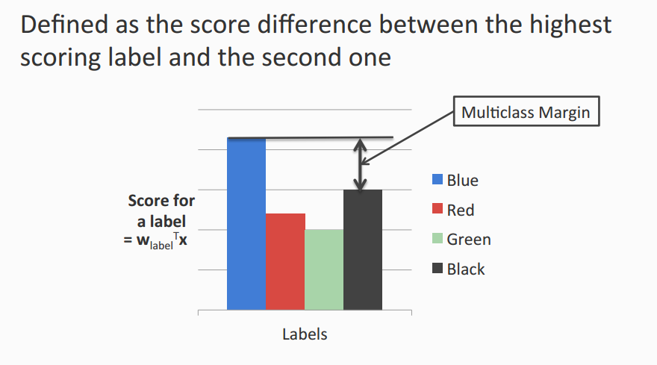
Multi-class SVM
In a risk minimization framework
Goal: ${D=\left\{\left(x_{i},y_{i}\right)\right\}}_{i=1}^{N}$
$w_{y_{i}}^{T}x_{i}>w_{y′}^{T}x_{i}$ for all $i, y$’
Maximizing the margin

Slide 62
Multiclass Margin

Slide 63
Multiclass SVM (Intuition)
Binary SVM
Maximize margin. Equivalently,
Minimize norm of weights such that the closest points to the hyperplane have a score 1
Multiclass SVM
Each label has a different weight vector (like one-vs-all)
Maximize multiclass margin. Equivalently,
Minimize total norm of the weights such that the true label is scored at least 1 more than the second best one

Slide 64
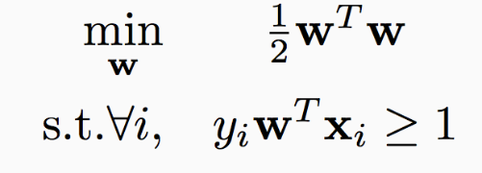
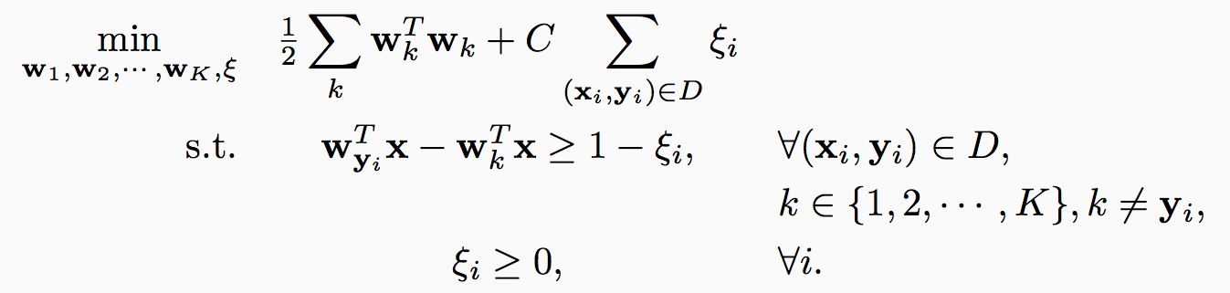
Multiclass SVM in the separable case
Recall hard binary SVM
Size of the weights. Effectively, regularizer
The score for the true label is higher than the score for any other label by 1

Slide 65
Multiclass SVM: General case
Total slack. Effectively, don’t allow too many examples to violate the margin constraint
Size of the weights. Effectively, regularizer
The score for the true label is higher than the score for any other label by 1
Slack variables. Not all examples need to satisfy the margin constraint.
Slack variables can only be positive

Slide 66
Multiclass SVM: General case
Total slack. Effectively, don’t allow too many examples to violate the margin constraint
Size of the weights. Effectively, regularizer
The score for the true label is higher than the score for any other label by
1 - »_{i}
Slack variables. Not all examples need to satisfy the margin constraint.
Slack variables can only be positive

Slide 67
Recap: An alternative SVM formulation
$\min_{w,b, ξ} \frac{1}{2}w^{T}w+C\sum_{i}{ξ_{i}}$ $s.t y_{i}{(w}^{T}x_{i}+b)≥1−ξ_{i}; ξ_{i}≥0 ∀i$
Rewrite the constraints:
$ξ_{i}≥1− y_{i}{(w}^{T}x_{i}+b); ξ_{i}≥0$ $∀i$
In the optimum, $ξ_{i}=\max{(0, }1− y_{i}{(w}^{T}x_{i}+b))$
Soft SVM can be rewritten as: $\min_{w,b} \frac{1}{2}w^{T}w+C\sum_{i}{\max{(0, }1− y_{i}{(w}^{T}x_{i}+b))}$
Regularization term
Empirical loss

Slide 68
Rewrite it as unconstraint problem
$\min_{w}{\frac{1}{2}} \sum_{k}{w_{k}^{T}}w_{k}+C \sum_{i}{(\max_{k}\left(Δ\left(y_{i},k\right)+w_{k}^{T}x\right)−w_{y_{i}}^{T}x )}$
Let’s define:
$$Δ\left(y,y^{′}\right)=\left\{\begin{aligned}δ if y≠y′ \\ 0 if y=y′\end{aligned}\right.$$

Slide 69
Multiclass SVM
Generalizes binary SVM algorithm
If we have only two classes, this reduces to the binary (up to scale)
Comes with similar generalization guarantees as the binary SVM
Can be trained using different optimization methods
Stochastic sub-gradient descent can be generalized

Slide 70
Exercise!
Write down SGD for multiclass SVM
Write down multiclas SVM with Kesler construction

Slide 71
This Lecture
Multiclass classification overview
Reducing multiclass to binary
One-against-all & One-vs-one
Error correcting codes
Training a single classifier
Multiclass Perceptron: Kesler’s construction
Multiclass SVMs: Crammer&Singer formulation
Multinomial logistic regression

Slide 72
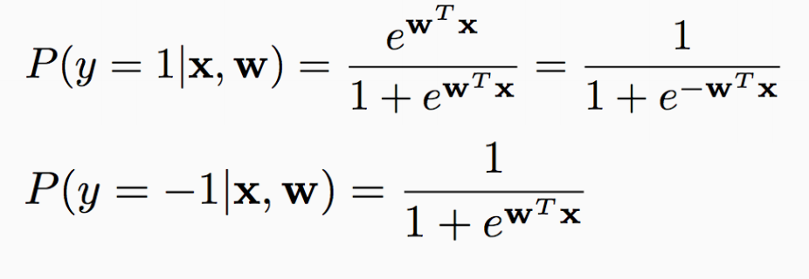
Recall: (binary) logistic regression
$$\min_{w} \frac{1}{2}w^{T}w+C\sum_{i}{\log{(}1+e^{−y_{i}{(w}^{T}x_{i})})}$$
Assume labels are generated using the following probability distribution:

Slide 73
(multi-class) log-linear model
Partition function
Assumption: $P\left(y | x, w\right)=\frac{\exp\left(w_{y}^{T}x\right)}{\sum_{y′∈\{1,2,…K\}}{exp⁡(w_{y′}^{T}x)}}$
This is a valid probability assumption. Why?
Another way to write this (with Kesler construction) is $P\left(y | x, w\right)=\frac{\exp\left(w^{T}φ(x,y)\right)}{\sum_{y′∈\{1,2,…K\}}{exp⁡(w^{T}φ(x,y′))}}$
This often called soft-max

Slide 74
Softmax
Softmax: let s(y) be the score for output y here s(y)=$w^{T}φ(x,y)$ (or $w_{y}^{T}x)$ but it can be computed by other metric.
We can control the peakedness of the distribution
$$P(y)=\frac{\exp\left(s(y)\right)}{\sum_{y′∈\{1,2,…K\}}{exp⁡(s(y))}}$$
$$P(y|σ)=\frac{\exp\left(s\left(y\right)/σ\right)}{\sum_{y′∈\{1,2,…K\}}{exp⁡(s(y/σ))}}$$

Slide 75
Example

Slide 76
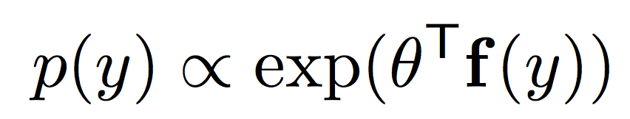
Log linear model
$P\left(y | x, w\right)=\frac{\exp\left(w_{y}^{T}x\right)}{\sum_{y′∈\{1,2,…K\}}{exp⁡(w_{y′}^{T}x)}}$
$\log{P\left(y | x, w\right)}=log⁡(\exp\left(w_{y}^{T}x\right))−log⁡(\sum_{y′∈\{1,2,…K\}}{exp⁡(w_{y^{′}}^{T}x))}$
$=w_{y}^{T}x−log⁡(\sum_{y′∈\{1,2,…K\}}{exp⁡(w_{y^{′}}^{T}x))}$
Note:
Linear function
Except this term

Slide 77
Maximum log-likelihood estimation
Training can be done by maximum log-likelihood estimation i.e. $\max_{w}\log{P(D\left|w\right)}$
D=${\{(x}_{i},y_{i})\}$
$P(D\left|w\right)=Π_{i}\frac{\exp\left(w_{y_{i}}^{T}x_{i}\right)}{\sum_{y′∈\{1,2,…K\}}{exp⁡(w_{y^{′}}^{T}x_{i})}}$
$\log{P(D\left|w\right)}$ $=\sum_{i}{[w_{y_{i}}^{T}x_{i}−}\log{\sum_{y′∈\{1,2,…K\}}{exp⁡(w_{y^{′}}^{T}x_{i})}}]$

Slide 78
Maximum a posteriori
Can you use Kesler construction to rewrite this formulation?
D=${\{(x}_{i},y_{i})\}$
$P\left(w | D\right)∝P\left(w\right)P\left(D | w\right)$
$max_{w} −\frac{1}{2}\sum_{y}{w_{y}^{T}w_{y}+ }C\sum_{i}{[w_{y_{i}}^{T}x_{i}−}\log{\sum_{y′∈\{1,2,…K\}}{exp⁡(w_{y^{′}}^{T}x_{i})}}]$
or
$\min_{w} \frac{1}{2}{\sum_{y}{w_{y}^{T}w_{y}+ }C\sum_{i}{[}\log{\sum_{y′∈\{1,2,…K\}}{\exp\left(w_{y^{′}}^{T}x_{i}\right)−w_{y_{i}}^{T}x_{i}}}] }$

Slide 79
Comparisons
Multi-class SVM: $\min_{w}{\frac{1}{2}} \sum_{k}{w_{k}^{T}}w_{k}+C \sum_{i}{(\max_{k}{(Δ\left(y_{i},k\right)+w_{k}^{T}x−w_{y_{i}}^{T}x)})}$
Log-linear model w/ MAP (multi-class) $\min_{w}\frac{1}{2}{\sum_{k}{w_{k}^{T}w_{k}+C}\sum_{i}{[}\log{\sum_{k∈\{1,2,…K\}}{\exp\left(w_{k}^{T}x_{i}\right)−w_{y_{i}}^{T}x_{i}}}] }$
Binary SVM:
$\min_{w} \frac{1}{2}w^{T}w+C\sum_{i}{\max{(0, }1− y_{i}{(w}^{T}x_{i}))}$
Log-linear mode (logistic regression)
$\min_{w} \frac{1}{2}w^{T}w+C\sum_{i}{\log{(}1+e^{−y_{i}{(w}^{T}x_{i})})}$

