Slide 1
Lecture 4: Structured Prediction Models
Kai-Wei Chang
CS @ UCLA
kw@kwchang.net
Couse webpage: https://uclanlp.github.io/CS269-17/

Slide 2
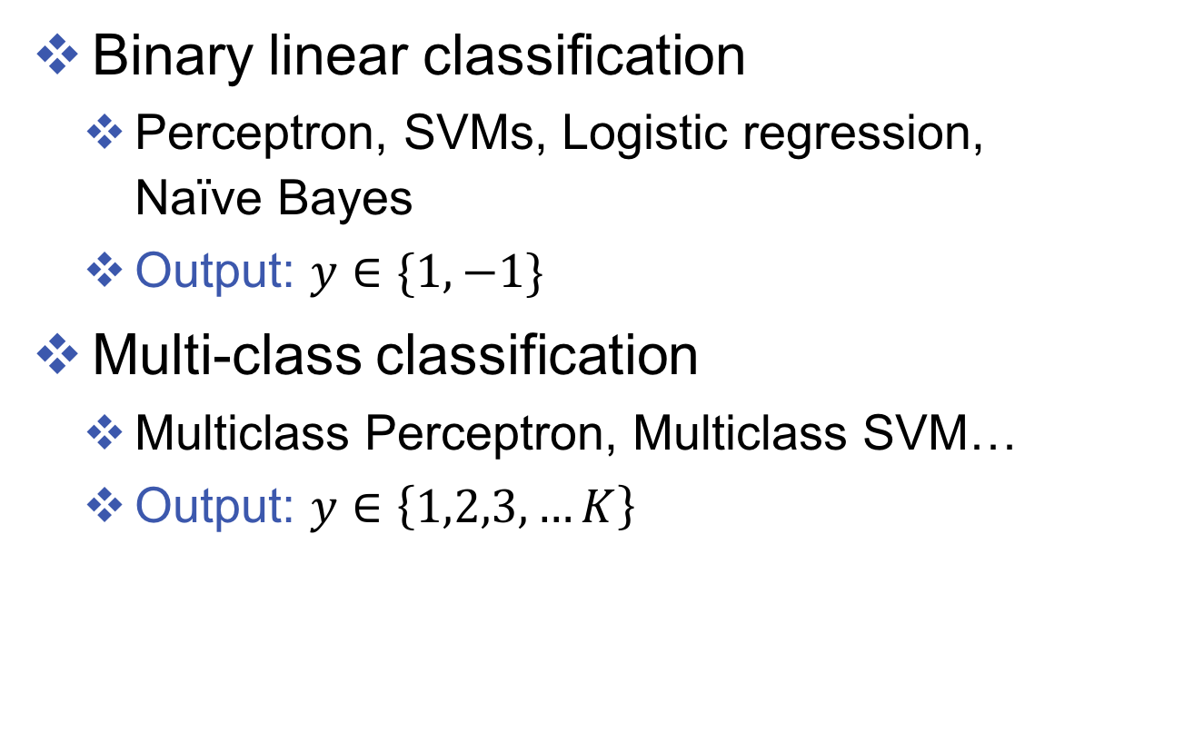
Previous Lecture
Binary linear classification
Perceptron, SVMs, Logistic regression, Naïve Bayes
Output: $y∈\{1,−1\}$
Multi-class classification
Multiclass Perceptron, Multiclass SVM…
Output: $y$ $∈\left\{1,2,3, …K\right\}$

Slide 3
What we have seen: multiclass
Reducing multiclass to binary
One-against-all & One-vs-one
Error correcting codes
Extension: Learning to search
Training a single classifier
Multiclass Perceptron: Kesler’s construction
Multiclass SVMs: Crammer&Singer formulation
Multinomial logistic regression
Extension: Graphical models

Slide 4
This lecture
What is structured output?
Multiclass as structure
Sequence as structure
General graph structure

Slide 5
Global decisions
“Understanding” is a global decision
Several local decisions play a role
There are mutual dependencies on their outcome.
Essential to make coherent decisions
Joint, Global Inference

Slide 6
Inference with Constraints [Roth&Yih’04,07,….]
Bernie’s wife, Jane, is a native of Brooklyn
E1 E2 E3
R₁₂
R₂₃
Models could be learned separately/jointly; constraints may come up only at decision time.
Notes:
6
Let’s look at another example in more details.
We want to extract entities (person, location and organization) and relations between them (born in, spouse of).
Given a sentence, suppose the entity classifier and relation classifier have already given us their predictions along with the confidence values. The blue ones are the labels that have the highest confidence individually. However, this global assignment has some obvious mistakes. For example, the second argument of a born_in relation should be location instead of person. Since the classifiers are pretty confident on R23, but not on E3, so we should correct E3 to be location.
Similarly, we should change R12 from “born_in” to “spouse_of”

Slide 7
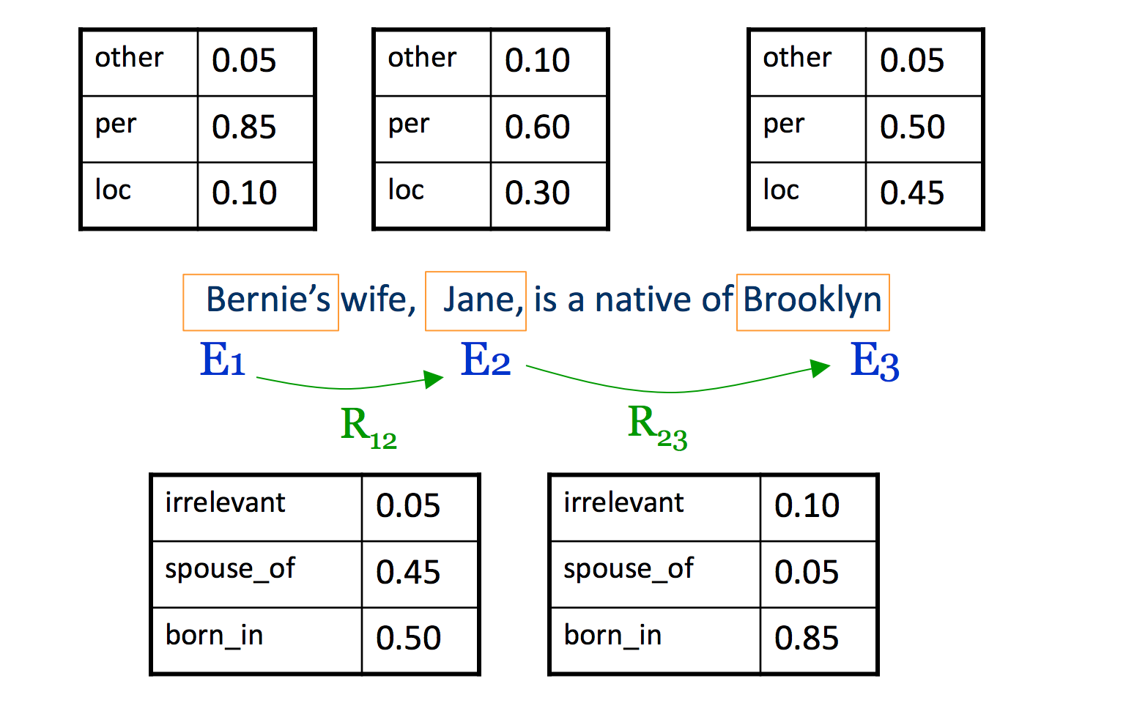
Inference with Constraints [Roth&Yih’04,07,….]
Models could be learned separately/jointly; constraints may come up only at decision time.
Notes:
7
Let’s look at another example in more details.
We want to extract entities (person, location and organization) and relations between them (born in, spouse of).
Given a sentence, suppose the entity classifier and relation classifier have already given us their predictions along with the confidence values. The blue ones are the labels that have the highest confidence individually. However, this global assignment has some obvious mistakes. For example, the second argument of a born_in relation should be location instead of person. Since the classifiers are pretty confident on R23, but not on E3, so we should correct E3 to be location.
Similarly, we should change R12 from “born_in” to “spouse_of”

Slide 8
Inference with Constraints [Roth&Yih’04,07,….]
other | 0.05
per | 0.85
loc | 0.10
other | 0.05
per | 0.85
loc | 0.10
other | 0.10
per | 0.60
loc | 0.30
other | 0.10
per | 0.60
loc | 0.30
other | 0.05
per | 0.50
loc | 0.45
other | 0.05
per | 0.50
loc | 0.45
other | 0.05
per | 0.50
loc | 0.45
Bernie’s wife, Jane, is a native of Brooklyn
E1 E2 E3
R₁₂
R₂₃
irrelevant | 0.05
spouse_of | 0.45
born_in | 0.50
irrelevant | 0.05
spouse_of | 0.45
born_in | 0.50
irrelevant | 0.05
spouse_of | 0.45
born_in | 0.50
irrelevant | 0.10
spouse_of | 0.05
born_in | 0.85
irrelevant | 0.10
spouse_of | 0.05
born_in | 0.85
Models could be learned separately/jointly; constraints may come up only at decision time.
Notes:
8
Let’s look at another example in more details.
We want to extract entities (person, location and organization) and relations between them (born in, spouse of).
Given a sentence, suppose the entity classifier and relation classifier have already given us their predictions along with the confidence values. The blue ones are the labels that have the highest confidence individually. However, this global assignment has some obvious mistakes. For example, the second argument of a born_in relation should be location instead of person. Since the classifiers are pretty confident on R23, but not on E3, so we should correct E3 to be location.
Similarly, we should change R12 from “born_in” to “spouse_of”

Slide 9
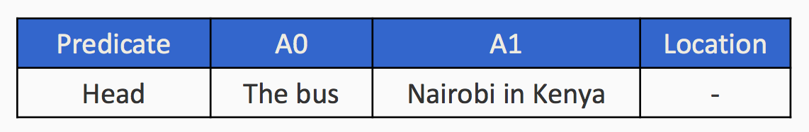
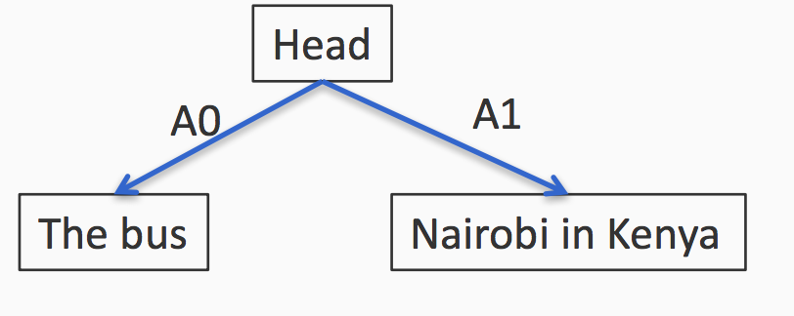
Structured output is…
A predefine structure
Can be represented as a graph

Slide 10
Sequential tagging
The process of assigning a part-of-speech to each word in a collection (sentence).
WORD tag
the DET
koala N
put V
the DET
keys N
on P
the DET
table N

Slide 11
Let’s try
Don’t worry! There is no problem with your eyes or computer.
a/DT dog/NN is/VBZ chasing/VBG a/DT cat/NN ./.
a/DT fox/NN is/VBZ running/VBG ./.
a/DT boy/NN is/VBZ singing/VBG ./. a/DT happy/JJ bird/NN
What is the POS tag sequence of the following sentence?
a happy cat was singing .

Slide 12
Let’s try
a/DT dog/NN is/VBZ chasing/VBG a/DT cat/NN ./. a/DT dog/NN is/VBZ chasing/VBG a/DT cat/NN ./.
a/DT fox/NN is/VBZ running/VBG ./. a/DT fox/NN is/VBZ running/VBG ./.
a/DT boy/NN is/VBZ singing/VBG ./. a/DT boy/NN is/VBZ singing/VBG ./.
a/DT happy/JJ bird/NN a/DT happy/JJ bird/NN
a happy cat was singing . a happy cat was singing .

Slide 13
How you predict the tags?
Two types of information are useful
Relations between words and tags
Relations between tags and tags
DT NN, DT JJ NN…
Fed in “The Fed” is a Noun because it follows a Determiner

Slide 14
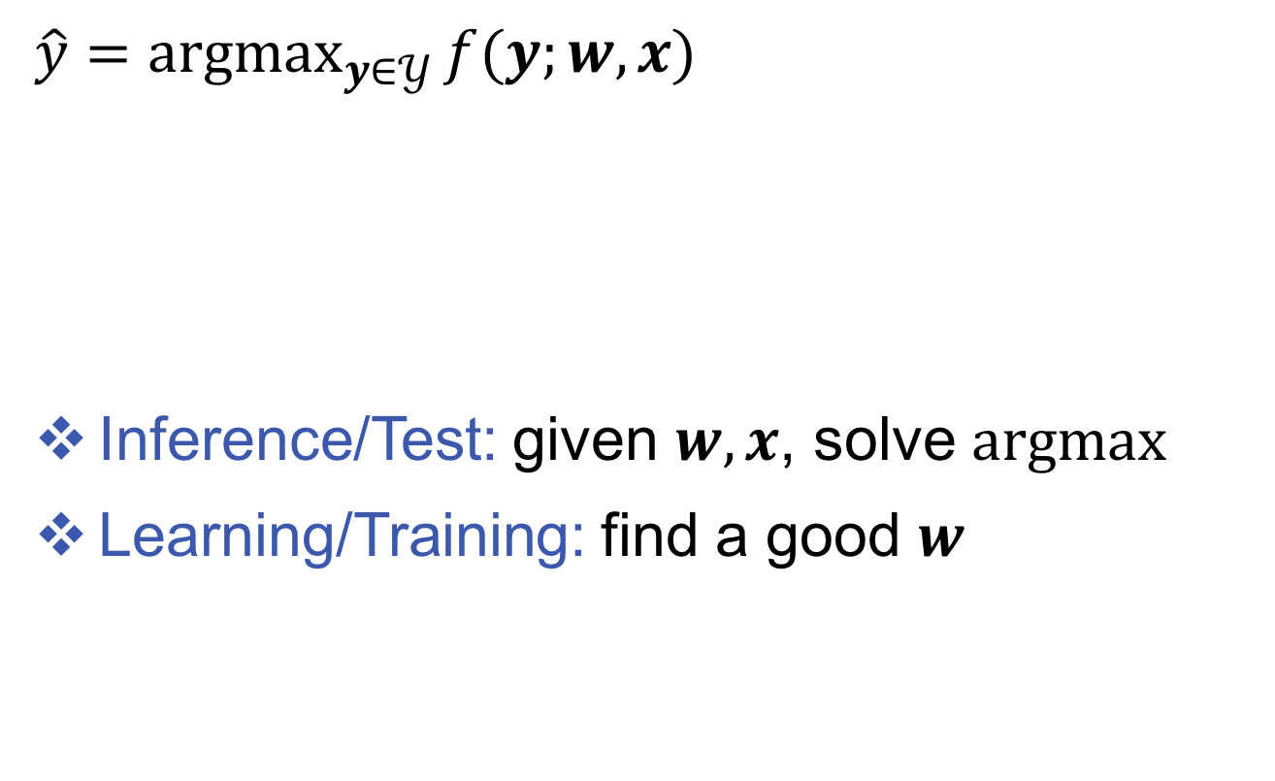
Combinatorial optimization problem
$\hat{y}={argmax}_{y∈𝒴}{f(y;w,x)}$
Inference/Test: given $w,x$, solve $argmax$
Learning/Training: find a good $w$
input
model parameters
output space

Slide 15
Challenges with structured output
We cannot train a separate weight vector for each possible inference outcome (why?)
For multi-class we train one weight vector for each class
We cannot enumerate all possible structures for inference
Inference for multiclass was easy

Slide 16
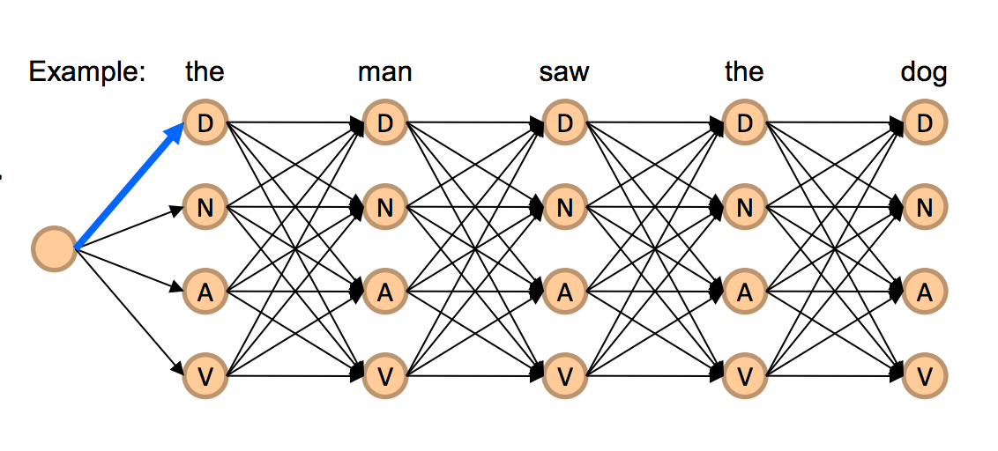
Deal with combinatorial output
Decompose the output into parts that are labeled
Define a graph to represent
how the parts interact with each other
These labeled interacting parts are scored; the total score for the graph is the sum of scores of each part
an inference algorithm to assign labels to all the parts

Slide 17
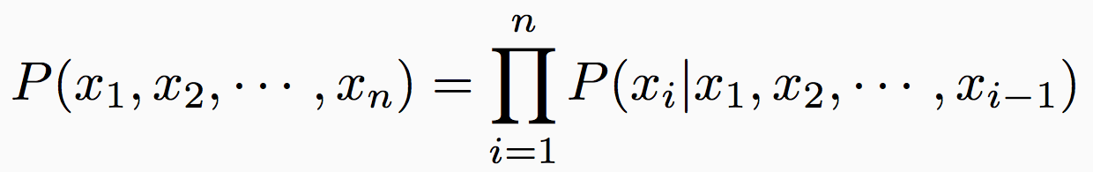
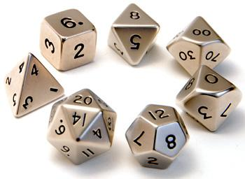
A history-based model
Each token is dependent on all the tokens that came before it
Simple conditioning
Each P(x_{i} | …) is a multinomial probability distribution over the tokens

Slide 18
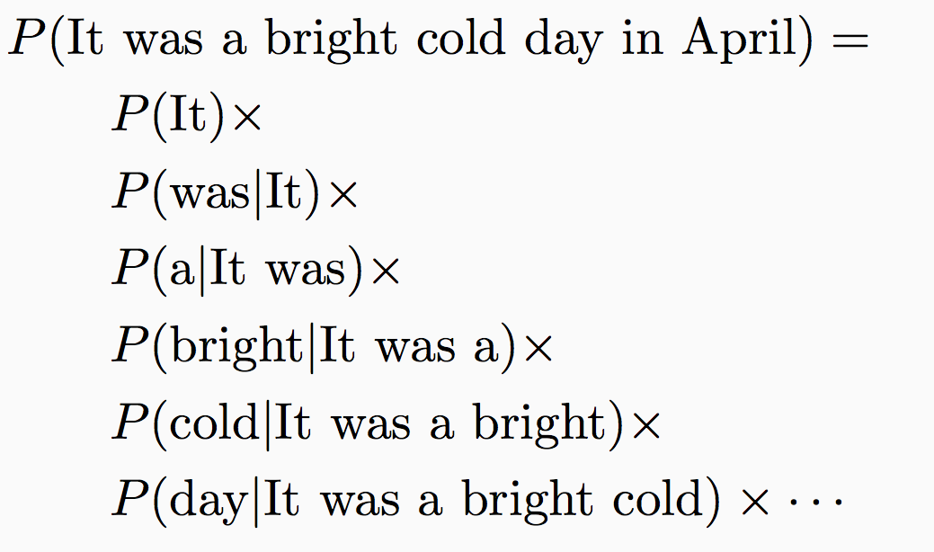
Example: A Language model
It was a bright cold day in April.
Probability of a word starting a sentence
Probability of a word following “It”
Probability of a word following “It was”
Probability of a word following “It was a”

Slide 19
A history-based model
Each token is dependent on all the tokens that came before it
Simple conditioning
Each P(x_{i} | …) is a multinomial probability distribution over the tokens
What is the problem here?
How many parameters do we have?
Grows with the size of the sequence!

Slide 20
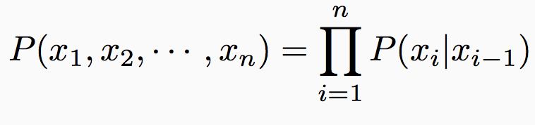
Solution: Lose the history
Discrete Markov Process
A system can be in one of K states at a time
State at time t is x_{t}
First-order Markov assumption
The state of the system at any time is independent of the full sequence history given the previous state
Defined by two sets of probabilities:
Initial state distribution: P(x₁ = S_{j})
State transition probabilities: P(x_{i} = S_{j} | x_{i-1} = S_{k})

Slide 21
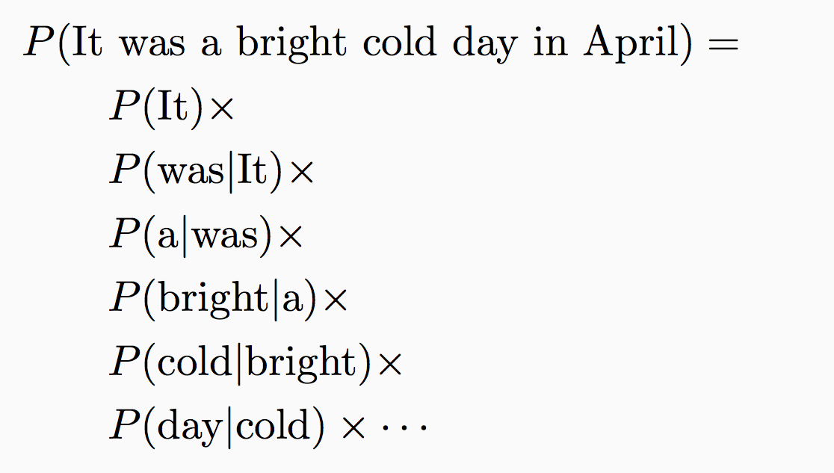
Example: Another language model
It was a bright cold day in April
Probability of a word starting a sentence
Probability of a word following “It”
Probability of a word following “was”
Probability of a word following “a”
If there are K tokens/states, how many parameters do we need?
O(K²)

Slide 22
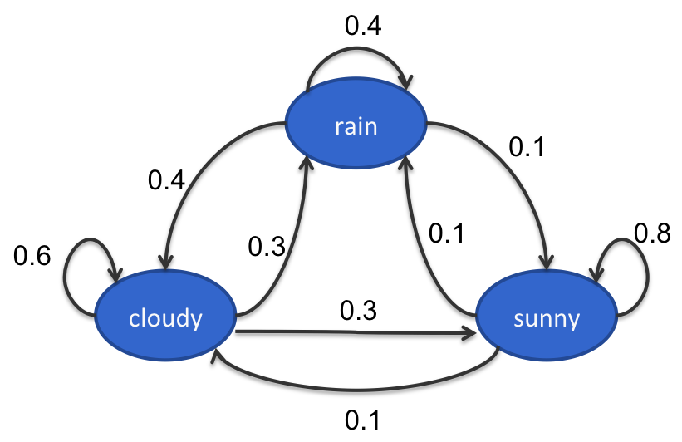
Example: The weather
Three states: rain, cloudy, sunny
Observations are Markov chains:
Eg: cloudy sunny sunny rain Probability of the sequence = P(cloudy) P(sunny|cloudy) P(sunny | sunny) P(rain | sunny)
State transitions:
Initial probability
Transition probabilities

Slide 23
Example: The weather
Three states: rain, cloudy, sunny
Observations are Markov chains:
Eg: cloudy sunny sunny rain Probability of the sequence = P(cloudy) P(sunny|cloudy) P(sunny | sunny) P(rain | sunny)
State transitions:
These probabilities define the model;
can find P(any sequence)
Initial probability
Transition probabilities

Slide 24
Outline
Sequence models
Hidden Markov models
Inference with HMM
Learning
Conditional Models and Local Classifiers
Global models
Conditional Random Fields
Structured Perceptron for sequences

Slide 25
Hidden Markov Model
Discrete Markov Model:
States follow a Markov chain
Each state is an observation
Hidden Markov Model:
States follow a Markov chain
States are not observed
Each state stochastically emits an observation

Slide 26
Toy part-of-speech example
The Fed raises interest rates
Transitions
Emissions
P(The | Determiner) = 0.5
P(A | Determiner) = 0.3
P(An | Determiner) = 0.1
P(Fed | Determiner) = 0
…
P(Fed| Noun) = 0.001
P(raises| Noun) = 0.04
P(interest| Noun) = 0.07
P(The| Noun) = 0
…
Determiner
Noun
Verb
start
Determiner
Noun
Verb
Noun
Noun
Initial
The
Fed
raises
interest
rates

Slide 27
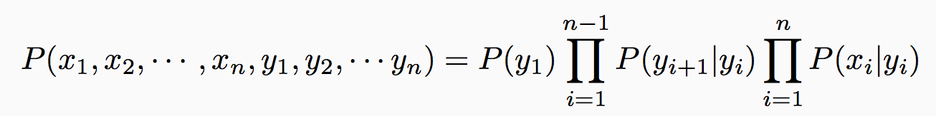
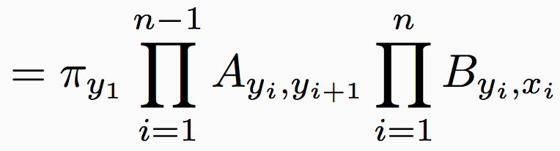
Joint model over states and observations
Notation
Number of states = K, Number of observations = M
π: Initial probability over states (K dimensional vector)
A: Transition probabilities (K×K matrix)
B: Emission probabilities (K×M matrix)
Probability of states and observations
Denote states by y₁, y₂, ☹ and observations by x₁, x₂, ☹

Slide 28
Other applications
Speech recognition
Input: Speech signal
Output: Sequence of words
NLP applications
Information extraction
Text chunking
Computational biology
Aligning protein sequences
Labeling nucleotides in a sequence as exons, introns, etc.
Questions?

Slide 29
Three questions for HMMs
[Rabiner 1999]
Given an observation sequence, x₁, x₂, ☹ x_{n} and a model (π, A, B), how to efficiently calculate the probability of the observation?
Given an observation sequence, x₁, x₂, ☹, x_{n} and a model (π, A, B), how to efficiently calculate the most probable state sequence?
How to calculate (π, A, B) from observations?
Inference
Learning

Slide 30
Outline
Sequence models
Hidden Markov models
Inference with HMM
Learning
Conditional Models and Local Classifiers
Global models
Conditional Random Fields
Structured Perceptron for sequences

Slide 31
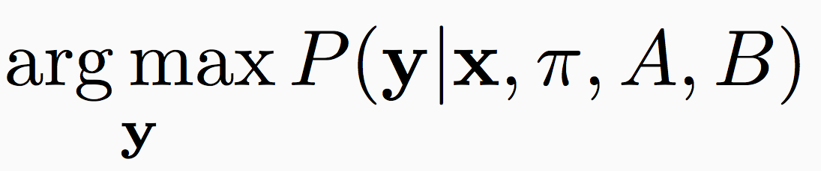
Most likely state sequence
Input:
A hidden Markov model (π, A, B)
An observation sequence x = (x₁, x₂, ☹, x_{n})
Output: A state sequence y = (y₁, y₂, ☹, y_{n}) that corresponds to
Maximum a posteriori inference (MAP inference)
Computationally: combinatorial optimization

Slide 32
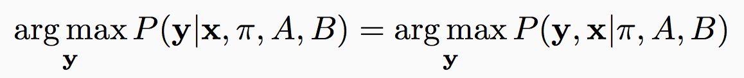
MAP inference
We want
We have defined
But
And we don’t care about P(x) we are maximizing over y
So,

Slide 33
How many possible sequences?
The | Fed | raises | interest | rates
Determiner | Verb | Verb | Verb | Verb
 | Noun | Noun | Noun | Noun
1 | 2 | 2 | 2 | 2
List of allowed tags for each word
In this simple case, 16 sequences (1×2×2×2×2)

Slide 34
Naïve approaches
Try out every sequence
Score the sequence y as P(y|x, π, A, B)
Return the highest scoring one
What is the problem?
Correct, but slow, O(K^{n})
Greedy search
Construct the output left to right
For each i, elect the best y_{i} using y_{i-1} and x_{i}
What is the problem?
Incorrect but fast, O(nK)

Slide 35
Solution: Use the independence assumptions
Recall: The first order Markov assumption
The state at token i is only influenced by the previous state, the next state and the token itself
Given the adjacent labels, the others do not matter
Suggests a recursive algorithm

Slide 36
Jason’s ice cream
Best tag sequence for P(”1,2,1”)?
#cones
0.5
0.4
0.5
C
0.8
C
0.8
C
0.5
0.2
0.2
0.2
0.2
0.5
H
H
H
0.1
0.8
0.2
0.8
0.1

Slide 37
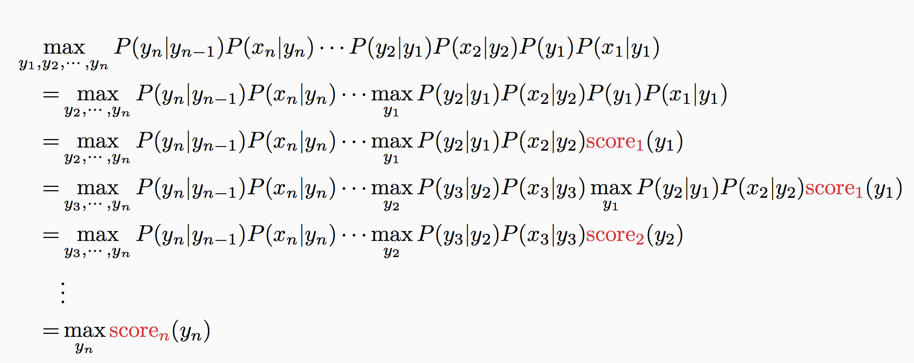
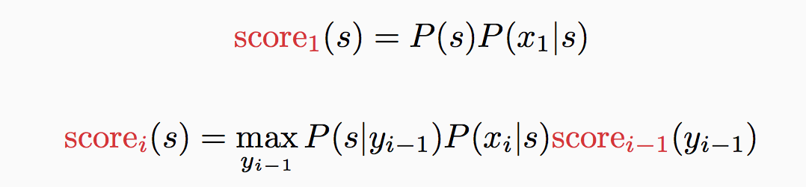
Deriving the recursive algorithm
Transition probabilities
Emission probabilities
Initial probability
y₁
y₂
y₃
…
y_{n}
x₁
x₂
x₃
x_{n}

Slide 38
Deriving the recursive algorithm
The only terms that depend on y₁
y₁
y₂
y₃
…
y_{n}
x₁
x₂
x₃
x_{n}

Slide 39
Deriving the recursive algorithm
Abstract away the score for all decisions till here into score
y₁
y₂
y₃
…
y_{n}
x₁
x₂
x₃
x_{n}

Slide 40
Deriving the recursive algorithm
Only terms that depend on y₂
y₁
y₂
y₃
…
y_{n}
x₁
x₂
x₃
x_{n}

Slide 41
Deriving the recursive algorithm
y₁
y₂
y₃
…
y_{n}
x₁
x₂
x₃
x_{n}
Abstract away the score for all decisions till here into score

Slide 42
Deriving the recursive algorithm
y₁
y₂
y₃
…
y_{n}
x₁
x₂
x₃
x_{n}
Abstract away the score for all decisions till here into score

Slide 43
Deriving the recursive algorithm

Slide 44

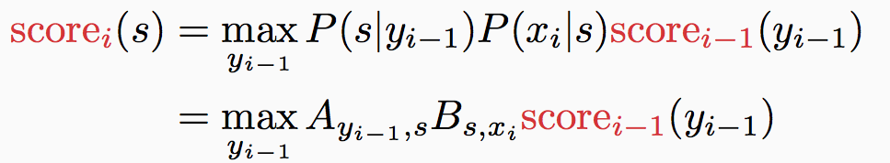

Viterbi algorithm
π: Initial probabilities
A: Transitions
B: Emissions
Max-product algorithm for first order sequences
Initial: For each state s, calculate
Recurrence: For i = 2 to n, for every state s, calculate
Final state: calculate
This only calculates the max. To get final answer (argmax),
keep track of which state corresponds to the max at each step
build the answer using these back pointers
Questions?

Slide 45
General idea
Dynamic programming
The best solution for the full problem relies on best solution to sub-problems
Memoize partial computation
Examples
Viterbi algorithm
Dijkstra’s shortest path algorithm
…

Slide 46
Complexity of inference
Complexity parameters
Input sequence length: n
Number of states: K
Memory
Storing the table: nK (scores for all states at each position)
Runtime
At each step, go over pairs of states
O(nK²)

Slide 47
Outline
Sequence models
Hidden Markov models
Inference with HMM
Learning
Conditional Models and Local Classifiers
Global models
Conditional Random Fields

Slide 48
Learning HMM parameters
Assume we know the number of states in the HMM
Two possible scenarios
We are given a data set D = {<x_{i}, y_{i}>} of sequences labeled with states
And we have to learn the parameters of the HMM (π, A, B)
We are given only a collection of sequences D = {x_{i}}
And we have to learn the parameters of the HMM (π, A, B)
Supervised learning with complete data
Unsupervised learning, with incomplete data

Slide 49
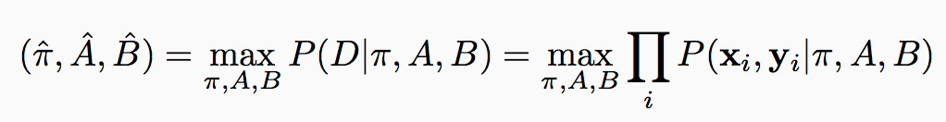
Supervised learning of HMM
We are given a dataset D = {<x_{i}, y_{i}>}
Each x_{i} is a sequence of observations and y_{i} is a sequence of states that correspond to x_{i}
Goal: Learn initial, transition, emission distributions (π, A, B)
How do we learn the parameters of the probability distribution?
The maximum likelihood principle
Where have we seen this before?
And we know how to write this in terms of the parameters of the HMM

Slide 50
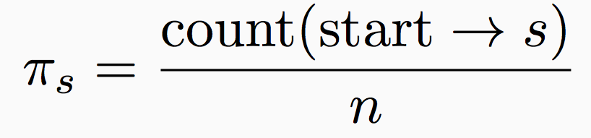
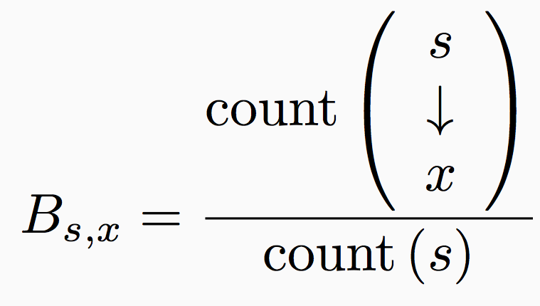
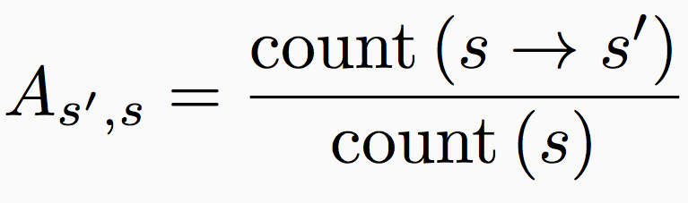
Supervised learning details
π, A, B can be estimated separately just by counting
Makes learning simple and fast
[Exercise: Derive the following using derivatives of the log likelihood. Requires Lagrangian multipliers.]
Number of instances where the first state is s
Number of examples
Initial probabilities
Transition probabilities
Emission probabilities

Slide 51
Outline
Sequence models
Hidden Markov models
Inference with HMM
Learning
Conditional Models and Local Classifiers
Global models
Conditional Random Fields

Slide 52
Outline
Sequence models
Hidden Markov models
Inference with HMM
Learning
Conditional Models and Local Classifiers
Global models
Conditional Random Fields

Slide 53
Modeling next-state directly
Instead of modeling the joint distribution P(x, y) only focus on P(y|x)
Which is what we care about eventually anyway
For sequences, different formulations
Maximum Entropy Markov Model [McCallum, et al 2000]
Projection-based Markov Model [Punyakanok and Roth, 2001]
(other names: discriminative/conditional markov model, …)

Slide 54
Generative vs Discriminative models
Generative models
learn P(x, y)
Characterize how the data is generated (both inputs and outputs)
Eg: Naïve Bayes, Hidden Markov Model
Discriminative models
learn P(y | x)
Directly characterizes the decision boundary only
Eg: Logistic Regression, Conditional models (several names)

Slide 55
Generative vs Discriminative models
Generative models
learn P(x, y)
Characterize how the data is generated (both inputs and outputs)
Eg: Naïve Bayes, Hidden Markov Model
Discriminative models
learn P(y | x)
Directly characterizes the decision boundary only
Eg: Logistic Regression, Conditional models (several names)
A generative model tries to characterize the distribution of the inputs, a discriminative model doesn’t care

Slide 56

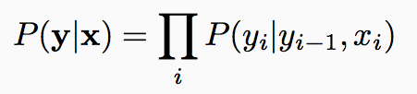
Another independence assumption
This assumption lets us write the conditional probability of the output as
y_{t-1}
y_{t}
y_{t-1}
y_{t}
HMM
Conditional
model
x_{t}
x_{t}

Slide 57
Modeling P(y_{i} | y_{i-1}, x_{i})
Different approaches possible
Train a log-linear classifier
Or, ignore the fact that we are predicting a probability, we only care about maximizing some score. Train any classifier (e.g, perceptron algorithm)
For both cases:
Use rich features that depend on input and previous state
We can increase the dependency to arbitrary neighboring x_{i}’s
Eg. Neighboring words influence this words POS tag

Slide 58
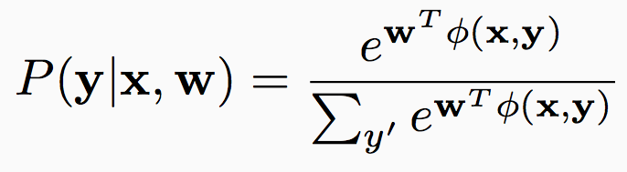
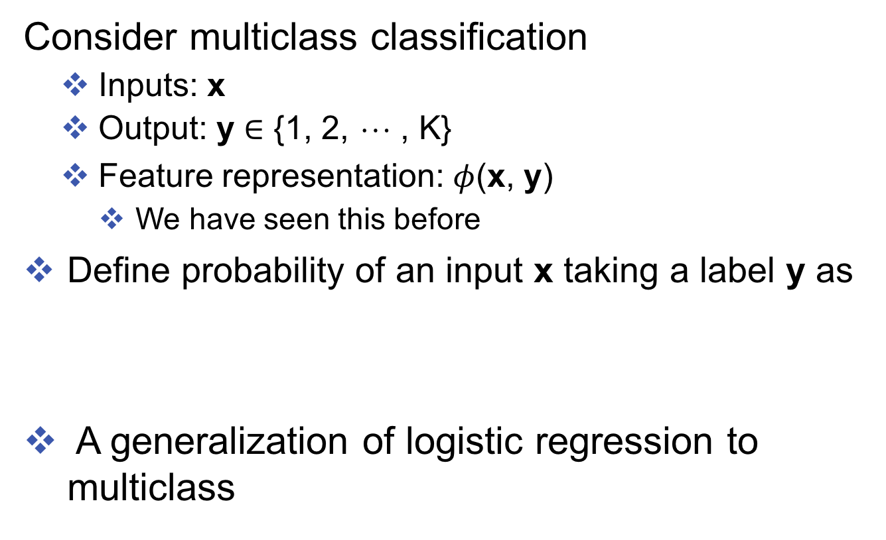
Log-linear models for multiclass
Consider multiclass classification
Inputs: x
Output: y $∈$ {1, 2, ☹ , K}
Feature representation: $φ$(x, y)
We have seen this before
Define probability of an input x taking a label y as
A generalization of logistic regression to multiclass
Interpretation: Score for label, converted to a well-formed probability distribution by exponentiating + normalizing

Slide 59
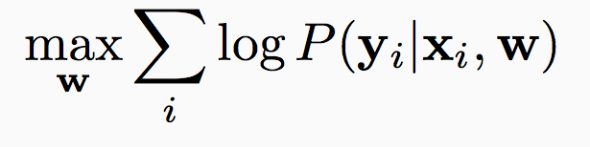
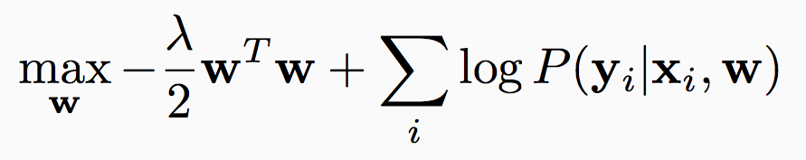
Training a log-linear model (multi-class)
Given a data set D = {<x_{i}, y_{i}>}
Apply the maximum likelihood principle
Maybe with a regularizer
Here

Slide 60
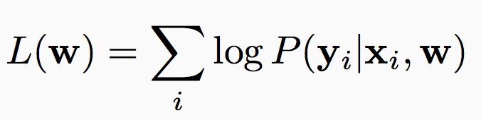
Training a log-linear model
Gradient based methods to minimize
Usual stochastic gradient descent
Initialize $w←0$
Iterate through examples for multiple epochs
For each example $\left(x_{i} y_{i}\right)$ take gradient step for the loss at that example
Update $w←w −r_{t}∇L(w, x_{i}, y_{i})$
Return $w$

Slide 61
The next-state model
Back to sequences
This assumption lets us write the conditional probability of the output as
y_{t-1}
y_{t}
y_{t-1}
y_{t}
HMM
Conditional
model
x_{t}
x_{t}
We need to learn this function

Slide 62
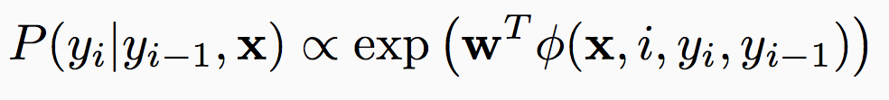
Maximum Entropy Markov Model
Goal: Compute P(y | x)
start
Determiner
Noun
Verb
Noun
Noun
The
Fed
raises
interest
rates
The prediction task: Using the entire input and the current label, predict the next label

Slide 63
Maximum Entropy Markov Model
Goal: Compute P(y | x)
start
Determiner
Noun
Verb
Noun
Noun
The
Fed
raises
interest
rates
word
Caps
To model the probability, first, we need to define features for the current classification problem
-es
Previous

Slide 64
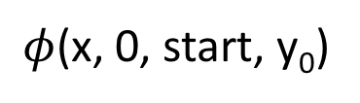
Maximum Entropy Markov Model
Goal: Compute P(y | x)
start
Determiner
Noun
Verb
Noun
Noun
The
Fed
raises
interest
rates
word
The
Caps
Y
-es
N
Previous
start
$φ$(x, 0, start, y₀)

Slide 65
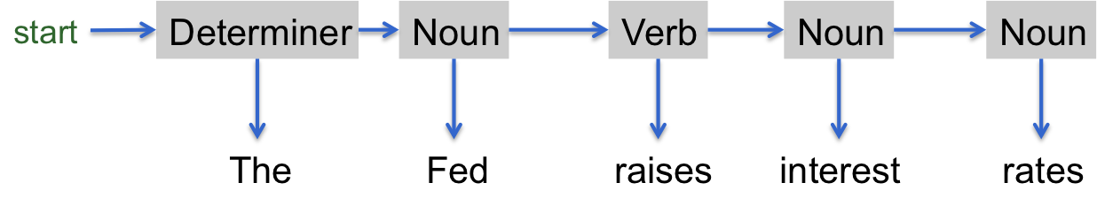


Maximum Entropy Markov Model
Goal: Compute P(y | x)
start
Determiner
Noun
Verb
Noun
Noun
The
Fed
raises
interest
rates
word
The
Fed
raises
interest
rates
Caps
Y
Y
N
N
N
Can get very creative here
-es
N
N
Y
N
N
Previous
start
Determiner
Noun
Verb
Noun
$ϕ$(x, 0, start, y₀)
$ϕ$(x, 1, y_{0,} y₁)
Á(x, 2, y₁, y₂)
Á(x, 3, y₂, y₃)
Á(x, 4, y₃, y₄)
Compare to HMM: Only depends on the word and the previous tag
Questions?

Slide 66





Maximum Entropy Markov Model
Goal: Compute P(y | x)
start
Determiner
Noun
Verb
Noun
Noun
The
Fed
raises
interest
rates
word
The
Fed
raises
interest
rates
Caps
Y
Y
N
N
N
Can get very creative here
-es
N
N
Y
N
N
Previous
start
Determiner
Noun
Verb
Noun
$ϕ$(x, 0, start, y₀)
$ϕ$(x, 1, y_{0,} y₁)
$ϕ$(x, 2, y₁, y₂)
$ϕ$(x, 3, y₂, y₃)
$ϕ$(x, 4, y₃, y₄)
Compare to HMM: Only depends on the word and the previous tag
Questions?

Slide 67
Maximum Entropy Markov Model
Goal: Compute P(y | x)
start
Determiner
Noun
Verb
Noun
Noun
The
Fed
raises
interest
rates
word
The
Fed
raises
interest
rates
Caps
Y
Y
N
N
N
Can get very creative here
-es
N
N
Y
N
N
Previous
start
Determiner
Noun
Verb
Noun
$ϕ$(x, 0, start, y₀)
$ϕ$(x, 1, y_{0,} y₁)
$ϕ$(x, 2, y₁, y₂)
$ϕ$(x, 3, y₂, y₃)
$ϕ$(x, 4, y₃, y₄)
Compare to HMM: Only depends on the word and the previous tag
Questions?

Slide 68
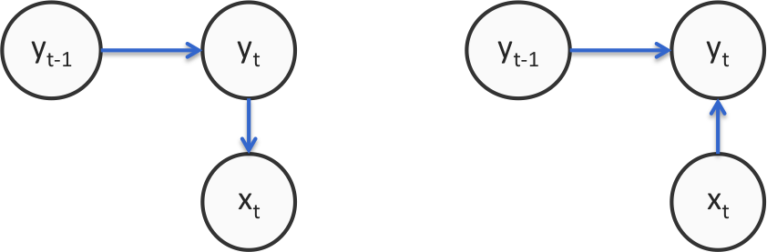
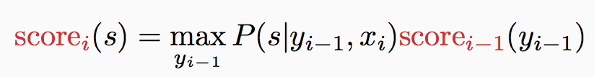
Using MEMM
Training
Next-state predictor locally as maximum likelihood
Similar to any maximum entropy classifier
Prediction/decoding
Modify the Viterbi algorithm for the new independence assumptions
HMM
Conditional Markov model

Slide 69
Generalization: Any multiclass classifier
Viterbi decoding: we only need a score for each decision
So far, probabilistic classifiers
In general, use any learning algorithm to build get a score for the label y_{i} given y_{i-1} and x
Multiclass versions of perceptron, SVM
Just like MEMM, these allow arbitrary features to be defined
Exercise: Viterbi needs to be re-defined to work with sum of scores rather than the product of probabilities

Slide 70
Comparison to HMM
What we gain
Rich feature representation for inputs
Helps generalize better by thinking about properties of the input tokens rather than the entire tokens
Eg: If a word ends with –es, it might be a present tense verb (such as raises). Could be a feature; HMM cannot capture this
Discriminative predictor
Model P(y | x) rather than P(y, x)
Joint vs conditional

Slide 71
Outline
Sequence models
Hidden Markov models
Inference with HMM
Learning
Conditional Models and Local Classifiers
Global models
Conditional Random Fields

Slide 72
Outline
Conditional models for predicting sequences
Log-linear models for multiclass classification
Maximum Entropy Markov Models
The Label Bias Problem

Slide 73
The next-state model for sequences
This assumption lets us write the conditional probability of the output as
y_{t-1}
y_{t}
y_{t-1}
y_{t}
HMM
Conditional
model
x_{t}
x_{t}
We need to train local multiclass classifiers that predicts the next state given the previous state and the input

Slide 74
…local classifiers! Label bias problem
Let’s look at the independence assumption
“Next-state” classifiers are locally normalized
Eg: Part-of-speech tagging the sentence
Option 1: P(D | The) ¢
P(N | D, robot) ¢
P(N | N, wheels) ¢
P(V | N, are) ¢
P(A | V, round)
The
robot
wheels
are
round
1
1
N
V
A
0.8
1
Option 2: P(D | The) ¢
P(N | D, robot) ¢
P(V | N, wheels) ¢
P(N | V, are) ¢
P( R| N, round)
D
N
1
1
0.2
V
N
R
Suppose these are the only state transitions allowed
Example based on [Wallach 2002]

Slide 75
…local classifiers! Label bias problem
Let’s look at the independence assumption
“Next-state” classifiers are locally normalized
Eg: Part-of-speech tagging the sentence
Option 1: P(D | The) ¢
P(N | D, robot) ¢
P(N | N, wheels) ¢
P(V | N, are) ¢
P(A | V, round)
The
robot
wheels
are
round
1
1
N
V
A
0.8
1
Option 2: P(D | The) ¢
P(N | D, robot) ¢
P(V | N, wheels) ¢
P(N | V, are) ¢
P( R| N, round)
D
N
1
1
0.2
V
N
R
Suppose these are the only state transitions allowed
Example based on [Wallach 2002]

Slide 76
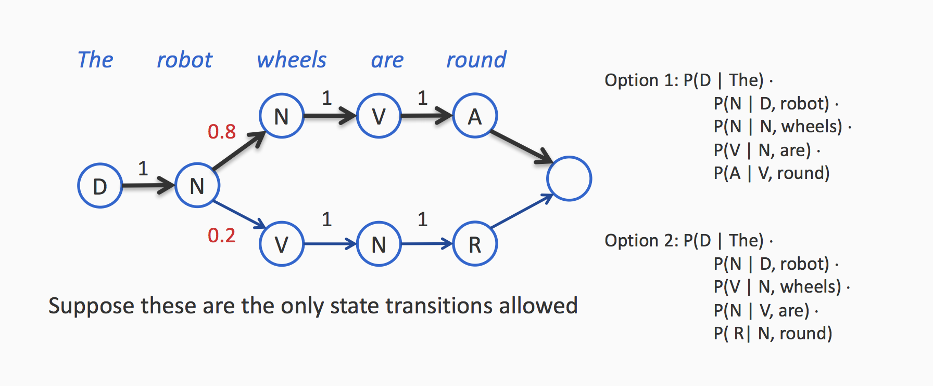
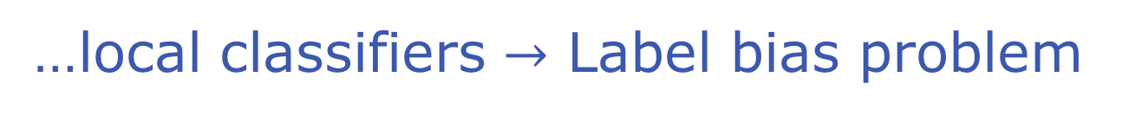
…local classifiers $→$ Label bias problem

Slide 77
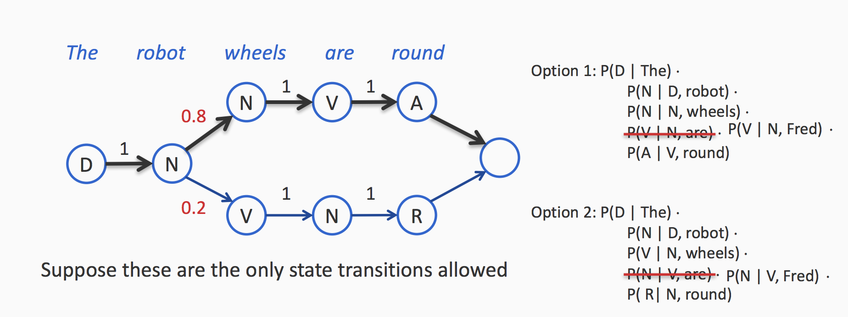
…local classifiers $→$ Label bias problem
The path scores are the same
Even if the word Fred is never observed as a verb in the data,
it will be predicted as one
The input Fred does not influence the output at all

Slide 78
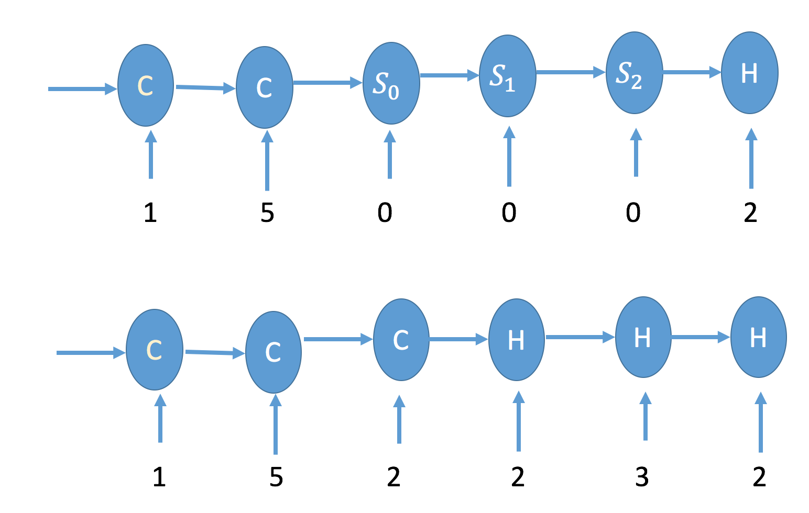
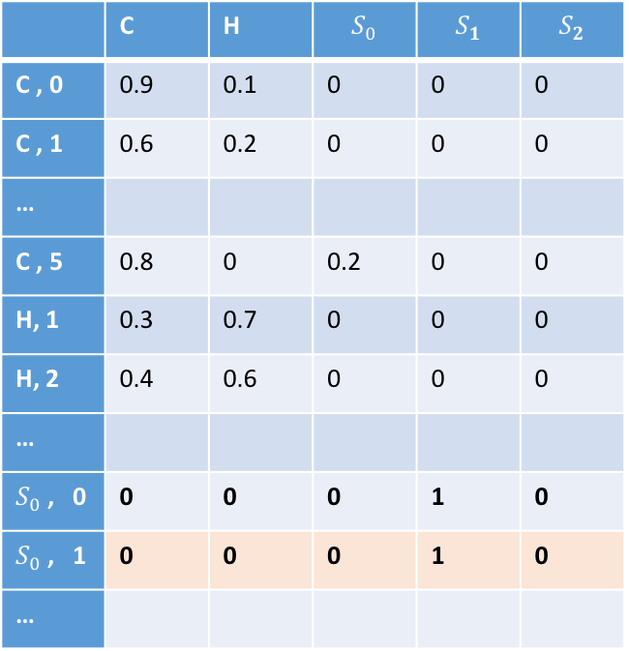
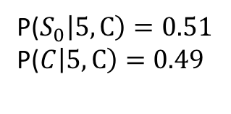
Example: Label bias problem
P($S_{0}\left|5, C\right)=0.51$
P($C\left|5, C\right)=0.49$
Very hot
Dinosaur attack
 | C | H | $$S_{0}$$ | $$S_{1}$$ | $$S_{2}$$
C , 0 | 0.9 | 0.1 | 0 | 0 | 0
C , 1 | 0.6 | 0.2 | 0 | 0 | 0
…
C , 5 | 0.8 | 0 | 0.2 | 0 | 0
H, 1 | 0.3 | 0.7 | 0 | 0 | 0
H, 2 | 0.4 | 0.6 | 0 | 0 | 0
…
$S_{0}$ , 0 | 0 | 0 | 0 | 1 | 0
$S_{0}$ , 1 | 0 | 0 | 0 | 1 | 0
…
In MEMM: even you’ve never seen this event, you still need to make this row sum up to 1.
For CRF, there is no such restriction.

Slide 79
Label Bias
States with a single outgoing transition effectively ignore their input
States with lower-entropy next states are less influenced by observations
Why?
Each the next-state classifiers are locally normalized.
If a state has fewer next states, each of those will get a higher probability mass …and hence preferred
Side note: Surprisingly doesn’t affect some tasks
Eg: part-of-speech tagging

Slide 80
Summary: Local models for Sequences
Conditional models
Use rich features in the mode
Possibly suffer from label bias problem

Slide 81
Outline
Sequence models
Hidden Markov models
Inference with HMM
Learning
Conditional Models and Local Classifiers
Global models
Conditional Random Fields

Slide 82
Outline
Sequence models
Hidden Markov models
Inference with HMM
Learning
Conditional Models and Local Classifiers
Global models
Conditional Random Fields

Slide 83
So far…
Hidden Markov models
Pros: Decomposition of total probability with tractable
Cons: Doesn’t allow use of features for representing inputs
Also, generative model
not really a downside, but we may get better performance with conditional models if we care only about predictions
Local, conditional Markov Models
Pros: Conditional model, allows features to be used
Cons: Label bias problem

Slide 84
Global models
Train the predictor globally
Instead of training local decisions independently
Normalize globally
Make each edge in the model undirected
Not associated with a probability, but just a “score”
Recall the difference between local vs. global for multiclass

Slide 85
HMM vs. A local model vs. A global model
P(y_{t} | y_{t-1})
P(y_{t} | y_{t-1}, x_{t})
f^{T}(y_{t}, y_{t-1})
y_{t-1}
y_{t}
y_{t-1}
y_{t}
y_{t-1}
y_{t}
P(x_{t} | y_{t})
f^{E}(y_{t}, x_{t})
HMM
x_{t}
Conditional
model
Global
model
x_{t}
x_{t}
Generative
Discriminative
Local: P is locally normalized to add up to one for each t
Global: The functions f^{T} and f^{E} are scores that are not normalized

Slide 86
HMM vs. A local model vs. A global model
P(y_{t} | y_{t-1})
P(y_{t} | y_{t-1}, x_{t})
f^{T}(y_{t}, y_{t-1})
y_{t-1}
y_{t}
y_{t-1}
y_{t}
y_{t-1}
y_{t}
P(x_{t} | y_{t})
f^{E}(y_{t}, x_{t})
HMM
x_{t}
Conditional
model
Global
model
x_{t}
x_{t}
Generative
Discriminative
Local: P is locally normalized to add up to one for each t
Global: The functions f^{T} and f^{E} are scores that are not normalized

Slide 87
HMM vs. A local model vs. A global model
P(y_{t} | y_{t-1})
P(y_{t} | y_{t-1}, x_{t})
f^{T}(y_{t}, y_{t-1})
y_{t-1}
y_{t}
y_{t-1}
y_{t}
y_{t-1}
y_{t}
P(x_{t} | y_{t})
f^{E}(y_{t}, x_{t})
HMM
x_{t}
Conditional
model
Global
model
x_{t}
x_{t}
Generative
Discriminative
Local: P is locally normalized to add up to one for each t
Global: The functions f^{T} and f^{E} are scores that are not normalized

Slide 88
Conditional Random Field
y₀
y₁
y₂
y₃
x
Each node is a random variable
We observe some nodes and the rest are unobserved
The goal: To characterize a probability distribution over the unobserved variables, given the observed

Slide 89
Conditional Random Field
y₀
y₁
y₂
y₃
x
score(x, y₀, y₁)
score(x, y₁, y₂)
score(x, y₂, y₃)
Each node is a random variable
We observe some nodes and need to assign the rest
Each clique is associated with a score

Slide 90



Conditional Random Field
y₀
y₁
y₂
y₃
x
$w^{T}φ$(x, y₀, y₁)
$w^{T}φ$(x, y₁, y₂)
$w^{T}φ$(x, y₂, y₃)
Each node is a random variable
We observe some nodes and need to assign the rest
Each clique is associated with a score

Slide 91



Conditional Random Field: Factor graph
Factors
y₀
y₁
y₂
y₃
x
$w^{T}φ$(x, y₀, y₁)
$w^{T}φ$(x, y₁, y₂)
$w^{T}φ$(x, y₂, y₃)
Each node is a random variable
We observe some nodes and need to assign the rest
Each clique is associated with a score
factor

Slide 92
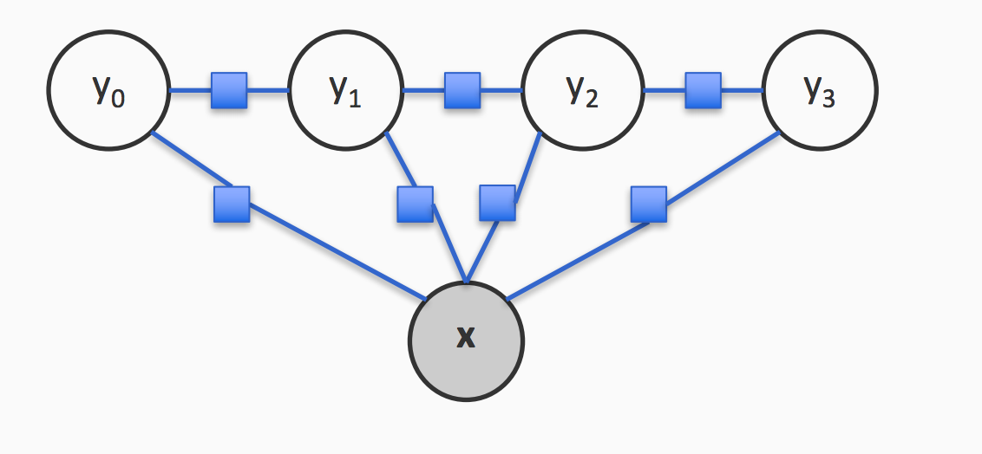
Conditional Random Field: Factor graph
A different factorization:
Recall decomposition of structures into parts. Same idea
Each node is a random variable
We observe some nodes and need to assign the rest
Each factor is associated with a score

Slide 93
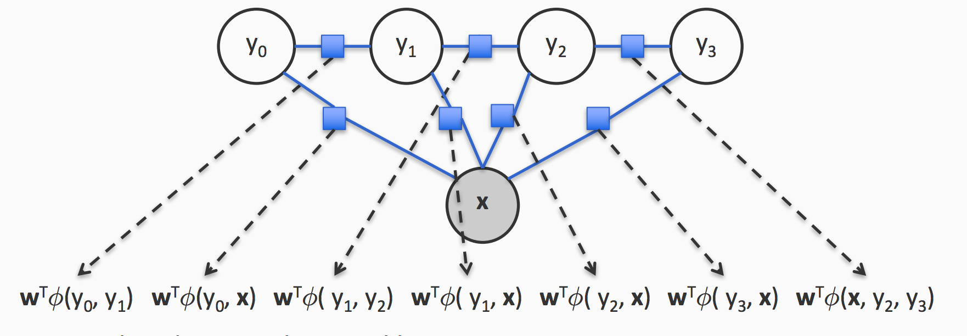
Conditional Random Field: Factor graph
Each node is a random variable
We observe some nodes and need to assign the rest
Each factor is associated with a score

Slide 94
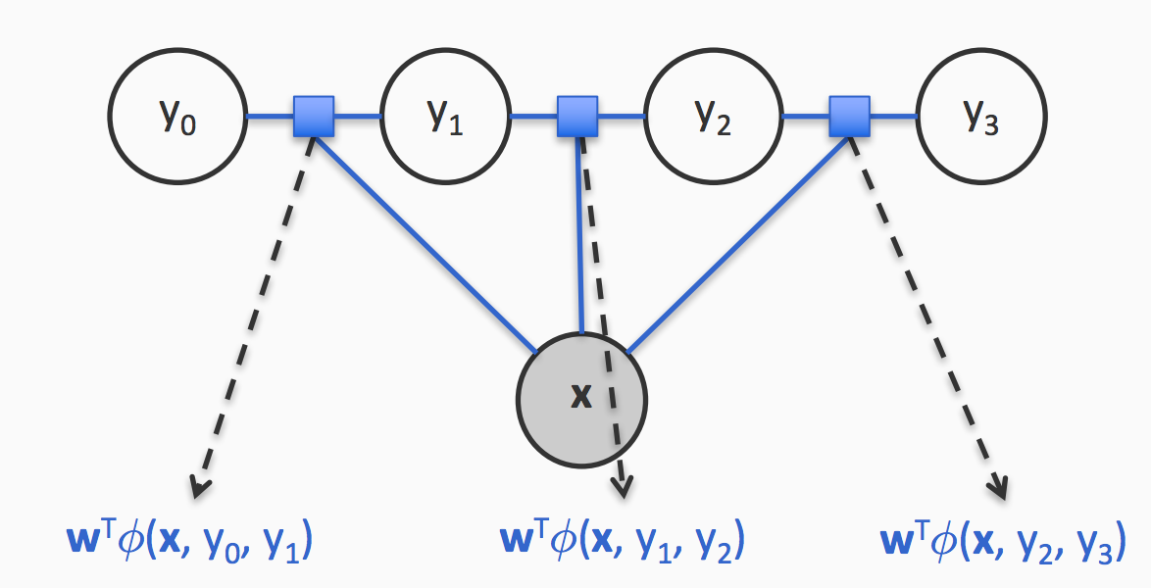
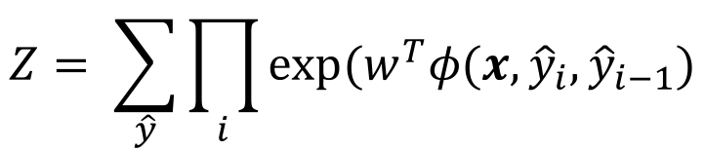
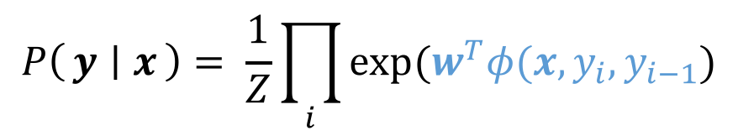
Conditional Random Field for sequences
$$P\left(y ∣ x\right)= \frac{1}{Z}\prod_{i}{exp⁡(w^{T}φ(x, y_{i}, y_{i−1})}$$
Z: Normalizing constant, sum over all sequences
$$Z= \sum_{\hat{y}}{\prod_{i}{exp⁡(w^{T}φ(x, {\hat{y}}_{i},{\hat{y}}_{i−1})}}$$

Slide 95
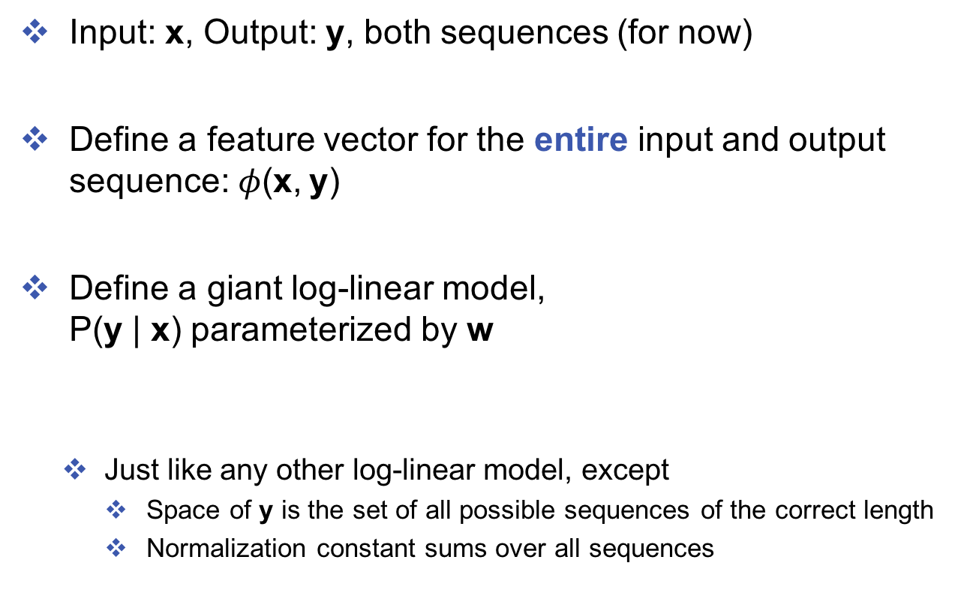
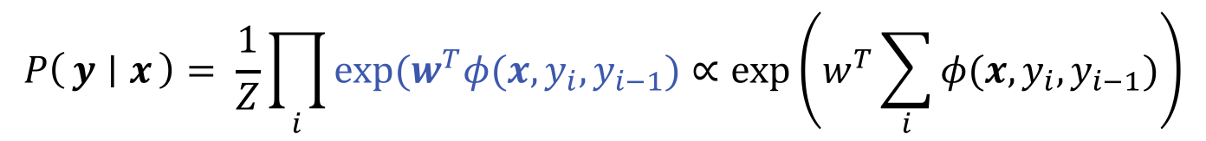
CRF: A different view
Input: x, Output: y, both sequences (for now)
Define a feature vector for the entire input and output sequence:$φ$(x, y)
Define a giant log-linear model, P(y | x) parameterized by w
Just like any other log-linear model, except
Space of y is the set of all possible sequences of the correct length
Normalization constant sums over all sequences
$$P\left(y ∣ x\right)= \frac{1}{Z}\prod_{i}{exp⁡(w^{T}φ(x, y_{i}, y_{i−1})}∝\exp\left(w^{T}\sum_{i}{φ(x,y_{i},y_{i−1})}\right)$$
In an MEMM, probabilities were locally normalized

Slide 96
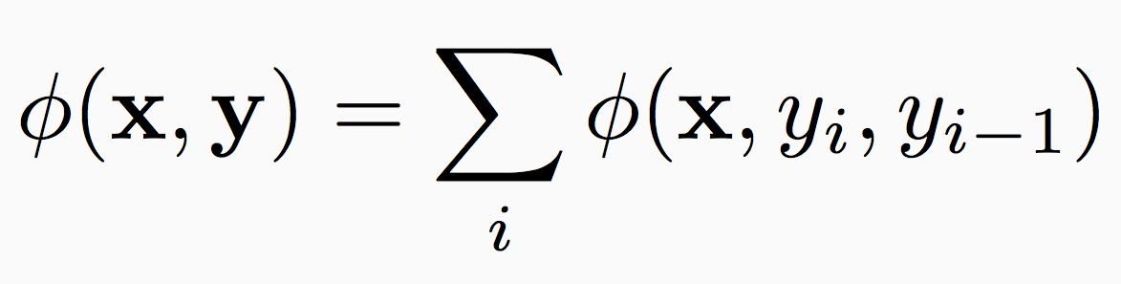
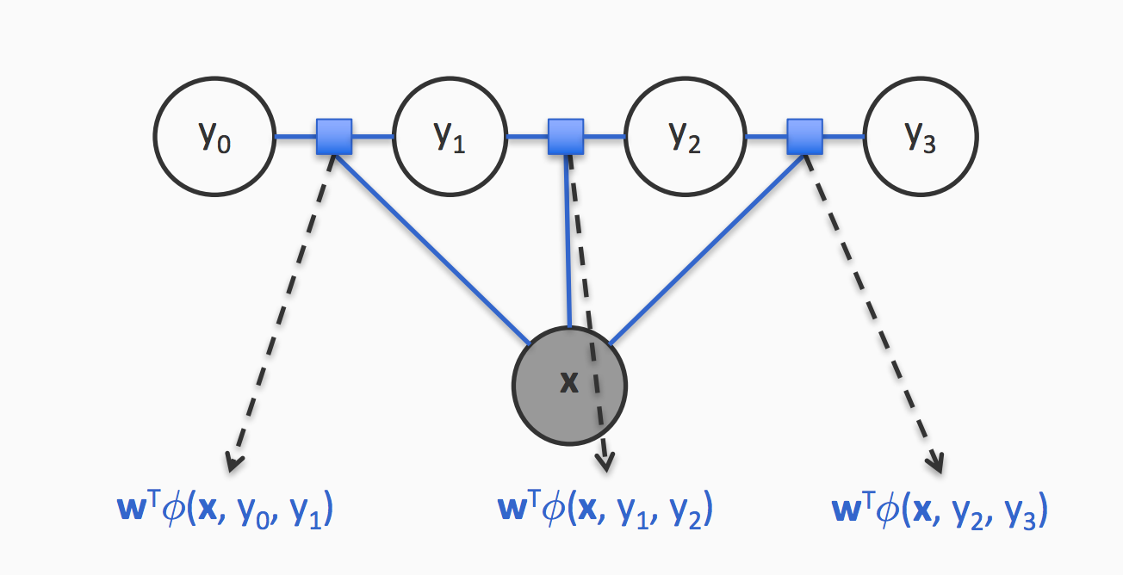
Global features
The feature function decomposes over the sequence

Slide 97
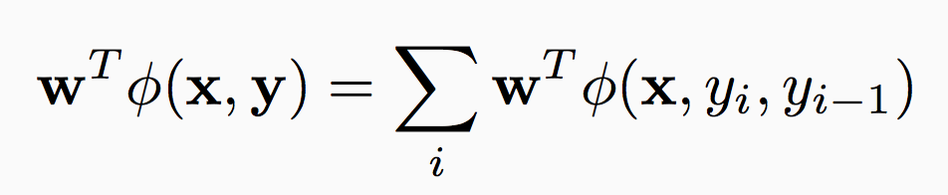

Prediction
Goal: To predict most probable sequence y an input x
But the score decomposes as
Prediction via Viterbi (with sum instead of product)

Slide 98

Training a chain CRF
Input:
Dataset with labeled sequences, D = {<x_{i}, y_{i}>}
A definition of the feature function
How do we train?
Maximize the (regularized) log-likelihood
Recall: Empirical loss minimization

Slide 99

Training with inference
Many methods for training
Numerical optimization
Can use a gradient or hessian based method
Simple gradient ascent
Training involves inference!
A different kind than what we have seen so far
Summing over all sequences is just like Viterbi
With summation instead of maximization

Slide 100
Training with inference
Many methods for training
Numerical optimization
Can use a gradient or hessian based method
Simple gradient ascent
Training involves inference!
A different kind than what we have seen so far
Summing over all sequences is just like Viterbi
With summation instead of maximization

Slide 101

CRF summary
An undirected graphical model
Decompose the score over the structure into a collection of factors
Each factor assigns a score to assignment of the random variables it is connected to
Training and prediction
Final prediction via argmax $w^{T}φ$(x, y)
Train by maximum (regularized) likelihood (also need inference)
Relation to other models
Effectively a linear classifier
A generalization of logistic regression to structures
An instance of Markov Random Field, with some random variables observed (We will see this soon)

Slide 102

From generative models to CRF
[Figure from Sutton and McCallum, ‘05]

Slide 103
General CRFs
y₁
y₃
y₂
x₁
x₂
x₃

Slide 104





General CRFs
$w^{T}φ$(y₁, y₂, y₃)
y₁
y₃
$w^{T}φ$(x₁, y₁)
y₂
$w^{T}φ$(x₃, y₂, y₃)
x₁
x₂
x₃
$w^{T}φ$(x₁, x₂, y₂)
$φ$(x, y) = $φ$(x₁, y₁) + $φ$(y₁, y₂, y₃) + $φ$(x₃, y₂, y₃) + $φ$(x₁, x₂, y₂)

Slide 105



Computational questions
Learning: Given a training set {<x_{i}, y_{i}>}
Train via maximum likelihood (typically regularized)
Need to compute partition function during training
Prediction
Go over all possible assignments to the y’s
Find the one with the highest probability/score

Slide 106
Computational questions
Learning: Given a training set {<x_{i}, y_{i}>}
Train via maximum likelihood (typically regularized)
Need to compute partition function during training
Prediction
Go over all possible assignments to the y’s
Find the one with the highest probability/score

Slide 107
Computational questions
Learning: Given a training set {<x_{i}, y_{i}>}
Train via maximum likelihood (typically regularized)
Need to compute partition function during training
Prediction:
Go over all possible assignments to the y’s
Find the one with the highest probability/score

Slide 108
Inference in graphical models
1
2
3
4
5
In general, compute probability of a subset of states
P(x_{A}), for some subsets of random variables x_{A}
Exact inference
Variable elimination
Marginalize by summing out variables in a “good” order
Think about what we did for Viterbi
Belief propagation (exact only for graphs without loops)
Nodes pass messages to each other about their estimate of what the neighbor’s state should be
Generally efficient for trees, sequences (and maybe other graphs too)
“Approximate” inference
What makes an ordering good?

Slide 109
Inference in graphical models
In general, compute probability of a subset of states
P(x_{A}), for some subsets of random variables x_{A}
Exact inference
“Approximate” inference
Markov Chain Monte Carlo
Gibbs Sampling/Metropolis-Hastings
Variational algorithms
Frame inference as an optimization problem, perturb it to an approximate one and solve the approximate problem
Loopy Belief propagation
Run BP and hope it works!
1
2
3
NP-hard in general, works for simple graphs
4
5

