Slide 1

STEP2 7주차

Slide 2
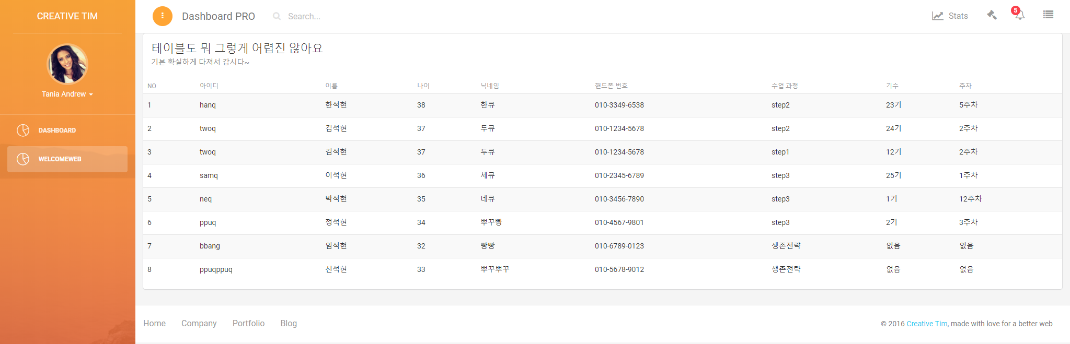

처음화면

Slide 3
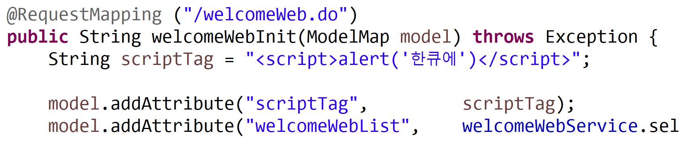

Slide 4

WelcomeWeb.jsp

Slide 5
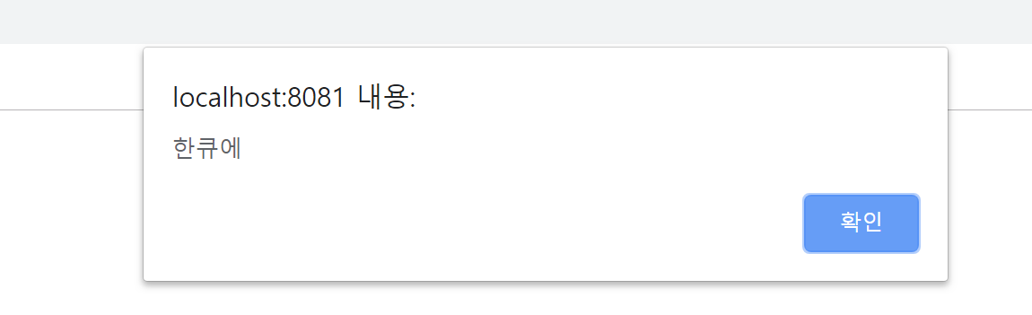

Slide 6
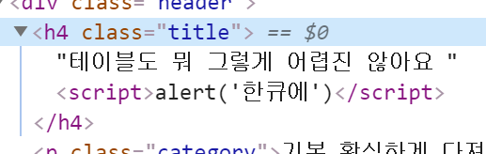

Slide 7
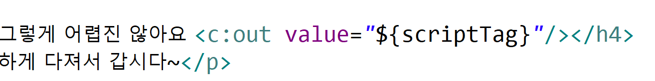

Slide 8
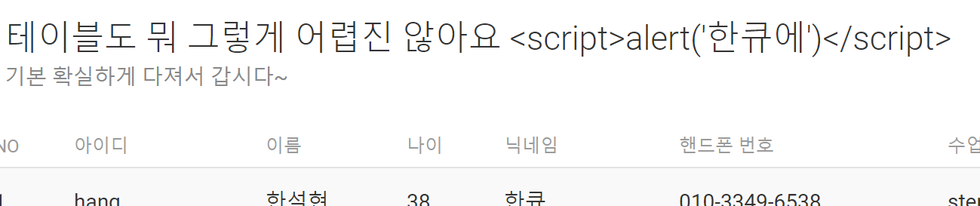

Slide 10
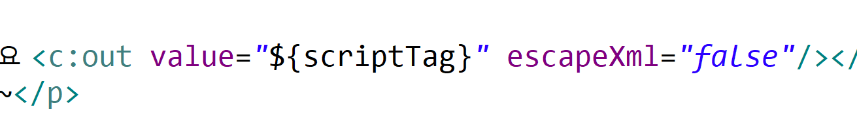

Slide 11
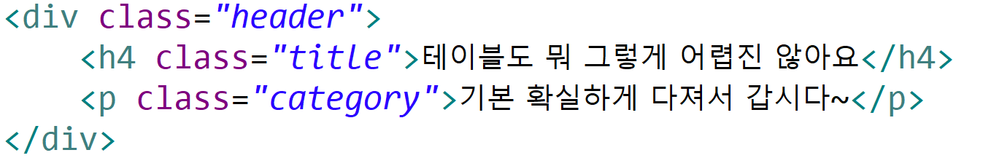

Slide 12
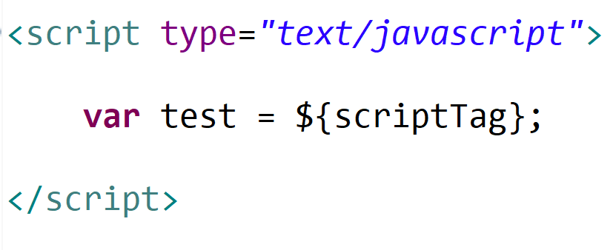
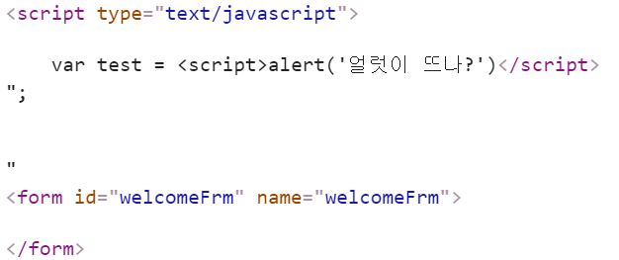

Slide 13
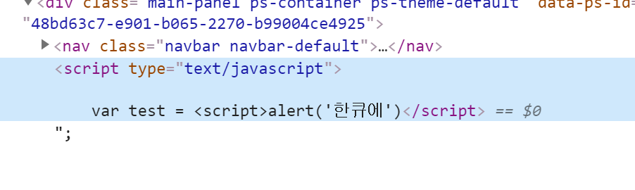

Slide 14
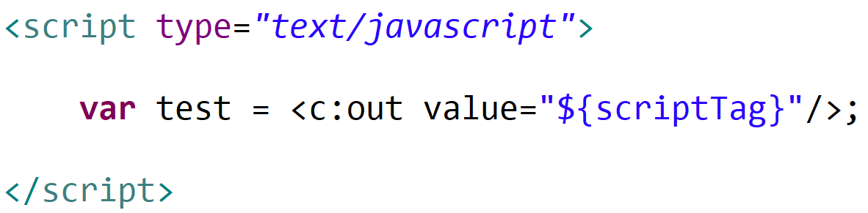

Slide 15
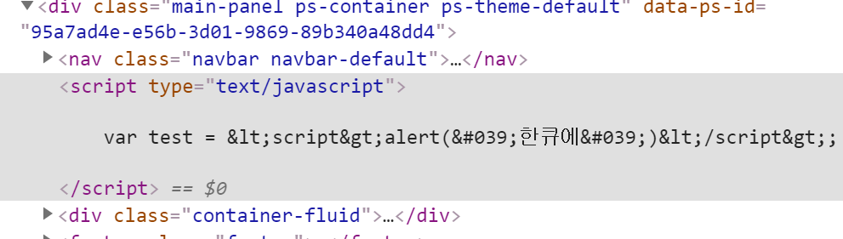

Slide 17
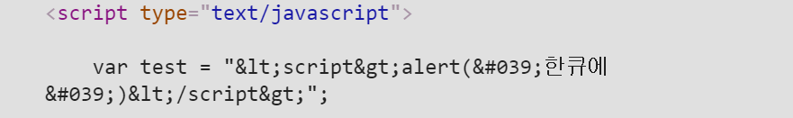

Slide 18
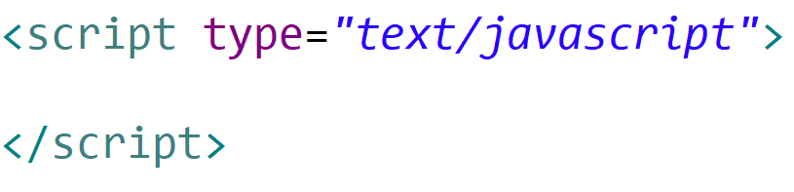
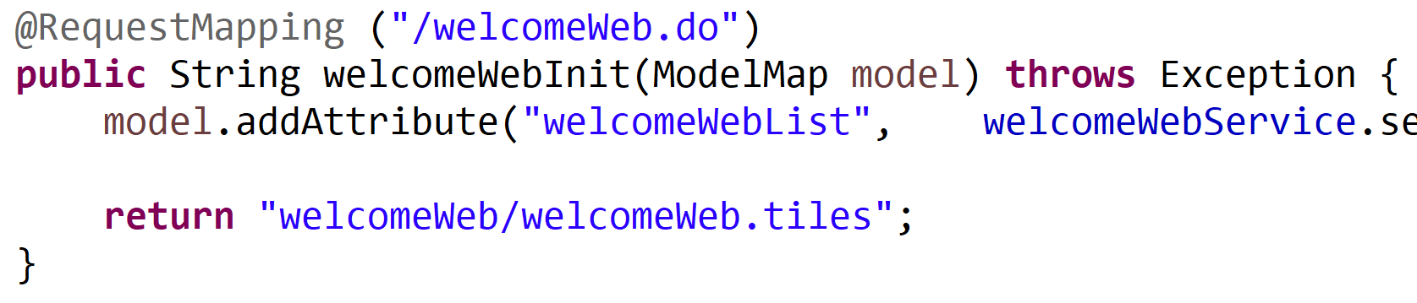

Slide 20
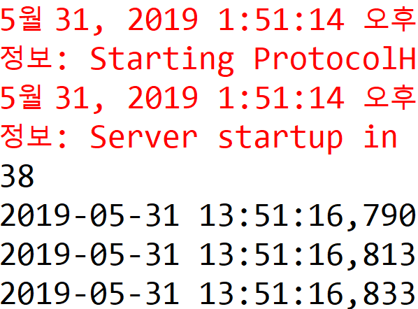
Form으로 보낸 38 을
Eclips 콘솔에 띄워주세요.

Slide 21
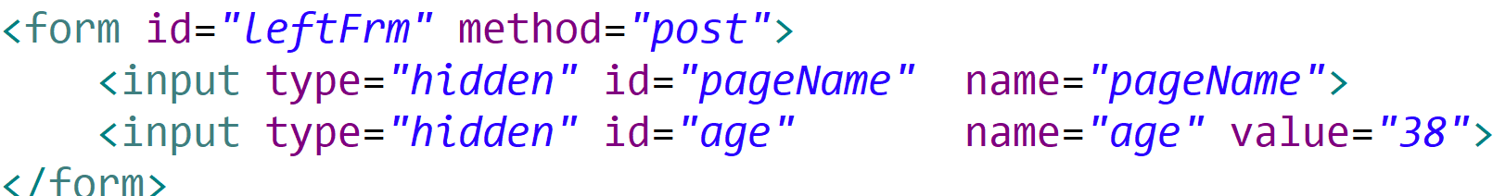
default-left.jsp

Slide 22
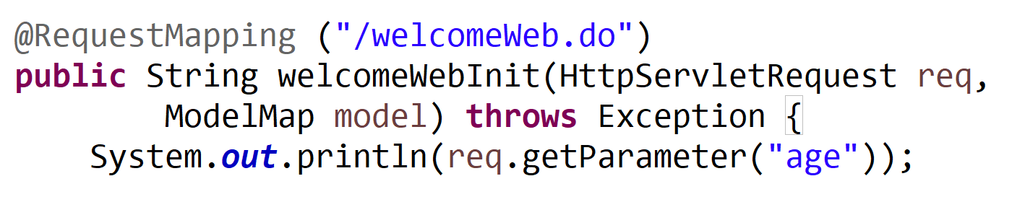

Slide 23
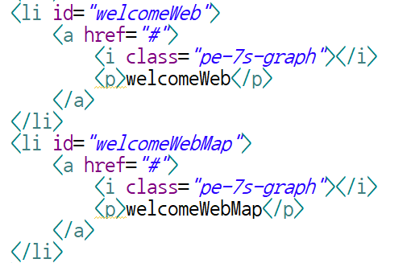
default-left.jsp

Slide 24
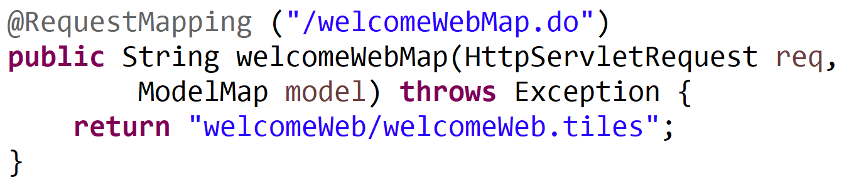

Slide 25
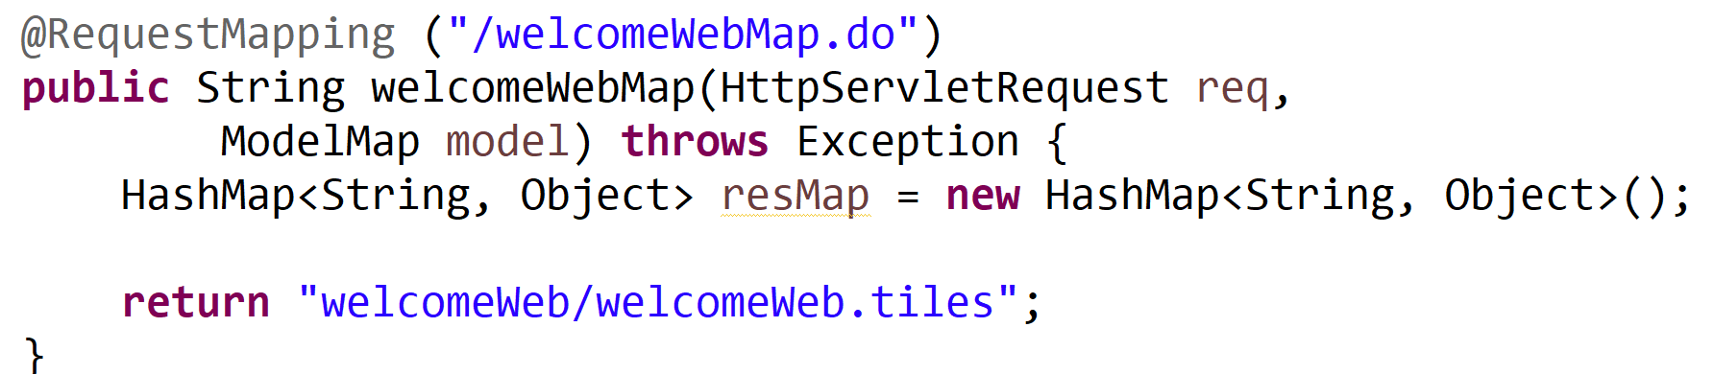

Slide 26
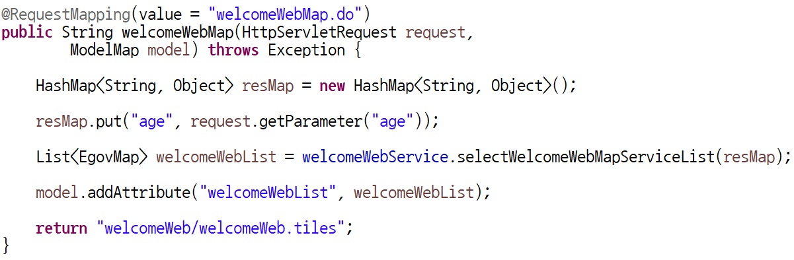
WelcomeWebController.java

Slide 27
WelcomeWebController.java

Slide 28
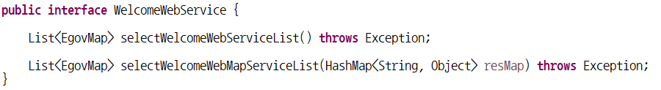
WelcomeWebService.java

Slide 29
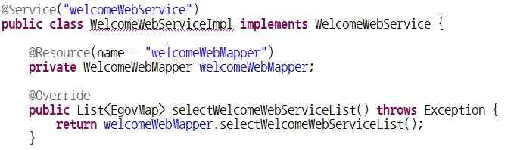
WelcomeWebServiceImpl.java

Slide 30

WelcomeWebServiceImpl.java

Slide 31
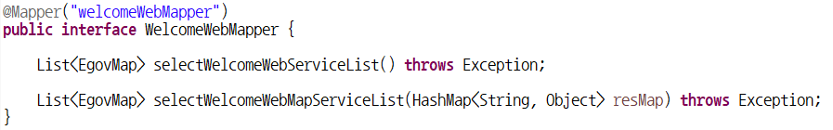
WelcomeWebMapper.java

Slide 32
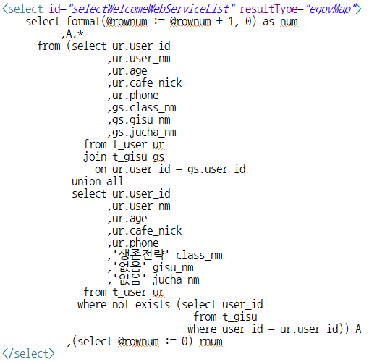
Ctrl+C
Ctrl+V

Slide 33
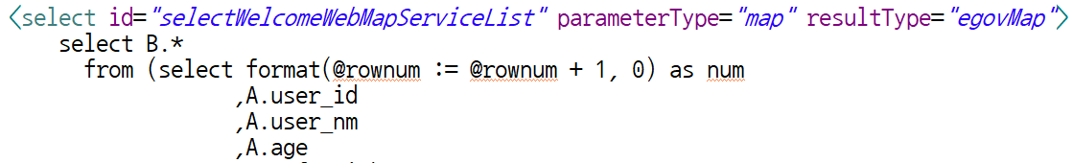
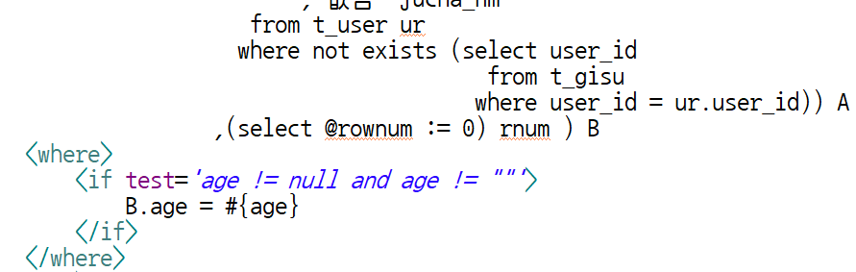
Welcome_Web.xml
…

Slide 34
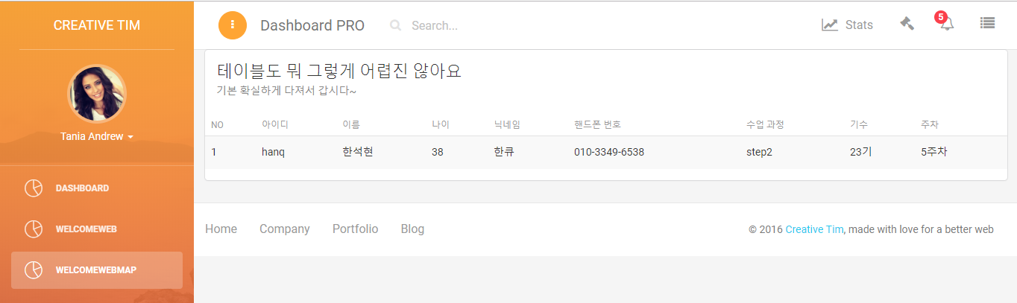
화면 확인

Slide 35
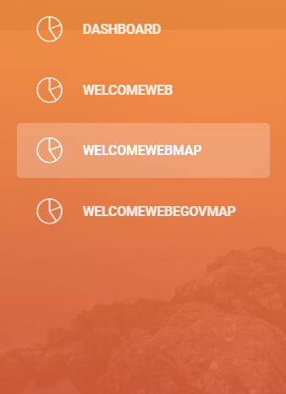
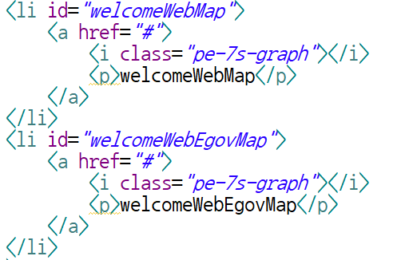

Slide 36
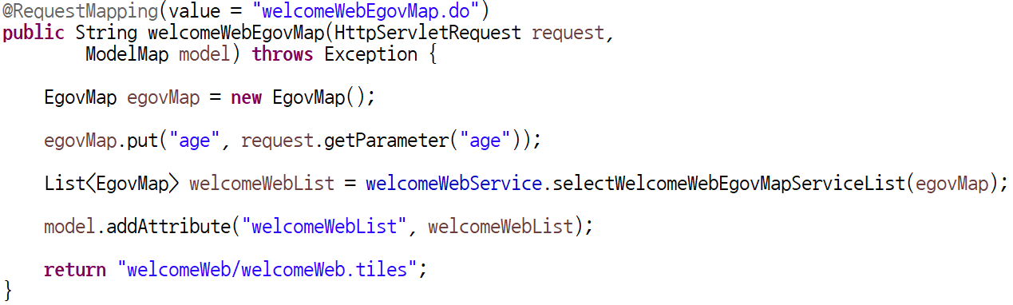
WelcomeWebController.java

Slide 37
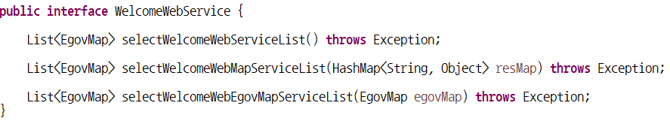
WelcomeWebService.java

Slide 38

WelcomeWebServiceImpl.java

Slide 39
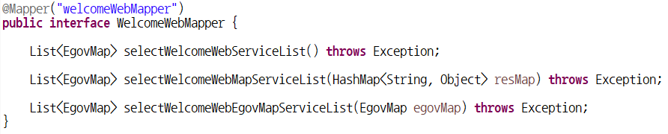
WelcomeWebMapper.java

Slide 40
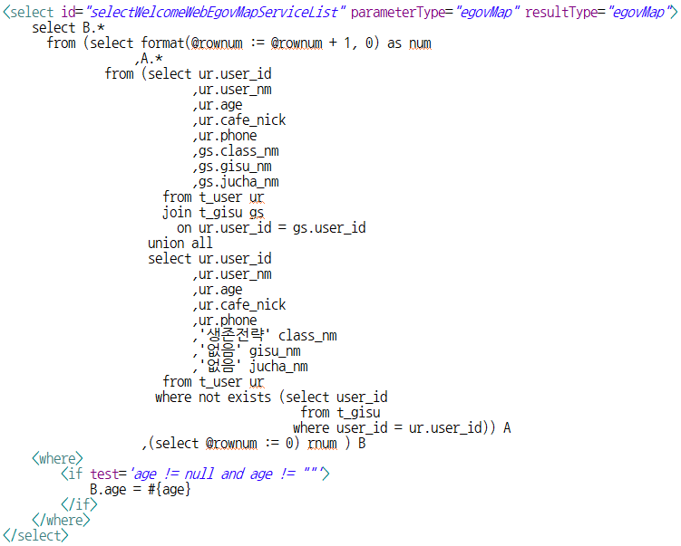
Welcome_Web.xml

Slide 41
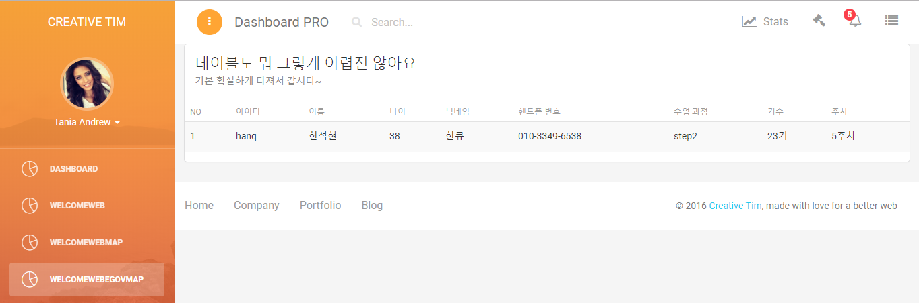
화면확인

Slide 42
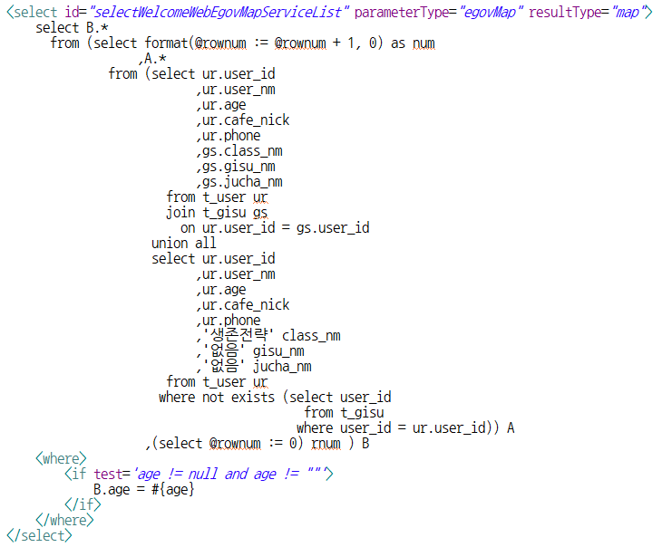

Slide 43
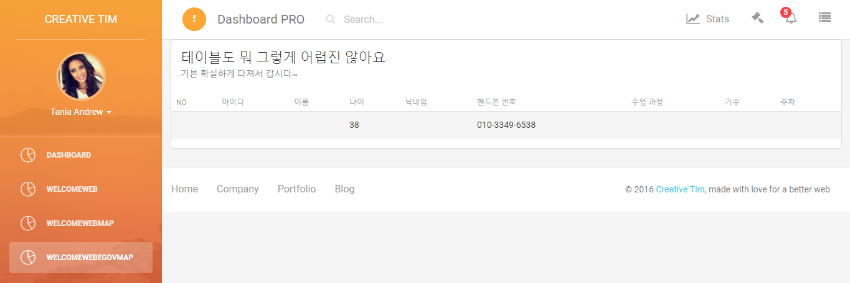

Slide 44
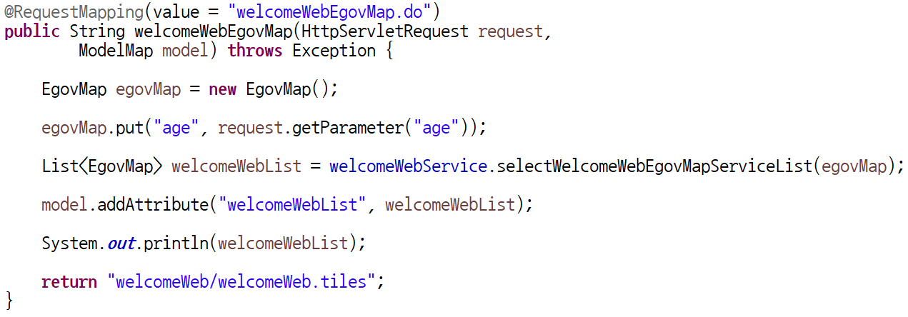
WelcomeWebController.java

Slide 45
Console

Slide 46
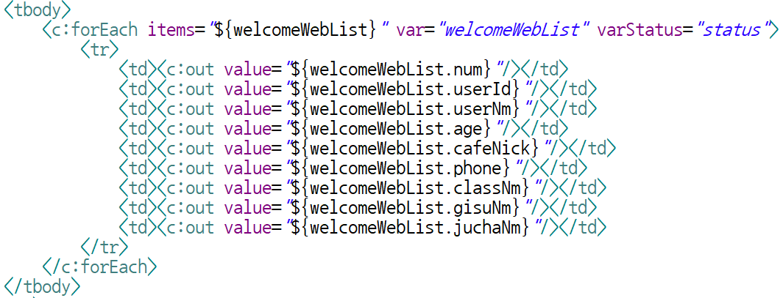
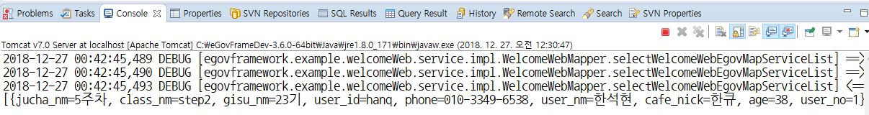
welcomeWeb.jsp

Slide 47
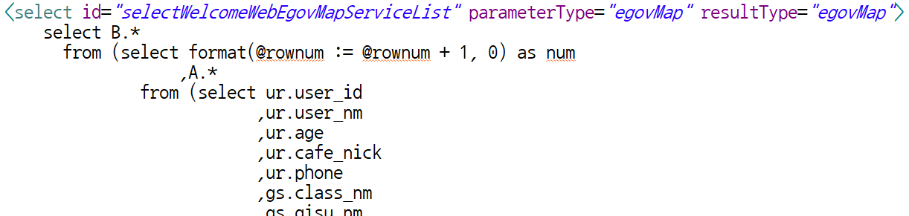
Welcome_Web.xml

Slide 48
Console

Slide 49
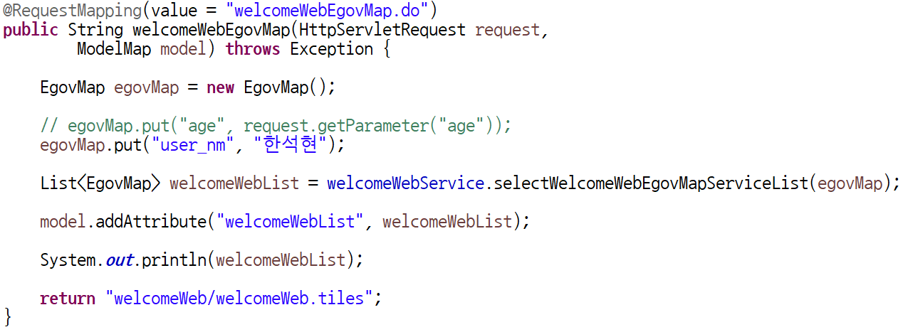
WelcomeWebController.java

Slide 50
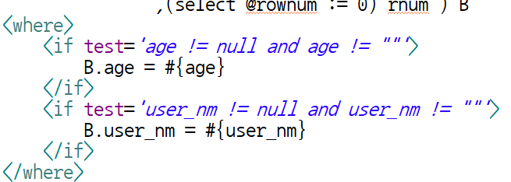
Welcome_Web.xml

Slide 51
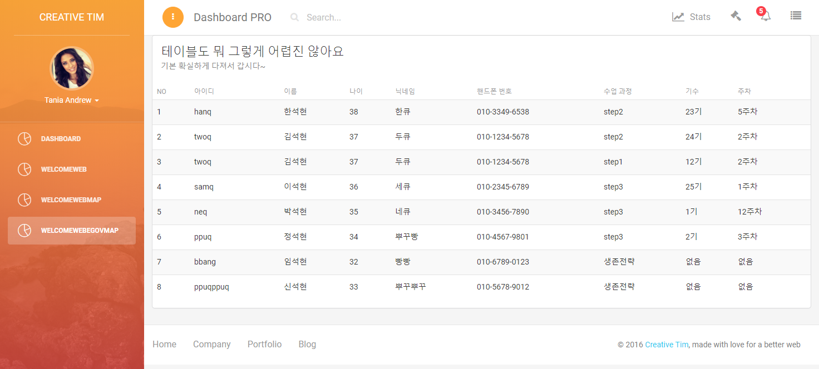
화면확인

Slide 52
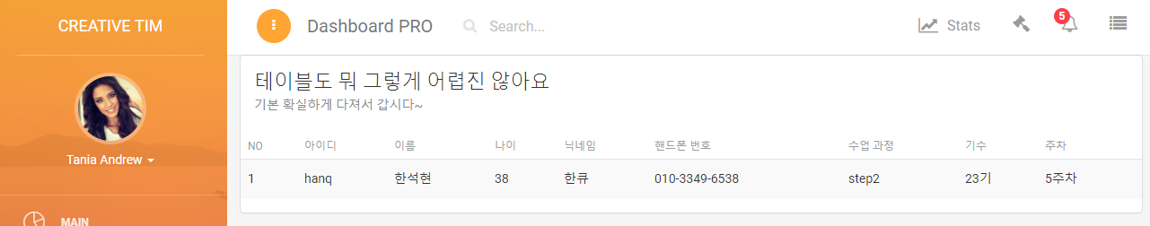
화면확인

Slide 53
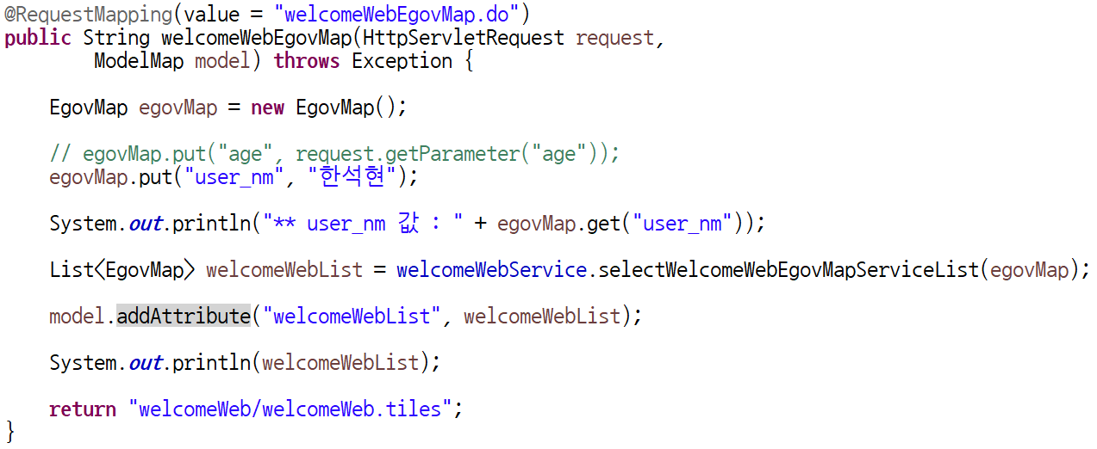
WelcomeWebController.java

Slide 54

Console

Slide 55
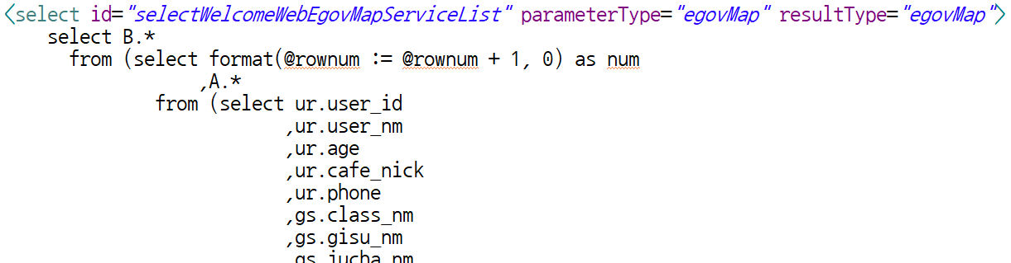
Welcome_Web.xml
Console

Slide 56
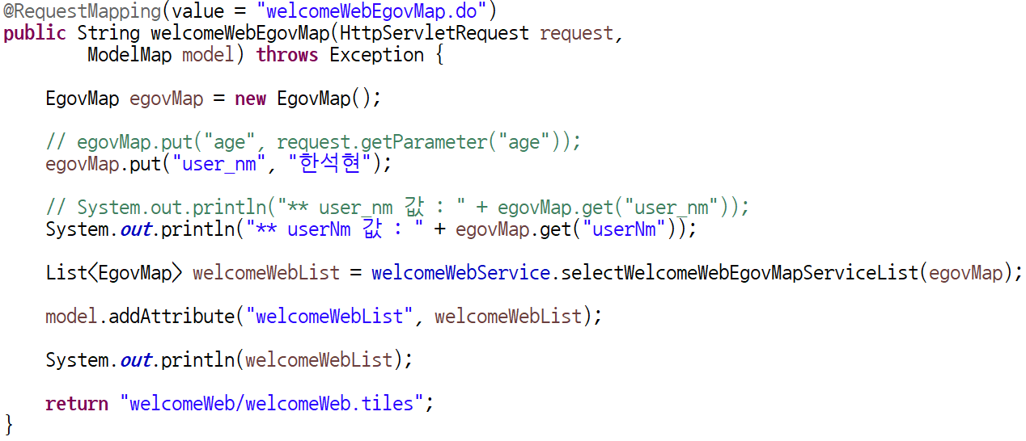
WelcomeWebController.java

Slide 57

Console

Slide 59

Welcome_Web.xml

Slide 60

WelcomeWebController.java

Slide 62


Slide 63



Slide 64

WelcomeWebController.java

Slide 65

Console

Slide 66


Slide 67

WelcomeWebService.java

Slide 68

WelcomeWebServiceImpl.java

Slide 69

WelcomeWebMapper.java

Slide 70



...
Welcome_Web.xml

Slide 71

WelcomeWebController.java

Slide 72


화면확인

