Slide 1
HCS221 | MACHINE LEARNING PROJECT
Predicting Food Commodity Prices in Zimbabwe Using Machine Learning Techniques
A Historical Price-Estimation Prototype for Roller Maize Meal
Presented by: mamire charlome t
Student number: [m252012]
Institution: Great Zimbabwe University

Slide 2
Project Overview
This project investigates whether machine learning techniques can predict the historical prices of a staple food commodity in Zimbabwe using past price observations.
The project focuses on:
Analysing historical Roller Maize Meal prices.
Preparing and exploring the dataset.
Developing Linear Regression and Random Forest regression models.
Comparing the models against a previous-price baseline.
Building a simple prototype that estimates price per kilogram and total cost for a specified quantity.
Evaluating the models using MAE, RMSE, and \(R^2\).

Slide 3
Background and Problem Statement
Background
Staple foods play an important role in household food security in Zimbabwe. Roller Maize Meal is one of the commodities whose historical prices can be analysed to understand price changes over time.
Problem Statement
Food commodity prices can change considerably over time.
Historical price records can help identify patterns and support data-driven analysis.
It is important to investigate whether machine learning models can estimate future prices from historical observations.
Prediction errors may limit the usefulness of a model, so its performance must be compared with a simple baseline.
Proposed Approach
This project uses historical FEWS NET price data for Roller Maize Meal, develops regression models, and evaluates their performance against a previous-price baseline.

Slide 4

Aim and Objectives
Aim
To investigate the effectiveness of machine learning regression techniques in predicting historical Roller Maize Meal prices in Zimbabwe using past price observations.
Specific Objectives
Obtain and examine historical staple food price data for Zimbabwe.
Select Roller Maize Meal prices recorded in US dollars to maintain currency consistency.
Clean and prepare the data for regression modelling.
Develop Linear Regression and Random Forest models using historical price-related features.
Evaluate model performance using Mean Absolute Error (MAE), Root Mean Squared Error (RMSE), and the coefficient of determination ($R^{2}$).
Compare the models with a previous-price baseline and develop a simple price-estimation prototype.

Slide 5
Dataset Description
Dataset source: FEWS NET Staple Food Price Data for Zimbabwe, obtained from Hugging Face.
Dataset characteristics
Original dataset size: 4,878 records and 17 columns.
Selected commodity: Roller Maize Meal.
Target variable: Historical price in US dollars per kilogram (USD/kg).
Valid USD price observations before feature engineering: 169.
Period covered by the selected USD series: April 2004 – February 2019.
Relevant variables
period_date — date of the price observation.
product — food commodity.
market — market where the price was recorded.
currency — currency used for the price.
value — recorded commodity price.
Data selection: Only valid USD observations for Roller Maize Meal were used to avoid mixing prices recorded in different currencies.

Slide 6
Data Preparation and Exploratory Analysis
Data preparation
Loaded the original dataset and examined its columns and data types.
Selected Roller Maize Meal records priced in USD.
Removed observations with missing values required for modelling.
Created year and month features from the observation date.
Created lag features using previous available price observations.
Used a chronological train–test split to preserve time order.
Exploratory findings
The selected USD series contained 169 valid observations before feature engineering.
Prices varied over the historical period.
The observed prices ranged approximately from $0.02 to $0.96 per kg.
Some unusually low and high prices were retained because they could represent genuine historical conditions rather than data errors.
Final modelling dataset
After lag-feature creation and removal of rows without the required lag values, 166 observations remained. The chronological split produced 132 training observations and 34 test observations.

Slide 7
Machine Learning Methodology
he project followed a supervised machine learning regression approach to estimate Roller Maize Meal prices from historical data.
Input features
Year: Year of the price observation.
Month: Month of the observation.
Previous available price: Price from the preceding available observation.
Price three observations earlier: Price recorded three available observations before the current one.
Target variable
The observed Roller Maize Meal price in USD per kilogram.
Experimental procedure
Prepare the selected historical price series.
Generate numerical features from dates and previous prices.
Split the observations chronologically into training and testing sets.
Train Linear Regression and Random Forest regression models.
Evaluate predictions using MAE, RMSE, and \(R^2\).
Compare both models with a previous-price baseline.

Slide 8
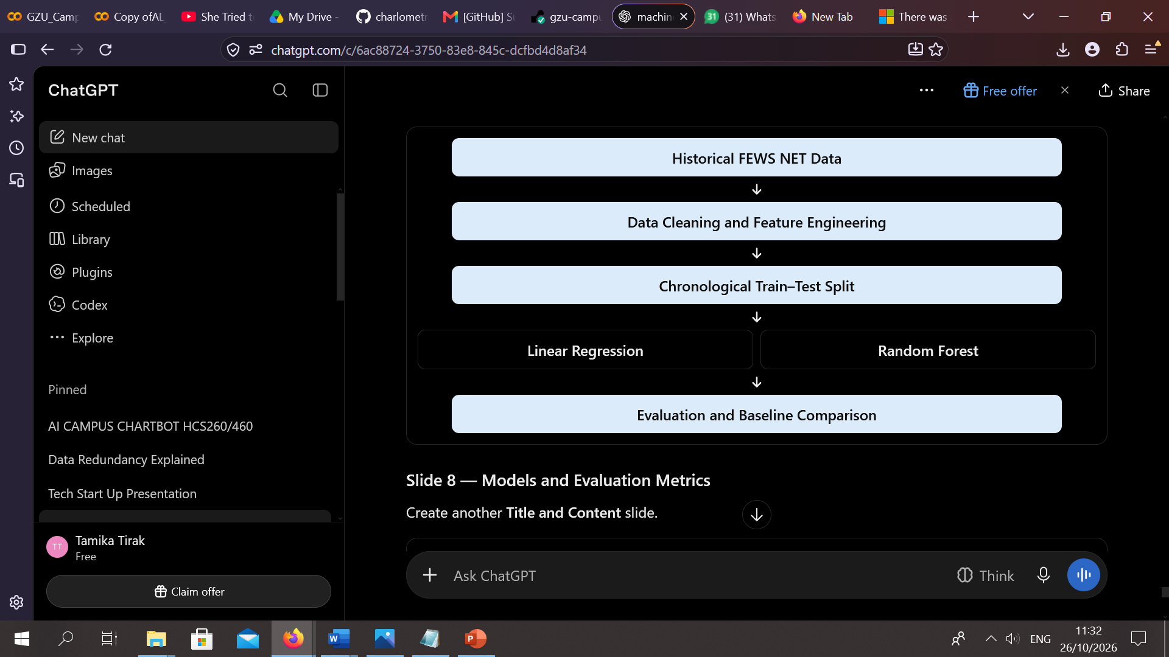
simple workflow diagram

Slide 9
Models and Evaluation Metrics
. Linear Regression
A supervised learning algorithm that estimates a numerical outcome by modelling relationships between input features and the target variable.
2. Random Forest Regression
An ensemble learning method that combines predictions from multiple decision trees to estimate a numerical value. The model was tuned using validation data.
3. Previous-Price Baseline
A simple benchmark that predicts the next price using the previous available observation. It helps determine whether the machine learning models offer a meaningful improvement.
Evaluation metrics
MAE: Mean Absolute Error; measures the average absolute prediction error. Lower is better.
RMSE: Root Mean Squared Error; penalises larger prediction errors more heavily. Lower is better.
\(R^2\): Measures how well predictions explain variation in the target values. Higher is generally better.

Slide 10
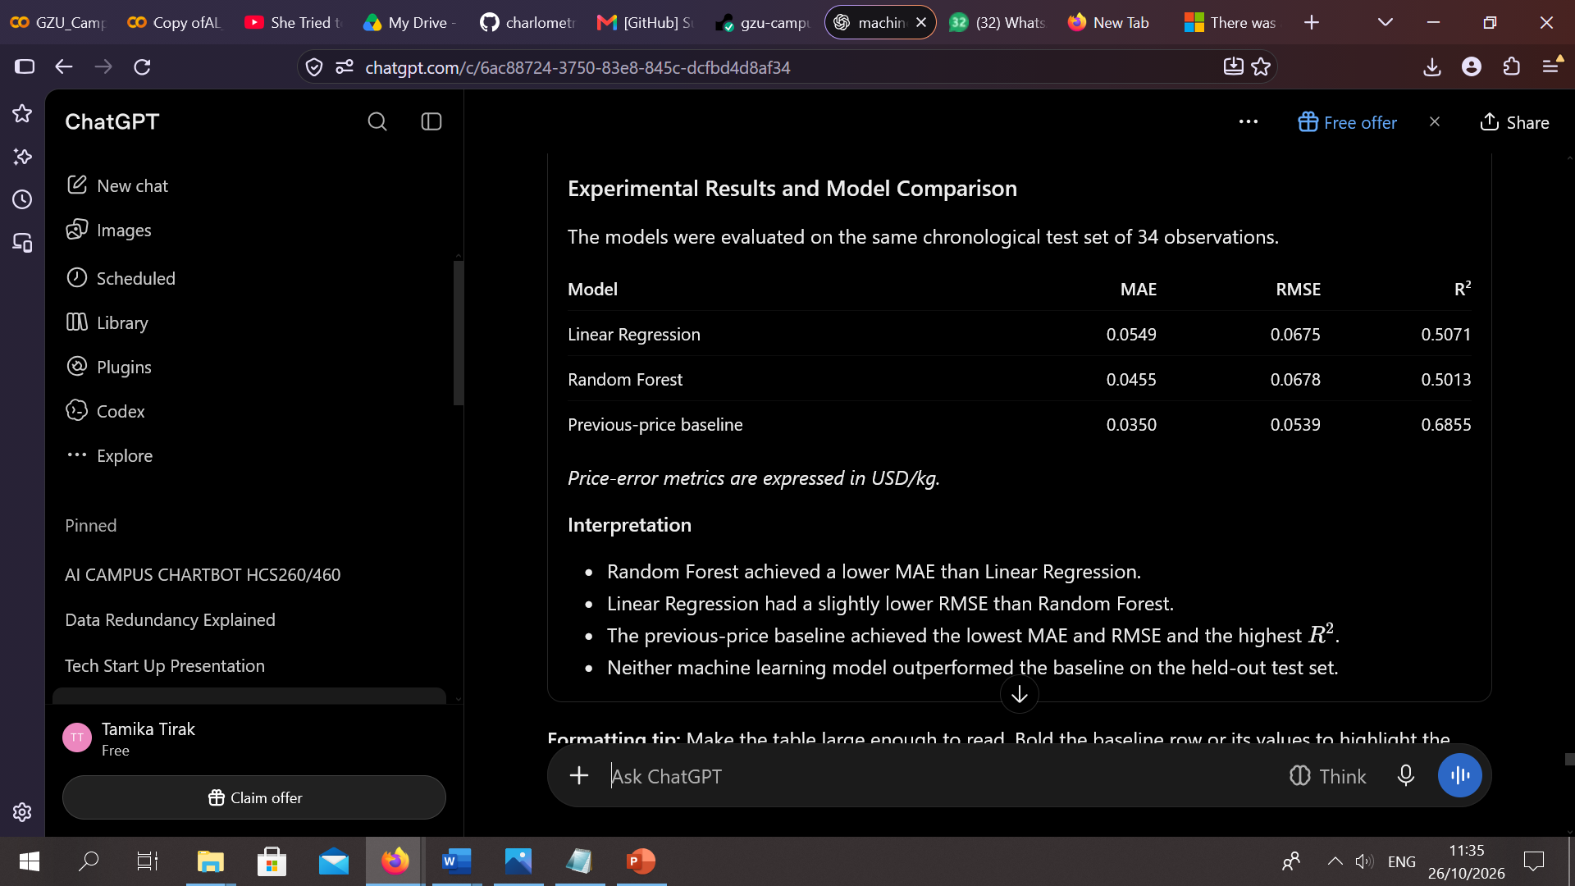
Experimental Results and Model Comparison

Slide 11
Discussion, Limitations and Recommendations
Discussion
The results show that the more complex machine learning models did not improve on the simple previous-price baseline. This suggests that model complexity alone does not guarantee better predictive performance.
Limitations
The selected USD price series contained only 169 valid observations before feature engineering.
The historical series ends in February 2019 and does not represent present-day market conditions.
Missing calendar months mean the lag features refer to previous available observations rather than guaranteed monthly intervals.
The baseline's strong performance highlights the need for careful model comparison.
Recommendations
Obtain more recent and complete price observations.
Investigate additional explanatory variables, such as market location and seasonal factors.
Explore further model tuning and alternative forecasting approaches.
Evaluate models on future observations before considering practical deployment.

Slide 12
Conclusion and References
Conclusion
This project investigated the use of Linear Regression and Random Forest Regression to estimate historical Roller Maize Meal prices in Zimbabwe. A prototype was developed to provide price estimates and quantity-based cost calculations.
Although Random Forest achieved a lower MAE than Linear Regression, the previous-price baseline performed best on the held-out test set. Therefore, the findings do not establish that the machine learning models provide superior predictive performance. More recent data and further experimentation are needed.
References
FEWS NET staple food price dataset for Zimbabwe. Hugging Face dataset: electricsheepafrica/africa-fewsnet-staple-food-price-data-for-zimbabwe-monthly-4566.
Pedregosa, F., et al. (2011). Scikit-learn: Machine Learning in Python. Journal of Machine Learning Research, 12, 2825–2830.
Breiman, L. (2001). Random Forests. Machine Learning, 45, 5–32.

