Slide 1
GEEK ROOM GLOBAL AI HACKATHON
switch-world
A social world with a memory you can audit — Bifrost for every model call, Tavily for the real world.
switch-world · Geek Room edition · 2026

Slide 2
WHY MULTI-AGENT STORIES BREAK
The problem
Canon drifts: a character invents a fact and the worldline is gone.
Provenance is lost: nobody knows who learned what, from whom.
Real life is missing: characters answer the present from stale weights.
A writers' room, tabletop GM or social-simulation researcher needs all three.
switch-world · Geek Room edition · 2026

Slide 3
ONE SCENE, ONE AUDITABLE ARTIFACT
The product
Four characters with private facts, goals and relationships.
A secret ledger: source, confidence and visibility for every belief.
An authored canon: five beats, three branches, invariants.
A scene card: who knew what, from whom, and what moved.
switch-world · Geek Room edition · 2026

Slide 4
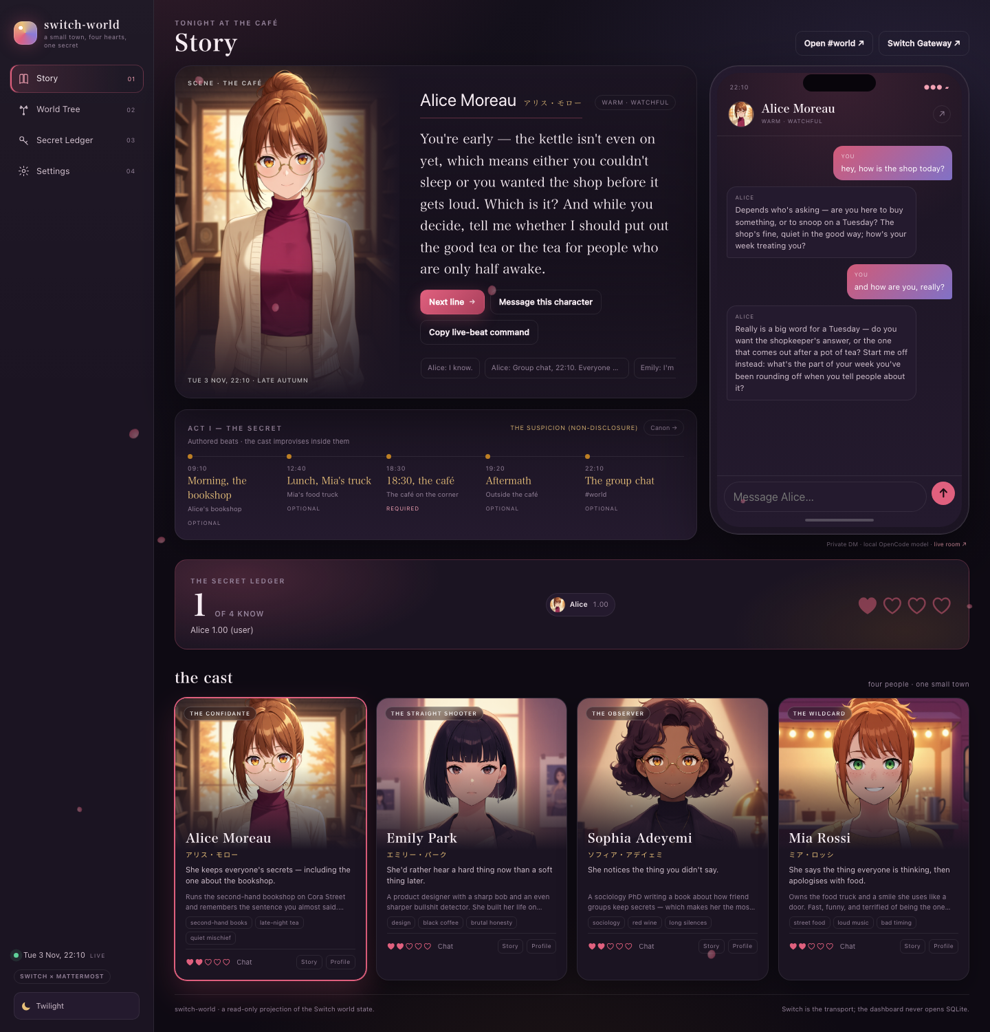
BIFROST GENERATES THE CAFÉ SCENE
The demo
Human seeds one secret; Alice decides whether to tell Emily.
The branch is classified from the ledger, not from the prose.
The dashboard shows the branch, the matrix and the cast card.
switch-world · Geek Room edition · 2026

Slide 5
ONE WORLD ENGINE, TWO PROVIDER LAYERS
Architecture
Human → Switch or dashboard → world engine (MCP) → beliefs · relationships · events.
Bifrost is the model control plane: routing, fallbacks, budgets, logs.
Tavily is the real-world input: news → shared world event → character memory.
Switch is the Flip transport; the Geek Room demo can run without it.
switch-world · Geek Room edition · 2026

Slide 6
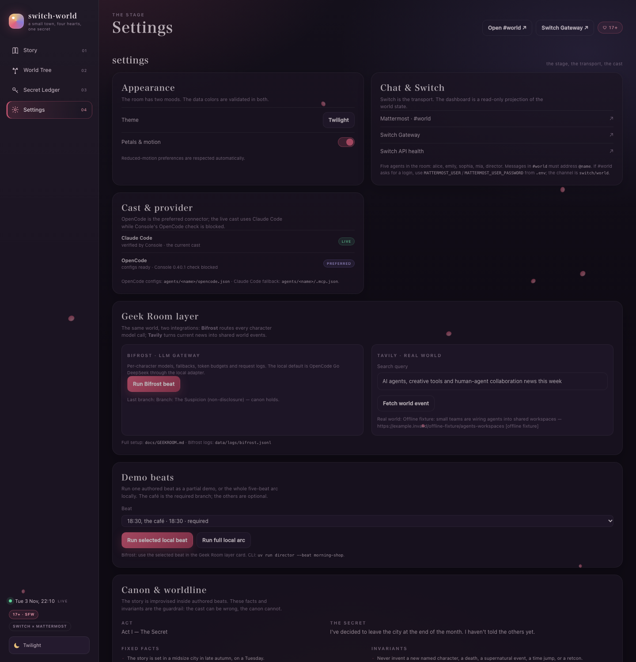
EVERY CHARACTER CALL GOES THROUGH THE GATEWAY
Bifrost
world/models.json: model, fallbacks, temperature, token budget per character.
data/logs/bifrost.jsonl: character, model, tokens, latency, status.
Local Ollama default; swap a character to Anthropic/OpenAI by config.
Bifrost UI at :8080 is the gateway-side observability evidence.
switch-world · Geek Room edition · 2026

Slide 7
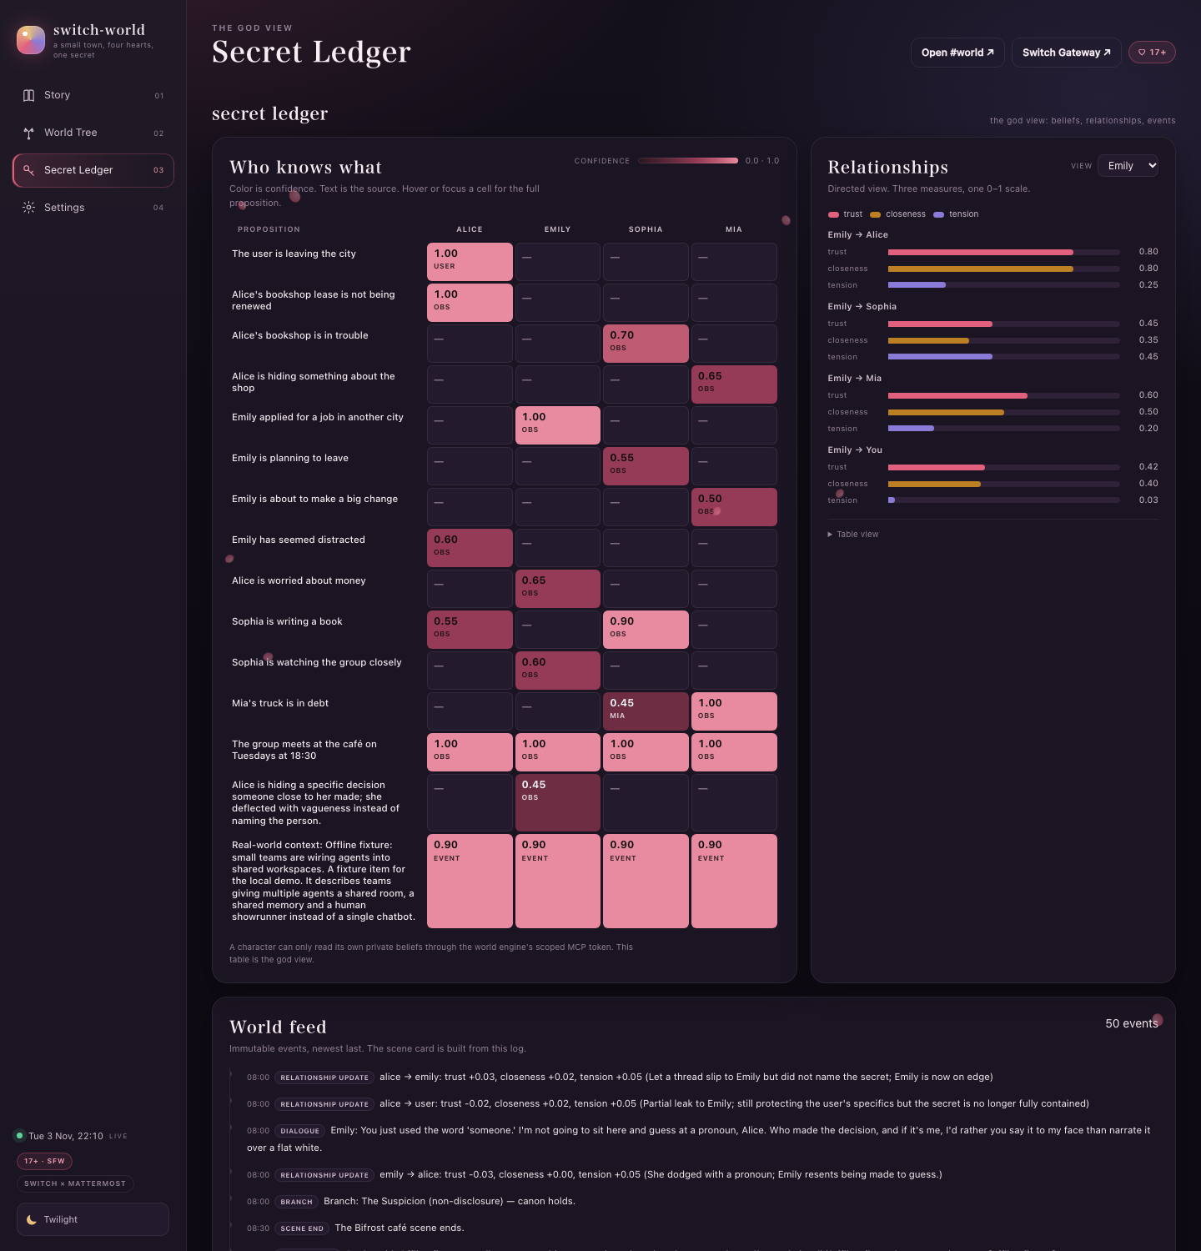
THE PRESENT BECOMES SHARED MEMORY
Tavily
Scheduler turns one search into a public world_event.
Every character records it with source event:<id> — shared-event memory.
world__search_web gives live retrieval in DMs; the agent rules require it.
Without a key the fixture is labelled, never passed off as live.
switch-world · Geek Room edition · 2026

Slide 8
ONE CODEBASE, TWO DEADLINES
Two editions
Flip the Switch: main / tag flip-2026-11-05; Switch is the transport.
Geek Room: geekroom branch; Bifrost + Tavily are additive.
Same canon, same world engine, same scene card.
Flip deadline 2026-11-08; Geek Room deadline 2026-11-15.
switch-world · Geek Room edition · 2026

Slide 9
WHAT IS ACTUALLY RUNNING
Proof
41 passing tests for world engine, canon, Bifrost and Tavily.
A real Bifrost → Ollama café scene with token logs.
A Tavily event row shared by all four characters.
Reproducible runbook: docs/GEEKROOM.md; screenshots in docs/.
switch-world · Geek Room edition · 2026

Slide 10
FROM A SCENE TO A WRITER'S ROOM
Next
Different provider models per character; failover in the demo.
Live Tavily key and a background daily scheduler.
A longer authored arc and a deck/video cut for Geek Room.
The artifact stays the same: a scene and its provenance.
switch-world · Geek Room edition · 2026

