Slide 2
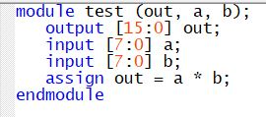

Verilog HDL Unsigned Multiplier

Slide 3
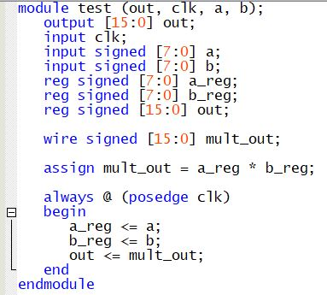
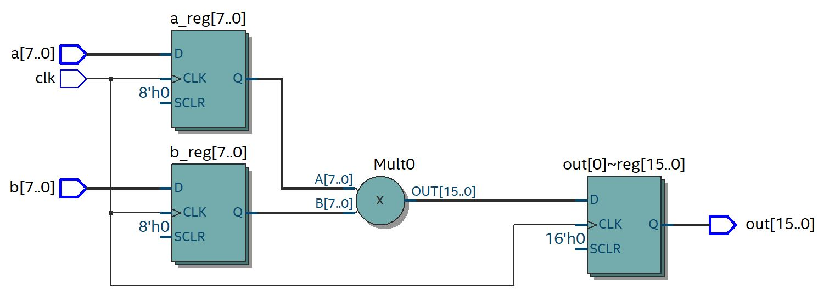
Verilog HDL Signed Multiplier with Input and Output Registers

