Slide 1
W14-on site assignment
Follow the assignment of week 13 again
Let the queue size to be robust
Only two malloc are allowed

Slide 2
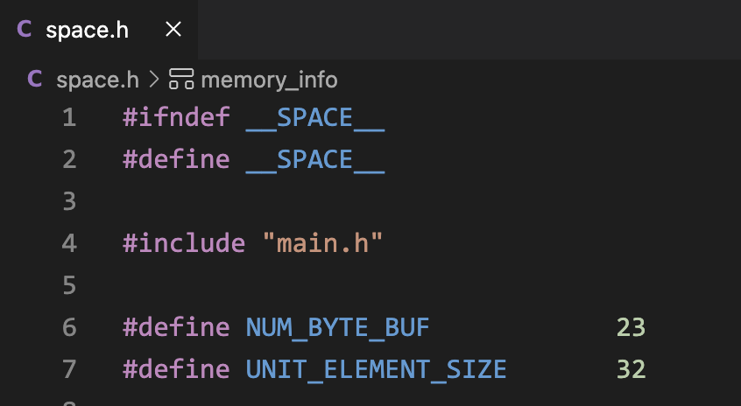
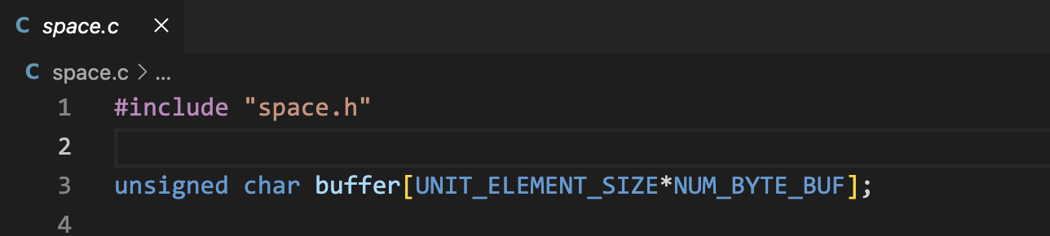
You can only use our_malloc to allocate for tQueueNode data structure
The data type represent needed size

Slide 3
Design your program flow by yourselves
You should also submit a PDF to briefly describe the designed program flow
You can use another malloc to allocate memory for the mask.

