Slide 1
Adaptive Omnivore & Temperature Plots
May 31 2021

Slide 2
Top Predator
Top Predator
Top Predator
Littoral
Consumer
Pelagic
Consumer
Littoral
Consumer
Pelagic
Consumer
Littoral
Consumer
Pelagic
Consumer
Littoral Resource
Pelagic Resource
Littoral Resource
Pelagic Resource
Littoral Resource
Pelagic Resource

Slide 3
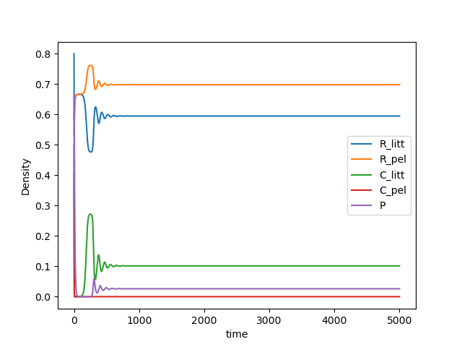
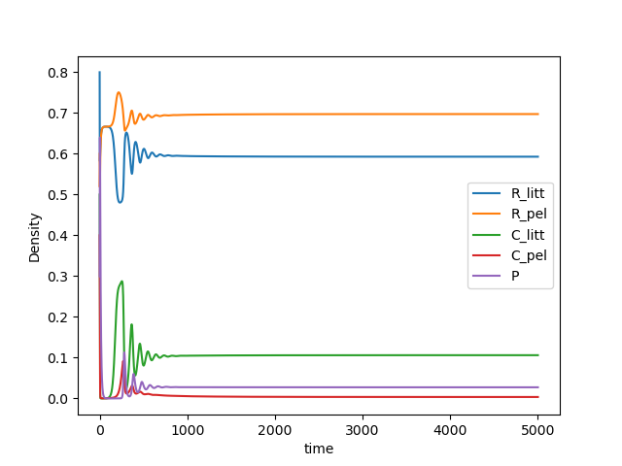
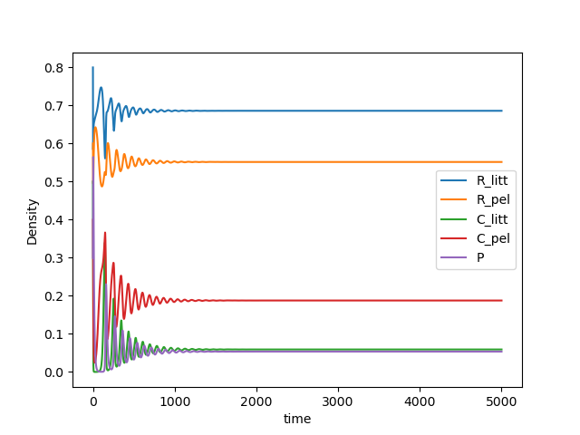
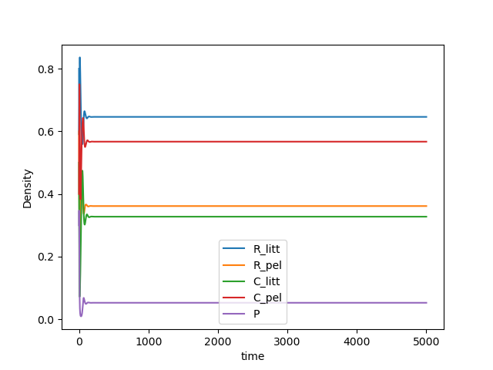
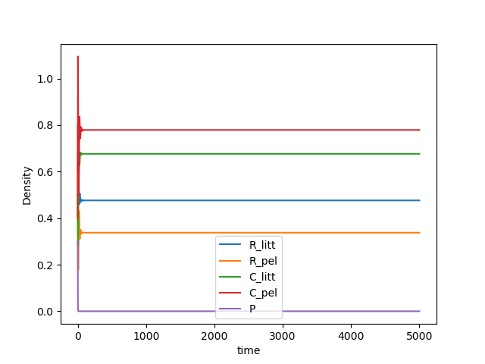
Varying Temp from 25 – 31.5 degrees. Predator dies at around 31 degrees
T = 25
T = 27.5
T = 29
T = 30.5
T = 31.5
Time Series

Slide 4
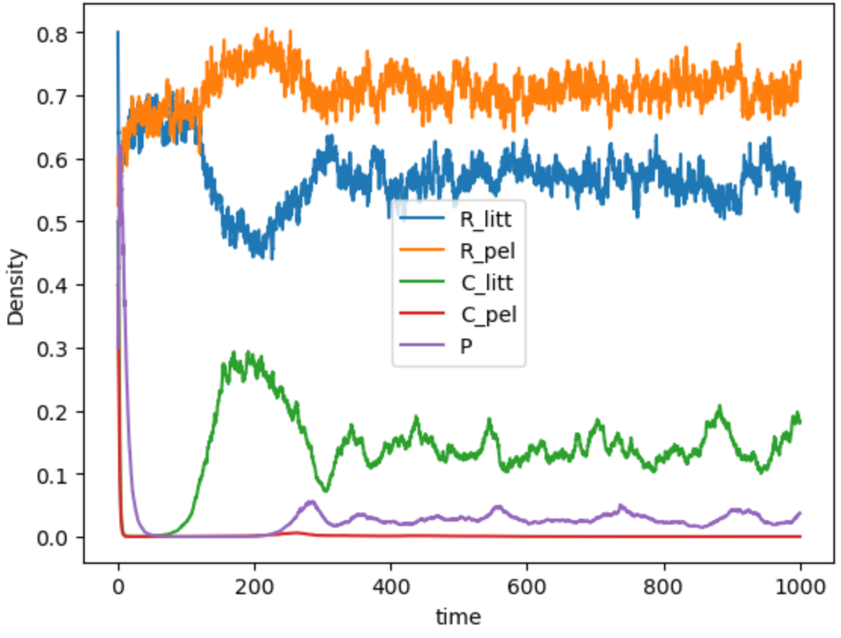
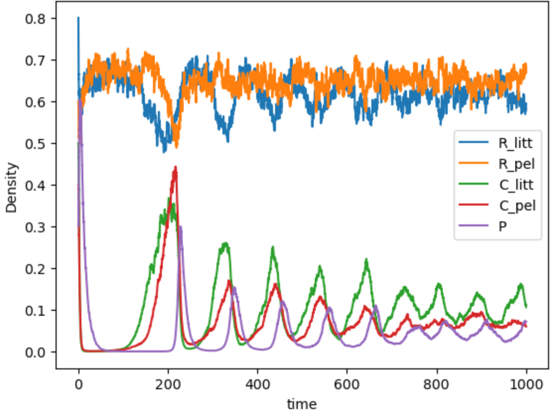
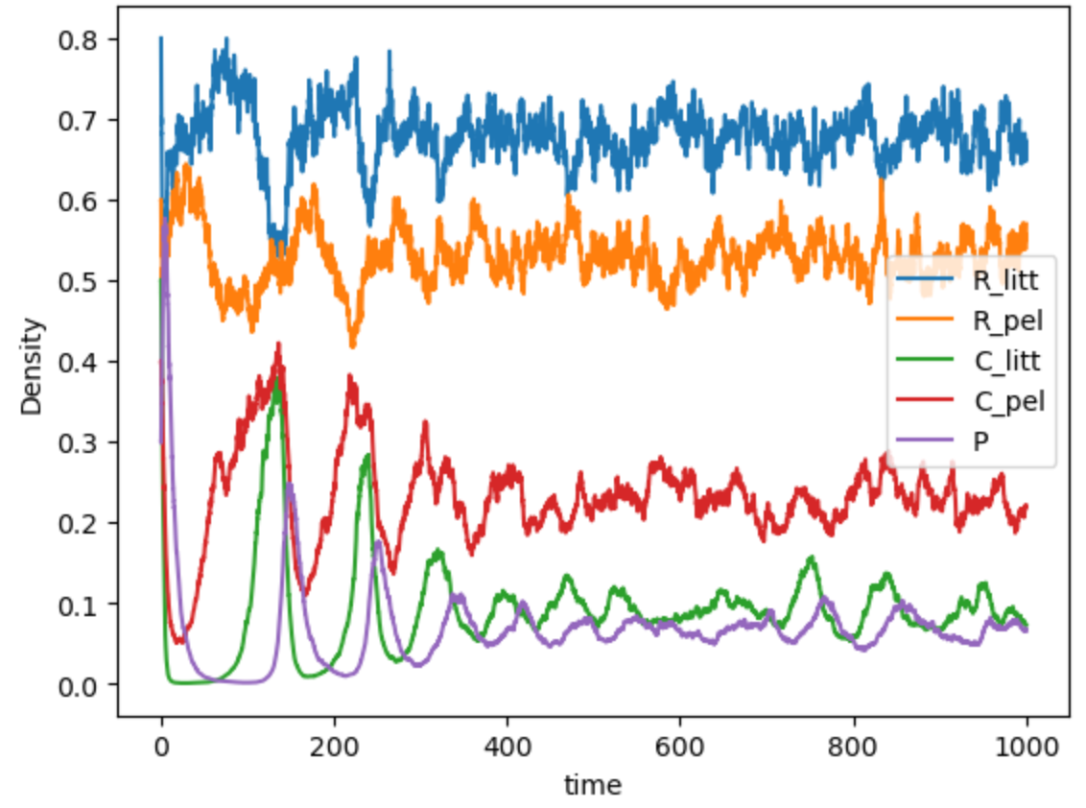
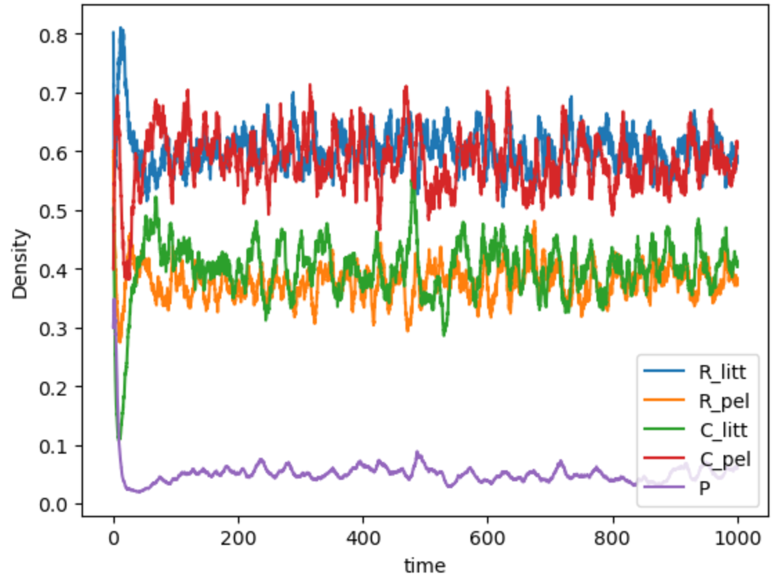
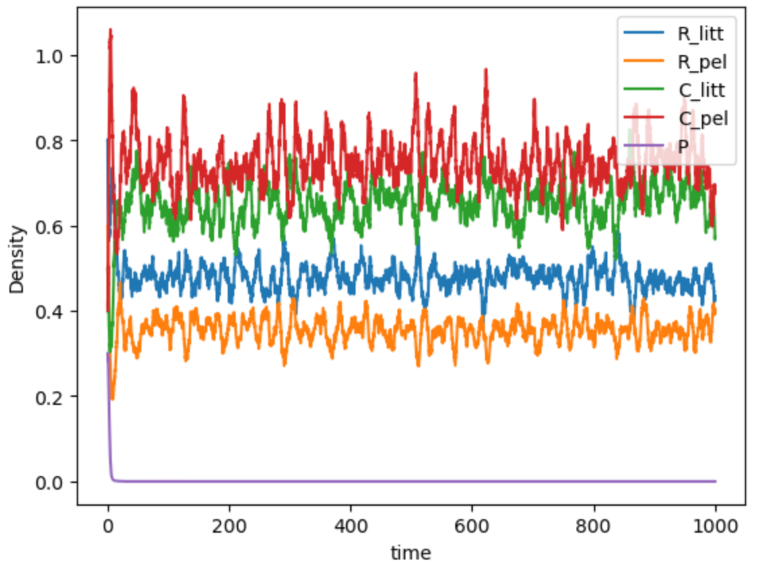
T = 25
T = 27.5
T = 29
T = 30.5
T = 31.5

Slide 5
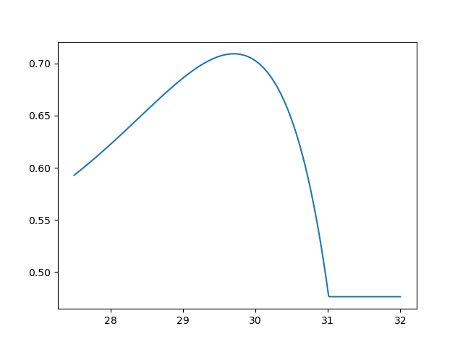
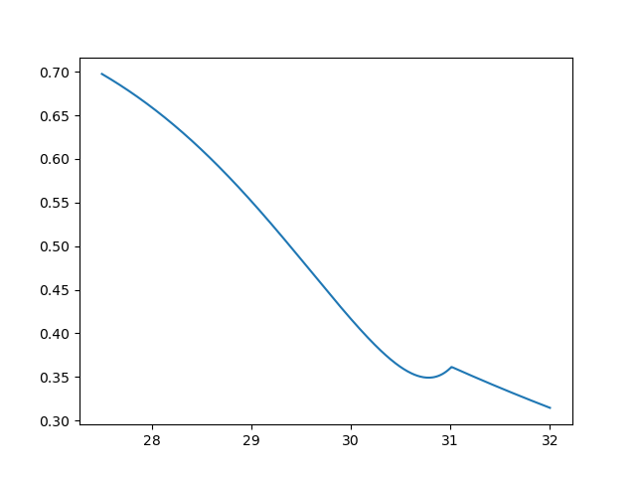
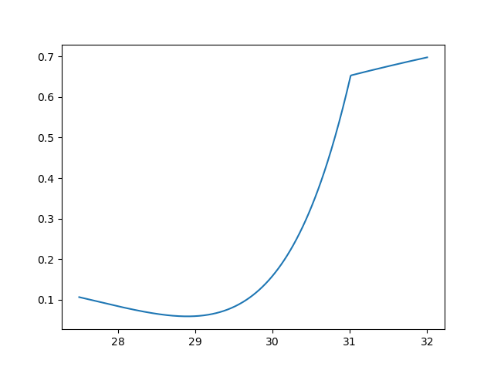
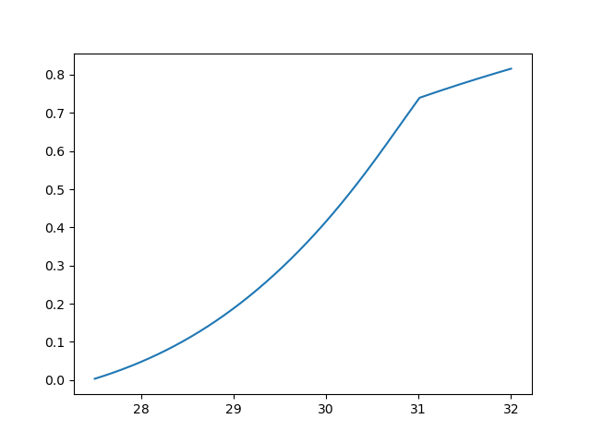
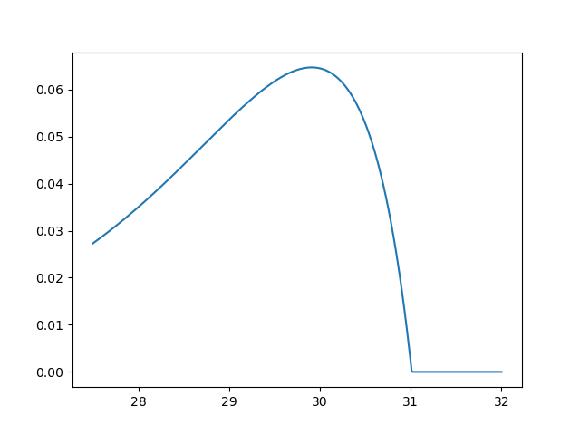
R littoral
R Pelagic
C littoral
C pelagic
Predator
Equilibrium densities of each population across temperature (where we get positive interior equilibrium)

Slide 6
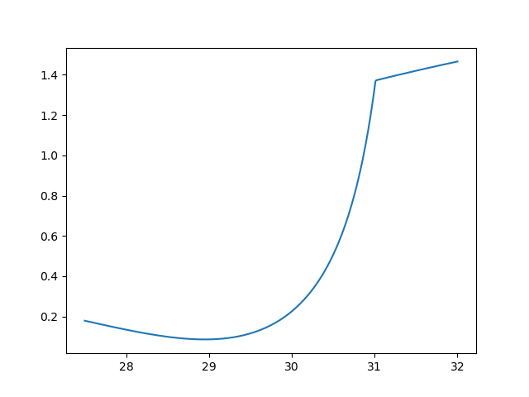
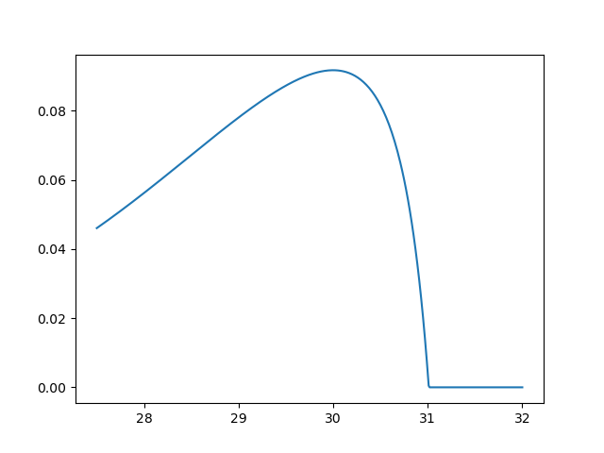
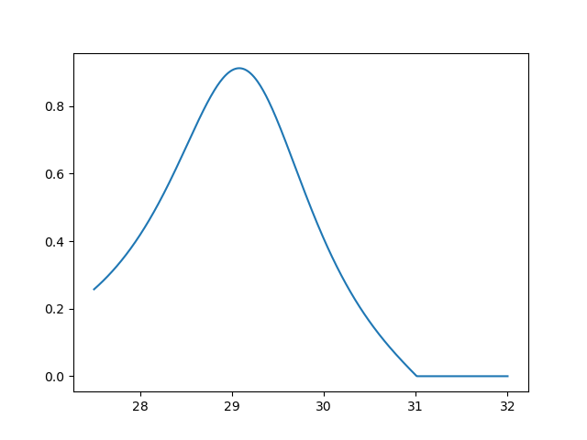
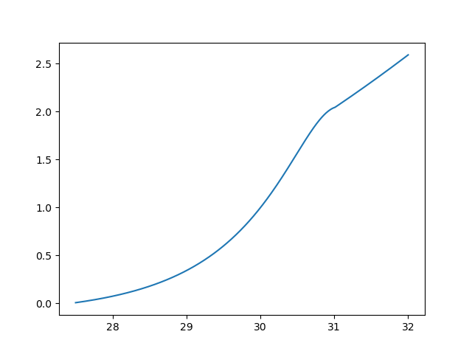
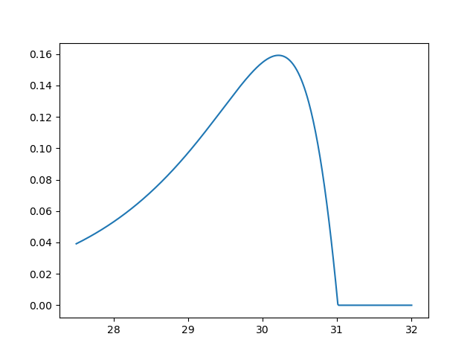
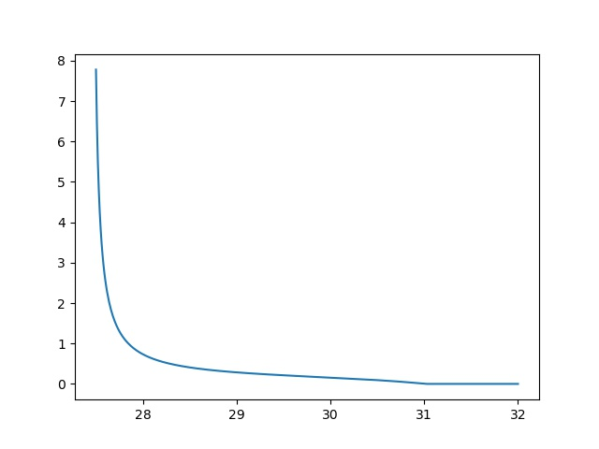
Littoral
CR
PR
PC
Pelagic
CR
PR
PC
Biomass Ratios across temp (these are equilibrium density biomass ratios)

Slide 7
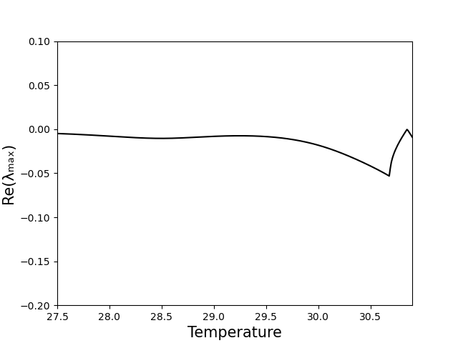
Eigenvalues across temp

Slide 8
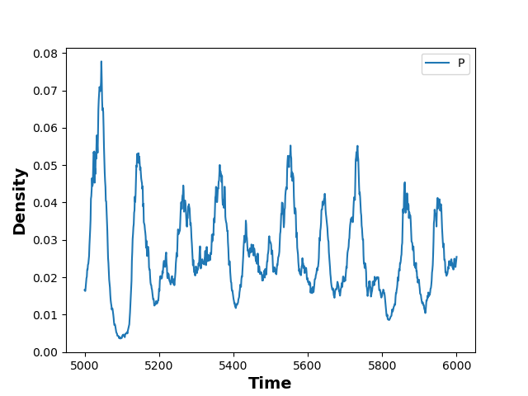
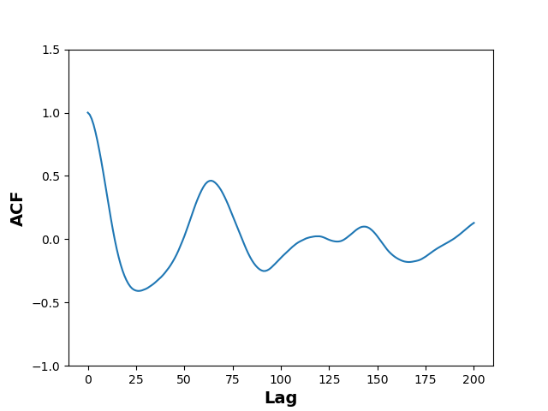
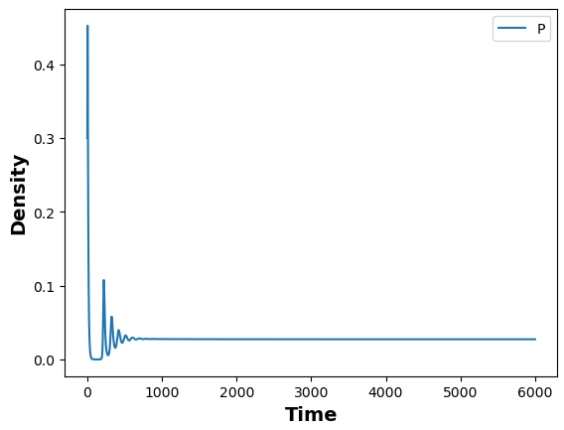
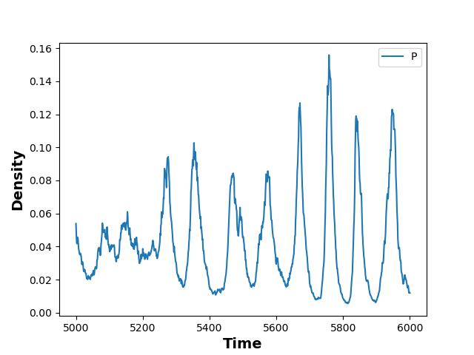
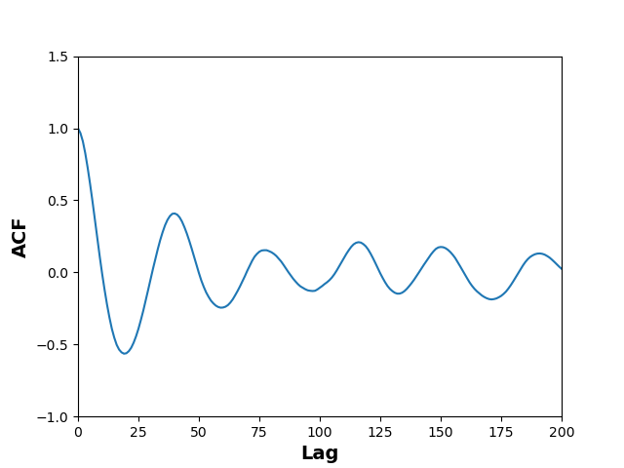
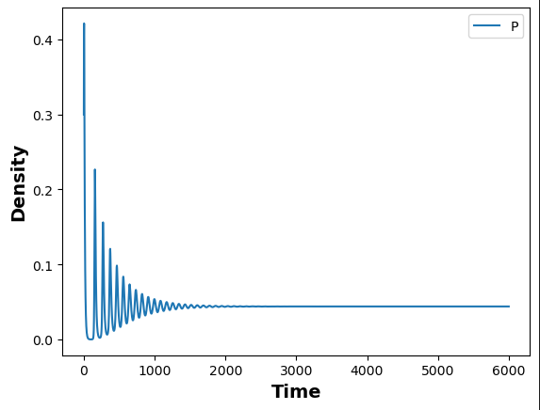
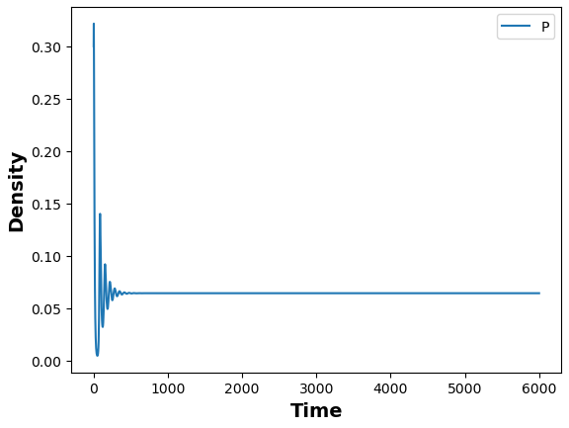
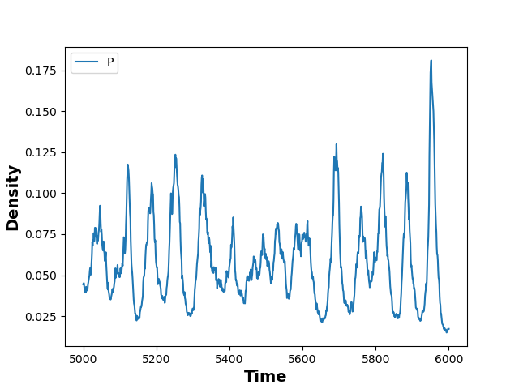
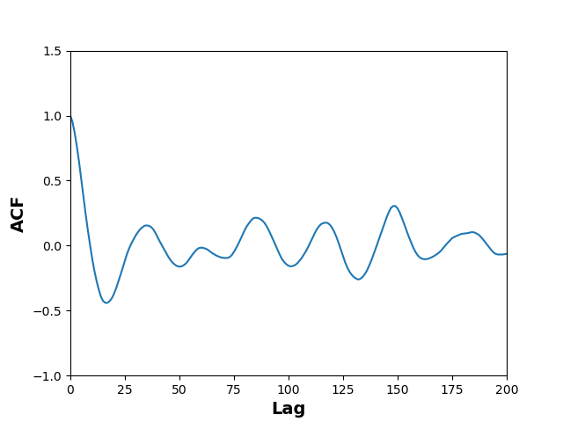
27.5
27.5
27.5
28.5
28.5
28.5
30.0
30.0
30.0

