Slide 1
Seasonal habitat use of prey fish and food web implications…
December 2023 Update

Slide 2
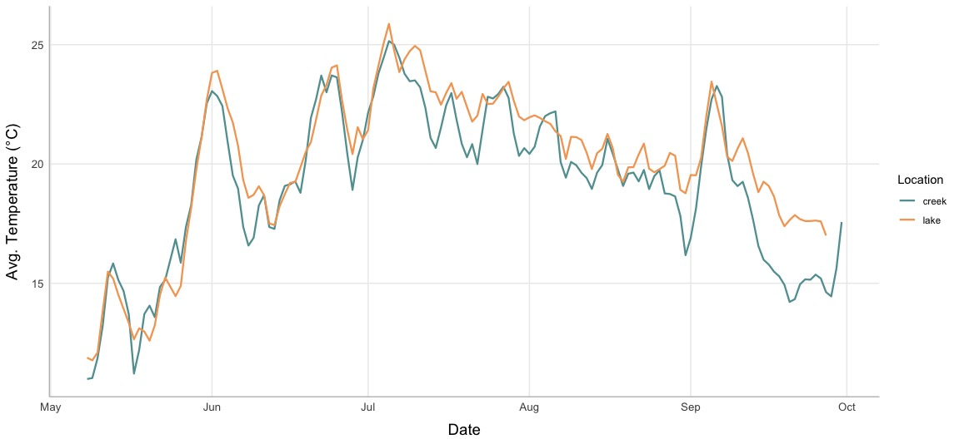
Average Temperature in Lake & Creek

Slide 3
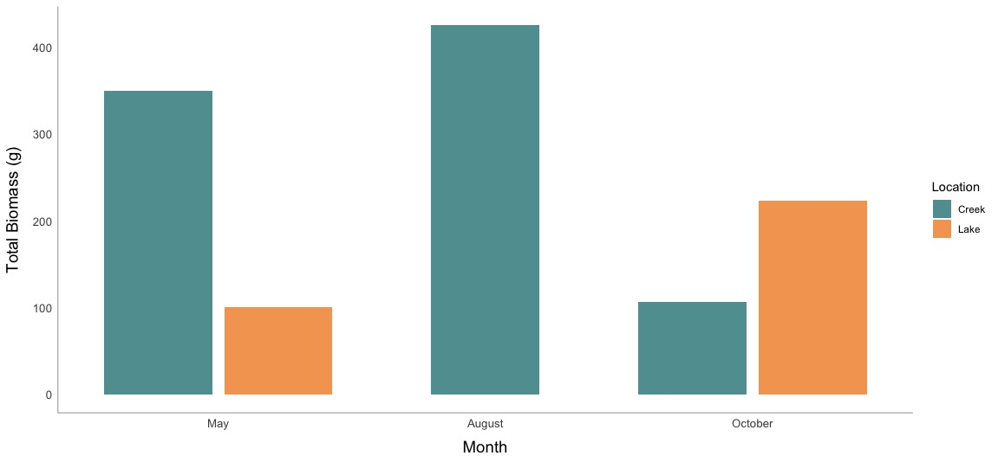
Minnow Traps: Golden Shiner Biomass

Slide 4
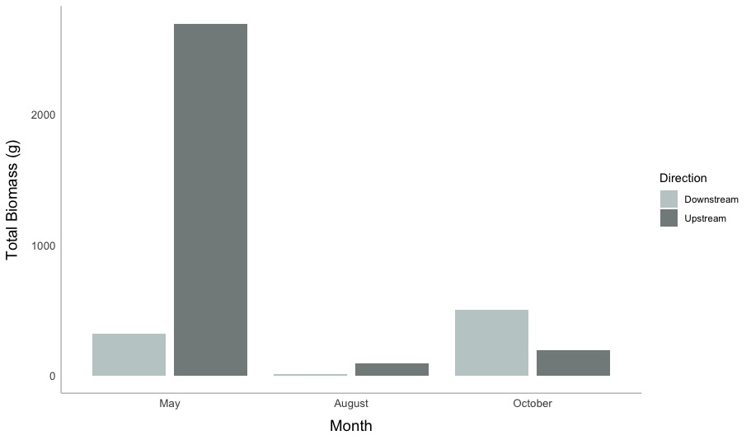
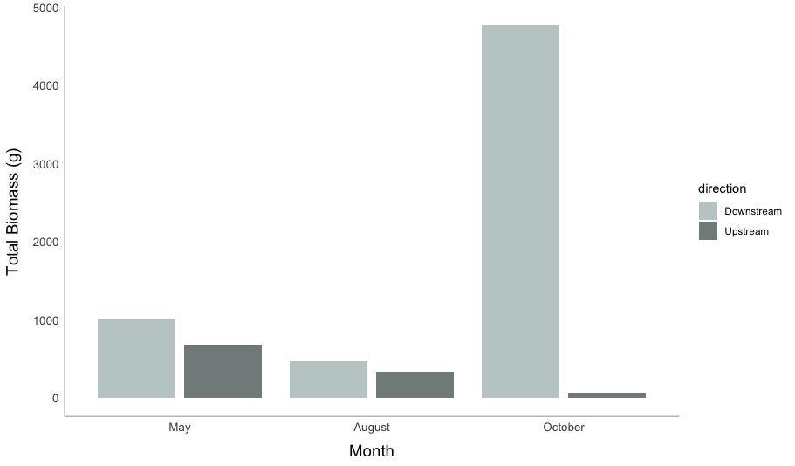
Directional Traps: Golden Shiner Biomass
Fyke (mouth of Costello Creek)
Weir ( ~2km up Costello Creek)

Slide 5
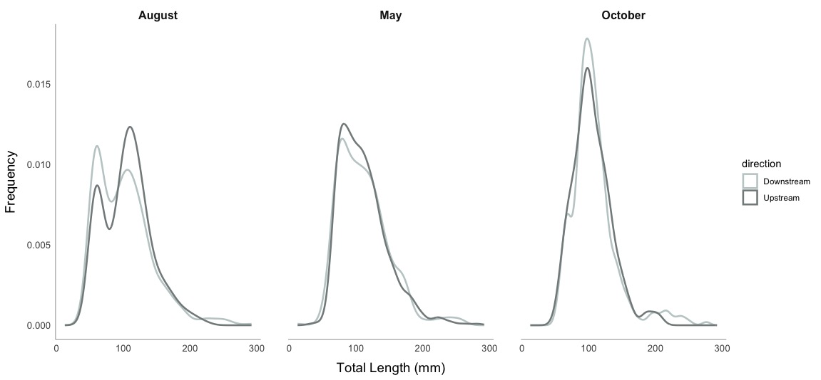
Golden Shiner Size Distributions at Weir

Slide 6
