Slide 1
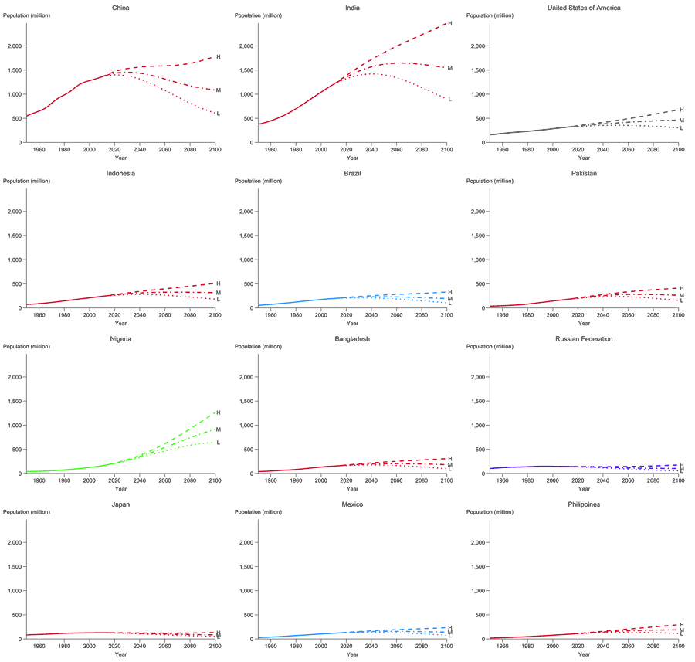
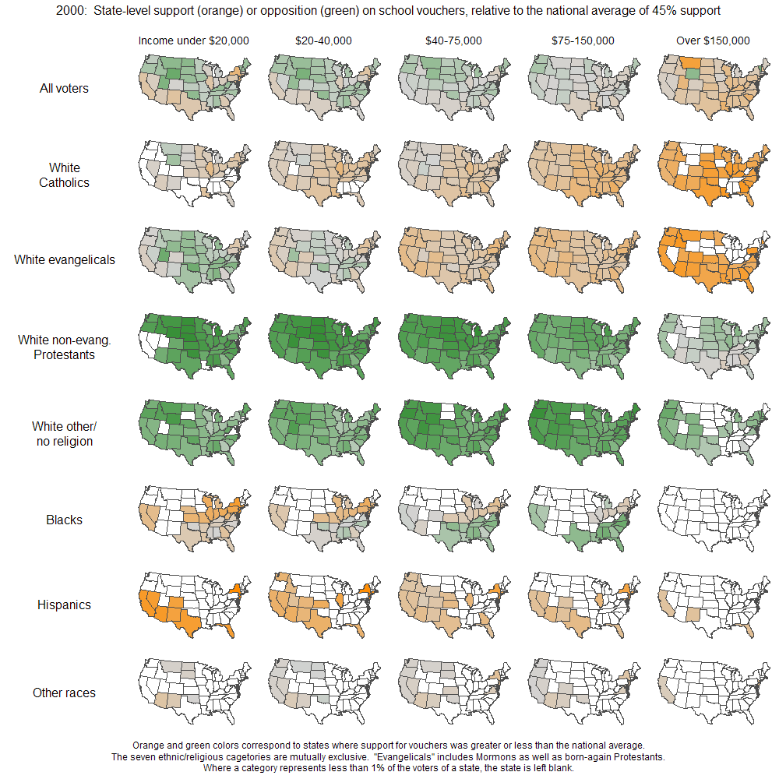
(a) Past estimates and future projections for population for the world’s twelve largest countries
(b) Public support for vouchers, broken down by religion/ethnicity, income, and state

