Slide 1
Things to consider : user interactive, web viz, 3D, spatial data, scalability, robustness, speed, customizability, user adoption, ease of use.
SHOW (legend w/ color dots ?)
Dynamic
Price
Handling spatial data
Adoption
Customizability
user interactive: web viz ?
spatial data`
3D
scalability
robustness
speed
* user interactivity
$$ : commercial
basemap
spatial data:
* user interactivity
$$ : commercial
SOFTWARES
LIBRARIES
Adoption
JAVASCRIPT
Leaflet
D3*
Raw
Processing*
FusionCharts
Dc.js
Anychart*
ModestMap
Tableau
Chart*
crossfilter
QlickView
Dygraphs
Three^{3D}
Polychart
Highchart$$ highmaps$$
Zingchart$$
Spotfire
Mondrian
Amcharts
Plot.ly
ArcGIS
PYTHON
animint
R
MS BI Stack
rCharts
QGIS
Datadesk
matplotlib
ggplot
GGobi
Xmdv Tools
Bokeh
ggplot2
basemap
Shiny*
InstantAtlas
ggmap
OpenDX
geopandas
ggvis*
Customizability
Notes:
EXPLORING SOME DATA VIZ TOOLS
not exhaustive nor exact, qualitative
D3 : steep learning curve, but ☺ for complex interactive
CONSIDER:
dynamic
user interactive: web viz ?
spatial data,
robustness
performance :speed
http://techslides.com/50-javascript-charting-and-graphics-libraries

Slide 2
Things to consider : user interactive, web viz, 3D, spatial data, scalability, robustness, speed, customizability, user adoption, ease of use.
SHOW (legend w/ color dots ?)
Dynamic
Price
Handling spatial data
Adoption
Customizability
user interactive: web viz ?
spatial data`
3D
scalability
robustness
speed
* user interactivity
$$ : commercial
basemap
spatial data:
* user interactivity
$$ : commercial
SOFTWARES
LIBRARIES
Tableau
JAVASCRIPT
Leaflet
D3
QlickView
Raw
Chart
Zingchart
Processing
FusionCharts
Dc.js
Spotfire
Mondrian
crossfilter
Amcharts
Anychart
Dygraphs
ModestMap
ArcGIS
Highchart highmaps
Three
Polychart
MS BI Stack
QGIS
Plot.ly
PYTHON
animint
Datadesk
R
Xmdv Tools
rCharts
basemap
Bokeh
ggplot
InstantAtlas
matplotlib
ggplot2
GGobi
OpenDX
geopandas
ggmap
Shiny
ggvis
Customizability
Notes:
EXPLORING SOME DATA VIZ TOOLS
not exhaustive nor exact, qualitative
D3 : steep learning curve, but ☺ for complex interactive
CONSIDER:
dynamic
user interactive: web viz ?
spatial data,
robustness
performance :speed
http://techslides.com/50-javascript-charting-and-graphics-libraries

Slide 3
Modal portfolio
Percent agreement map
Footprint map

Slide 4
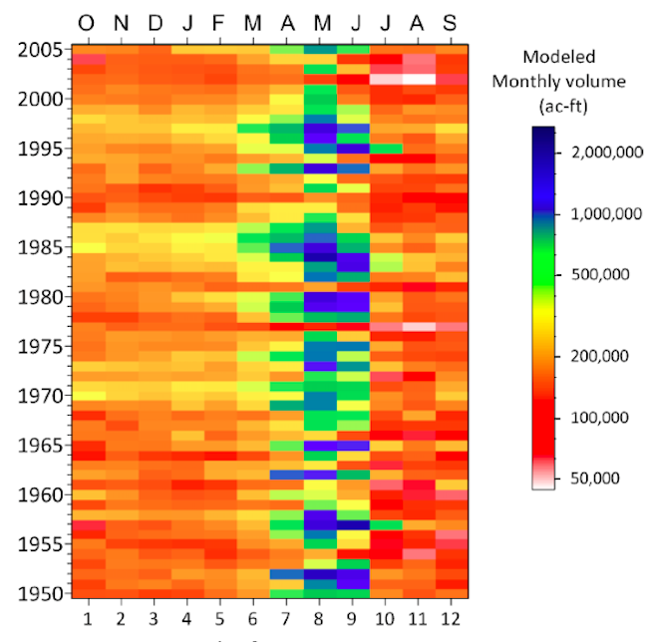
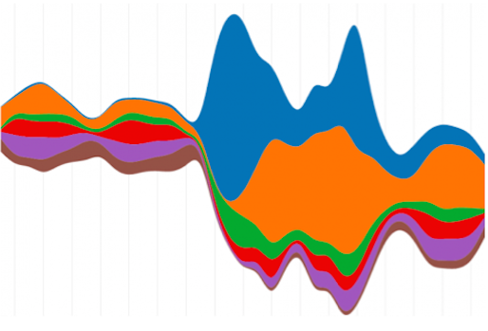
(a) Horizon graph
(b) Streamgraph
(c) Temporal map

Slide 5
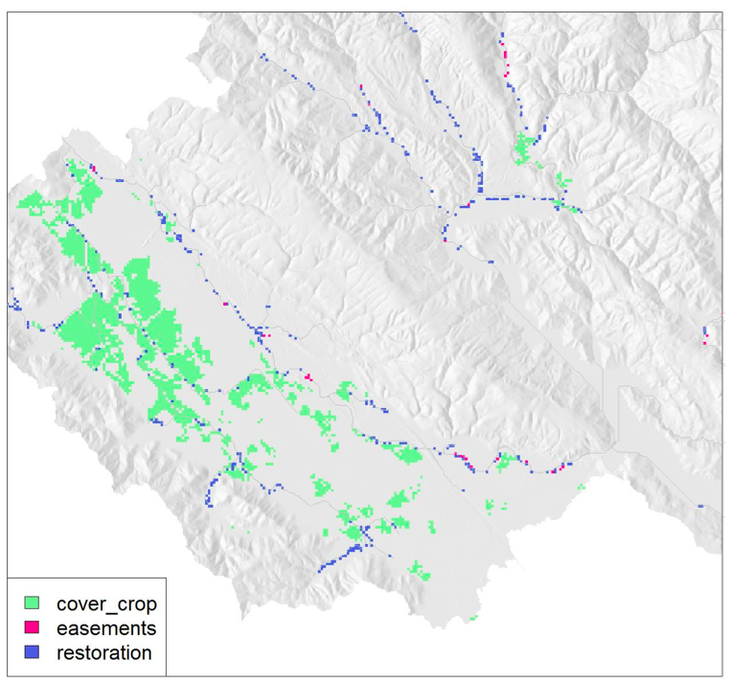
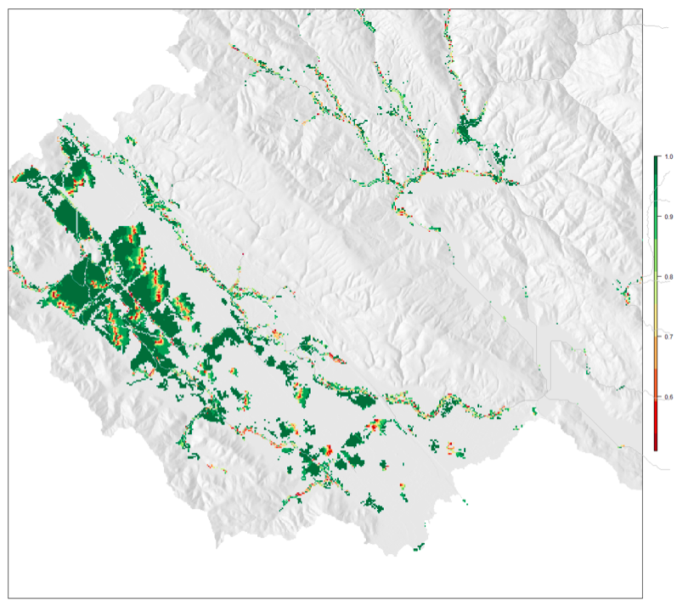
^{(a) Modal portfolio}
^{(b) Frequency map}

Slide 6
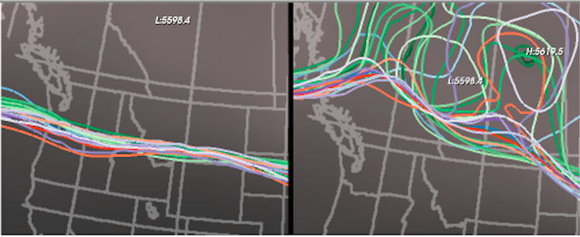
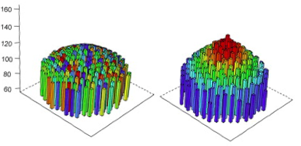
^{(a) Spaghetti plots}
^{(b) 3D histograms}

Slide 7
Tableau Gathering:
Comapre ES model outputs (maps): \ref{fig:coastal_2}

