Slide 1
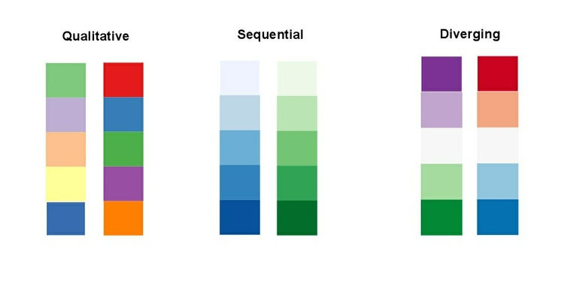
qualitative
sequential
diverging

