Slide 1
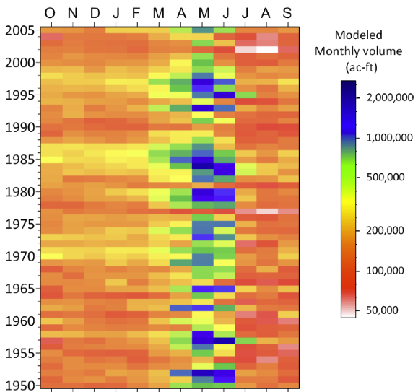
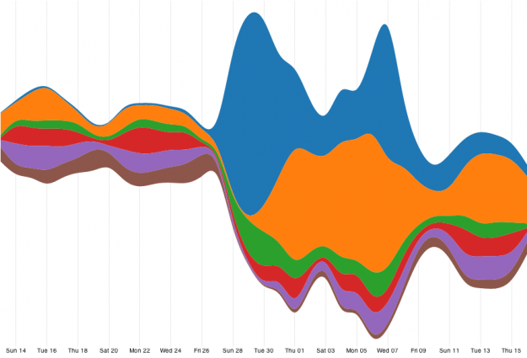
Horizon map
Temporal map
Streamgraph

Slide 2
Horizon map
Temporal map
Streamgraph

