Slide 1
BnF Ms. Fr. 640, fols. 6r-7v
Entry on fol. 7r: To gild with gold color and tinsel

Slide 2
BnF Ms. Fr. 640, fols. 6r-7v
Entry on fol. 7r: To gild with gold color and tinsel
Relationships relates to previous entry on previous folio
Sub-recipe describes a discrete process of making “fatty oil” “fatty oil” is necessary for the larger recipe
Purpose categories Making Observation Application

Slide 3
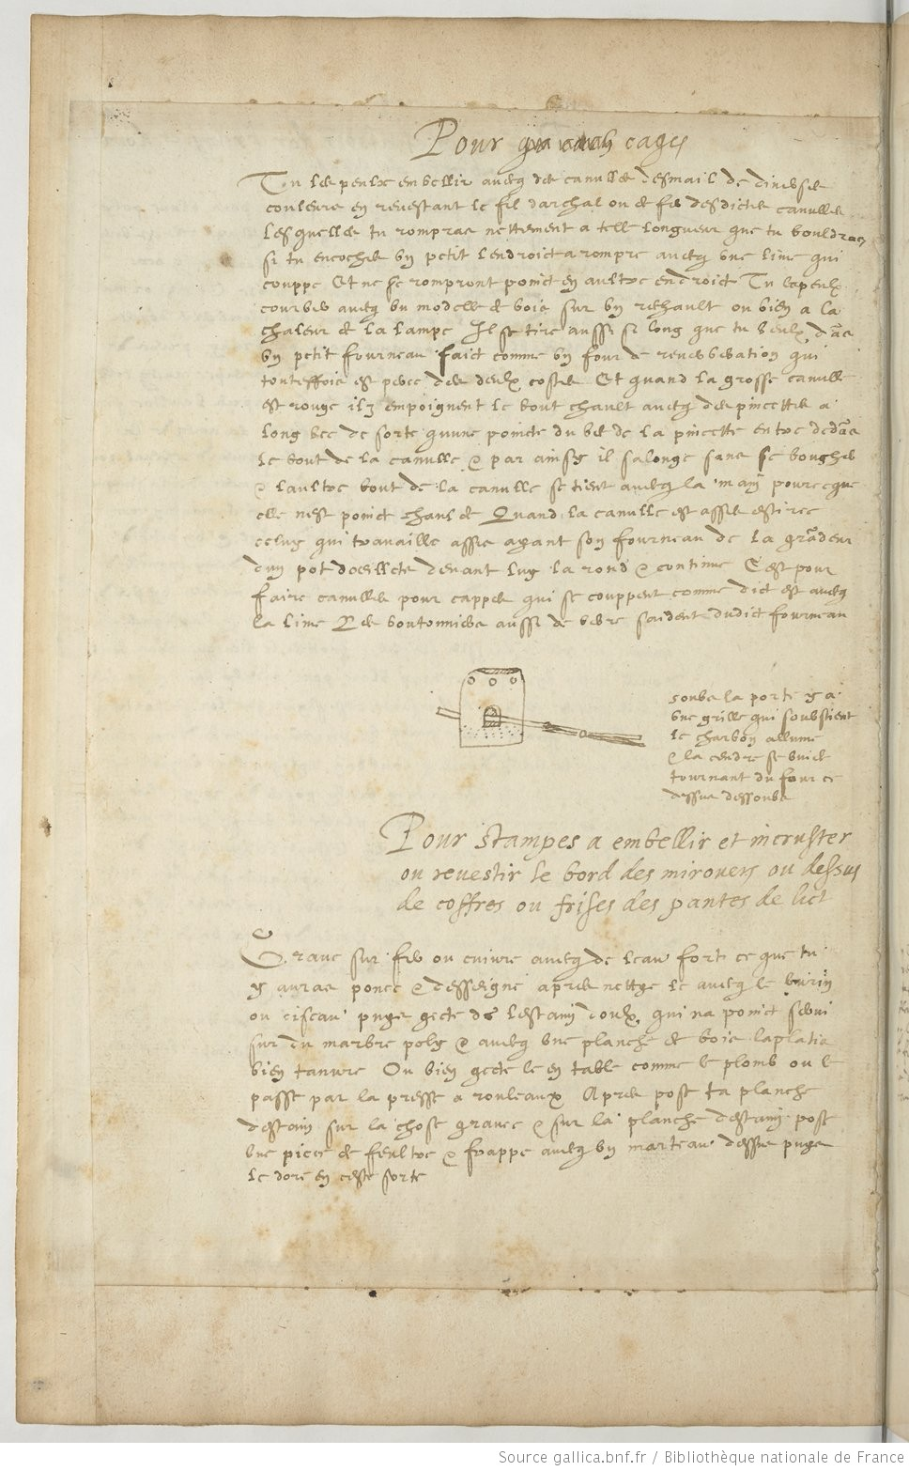
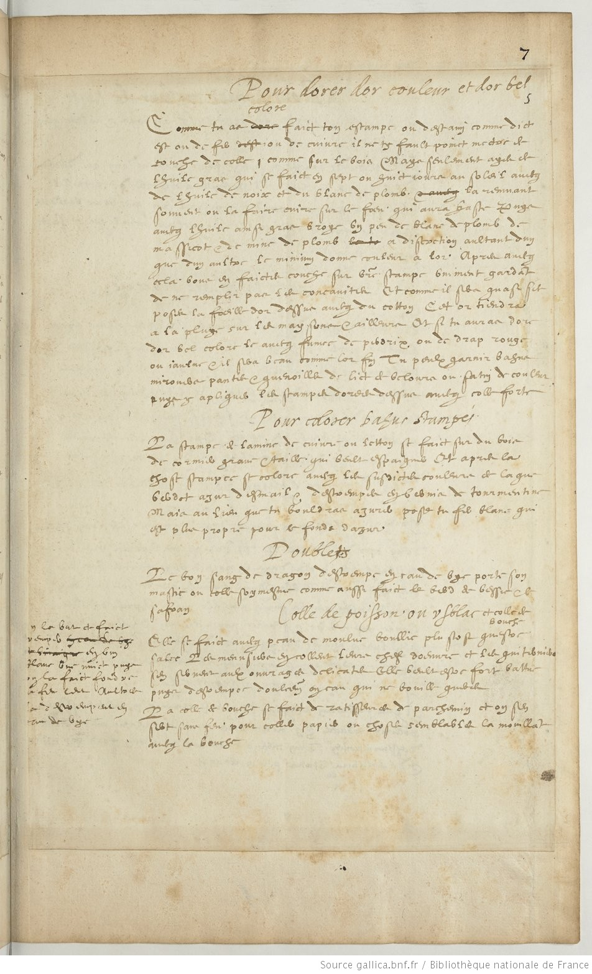

Slide 5
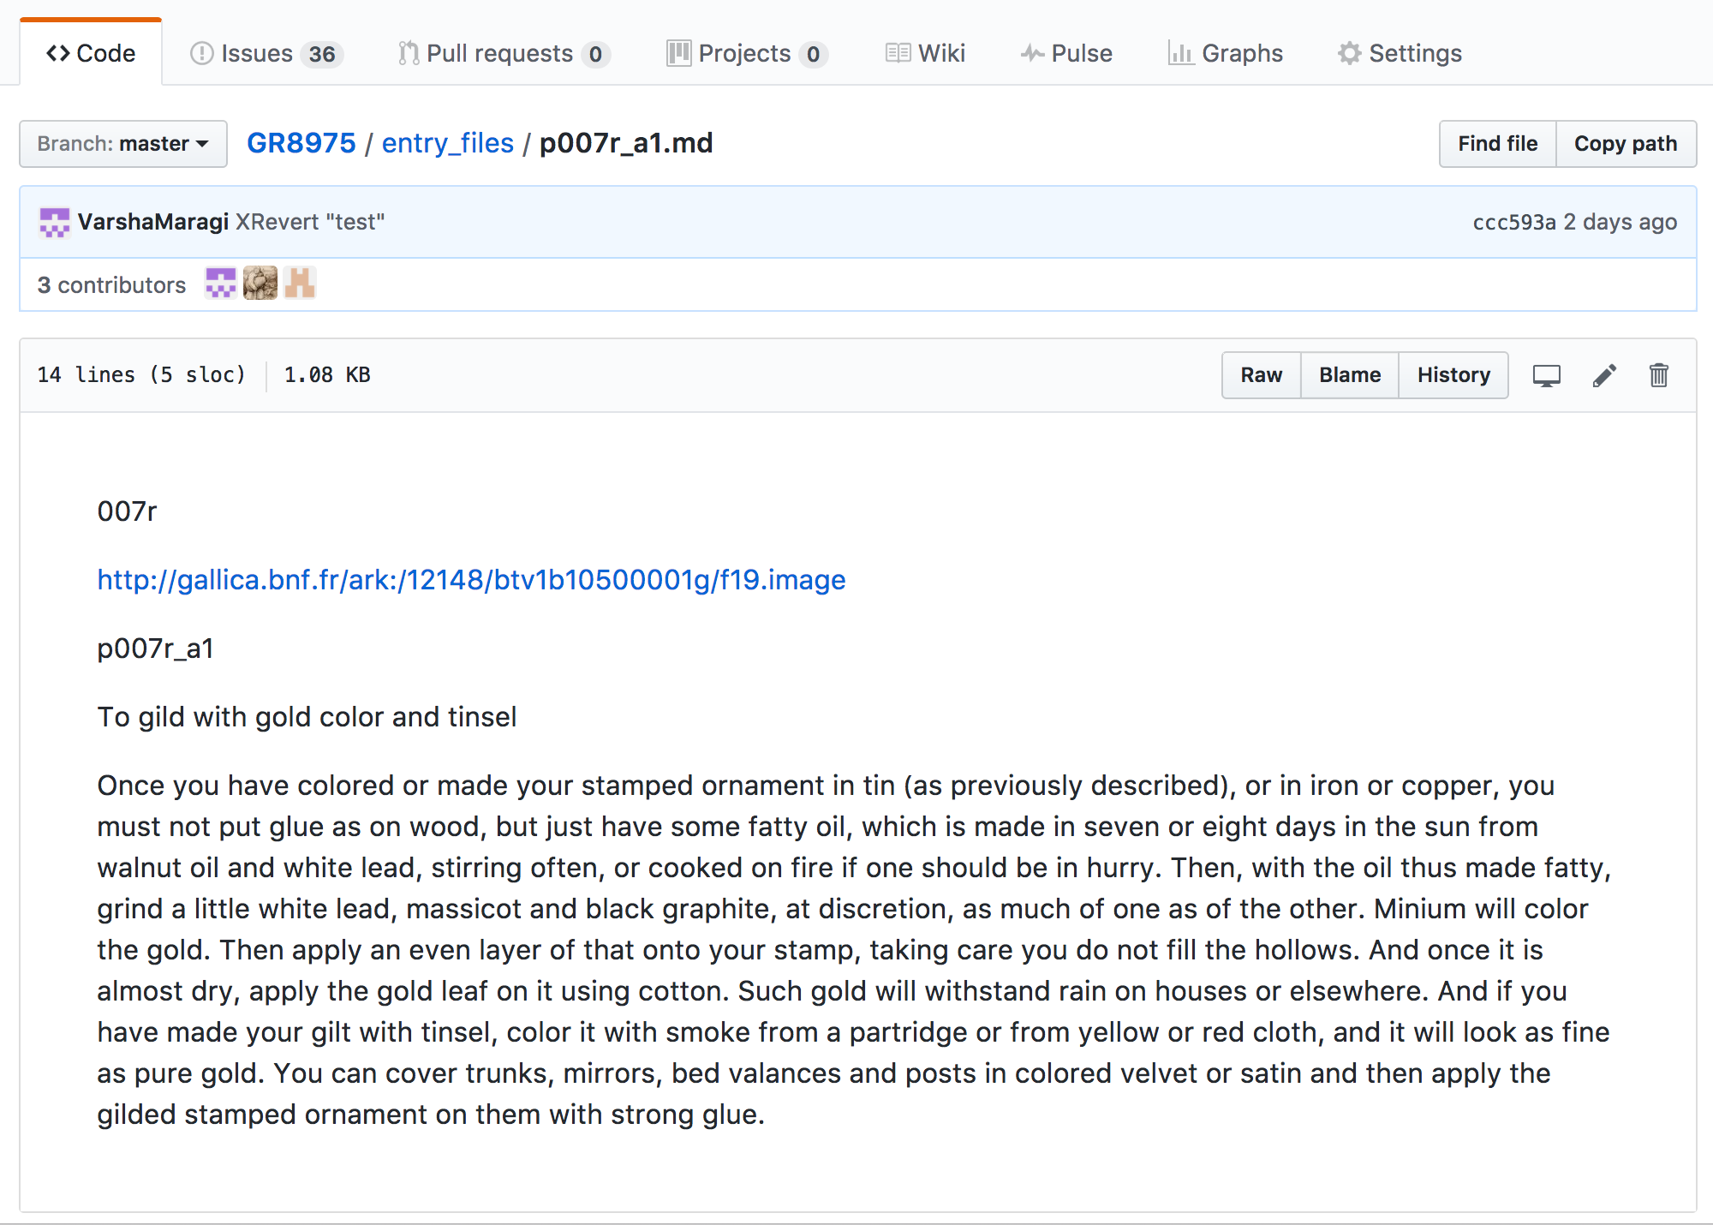

Slide 11
