Slide 1
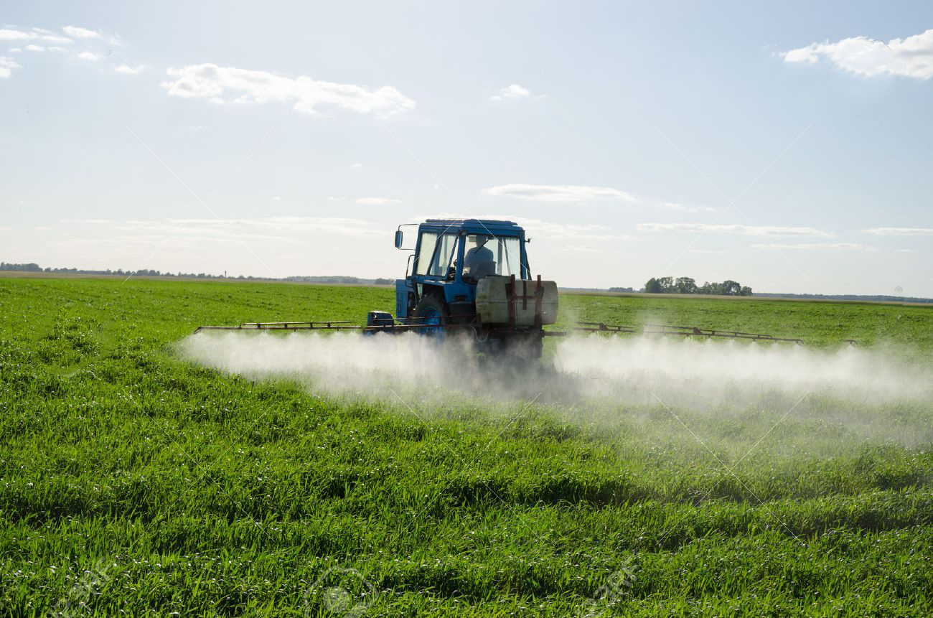
Spraying Guide
--Get simultaneous instructions on spraying
Group member:
Lai Wei
Charlotte Zhuang
Jiaqi Guo
Yi Wang

Slide 2

Wind

Slide 3
Wind speeds of 3 to 7 mph are preferable!

Slide 4

Dew point

Slide 5
Special features of our device

Slide 6
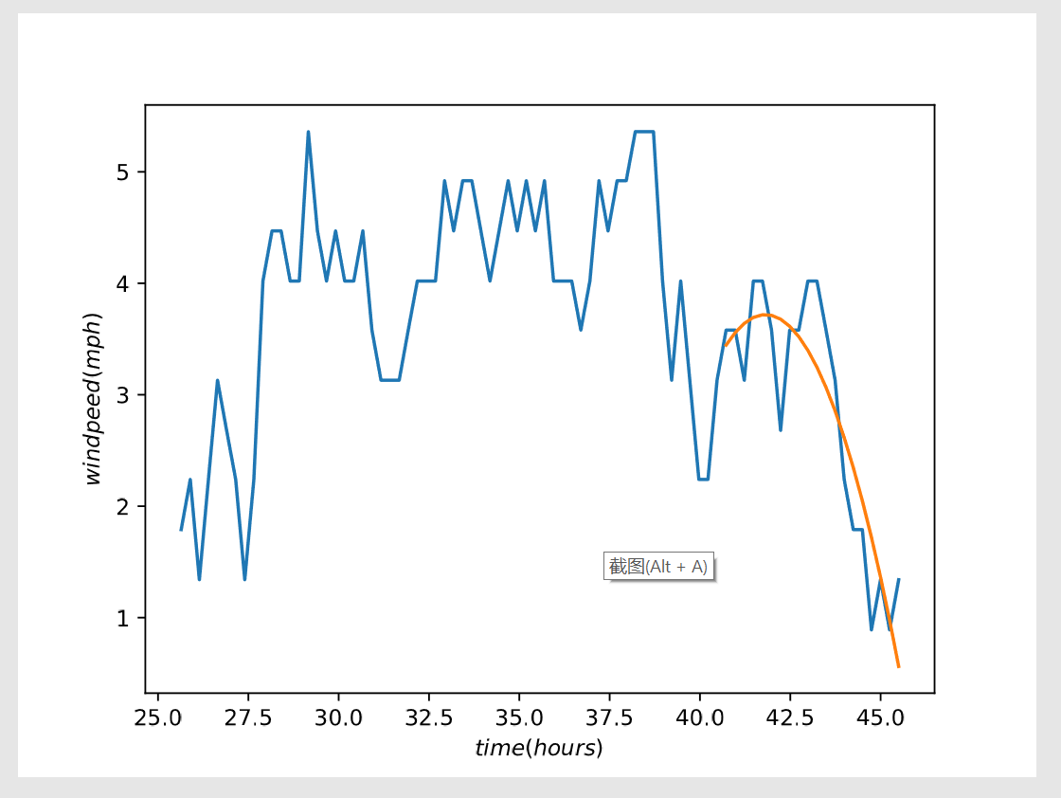
Application of our software
Wind speed Prediction

Slide 7
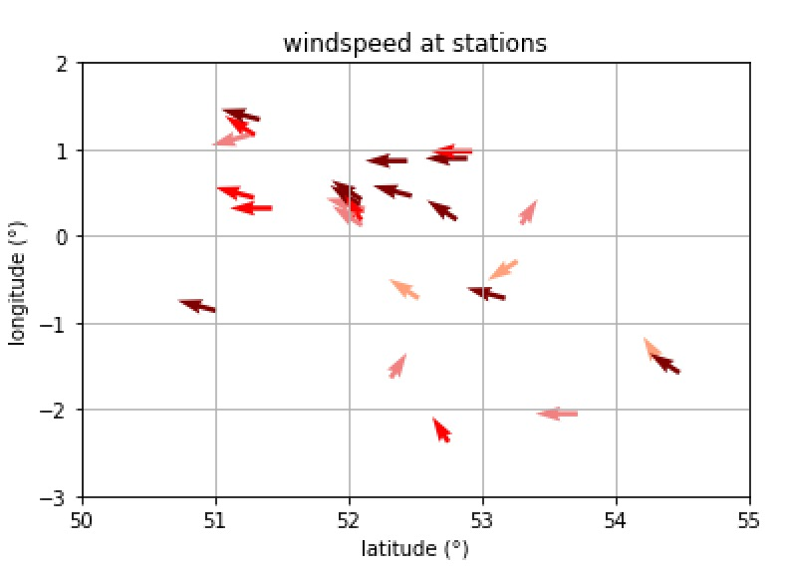

Application of our software
Visualize the wind speed

Slide 8
Next we will demonstrate the program
file:///C:/Users/Wei%20Lai/Sudo%20Grow/gmap_plot.html

Slide 9
Thank You for Your Attention!!!

