Slide 1

i’m feeling lucky
projects
contact
resume
i’m feeling lucky
projects
Wq
contact
resume
i’m feeling lucky
projects
contact
resume
charlton soesanto
personal website
charlton soesanto
personal website

Slide 2
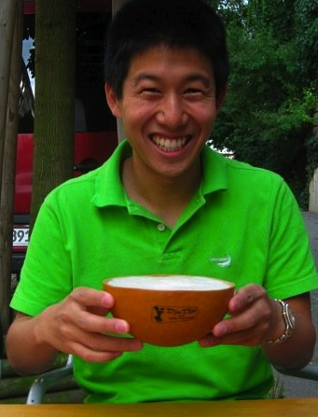
charlton soesanto
about
projects
contact
resume
I was born and grew up in Southern California, and now I am come to see the light and smell the fresh air of Northern California—and I don’t plan on leaving soon.
I am of Chinese-Indonesian descent, and my middle name “Yap-Chong” means “Industry Regulations.” My mother named me Charlton after Charlton Heston, specifically for his portrayal of Moses in The Ten Commandments.
In high school I was a part of the Junior Classical League (Odi et amo, indeed), and, lacking coordination to play sports requiring spherical objects, ran track and cross country.
In college I spent a significant amount of time in residential education. I was the kitchen manager (‘09-’10) in a house of 36 ravenous fraternity gentlemen, and decided to challenge myself with freshmen as a Resident Assistant )(‘10-’11) for Donner House led by the illustrious Linda Paulson.
I expect to be carded until I am well over 30 years of age, but do not take my youth for granted. I have spent summers traveling the world, camping, and ocassionally doing real work. I’m interested in #CalmingTechnology, #EdTech, and #hashtags.
You can check out my more personal professional achievements on my resume.

Slide 3
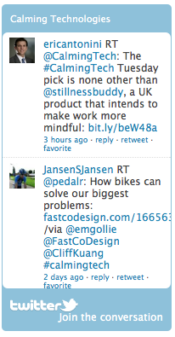
charlton soesanto
about
projects
contact
resume
how to get at me!
email: charlton at cs dot stanford dot edu
twitter: twitter.com/charltonys
facebook: facebook.com/charltonsoesanto
linkedin: linkedin.com/in/charltonsoesanto
re.vu: re.vu/charlton

Slide 4
charlton soesanto
about
projects
contact
resume
TEXT TEXT TEXT TEXT TEXT TEXT TEXT TEXT TEXT TEXT TEXT TEXT TEXT TEXT TEXT TEXT TEXT TEXT TEXT TEXT TEXT TEXT TEXT TEXT TEXT TEXT TEXT TEXT TEXT TEXT TEXT TEXT TEXT TEXT TEXT TEXT TEXT TEXT TEXT TEXT TEXT TEXT TEXT TEXT TEXT TEXT TEXT TEXT TEXT TEXT TEXT TEXT TEXT TEXT TEXT TEXT TEXT TEXT TEXT TEXT TEXT TEXT TEXT TEXT TEXT TEXT TEXT TEXT TEXT TEXT TEXT TEXT TEXT TEXT TEXT TEXT TEXT TEXT TEXT TEXT TEXT TEXT TEXT TEXT TEXT TEXT

Slide 5
charlton soesanto

