Slide 1
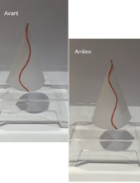
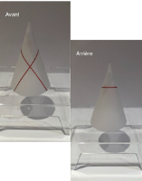


*
**
***
*
**
*
***
TEST 1
TEST 2
TEST 3
Test1_co
Test1_GC
Test1_PC
Test2_facNon
Test2_facOui
Test2_difNon
Test2_difOui
Test3_S
Test3_A
1.00
0.75
factor(args)
0
Performance
1
prob
0.50
3
5
0.25
7
0.00
Insight
-0.5
0.0
0.5
1.0
-0.5
0.0
0.5
1.0
-0.5
0.0
0.5
1.0
-0.5
0.0
0.5
1.0
-0.5
0.0
0.5
1.0
-0.5
0.0
0.5
1.0
-0.5
0.0
0.5
1.0
-0.5
0.0
0.5
1.0
-0.5
0.0
0.5
1.5
1.5
1.5
1.5
1.5
1.5
1.5
1.5
1.0
1.5
Insight

