Slide 1
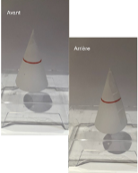



*
*
***
**
*
Test1_co
Test1_GC
Test1_PC
Test2_facNon
Test2_facOui
Test2_difNon
Test2_difOui
Test3_S
Test3_A
1.00
0.75
factor(args)
Performance
0
prob
0.50
1
3
5
0.25
7
0.00
Introspection rate
2.5
5.0
10.0
2.5
5.0
10.0
2.5
5.0
10.0
2.5
5.0
10.0
2.5
5.0
10.0
2.5
5.0
10.0
2.5
5.0
10.0
2.5
5.0
10.0
2.5
7.5
7.5
7.5
7.5
7.5
7.5
7.5
7.5
5.0
10.0
7.5
Pos2

