Slide 1
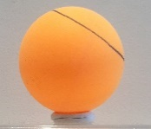


Introspection measure effect on performance
Without controlling for nb of learning items
Controlling for nb of learning items
Intro1
Insight
Intro1 | **
Insight |  | **
***
**
***

