Slide 1
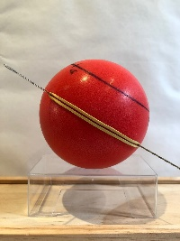
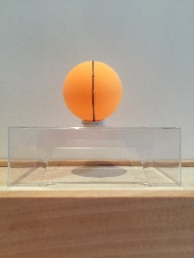
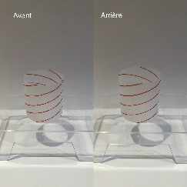
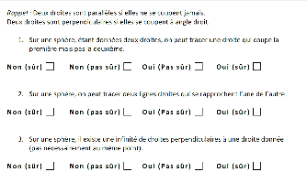

Test1 : straight lines on spheres
Test2 : straight lines on other surfaces
Test3 : reasoning about straight lines on various surfaces
1 to 7 learning items
Rating of learning items
Insight
Learning
Pre-test
Intro1
Intro2
Intro3
Introspection
Test

