Slide 1
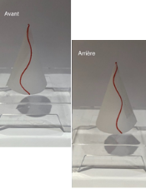
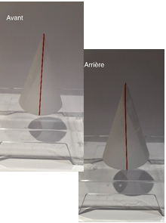
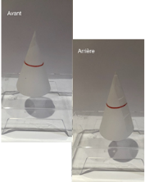
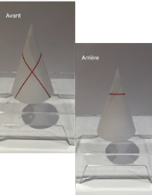



*
**
Test2_facNon
Test2_facOui
Test2_difNon
Test2_difOui
1.00
Learning items
0.75
factor(args)
0
% correct
1
prob
0.50
3
5
0.25
7
0.00
0
2
4
6
0
2
4
6
0
2
4
6
0
2
4
6
condition
args

