Slide 1

Android Jetpack
Layouts

Slide 2
Layouts
Structure for a UI screen

Slide 3
Layouts
Structure for a UI screen
Hierarchy of ViewGroup and View objects

Slide 4
Layouts
Structure for a UI screen
Hierarchy of ViewGroup and View objects
XML

Slide 5
Layouts
Structure for a UI screen
Hierarchy of ViewGroup and View objects
XML
Android Studio Visual Editor

Slide 6
Layouts
Structure for a UI screen
Hierarchy of ViewGroup and View objects
XML
Android Studio Visual Editor
Mandatory attributed
layout_width and layout_height

Slide 7
Layouts
Structure for a UI screen
Hierarchy of ViewGroup and View objects
XML
Android Studio Visual Editor
Mandatory attributed
layout_width and layout_height
Many optional parameters

Slide 8
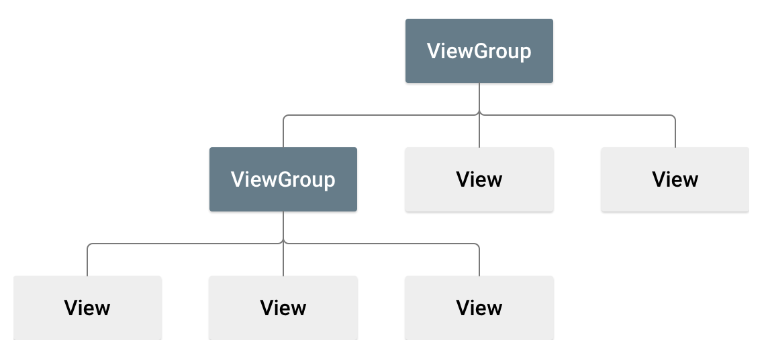
Layouts - Structure

Slide 9
Layouts - Structure
ViewGroup
LinearLayout
RelativeLayout
ConstraintLayout

Slide 10
Layouts - Structure
ViewGroup
LinearLayout
RelativeLayout
ConstraintLayout
View
TextView
ImageView
Button

Slide 11
Layouts - LinearLayout
Elements are organized in a linear fashion

Slide 12
Layouts - LinearLayout
Elements are organized in a linear fashion
Horizontal or Vertical

Slide 13
Layouts - LinearLayout
Elements are organized in a linear fashion
Horizontal or Vertical
Weighted elements

Slide 14
Layouts - RelativeLayout
Elements are organized in relation to each other

Slide 15
Layouts - RelativeLayout
Elements are organized in relation to each other
Or to the parent layout

Slide 16
Layouts - RelativeLayout
Elements are organized in relation to each other
Or to the parent layout
toLeftOf, toRightOf, below, above

Slide 17
Layouts - RelativeLayout
Elements are organized in relation to each other
Or to the parent layout
toLeftOf, toRightOf, below, above
Allows overlapping elements

Slide 18
Layouts - ConstraintLayout
Similar to RelativeLayout with more flexibility

Slide 19
Layouts - ConstraintLayout
Similar to RelativeLayout with more flexibility
Elements are constrained to other elements or to parent

Slide 20
Layouts - ConstraintLayout
Similar to RelativeLayout with more flexibility
Elements are constrained to other elements or to parent
Constraints based on
Other elements
Content
Barriers
Weighted constraints
etc

Slide 21
Layouts - RecyclerView
Displays large data sets efficiently

Slide 22
Layouts - RecyclerView
Displays large data sets efficiently
Can display elements in a linear, grid, staggered grid etc.

Slide 23
Layouts - RecyclerView
Displays large data sets efficiently
Can display elements in a linear, grid, staggered grid etc.
Flexible in the kind of views it can display

Slide 24
Layouts - RecyclerView
Displays large data sets efficiently
Can display elements in a linear, grid, staggered grid etc.
Flexible in the kind of views it can display
Behind the scene optimisations

