Slide 1
Microcosms 22

Slide 2
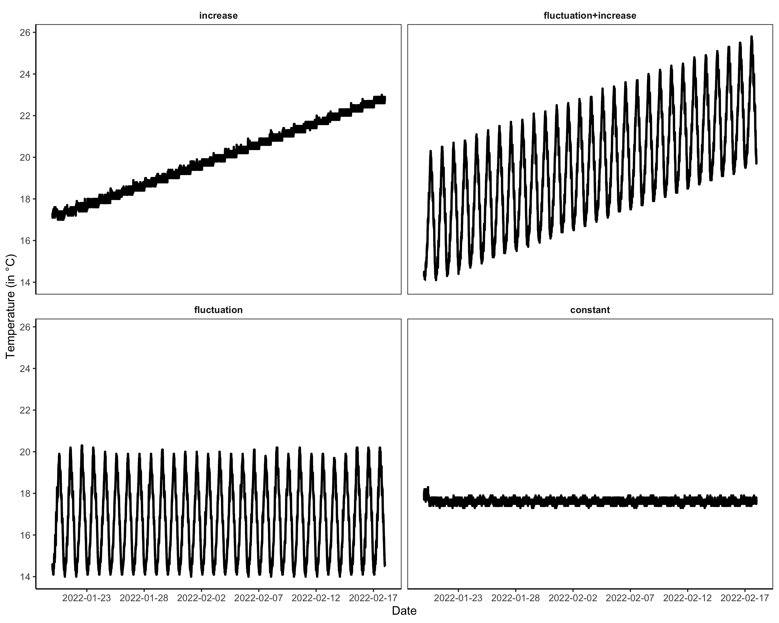

Slide 3
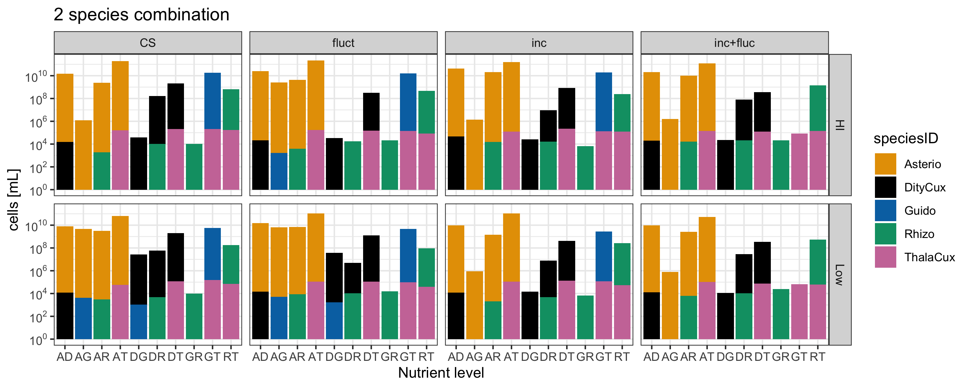
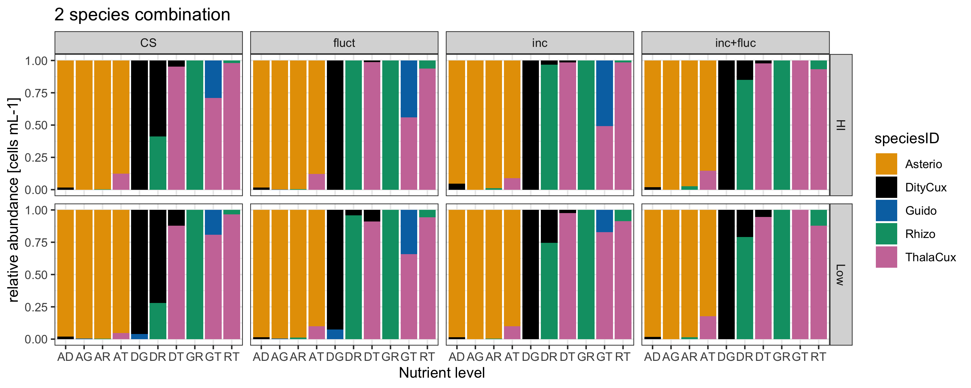

Slide 4
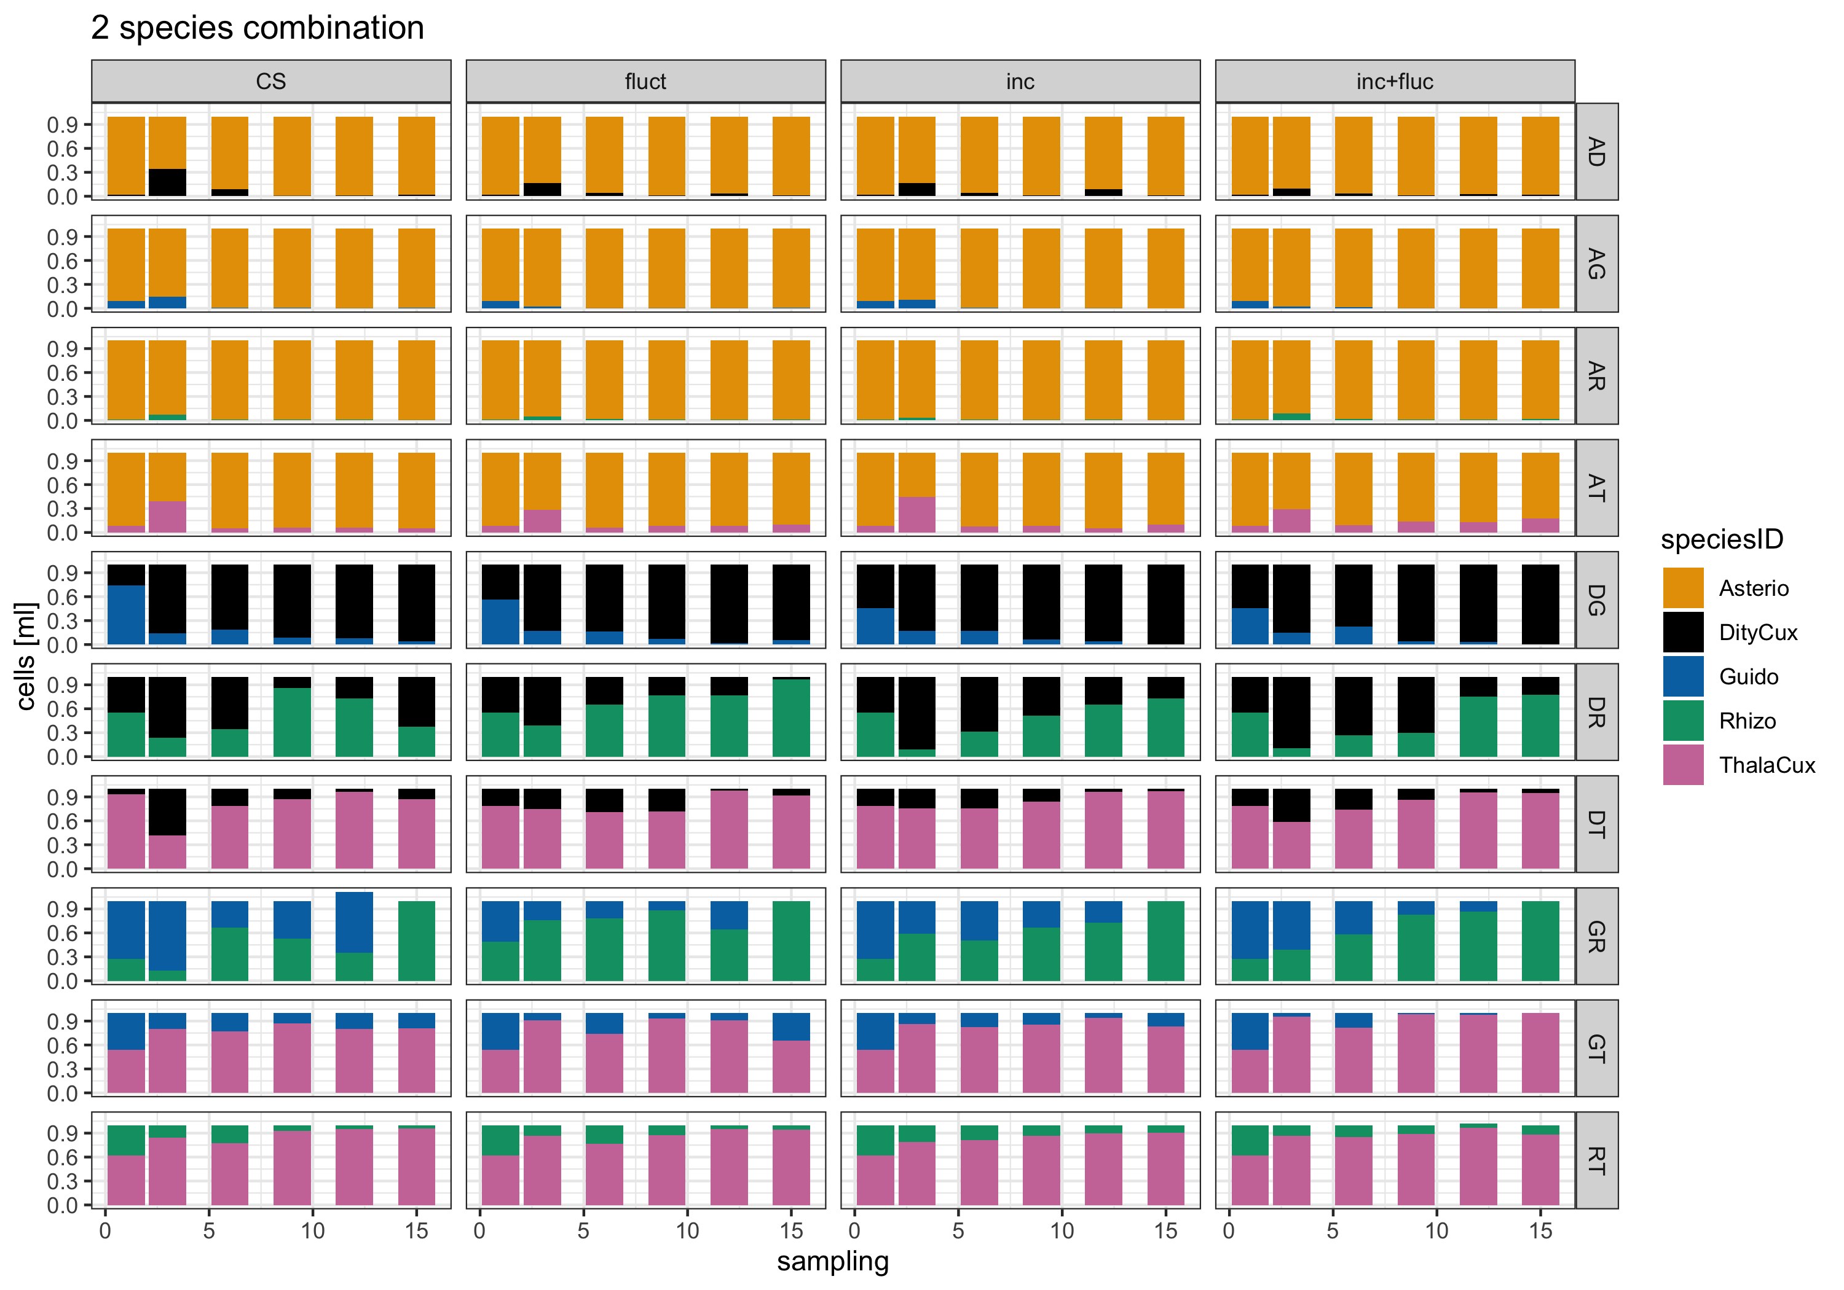

Slide 5
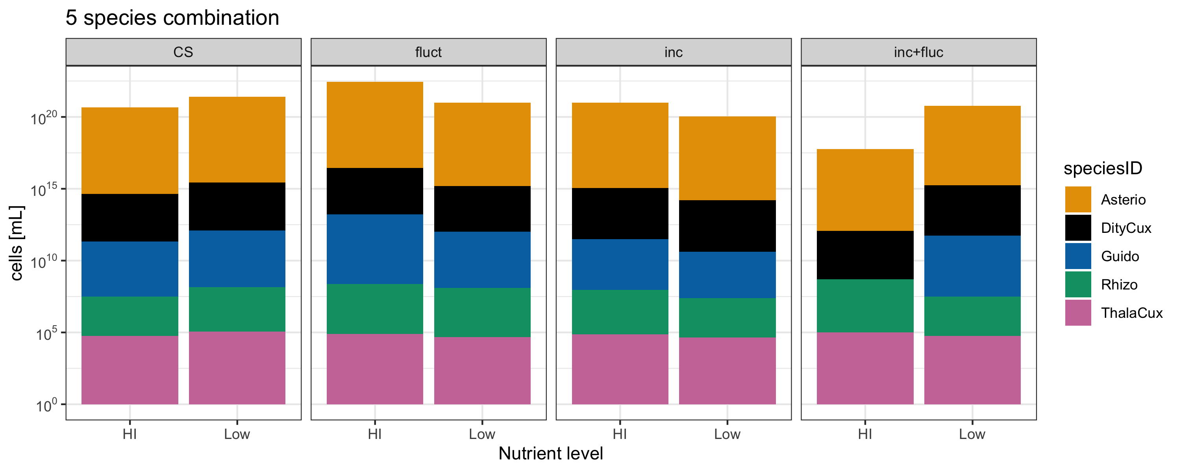
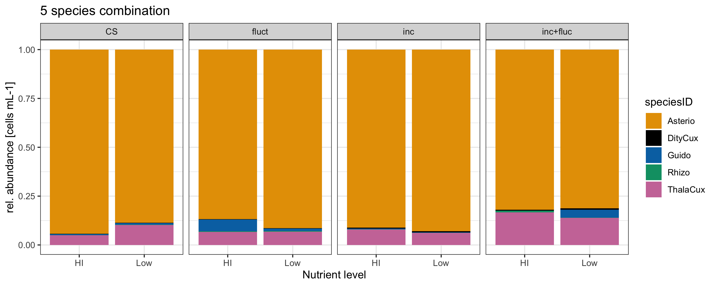

Slide 6
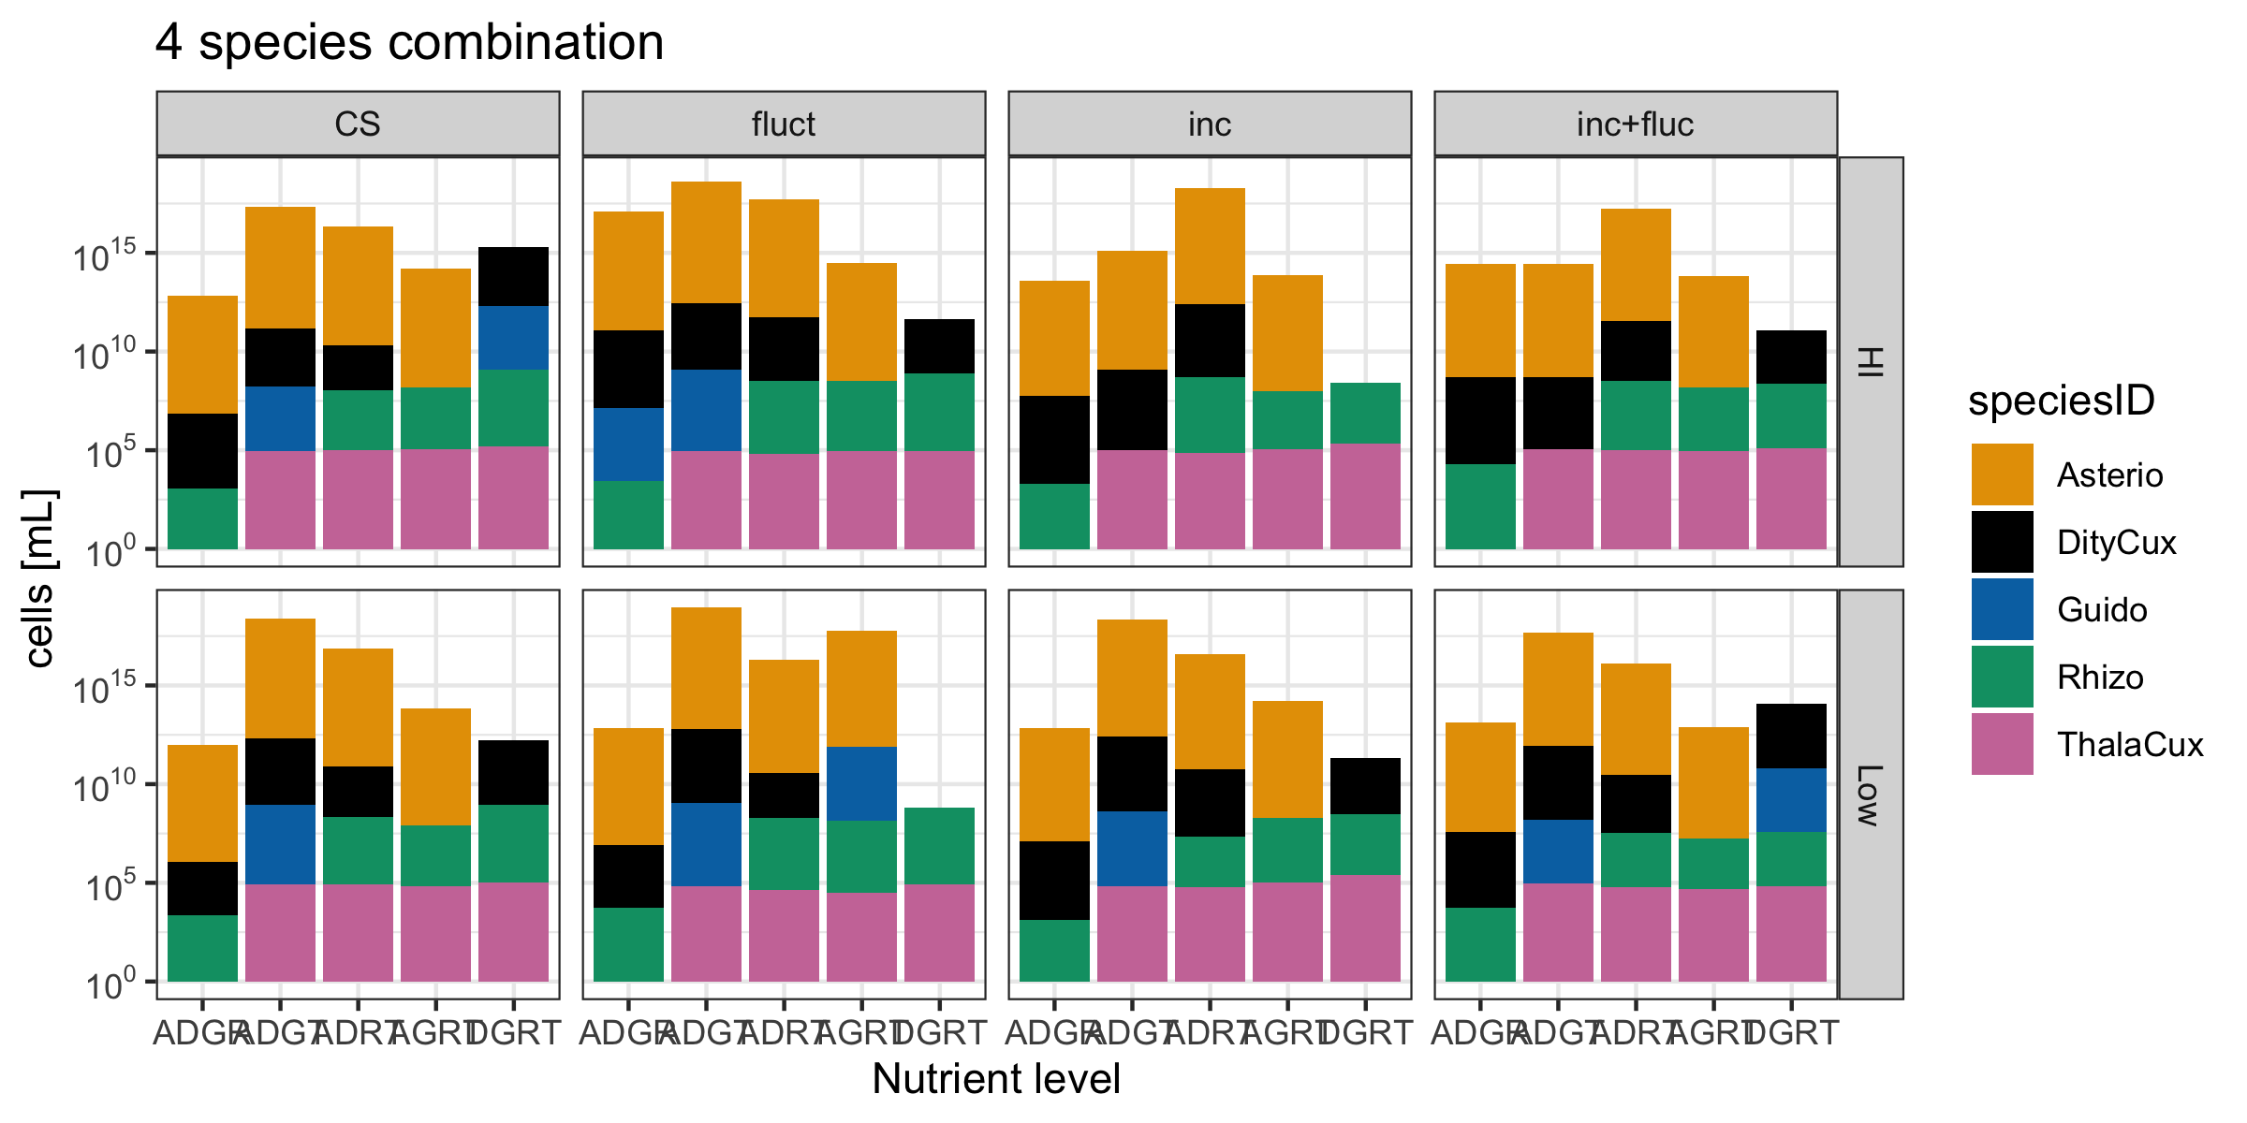
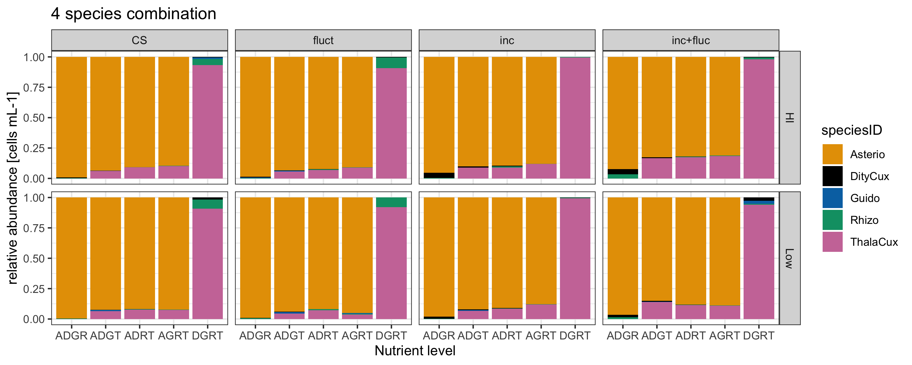

Slide 7
To-Dos
AUC of single species in disturbed treatments/ control treatments
Use monocultures as baseline and compare difference to duo-/polycultures to extract interaction strength w. Dome
Other experiment using heat waves and connectivity (Jan-April)
Ireland in Octobre

