Slide 1
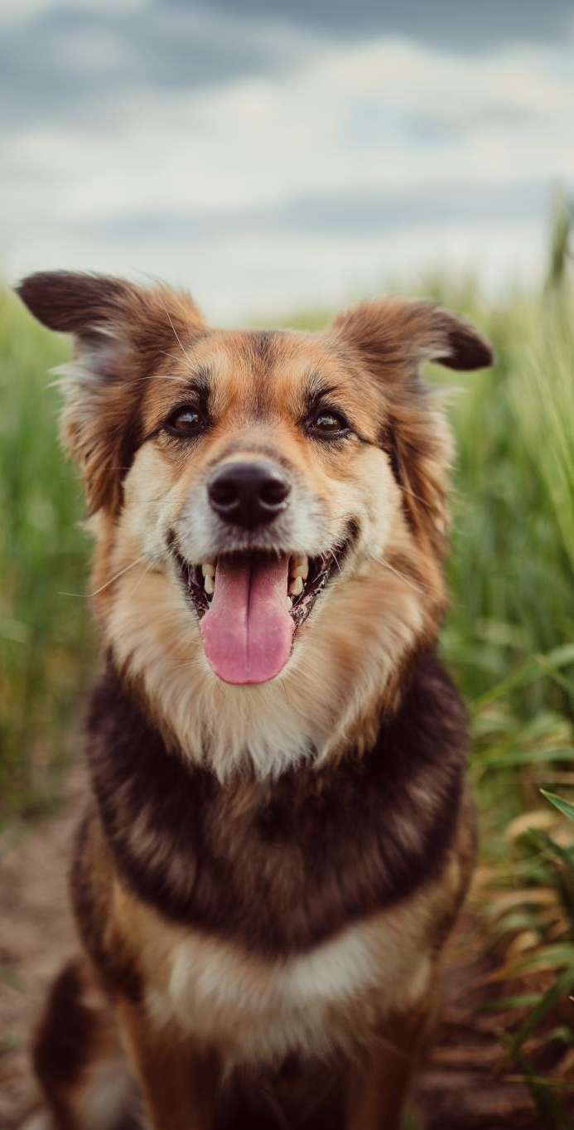
FurBot – A Smart Assistant for Pet Owners
Charlie Medialdea
CSIS 4495 - 01| Winter 2025

Slide 2
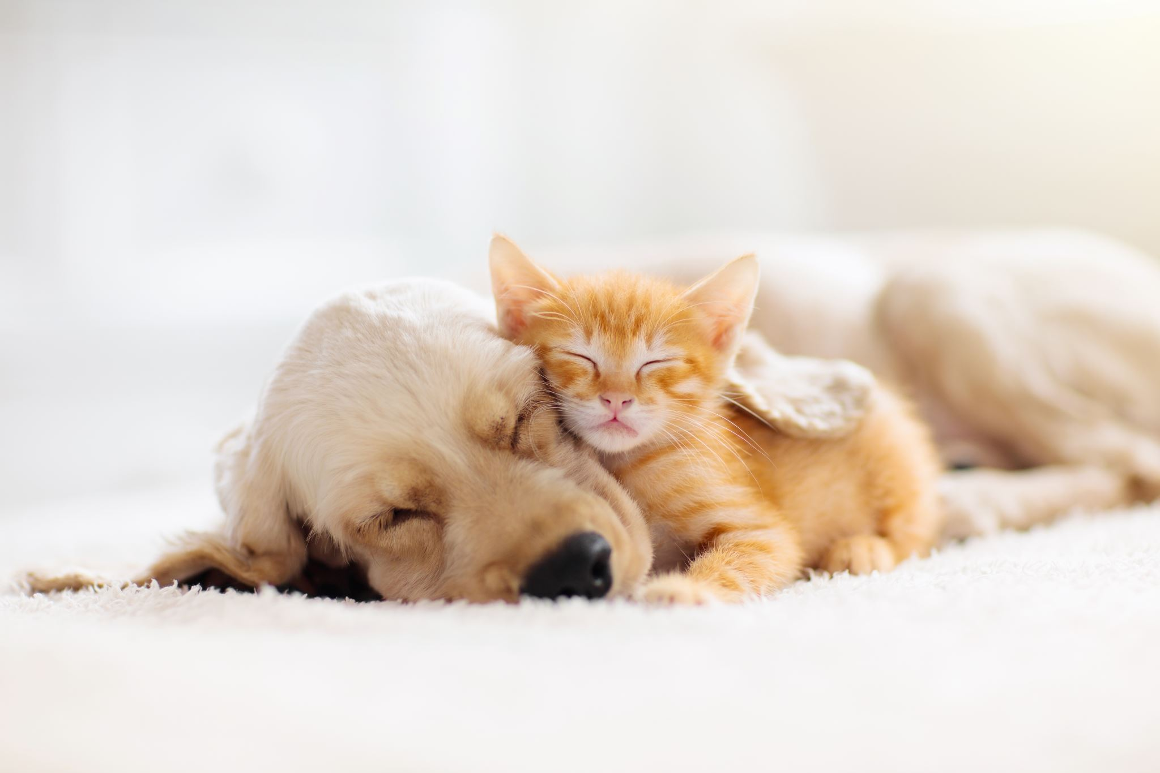
Project Overview
FurBot is a smart assistant designed to help pet owners manage their pet's care.
Key Features:
🐾 Pet Profile Management – Add & manage pets via dashboard
💬 Chatbot with Location Detection – Ask for nearby services
⏰ Smart Reminders – Auto-email alerts for care tasks
❤️ Favorites – Save pet-friendly services for quick access

Slide 3

Project Novelty
🌟 Tailored Pet Experience
Offers personalized interactions per pet — from profile data to reminders — ensuring relevance and a more engaging experience for every user.
🗨️ Proactive Reminders with email notification
FurBot intelligently suggests care reminders — such as grooming or vaccinations — based on each pet’s routine and reminder history.
Once identified, reminders are automatically sent to the user via email, helping pet owners stay on top of their pet's needs.
📌 Location-Aware Queries via NLP
Integrated with spaCy NLP, FurBot extracts city or place names from user messages to provide more accurate, location-specific results.
🐾 Yelp API Integration
Fetches real-time, nearby pet-friendly services such as groomers, veterinarians, and cafes based on the user’s detected location.

Slide 4
FurBot Utility
Centralizes all pet data — including profiles, reminders, and favorites — in one easy-to-manage dashboard.
Keeps pet owners on track with important care routines like grooming and vaccinations.
Minimizes the risk of missed schedules by sending timely, automated reminders.
Simplifies the search for nearby pet-friendly services through location-aware chatbot support.

Slide 5
🛠️ Technology Stack Overview
Frontend
Vue.js: Responsive and user-friendly UI
Backend & Framework
Flask (Python): Lightweight backend
Flask-Mail: Automated email reminders
APScheduler: Scheduled reminder dispatch
Authentication & Security
JWT: Secure login and access control
Database
MongoDB Atlas: Stores pet data, reminders
NLP & Matching
FuzzyWuzzy: Fuzzy keyword matching
spaCy: Location extraction from queries
APIs & Deployment
Yelp API: Pet service listings
Railway: Backend & DB deployment

Slide 6
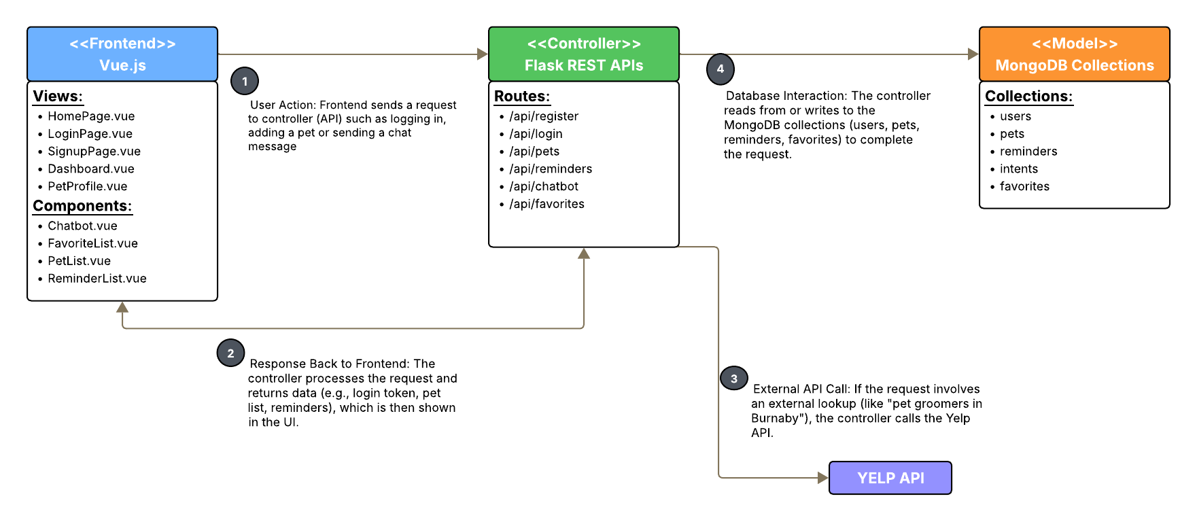
System Architecture

Slide 7
Challenges Faced
🧱 Full-Stack Development from Scratch
As this was my first time building a full-stack product independently after 18 years in the IT industry, I had to navigate the complete lifecycle—from design and backend logic to frontend development and deployment—on my own. This tested my ability to integrate multiple technologies while learning all the tools involved.
🌐 Deployment & CORS Issues
One of the most persistent challenges was deploying FurBot to Railway and handling CORS (Cross-Origin Resource Sharing) errors. Aligning the routes and headers between Flask and Vue.js taught me how critical environment-based configurations are when pushing a full-stack app to production.
🔌 API Integration
Integrating external APIs like Yelp and managing NLP tasks via spaCy brought unexpected hurdles around entity recognition, location detection, and ensuring relevance in chatbot responses. Balancing real-time results with user expectations was key.
👥 User-Centric Thinking & Personalization
What began as a chatbot evolved into a personalized assistant. Thinking like a user—and a pet owner—helped me shape FurBot to be more engaging, practical, and proactive for every user.

Slide 8

Lessons Learned
Soft Skills
Time Management - Effectively balanced priorities and deadlines.
Resilience - Persisted through debugging, blockers, and deployment setbacks.
Problem-Solving & Critical Thinking – These skills are essential in steering a project back on track, especially when things aren't going as planned.
Working under pressure - Delivered consistent results even in high-stress moments.
Self-Discipline & Independence – Maintained consistent progress with minimal supervision.
Technical Skills
Full-Stack Development – Built and integrated frontend, backend, and database components.
API & NLP Integration – Implemented Yelp API and spaCy for dynamic, smart responses.
Deployment Experience – Managed real-world issues like CORS and route handling in production.
Understanding of Asynchronous Schedulers – Used APScheduler to automate daily email reminders.
“While technical skills can be learned quickly, it’s these soft skills that form the foundation for long-term success in any career.”

Slide 9
Appreciation & Acknowledgements
I would like to express my sincere gratitude to everyone who contributed
to the success of this project:
Professor Priya – For your consistent support, encouragement, and dedication to our learning journey. Your guidance has been instrumental in helping me explore new technologies and push beyond my limits.
My Peers and Schoolmates – For your feedback, shared insights, and inspiration throughout the term.
Family and Friends - Unwavering support, encouragement, and belief in me made this journey possible. My strength behind the scenes.
FurBot Users – For testing the platform and providing valuable feedback that helped shape the user experience.
ChatGPT and GitHub Copilot – For being my round-the-clock virtual development assistants.

Slide 10
Thank You!
Questions?
GitHub: https://github.com/charlz1202/W25_4495_S1_CharlieM
Live Demo: https://furbot-production.up.railway.app

