Slide 1
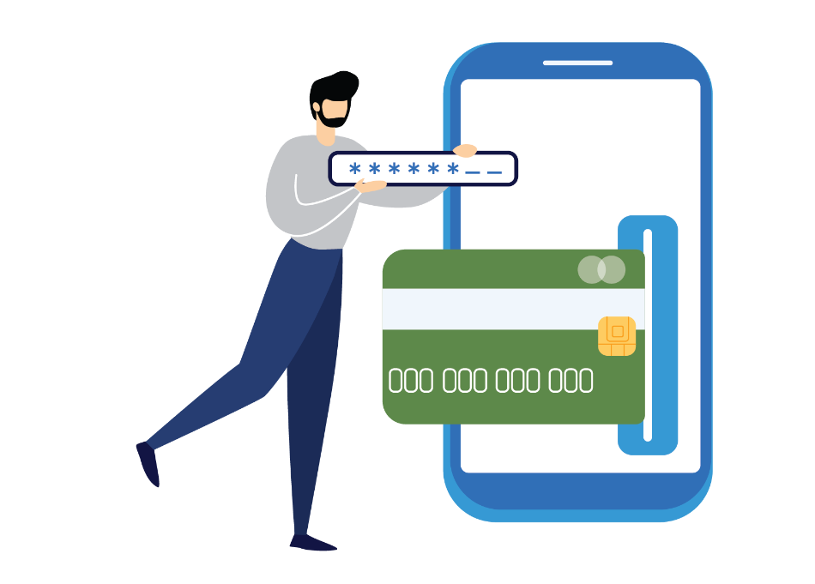
eWallet Project
CSIS 2200-008 - Systems Analysis & Design
July 27th, 2023
Group 2
Charlie Medialdea
Gunther Ogo
Ruchirani Adikaramge
Winnie Chen

Slide 2




Our Project aims to design an integrated electronic wallet through an app for cell phones that enables users to consult all bank accounts information in a single platform and allows them to use it as a means of payment.
Users have accounts at several banks, with each institution issuing its physical card, creating difficulties in carrying several cards in the wallet.
Although the banks provide specifics application for cell phones, it is necessary to log in to each account every time the user wants to, for instance, check the balance or make a payment.
In today's world characterized by information integration, reducing steps and creating convenience for users is necessary.
Provide users convenience and speed when consulting information from different banks in a single platform.
Be an accepted means of payment in any commercial establishment and for any product and service.

Slide 3

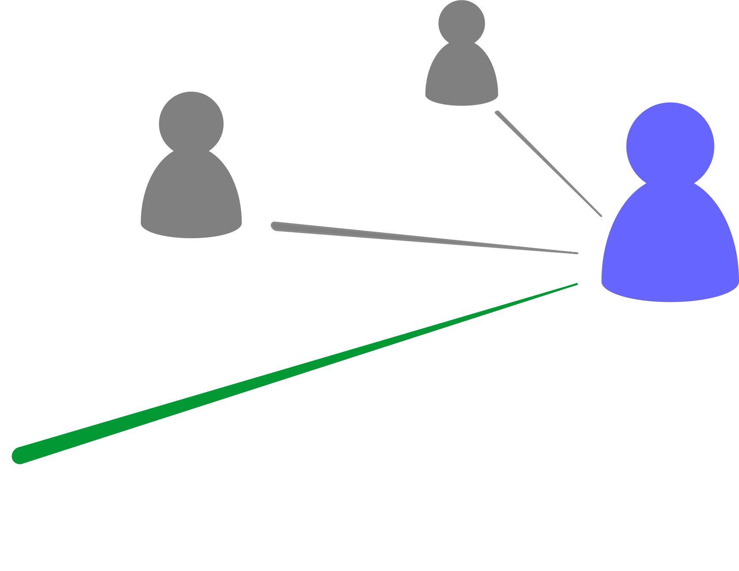





How does it work?
Each and every bank has integrated into the e-wallet application.
When a person opens an account, it directly giving access to the integrated app. Can use SIN or BC ID number as the common field to integrate all bank accounts to this app.
All the bank accounts and credit cards of the customer are visible in the home of e-wallet with the outstanding balance.
A customer can choose any bank account from that when making a payment without individually logging to each bank separately.
Can have access to integrated or individual account transactions history and all the other facilities available in traditional online banking apps.
eWallet

Slide 4

Users
Performing financial transactions can be a hassle for many individuals.
However, with e-Wallet, users will see an improvement in their everyday life. With their finances in one place, users can experience the ease of paying their bills, reloading monthly passes or prepaid cards, and managing their banking transactions with a single touch.

Slide 5


Functional Requirements
Linking e-Wallet to Bank account
Ability to link my e-Wallet to my bank account seamlessly. This functionality will enable me to transfer funds between my e-Wallet and bank account, facilitating easy and secure transactions.
Reloading Compass Card via e-Wallet
Convenience of reloading their Compass Card directly through the e-Wallet feature. This functionality will enable users to add funds to their Compass Card digitally, ensuring a seamless and efficient transit experience.
View All Bank Account Details
Ability to view all their linked bank accounts and relevant details within the application. This feature will offer users an overview of their financial accounts and facilitate easy access to essential information.

Slide 6
Functional Requirements
Payment via e-Wallet at Point of Sale (POS) in Any Store
Enable users to make payments seamlessly and securely at any physical store or point of sale (POS) that supports e-Wallet transactions. This functionality will provide users with a convenient and efficient way to complete purchases using their e-Wallet balance.
Bill Payment via e-Wallet
Offer users the capability to pay their bills seamlessly and securely using funds available in their e-Wallet balance.

Slide 7


Nonfunctional Requirements
Security and Privacy Measures
Implement robust security and privacy measures to ensure the confidentiality, integrity, and availability of user data and transactions.
Cross-Platform Compatibility and Consistency
Shall exhibit cross-platform compatibility, ensuring consistent functionality and user experience across various operating systems and devices.
User-Friendly Interface and User Experience
Prioritize user-friendliness, offering an intuitive and seamless interface that enhances user experience and minimizes the learning curve for users of varying technical backgrounds.

Slide 8
Video

