Slide 1

SEAS Educational Resource Management System
Presented by: Group 04
Date: May 11, 2017
Guided by: Dr. Daxesh Shah
Ms. Purnima Shah
CSC251 - Database Management System Lab
Group Members
Ashna Jain (201501008)
Dhruti Chandarana (201501015)
Charmi Chokshi (201501021)
Manasi Dubey (201501051)

Slide 2
Outline
Project Description
Entity Relation Diagram
Schema Diagram
Attribute, Data type and Constraints of each Entity
List of Queries
Normalised form of tables
Queries and Output
Queries using Stored Procedures
Queries using Triggers

Slide 3
Project Description
An organized and systematic office solution is essential for all universities and organizations.
There are many departments of administration for the maintenance of college information and student databases in any institution.
All the modules in college administration are interdependent. So they need to be centralized as, Information from one module will be needed by other modules.
The SEAS Educational Resource Management System is an automated version of manual system. In case of manual system they need a lot of time, manpower etc. Here all work is computerized. So the accuracy is maintained. Maintaining backup is very easy which it can do with in a few minutes.

Slide 4
Project Description Cont…
SEAS Educational Resource Management System deals with
All kind of student details
Professor details
Course & Exam details
Internship details
E-learning material details
Book & book store details
Summer Project details and other resource related details too.
Thus, this can be a very useful data base for the SEASers because it includes almost all kind of details related to study from the very first day at college to the last day!

Slide 5
Main features of this Database System
Find out internships
Find summer projects & extra credit courses of university
Know about exam schedule
Explore professor details
Checkout library availability status of any book
Find book shops near you
Find softcopy of books
Explore E-Learning
Know about upcoming events and seminars
Checkout your attendance
Know your Credits subject vies
Find backups

Slide 6
Entity Relationship
Diagram

Slide 7
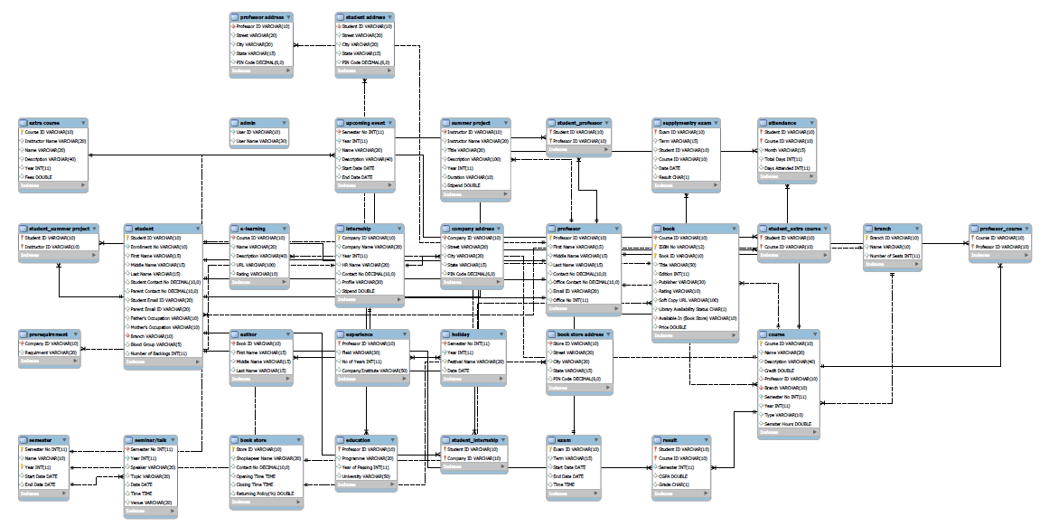
Schema Diagram

Slide 8
Attributes , Data Types and Constraint of Some Important Entities
Entity: Student
Attribute | Data type | Constraints
Student ID | Varchar(10) | Primary Key
Enrollment No | Varchar(10) | Not Null
First Name | Varchar(15) | Not Null
Middle Name | Varchar(15) | Not Null
Last Name | Varchar(15) | Not Null
Student Contact No | Decimal(10, 0) | Not Null
Parent Contact No | Decimal(10, 0) | Not Null
Student Email ID | Varchar(20) | Not Null
Parent Email ID | Varchar(20) | Not Null
Father’s Occupation | Varchar(10) | Not Null
Mother’s Occupation | Varchar(10) | Not Null
Branch | Varchar(10) | Foreign Key(Branch), Not null
Blood Group | Varchar(5) | Not Null
Number of Backlogs | Int
In the table shown above we have Student ID as the primary key which is unique for each row . The various other attributes store the details of the students which is provided to the institution at the time of admission.

Slide 9
Entity: Professor
Attribute | Datatype | Constraints
Professor ID | Varchar(10) | Primary Key
First Name | Varchar(20) | Not Null
Middle Name | Varchar(20) | Not Null
Last Name | Varchar(20) | Not Null
Contact No | Decimal(10, 0) | Not Null
Office Contact No | Decimal(10, 0) | Not Null
Email ID | Varchar(20) | Not Null
Office No | Int | Not Null
In the table shown above Professor ID is the primary key which uniquely identifies each professor. This table stores the personal details of the professor.
Entity: Book
Attribute | Datatype | Constraints
Course ID | Varchar(10) | Foreign Key(Course), Not
 |  | Null
ISBN No | Varchar(12) | Not Null
Book ID | Varchar(10) | Primary Key
Title | Varchar(50) | Not Null
Edition | Int
Publisher | Varchar(30) | Not Null
Rating | Varchar(10)
Soft Copy URL | Varchar(100)
Library Availability Status | Char | Not Null
Available In (Book Store) | Varchar(10)
Price | Real | Not Null
In the book table Book ID is the primary key which uniquely identifies each book. This table provides complete description of each book along with the URL of soft copy of the book.

Slide 10
Entity: Course
Attribute | Data type | Constraints
Course ID | VARCHAR(10) | PRIMARY KEY, NOT NULL
Name | VARCHAR(20) | NOT NULL
Description | VARCHAR(40) | NOT NULL
Credit | REAL | Foreign key (Professor), NOT
 |  | NULL
Professor ID | VARCHAR(10) | UNIQUE, NOT NULL
Branch | VARCHAR(10) | Foreign key (Branch), NOT
 |  | NULL
Semester No | INT | NOT NULL
Year | INT | NOT NULL
Type (core, elective) | VARCHAR(10) | NOT NULL
Semester Hours | REAL
In the table shown above we have Course ID as primary key which uniquely identifies each course. This table stores the complete description of a particular course along with the semester and the year in which the course is offered.
Entity: Internship
Attribute | Data type | Constraints
Company ID | Varchar(10) | Primary Key, Not Null
Company Name | Varchar(20) | Not Null
Year | Int | Not Null
HR Name | Varchar(20) | Not Null
Contact No | Decimal(10, 0) | Not Null
Profile | Varchar(30)
Stipend | Real
In the table shown above we have Company ID as primary key which uniquely identifies internship offer of each company. This table stores the complete description of a internship offered along with the profile the company looks for and the stipend they offer .

Slide 11
Entity: Semester
Attribute | Data type | Constraints
Semester No | INT | PRIMARY KEY, NOT NULL
Year | INT
Name (winter /monsoon) | VARCHAR(10) | NOT NULL
Start Date | DATE | NOT NULL
End Date | DATE
In the table shown above we have semester no and year as primary key which uniquely identifies each semester. This table stores the details like name, start date and end date of each semester.
Entity: Exam
In the table shown above we have exam id as the primary key which is unique for every exam conducted in each semester. This semester stores the details of the exam like the term in which the exam takes place and the start date and end date of exam.
Attribute | Data type | Constraints
Exam ID | VARCHAR(10) | PRIMARY KEY, NOT NULL
Term | VARCHAR(15) | NOT NULL
Start Date | DATE | NOT NULL
End Date | DATE | NOT NULL
Time | TIME | NOT NULL

Slide 12
Entity: Result
Attribute | Data type | Constraints
Student ID | VARCHAR(10) | PRIMARY KEY, FOREIGN
 |  | KEY(Student),NOT NULL
Course ID | VARCHAR(10) | PRIMARY KEY, FOREIGN
 |  | KEY(Course), NOT NULL
Semester | INT | NOT NULL
CGPA | REAL | NOT NULL
Grade | CHAR | NOT NULL
In the table shown above we have Student ID and Course ID as the primary key. Student ID denotes each student uniquely and Course ID denotes the course in which result has been declared.
Entity: Extra course
Attribute | Data Type | Constraints
Course ID | Varchar(10) | Not null
Instructor Name | Varchar(20) | Not null
Name | Varchar(20) | Not null
Description | Varchar(40) | -
Year | Int | Not null
Fees | Double | -
In the table shown above we have Course ID as the primary key. This table stores the details of the extra course provided by the institution along with the fees that should be paid to pursue the extra course.

Slide 13
Entity: Summer Project
Attribute | Data Type | Constraints
Instructor ID | Varchar(10) | Not null
Instructor Name | Varchar(20) | Not null
Title | Varchar(20) | Not null
Description | Varchar(100) | -
Year | Int | Not null
Duration | Varchar(10) | Not null
Stipend | Double | -
This table stores the description of summer project provided in each course. During summer vacation if a student wants to know the details of the project in a specific subject he may refer this table and contact the specific instructor in case he wants to join the project.
Entity: Attendance
Attribute | Data Type | Constraints
Student ID | Varchar(10) | Not null
Course ID | Varchar(10) | Not null
Month | Varchar(15) | Not null
Total Days | Int | Not null
Days Attended | Int | Not null
This table stores the attendance of each student in every subject month-wise. This table helps the institution to know the details of the students who have less attendance.

Slide 14
List of Queries
List the students who have attendance less the 80% in course ‘X’.
Retrieve all students of B.Tech.(ICT) batch ‘X’ having CGPA >= 3.0.
Display the Grade of student ‘X’ in course ‘Y’
List IDs of students of B.Tech.(ICT) batch ‘X’ having any F grade in subject ‘Y’.
List the pre requirements of company ‘X’ for profile ‘Y’.
List company names who are offering stipend more than amount ‘X’.
List all the offered summer projects in year ‘X’.
Find number of students in batch ‘X’ and branch ‘Y’.
List the names of professors who has experience of more than 10 years.
List professors having experience in field /company ‘X’.
Display the speaker and topic of talk on date ‘X’.

Slide 15
Cont…
Display all the seminars of month ‘X’ in year ‘Y’.
List the students who have taken extra course ‘X’ under the mentorship of instructor ‘Y’.
Display URL of soft copy of all the courses of semester ‘X’ of branch ‘Y’.
List the students who have taken extra course after every semester.
List out all the books of course ‘X’.
Find the library availability status of book ‘X’.
List all the book store of city ‘X’ having book ‘Y’.
Show all the books of course ‘X’ in ascending order of their rating.
Display the starting and ending date of mid semester and end semester exam of semester ‘X’.
Display top 3 students of course ‘X’.

Slide 16
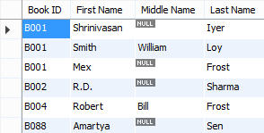
Normalized Form of Tables
1st Normal Form:
All tables in our project are in 1st normal form as no table contained multivalued attributes.
Tables that contained multivalued attributes are student, professor, book, internship and book store.
To make these tables in 1st NF we have created separate tables that contained only multivalued attributes.
Table shown in image is Book Author table.
As we can see that one book has multiple authors, so we cannot include this attribute in book table.

Slide 17
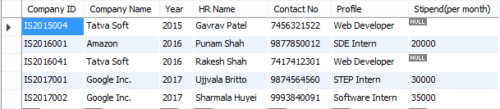
2nd Normal Form:
All tables in our project are in 2nd normal form as no table contains any partial dependency.
Which is not any non- prime attribute depends on any subset of candidate key, means all non- prime attributes depends on whole candidate key.
Table shown in image is internship table, as we can see that all non- prime attribute depends on whole candidate key which is “Company ID”.

Slide 18
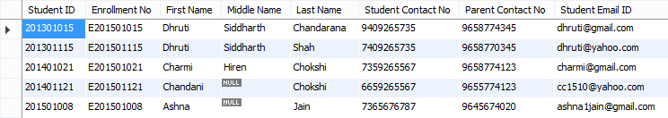
3rd Normal Form:
All tables in our project are in 3rd normal form, as there in no transitive dependency between attributes.
Which is not any non- prime attribute depends on non- prime attributes, means all non- prime attributes depends only on prime/ candidate key.
Table shown in image is professor table, We can also derive contact number of students from their name too that represent transitive dependency.
But it may be possible that two students have the same name, in this case contact number depends on Student ID only (candidate key); which represent 3rd normal form.

Slide 19
Boyce–Codd Normal Form (BCNF):
BCNF represents that there is no functional dependency in any table.
Which is that no prime attribute depends on any non- prime attribute.
In our project Student table has a functional dependency between attributes ‘Student ID’ and ‘Enrolment ID’.
Table shown in image in Student table, as we can see that ‘Student ID’ can be obtained from ‘Enrolment No’.
To remove this functional dependency we have created another table that contains only these two attributes.

Slide 20
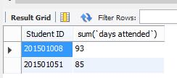

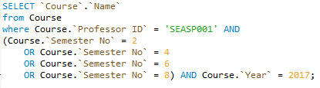
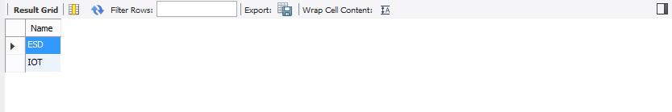
Queries and Output
Query: - Total Attendance of students for course ‘X’.
Query: - Name of courses taken by professor ‘X’ in winter.

Slide 21
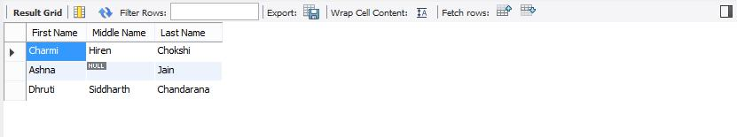


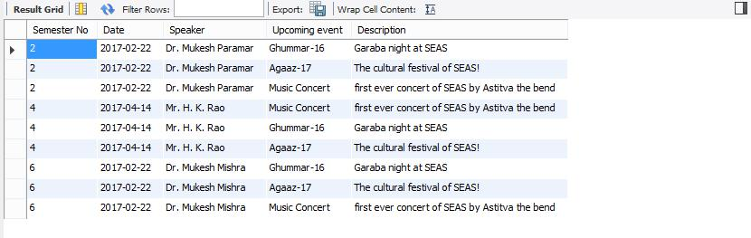
Query: - Top 3 Students of course ‘X’.
Query: - List of seminar/ talk details for in ascending order of semester.

Slide 22
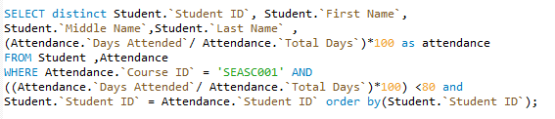

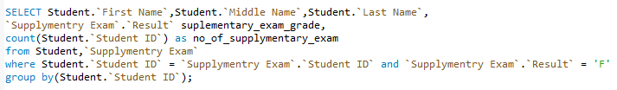
Query:- Display the details of all the students whose attendance is less than 80% in DBMS.
Query:- Display the details of student who have failed in supplementary exam.

Slide 23

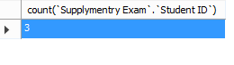
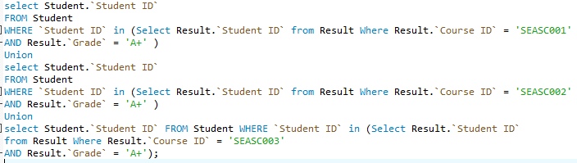
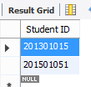
Query:-Find the total number of students from ICT branch who have to give supplementary exam.
Query:-Find the IDs of students who have A+ in ESD or A+ in Economics or A+ in ADC.

Slide 24
Inserting Using Sequence
CREATE TABLE Admin(
`User ID` INT(4) NOT NULL PRIMARY KEY AUTO_INCREMENT ,
`User Name` VARCHAR(30)
);
EXPLANATION:
While creating table admin the attribute ‘User ID’ is defined by auto increment function which indicates that whenever a new value is entered the attribute ‘User ID’ is automatically incremented.

Slide 25
Stored Procedures
A stored procedure is a set of Structured Query Language (SQL) statements to execute a particular instruction with a name assigned to it, so it can be reused to execute the same set of instruction with different values of parameters in it.
Benefits of using Stored Procedures:
Using stored procedures we can access and modify data in database.
It improves the productivity as statements in a stored procedure must be written once.
It reduces the network traffic on server as only the call to execute stored procedure needs to be sent over a network instead of writing every single line of the code.

Slide 26
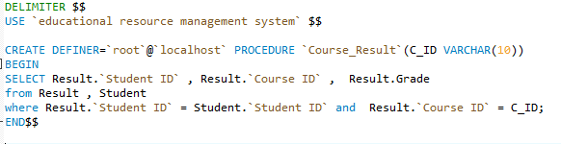
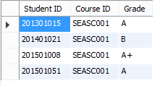
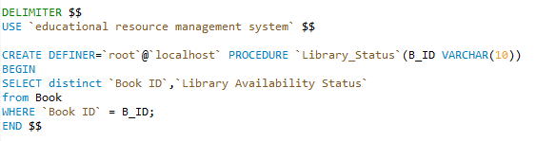

Examples
Example shown in image is to find out result details of a particular course as to find out overall performance in a particular subject, this is important and it is frequently used by professor and admin staff.
Example shown in image is to find out library status of a book, it is frequently used by students as it is important for them to check a library status of a particular book.

Slide 27
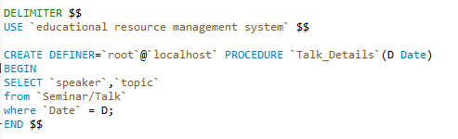

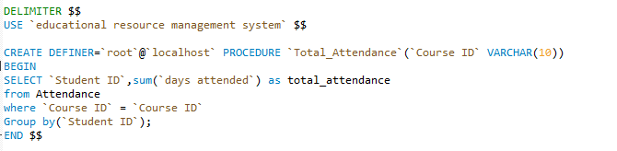

Example shown in image is to find out talk/seminar details of a particular day, which is frequently used by students.
Example shown in image is to find out total attendance of students in a particular course, this is frequently used by professor.

Slide 28
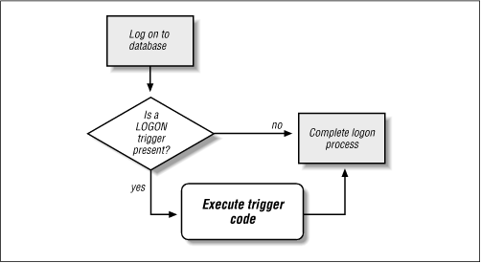
Trigger in DBMS
A trigger is a special kind of stored procedure that automatically executes when an event occurs in the database server.
DML triggers execute when a user tries to modify data through a data manipulation language (DML) event.
DML events are INSERT, UPDATE, or DELETE statements on a table or view.
These triggers fire when any valid event is fired, regardless of whether or not any table rows are affected.
Types of Triggers:
Row Triggers and Statement Triggers
BEFORE and AFTER Triggers
INSTEAD OF Triggers
Triggers on System Events and User Events

Slide 29
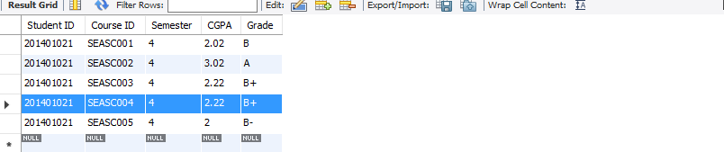
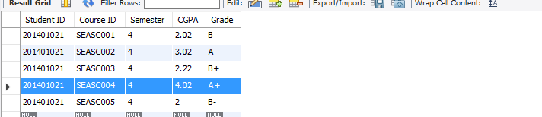

Queries using Triggers
Backing up data of Result table
This trigger will insert data in new table whenever result table is updated
Inserted data in table Result
Updated data in table Result
Backed up data in table trigger_result after update

Slide 30
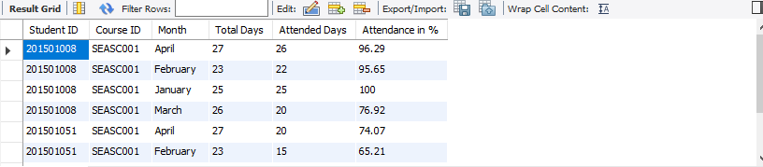
Cont…
Auto generate attendance in %
This trigger will calculate % of days attended in given month of a student at the time of insertion.

Slide 31
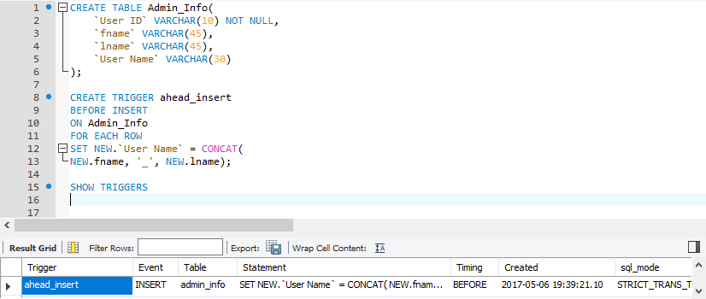
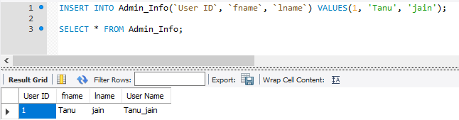
Cont…
Auto generate Username of Admin
This trigger will generate username for admin people whenever their first and last name is inserted into database.
Created trigger Before Insert
Output of admin table

Slide 32
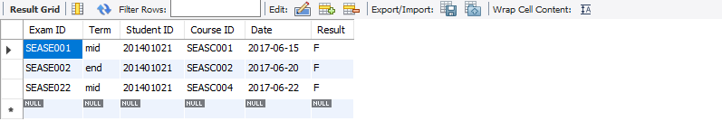
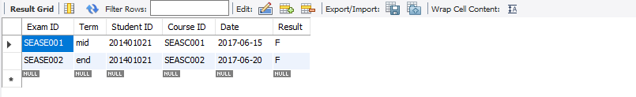

Cont…
Storing details of deleted student from supplementary exam table
This trigger will help to insert data of students in new backed up table whenever data is deleted form supplementary exam table.
Inserted data in supplementary exam table
When student 201401021 passes course SEASC004
Backed up data in trigger_s_exam table after deleting it from main table

Slide 33
Thank you!

