Slide 1

Travel Agency
Anusha Chandrakanth Lingadahalli (NUID:001007696)
Charmi Nimishkumar Dalal (NUID: 001582441)
Dinesh kumar Ravikumar (NUID: 001038358)

Slide 2


Problem Statement
Build an effective application to solve the real world problems and improve the features of travel agency, to make booking and traveling easier for the customers. The application is Multi-retailer and multi-airliner inventory system that enables the travel agency to manage its operations at the customer, flight schedule, including the car booking and hotel booking levels.

Slide 3

Airliner Directory
Airliner Directory has array of Airliners and connected to Flight and travel agency.
Airliner has all the details of the airlines.

Slide 4
Customer Directory
Customer Directory has all the details of customer personal details, Flight Booking details.
Using Travel agency customer directory can be accessed.
Customer is also connected to car directory and hotel directory with bookingID.

Slide 5

Flight Directory
Flight Directory has all the information to schedule the flight and it is connected to Airliner Directory and Travel agency.

Slide 6

Car Directory
Car Directory contains all the details of car such as Car Number,Destination,Source,Driver details and if the car is available at that location at that time or not.
Car directory is connected to travel agency and Through travel agency using bookingID we can link customer to cab rides.

Slide 7
Hotel Directory
Hotel Directory contains all the details of hotel room as Hotel Number, Location and if the room is available at that time or not.
Hotel directory is connected to travel agency and Through travel agency using bookingID we can link customer to hotel room.

Slide 8
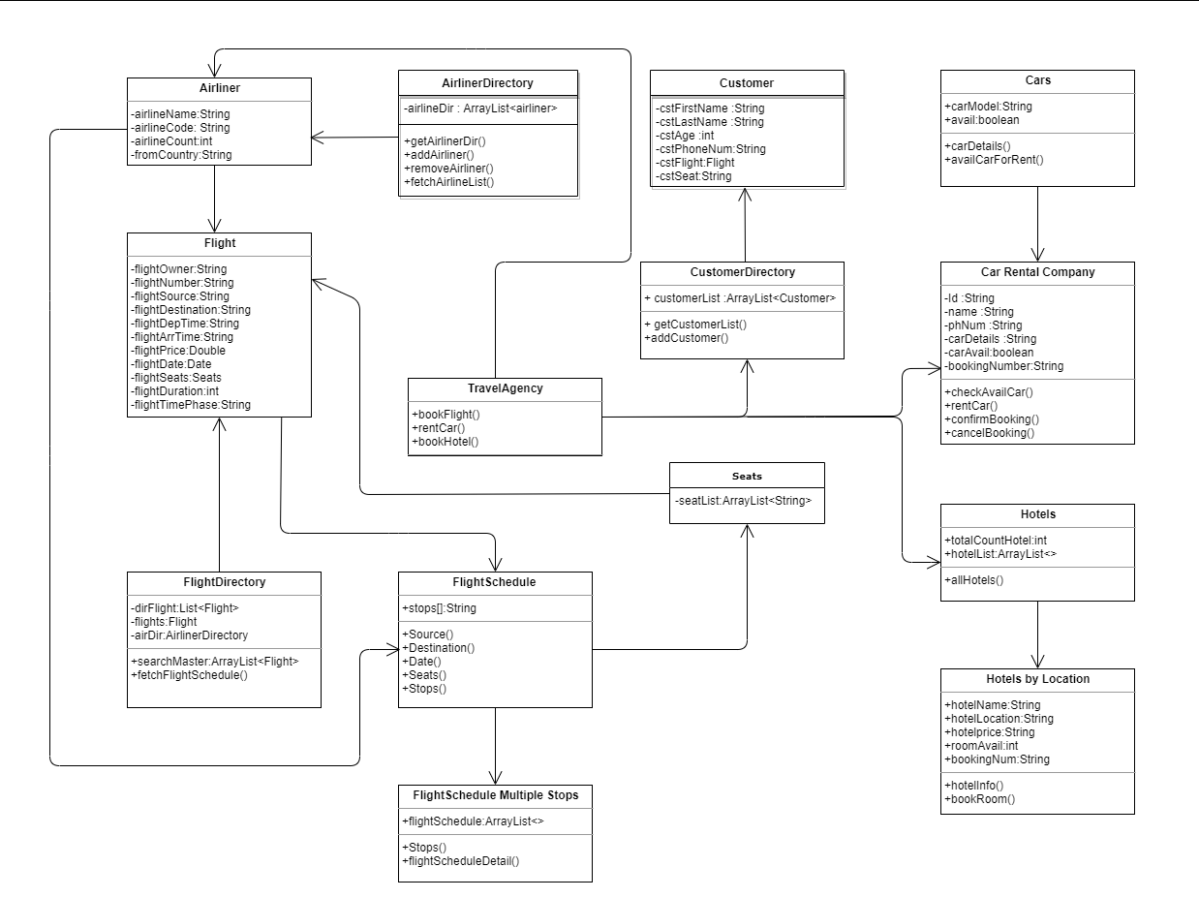
Object Model

Slide 9

Thank You.

