Slide 1




Smart Meeting and Intelligent Lecture Analytics Platform
Students Name:
Omkar Kasar (23)
Charmi Mehta (31)
Fahim Shaikh (43)
UNDER GUIDENCE OF : Prof. Sweta Nigam

Slide 2

DigiRoom is an AI-powered online learning platform designed to improve virtual education through enhanced student engagement and interaction.
It enables teachers to conduct online classes, share study materials, create assessments, and monitor student progress. Using AI-based analysis of student behavior, attendance, participation, and performance, the system provides insights and personalized learning support.
DigiRoom aims to create an interactive, efficient, and learner-centered online education environment.

Slide 3

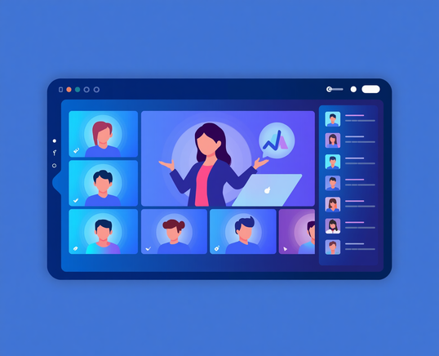
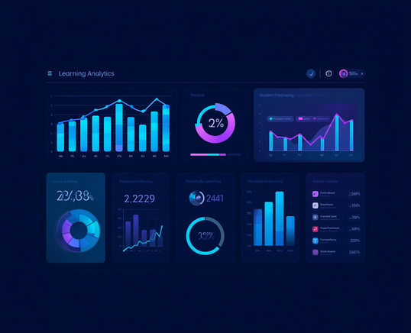

Objectives of DigiRoom
Live Classes & Attendance
Analytics & Learning
Conduct live online classes and automate attendance tracking seamlessly.
Simple tools to watch student focus and clear learning insights. Every lecture saved for later
Communication & Engagement
Enable real-time interaction and monitor student engagement effectively.

Slide 4

Problem Statement
Online learning platforms often face challenges such as low student engagement, limited teacher-student interaction, difficulty in monitoring participation, and a lack of personalized learning support.
Teachers struggle to assess student attentiveness and track progress effectively in virtual classrooms.
To address these issues, DigiRoom proposes an AI-powered online learning platform that monitors student engagement, analyzes learning behavior, and provides personalized recommendations, creating a more interactive, efficient, and learner-centered educational environment.

Slide 5

System Architecture
Architecture Flow
Institute
↓
Teacher
↓
Live Lecture
↓
FastAPI / Socket.IO / WebRTC
↓
Students
↓
Attendance · Analytics · Materials · Polls · Chat · Recordings
Core Technologies
FastAPI — Backend REST API & server logic
WebRTC — Peer-to-peer live video & audio streaming
Socket.IO — Real-time event communication
SQLite — Lightweight relational database
JSON + File System — Material & recording storage
AI & Analytics Stack
MediaPipe — Face detection & landmark tracking for attention monitoring
OpenCV — Frame processing & local video analysis

Slide 6

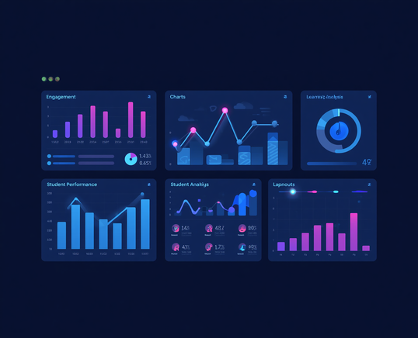
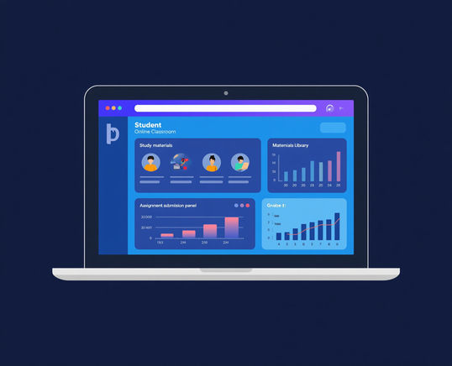
System Modules
Teacher Module
AI Analytics Module
Manage courses
Upload study materials
Schedule classes
Create assignments
View analytics
Engagement monitoring
Performance tracking
Learning insights
Student Module
Join classes
Access materials
Submit assignments
View performance

Slide 7

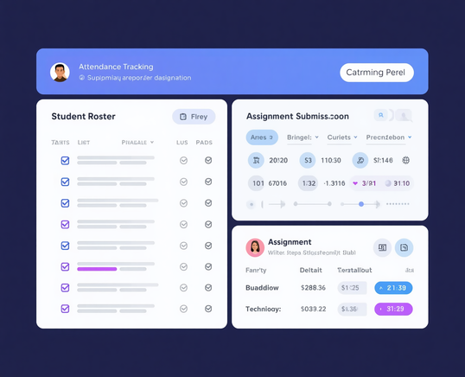

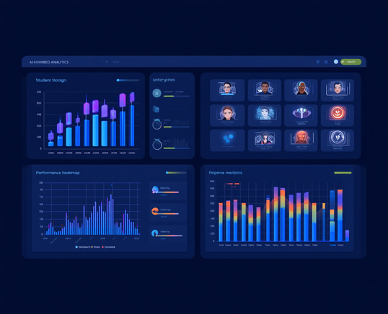
Attendance
Automated attendance tracking .
Key Features
Live Virtual Classroom
AI Engagement Analysis
Live classes, study material sharing, and real-time teacher-student interaction.
AI-powered student progress tracking, engagement monitoring, and performance insights.

Slide 8

AI-Powered Analytics
AI Features:
Facial Expression Analysis
Eye Movement Tracking
Head Pose Detection
Attendance Analytics
Participation Monitoring
Performance Evaluation
Benefits:
Identify disengaged students
Improve learning outcomes
Support personalized learning experiences.

Slide 9




Technology Stack
Frontend
Backend & Database
AI & Dev Tools
HTML , CSS for UI
and JavaScript for functioning
SQLite + SQLAlchemy, Socket.IO, WebRTC, FastAPI
OpenCV, MediaPipe, AI Models, Visual Studio, VS Code.

Slide 10

Conclusion
Successfully Developed
✔ Smart Virtual Classroom with live video & audio
✔ Automated Attendance Tracking system
✔ Real-Time Analytics & Attention Monitoring
✔ Live Polls, Chat & Communication Platform
✔ Privacy-focused, student-first architecture
Future Scope
✦ AI-powered Lecture Summaries using Ollama
✦ Cloud Deployment for scalability
✦ Mobile Application for Android & iOS
✦ Advanced Learning Analytics & Reports
✦ Chapter-Based Lecture Navigation

Slide 11
Thank You!!!!!!!

