Slide 1
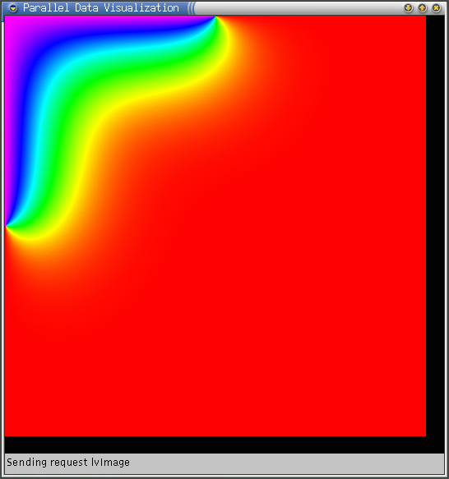
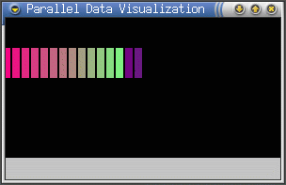
LiveViz – What is it?
Charm++ library
Visualization tool
Inspect your program’s current state
Client runs on any machine (java)
You code the image generation
2D and 3D modes

Slide 2
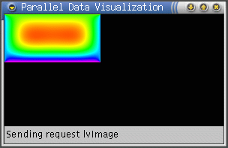
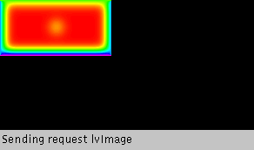
LiveViz – Monitoring Your Application
LiveViz allows you to watch your application’s progress
Can use it from work or home
Doesn’t slow down computation when there is no client

Slide 3
Documentation
http://charm.cs.illinois.edu/manuals/html/libraries/6.html
Or,(same material) section 6 of:
  http://charm.cs.illinois.edu/manuals/html/libraries/manual-1p.html
There are example programs, but:
  Old ones will not work (see the warning in section 6.7)
  Make sure liveVizInit call takes the 4th “opts” parameter, which means you are looking at an example with modern correct interface
See: http://charm.cs.uiuc.edu/tutorial/LiveViz.htm

Slide 4
How to use LiveViz
Get the Java Client: LiveViz (from ccs_tools) on to your desktop machine
How to run the charm program as a liveviz server
How to connect the client to server
How to construct the image/s
  On demand (This is what we will focus on)
  In Push mode

Slide 5
LiveViz Client
Client runs on your desktop
Server may be a remote machine,
  or as a special case,, for testing, your desktop
Client is a java app
Download (git clone) ccs_tools from charm website
The tool is in ccs_tools/bin/LiveViz

Slide 6
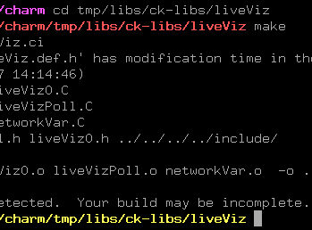
LiveViz - Compilation
Should not be needed
Compile the LiveViz library itself
  Must have built charm++ first!
From the charm directory, run:
  cd tmp/libs/ck-libs/liveViz
  make

Slide 7
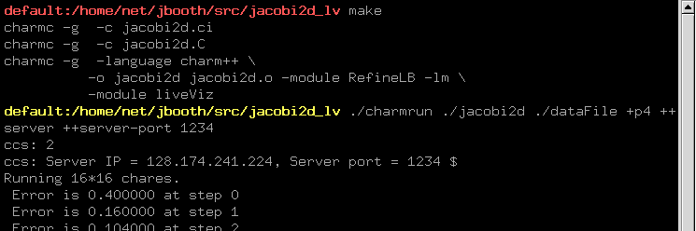
Running LiveViz
Build and run the server
  cd pgms/charm++/ccs/liveViz/serverpush
  Make
  ./run_server
Or in detail…

Slide 8
Running LiveViz
Run the client
  cd pgms/charm++/ccs/liveViz/client
  ./run_client [<host> [<port>]]
Should get a result window:

Slide 9
LiveViz Request Model
Client
Get Image
LiveViz Server Code
Send Image to Client
Image Chunk Passed to Server
Buffer Request
Server Combines Image Chunks
Poll Request Returns Work
Poll for Request
Parallel Application

Slide 10
When you run your charm++ program
./charmrun ./lvServer +p2 ++server ++server-port 1234
~/ccs_tools/bin/LiveViz localhost 1234
1234 is a port number .
You can (and should) use other port numbers
Tell the client the same # that you give to the server
In repeated runs, change the port#.. It stays in use for several seconds after the program is terminated.

Slide 11
abc

Slide 12
abc

Slide 13
abc

Slide 14
abc

Slide 15
Jacobi 2D Example Structure
Main:
Setup worker array, pass data to them
Workers:
Start looping
Send messages to all neighbors with ghost rows
Wait for all neighbors to send ghost rows to me
Once they arrive, do the regular Jacobi relaxation
Calculate maximum error, do a reduction to compute
global maximum error
If timestep is a multiple of 64, load balance the
computation. Then restart the loop.
Main:
Setup worker array, pass data to them
Workers:
Start looping
Send messages to all neighbors with ghost rows
Wait for all neighbors to send ghost rows to me
Once they arrive, do the regular Jacobi relaxation
Calculate maximum error, do a reduction to compute
global maximum error
If timestep is a multiple of 64, load balance the
computation. Then restart the loop.
Main:
Setup worker array, pass data to them
Workers:
Start looping
Send messages to all neighbors with ghost rows
Wait for all neighbors to send ghost rows to me
Once they arrive, do the regular Jacobi relaxation
Calculate maximum error, do a reduction to compute
global maximum error
If timestep is a multiple of 64, load balance the
computation. Then restart the loop.

Slide 16
LiveViz Setup
#include <liveVizPoll.h>
void main::main(. . .) {
// Do misc initilization stuff
// Now create the (empty) jacobi 2D array
work = CProxy_matrix::ckNew(0);
// Distribute work to the array, filling it as you do
}
#include <liveVizPoll.h>
void main::main(. . .) {
// Do misc initilization stuff
// Create the workers and register with liveviz
CkArrayOptions opts(0); // By default allocate 0
// array elements.
liveVizConfig cfg(true, true); // color image = true and
// animate image = true
liveVizPollInit(cfg, opts); // Initialize the library
// Now create the jacobi 2D array
work = CProxy_matrix::ckNew(opts);
// Distribute work to the array, filling it as you do
}

Slide 17
Adding LiveViz To Your Code
void matrix::serviceLiveViz() {
liveVizPollRequestMsg *m;
while ( (m = liveVizPoll((ArrayElement *)this, timestep))
!= NULL ) {
requestNextFrame(m);
}
}
void matrix::startTimeSlice() {
// Send ghost row north, south, east, west, . . .
sendMsg(dims.x-2, NORTH, dims.x+1, 1, +0, -1);
}
void matrix::startTimeSlice() {
// Send ghost row north, south, east, west, . . .
sendMsg(dims.x-2, NORTH, dims.x+1, 1, +0, -1);
// Now having sent all our ghosts, service liveViz
// while waiting for neighbor’s ghosts to arrive.
serviceLiveViz();
}

Slide 18
Generate an Image For a Request
void matrix::requestNextFrame(liveVizPollRequestMsg *m) {
// Compute the dimensions of the image bit we’ll send
// Compute the image data of the chunk we’ll send –
// image data is just a linear array of bytes in row-major
// order. For greyscale it’s 1 byte, for color it’s 3
// bytes (rgb).
// The liveViz library routine colorScale(value, min, max,
// *array) will rainbow-color your data automatically.
// Finally, return the image data to the library
liveVizPollDeposit((ArrayElement *)this, timestep, m,
loc_x, loc_y, width, height, imageBits);
}

Slide 19
Link With The LiveViz Library
OPTS=-g
CHARMC=charmc $(OPTS)
LB=-module RefineLB
OBJS = jacobi2d.o
all: jacobi2d
jacobi2d: $(OBJS)
$(CHARMC) -language charm++ \
-o jacobi2d $(OBJS) $(LB) –lm
jacobi2d.o: jacobi2d.C jacobi2d.decl.h
$(CHARMC) -c jacobi2d.C
OPTS=-g
CHARMC=charmc $(OPTS)
LB=-module RefineLB
OBJS = jacobi2d.o
all: jacobi2d
jacobi2d: $(OBJS)
$(CHARMC) -language charm++ \
-o jacobi2d $(OBJS) $(LB) -lm \
-module liveViz
jacobi2d.o: jacobi2d.C jacobi2d.decl.h
$(CHARMC) -c jacobi2d.C

Slide 20
LiveViz Summary
Easy to use visualization library
Simple code handles any number of clients
Doesn’t slow computation when there are no clients connected
Works in parallel, with load balancing, etc.

