Slide 1

Card Recommender
Charlie Jansen

Slide 2
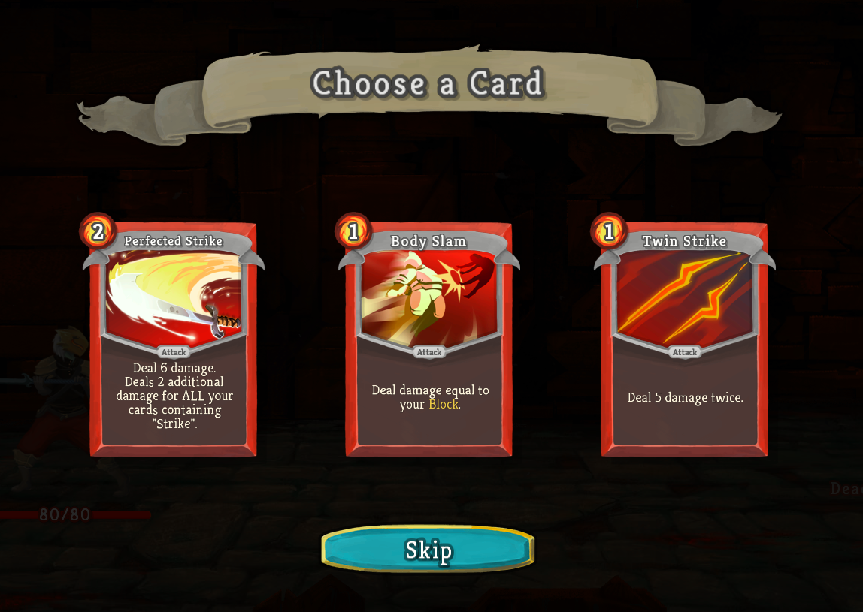
What is STS?
Why does this matter?
Deckbuilder Roguelike
Easy(ish) to learn, hard to master
Card rewards: choose 1 of 3 (usually)
Picking the correct card is difficult
Takes a ton of time (hundreds of hours) to learn cards
The answer is almost always “it depends”

Slide 3
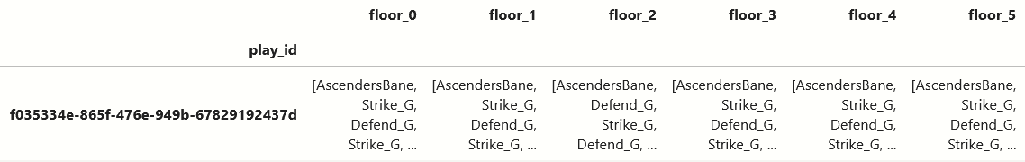
The Data
A dataset of 77 million Slay the Spire runs, made public by the developers of the game
I used a subset of 422,000 runs, filtered for only “good runs”
  Runs that made it far, only on high difficulty
  Ensured that the choices being made were relatively good choices, made by somewhat knowledgeable players
Ended with ~6700 “good runs,” with ~1340 of those set aside as a test set
Processed into a form that would contain the deck state of each run at each floor

Slide 4
The Models
v
01
Pick Rate Recommender
Recommends the card with the highest pick rate (is picked the most when offered)
02
High Rarity Recommender
Recommends the highest rarity card (very simple)
03
Appearance Rate Recommender
Recommends the card that appears the most often in final decks
04
Nearest Neighbors & Deck State
Finds the runs with the most similar decks, and recommends the card that those runs picked most often in the next few floors

Slide 5
Model Analysis
Metric of choice: Accuracy
Model | Accuracy
Random | 0.27
Pick Rate | 0.49
High Rarity | 0.35
Appearance Rate | 0.40
Nearest Neighbors | 0.79

Slide 6
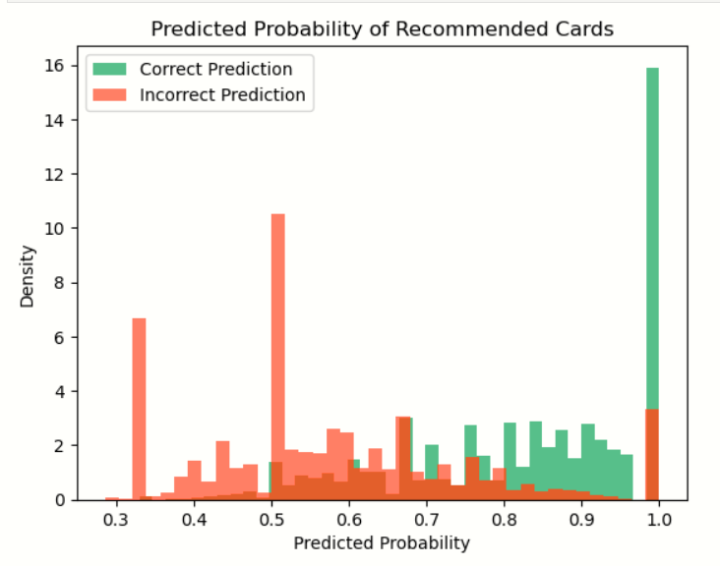
Model Analysis - Best Model
All models give “probabilities” of the recommendation
More like “confidence”
>~0.7 confidence more likely to be correct
Maybe do more to determine recommendation in low confidence cases

Slide 7
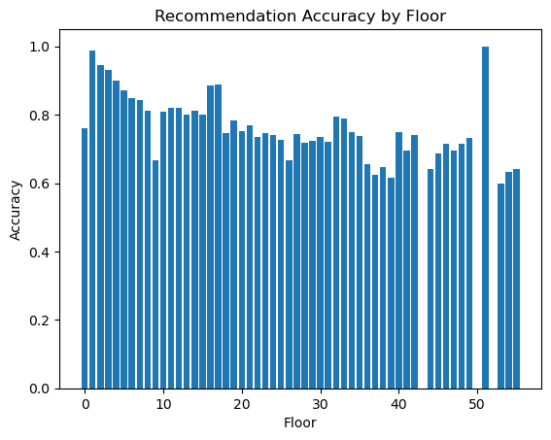
Model Analysis - Best Model
Model is more accurate on earlier floors
Accuracy decreases over time
Lower accuracy later is fine, still more than ~66% for most floors
Performance on earlier floors is more important to me

Slide 8
THANK YOU
Any questions?

