Slide 1
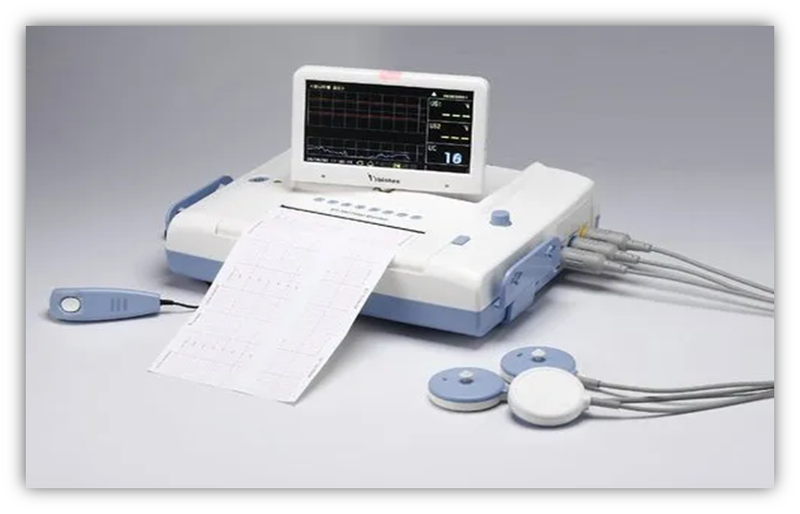
Charrie Mascio
Cardiotocogram
Fetal Health Classification

