Slide 1
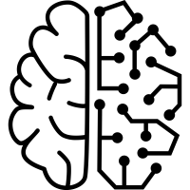
Machine Learning for Malignant Tumor Identification
Group W1

Slide 2
Introductions
Roger Goldsmith
Claire Harris
Mark Izquierdo
Author 1
Author 2
Author 3
Roger Goldsmith
Claire Harris
Mark Izquierdo

Slide 3
Agenda
Overview
Project Objective
Data Overview
Machine Learning Techniques
Conclusion

Slide 4
Breast Cancer and Misdiagnosis
False negatives lead to delay in diagnosis and treatment of breast cancer
Histopathological interpretation is a significant cause of false-negative results
2.23%
False Negatives Utilizing Current Methods
Notes:
Histopathological interpretation is a significant cause of false-negative results of needle biopsies of the breast.
In one study, 2.23% of 988 needle biopsies were later deemed false negatives
False negatives results can lead to a delay in diagnosis and treatment of breast cancer
Breast cancer is the most common malignant neoplasm and the most common cause of death among women.
https://www.ncbi.nlm.nih.gov/pmc/articles/PMC3389906/
A false negative happens when a test result indicates there is no disease present when there actually is disease. For cancer, this would mean a test or biopsy did not find cancer when, in fact, there is cancer. The test misses the cancer. This can delay diagnosis and ultimately lead to longer and more extensive treatment.
Some types of biopsy procedures are more prone to false negative results than others. In general, needle biopsies have a higher risk of a false negative result than a surgical biopsy. Needle biopsies take a smaller tissue sample and may miss the cancer. However, even with needle biopsies, false negative results are not common. One study looking at nearly 1,000 core needle biopsies found a false negative result rate of 2.2%. That’s just over 2 out of 100 biopsies.
Sensitivity and specificity are two terms you may hear when talking about testing accuracy, including screening tests. Sensitivity is a measurement of a test’s true positive rate—having a positive test result when cancer is actually present. The closer this number is to 100%, the more likely it is that a positive result means you have cancer. Specificity measures a test’s true negative rate—not having cancer when the test result is negative. Again, the closer to 100%, the more likely it is that a negative result means you do not have cancer.

Slide 5
Project objective
Training Data
Demonstrate machine learning techniques to assist in identifying malignant tumors
Decision Trees
Random Forest/Bagging
Kth Nearest Neighbors
Algorithm
New Input Data
Classifier
Prediction

Slide 6
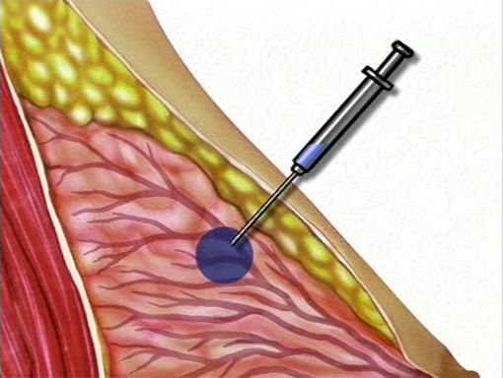
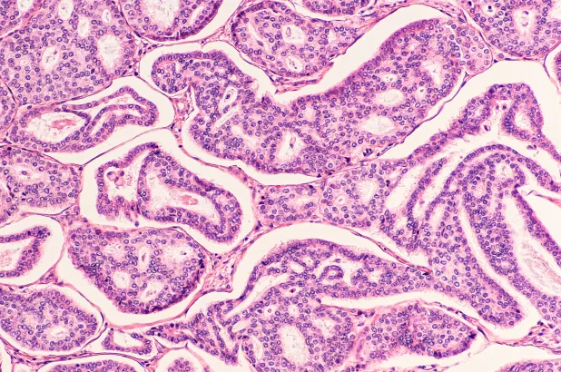

Data Overview
Fine Needle Aspiration of breast tissue masses
Boundary of nuclei established
Software calculates characteristics
Process repeated
Image Sources: https://preop.com/preop/needle-biopsy-breast/ https://www.ebuyer.com/blog/2014/07/what-do-the-buttons-on-a-calculator-do/ https://www.nfcrs.org
Notes:
500 measurements gathered from Fine Needle Aspiration of breast tissue masses
Trained technician drew the boundary of the nuclei from the photographs of these cells
Software calculated ten characteristics of the nuclei
Process repeated for most or all of the nuclei in the sample

Slide 7
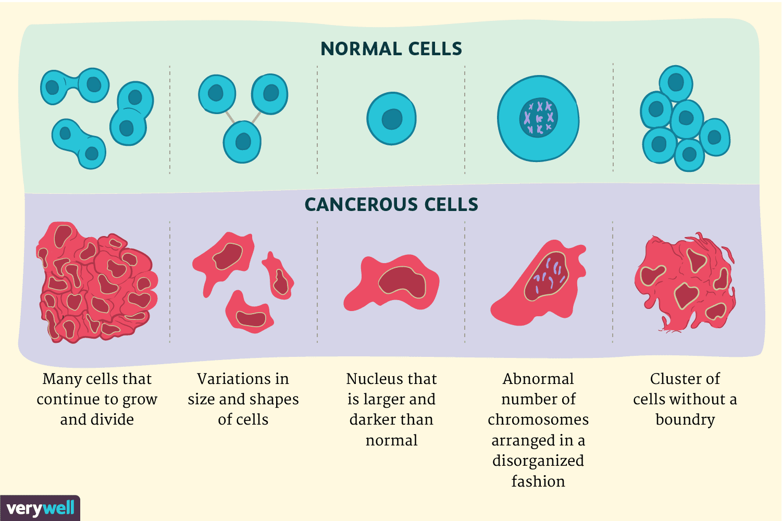
Cell Measurements
10 Characteristics
Radius
Texture
Perimeter
Area
Smoothness
Compactness
Concavity
Concave points
Symmetry
Fractal Dimension
Image Source:https://www.verywellhealth.com/cancer-cells-vs-normal-cells-2248794
Notes:
500 measurements gathered from Fine Needle Aspiration of breast tissue masses
Trained technician drew the boundary of the nuclei from the photographs of these cells
Software calculated ten characteristics of the nuclei
Process repeated for most or all of the nuclei in the sample

Slide 8
Machine Learning Techniques
1
Decision Trees
2
Random Forests
3
Kth Nearest Neighbors

Slide 9
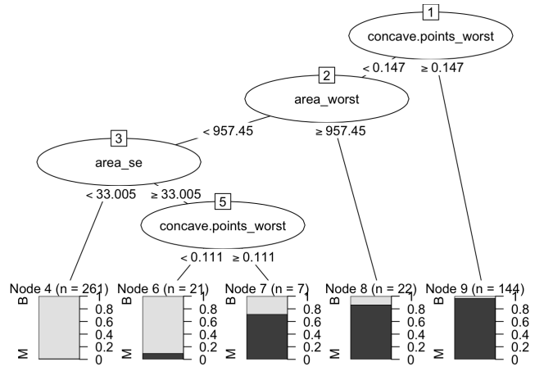
Decision Trees
Characteristic that best separates tumors into two groups:
Malignant (M)
Benign (B)
Repeats the process using the remaining properties
Split points choosing the maximum probability of a correct classification
Decision tree is created
Input new data for predictions
Notes:
To create the tree, a computer will perform the following steps:
From the list of tumor characteristics data, the algorithm finds the property that best separates the tumors into two groups: Malignant (M) or Benign (B)
Repeat step one for each of the above groups using the remaining properties.
In the end, you will have a tree where at each point, you can make one of two decisions. Following a path leads to a decision. The split points will be chosen to maximize the probability of a correct classification

Slide 10
Random Forests
Decision tree issues
Variance
Bias
An ‘ensemble’ method for decision trees
Aggregate distinct models
Result is a consensus of models
“Bootstrapping” data for the forest
Notes:
The training of decision trees requires a tradeoff between variance and bias.
Training of decision trees has potential to produce suboptimal results, which will not generalise well.
Random forests are a more robust method that trains multiple models for the same problem and aggregates predictions from multiple models. For classifiers such as we are building here, the reported classification is the majority vote of all components models.
Bias means that a classifier fails to identify a general features of the training data.
The training of decision trees is a heuristic-based process, which is not guaranteed to produce optimal results. The process is prone to identifying local minima.
Random forests makes a random choice of variables to consider at each split, for each tree. This forces the algorithm to explore a wider search space that would happen with decision trees.
A random forest might be able to generalise training data even where there is a particularly dominant variable in the training data, as it can force consideration of the data without that variable.

Slide 11
Random Forest Algorithm
Train N trees concurrently
Use modified decision tree algorithm.
Each split based on a randomly selected subset of variables.
Classify new observations with each of N trees.
Result is the consensus.
#1
#2
# N
…
Vote
Notes:
A simple illustration of the random forest. For a classifier system, the output is the majority vote.
There is no requirement nor expectation that decision trees within the forest will have similar depth, number of leaf nodes etc.
The number of trees (N) might be larger. Results in this presentation used 500 trees in the ensemble.
In general, random forests are problematic to visualise, particularly when N gets large.

Slide 12
Random Forest Performance
Reduce variance
Avoid overfitting
Avoid bias
Suitable for automatic optimization
Importance measures for variables
Notes:
Overfitting is where the system models noise in the training data, fitting the model to the training data rather than general features of the population being modelled.
Bias is introduced where a model cannot detect some general features of the data (and cannot therefore use them in its classification).
Averages of samples from a population have less variance than the population. Aggregating classifications from multiple decision trees reduces variance.
The random choice of variables to be considered at each split off the tree helps reduce the possibility of the algorithm arriving at a suboptimal decision.
If the training data is not representative of the population from which is drawn because it over-represents the importance of some variable, the random forest is able to seek generalized relationships amongst the other variables. Thus when operating on unseen data from that population, the random forest will still be able to make accurate predictions.
One disadvantage of the random forest is that it does not provide information about the significance of variables in the model. It is however able to indicate the relative importance of variables within in the forest. It does retain some explanatory power.

Slide 13

Kth Nearest Neighbors
Value determined by the data points around it
Looked at k= 9 closest samples
Image Source: https://blog.usejournal.com/a-quick-introduction-to-k-nearest-neighbors-algorithm-62214cea29c7
Notes:
Relies on the assumption that the value of a data point is determined by the data points around it
We looked at the 9 closest samples in order to assign benign vs. malignant designation

Slide 14
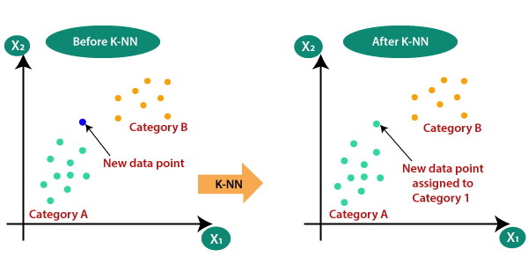
Kth Nearest Neighbors
Process:
Calculate the distance between test and training data
Sort the calculated distances
Get top k rows
Get the most frequent class of these rows
Return the predicted class
Advantages:
Ease of interpreting output
Calculation time
Image Source: https://medium.com/swlh/k-nearest-neighbor-ca2593d7a3c4
Notes:
Relies on the assumption that the value of a data point is determined by the data points around it
We looked at the 9 closest samples in order to assign benign vs. malignant designation
Calculate the distance between test data and each row of training data. Here we will use Euclidean distance as our distance metric since it’s the most popular method. The other metrics that can be used are Chebyshev, cosine, etc.
Sort the calculated distances in ascending order based on distance values
Get top k rows from the sorted array
Get the most frequent class of these rows
Return the predicted class

Slide 15
Misclassification
Misclassification = false positives or false negatives
Minimize both:
Benign classified as malignant
Malignant classified as benign
0.079
0.044
0.053
Decision Tree
Random Forests
Kth Nearest Neighbors

Slide 16
Specificity
High specificity = few false positives
Minimize benign tumors classified as malignant
0.944
0.986
0.954
Decision Tree
Random Forests
Kth Nearest Neighbors
Notes:
For this study, we are concerned with sensitivity.
High sensitivity means the model has few false negatives. In this case, minimizing the number of malignant tumors classified as benign.

Slide 17
Sensitivity
High sensitivity = few false negatives
Minimize malignant tumors classified as benign
0.884
0.907
0.986
Decision Tree
Random Forests
Kth Nearest Neighbors
Notes:
For this study, we are concerned with sensitivity.
High sensitivity means the model has few false negatives. In this case, minimizing the number of malignant tumors classified as benign.

Slide 18
Conclusion
With sensitivity being the main concern, the machine learning algorithms demonstrate a decrease in false negatives in comparison with current medical methods.
Notes:
You will then create a video presentation that explains the practical side of using machine learning techniques for classification
For your presentation, you should describe the results of your analysis. In your presentation, you should describe each algorithm at a level that is appropriate to your audience. You should also discuss the issue of misclassification. You may assume misclassifying a malignant as benign is worse than misclassifying a benign tumor as malignant

Slide 19
Thank you.

